Slide 1
CHAPTER 9
AIRWAY MANAGEMENT
By Isaiah Bennett
Notes:
Im gunna give you a brief over view of the important things, but this is a really important chapter and anything in it is fair game for both the midd exams and the OEC exam

Slide 2
OBJECTIVES:
List the major anatomical structures of the upper airway
Describe and demonstrate how to manually open the airway or mouth using the head-tilt, chin lift, crossed finger, and jaw thrust techniques
Describe how to place a patient’s airway using gravity, a finger sweep, and suction
Describe how to place a patient in the recovery position
Understand when and how to use rigid suction catheter and flexible suction catheter
Demonstrate proper methods for choosing the correct size and proper insertion of Oropharyngeal and Nasopharyngeal airway adjuncts
Describe how to calculate the oxygen flow duration rate
Describe and demonstrate how to properly set up an oxygen tank for use
List four tips for the safe use of oxygen
Describe and demonstrate how to use nasal cannula, nonrebreather mask, pocket mask, bag-valve mask, face shield
Notes:
List the major anatomical structures of the upper airway
Describe and demonstrate how to manually open the airway or mouth using the head-tilt, chin lift, crossed finger, and jaw thrust techniques
Describe how to place a patient’s airway using gravity, a finger sweep, and suction
Describe how to place a patient in the recovery position
Understand when and how to use rigid suction catheter and flexible suction catheter
Demonstrate proper methods for choosing the correct size and proper insertion of Oropharyngeal and Nasopharyngeal airway adjuncts
Describe how to calculate the oxygen flow duration rate
Describe and demonstrate how to properly set up an oxygen tank for use
List four tips for the safe use of oxygen
Describe and demonstrate how to use nasal cannula, nonrebreather mask, pocket mask, bag-valve mask, face shield

Slide 3
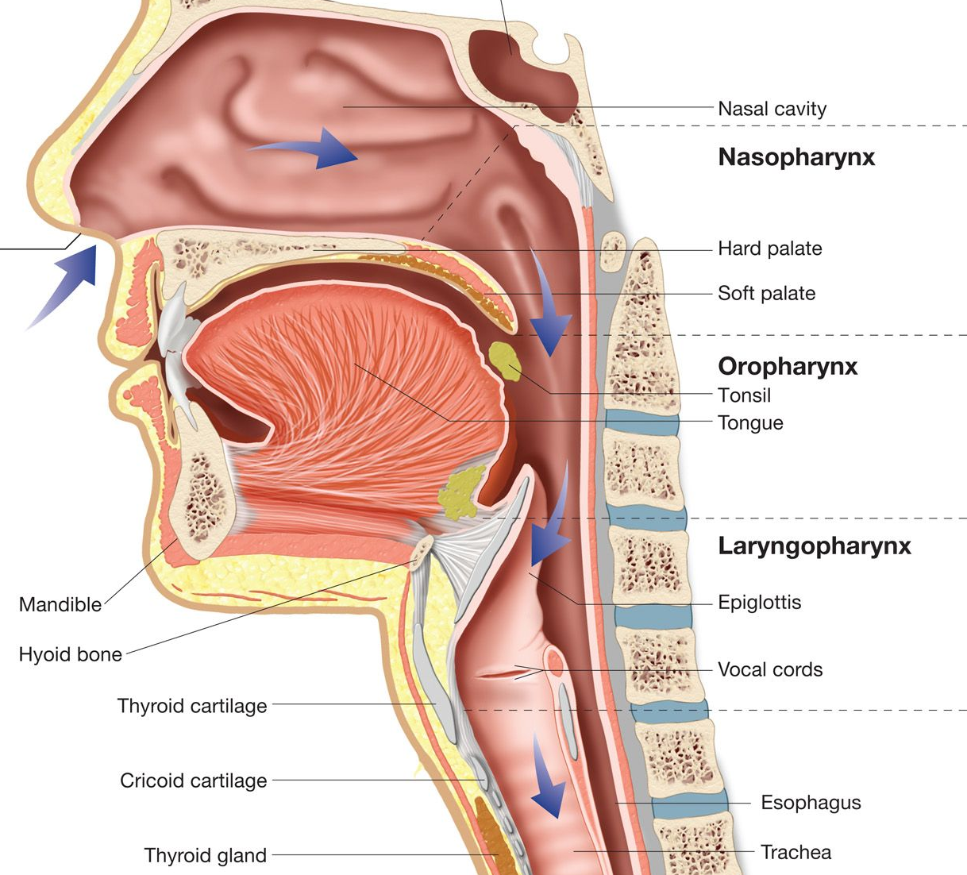
Anatomy and Physiology
Airway is divided into upper and lower components
Pharynx is divided into 3 parts
Nasopharynx (nasal cavity) warms and humidifies air
Oropharynx (oral cavity) also helps warm inhaled air
Laryngopharynx is behind pharynx and extends to esophagus
Epiglottis directs air into the trachea and lungs and prevents food/liquids from entering the lower airway
Larynx (voice box) is where sound originates
Upper Airway
Pharynx
Larynx
Notes:
Slide 3: Because ski patrollers arrive at the patients side way before other medical providers, they must be able to asses a patient’s airway quickly and immediately correct any problems they discover.
-Airway is divided into upper and lower components
-Pharynx is divided into 3 parts (nasopharynx, oropharynx, laryngogpharynx)
-nasopharynx (nasal cavity) humidifies air as it enters the body and the hairs in it remove small particles to prevent them from entering the trachea and lower airway
-oropharynx (oral cavity) also helps warm inhaled air
-Laryngopharynx is behind pharynx and extends to esophagus
-epiglotus is leaf like structure that directs air into the trachea and lungs and prevents food and liquids from entering the lower airway
-below the epiglotus is the larynx (voice box) where sound originates when we speak

Slide 4
Anatomy and Physiology Continued
Trachea is a tube made of cartilage that ends at the two main stem bronchi
Bronchi branch into many smaller bronchioles
Bronchioles end in alveoli
Alveoli is where gases are exchanged in the lung
Lower Airway
Notes:
Slide 4:
-lower airway includes trachea, bronchi, and alveoli
-trachea is a tube made of chartelage that ends at the two main stem bronchi (each of which extend into a lung)
-bronchi continue as smaller bronchi, eventually branching into many smaller bronchioles and end in alveoli
-alveoli are very important because it is where gases are exchanged in the lung
-Does anyone know what gases are exchanged in the lungs? (Oxygen and Carbon Dioxide)
-

Slide 5
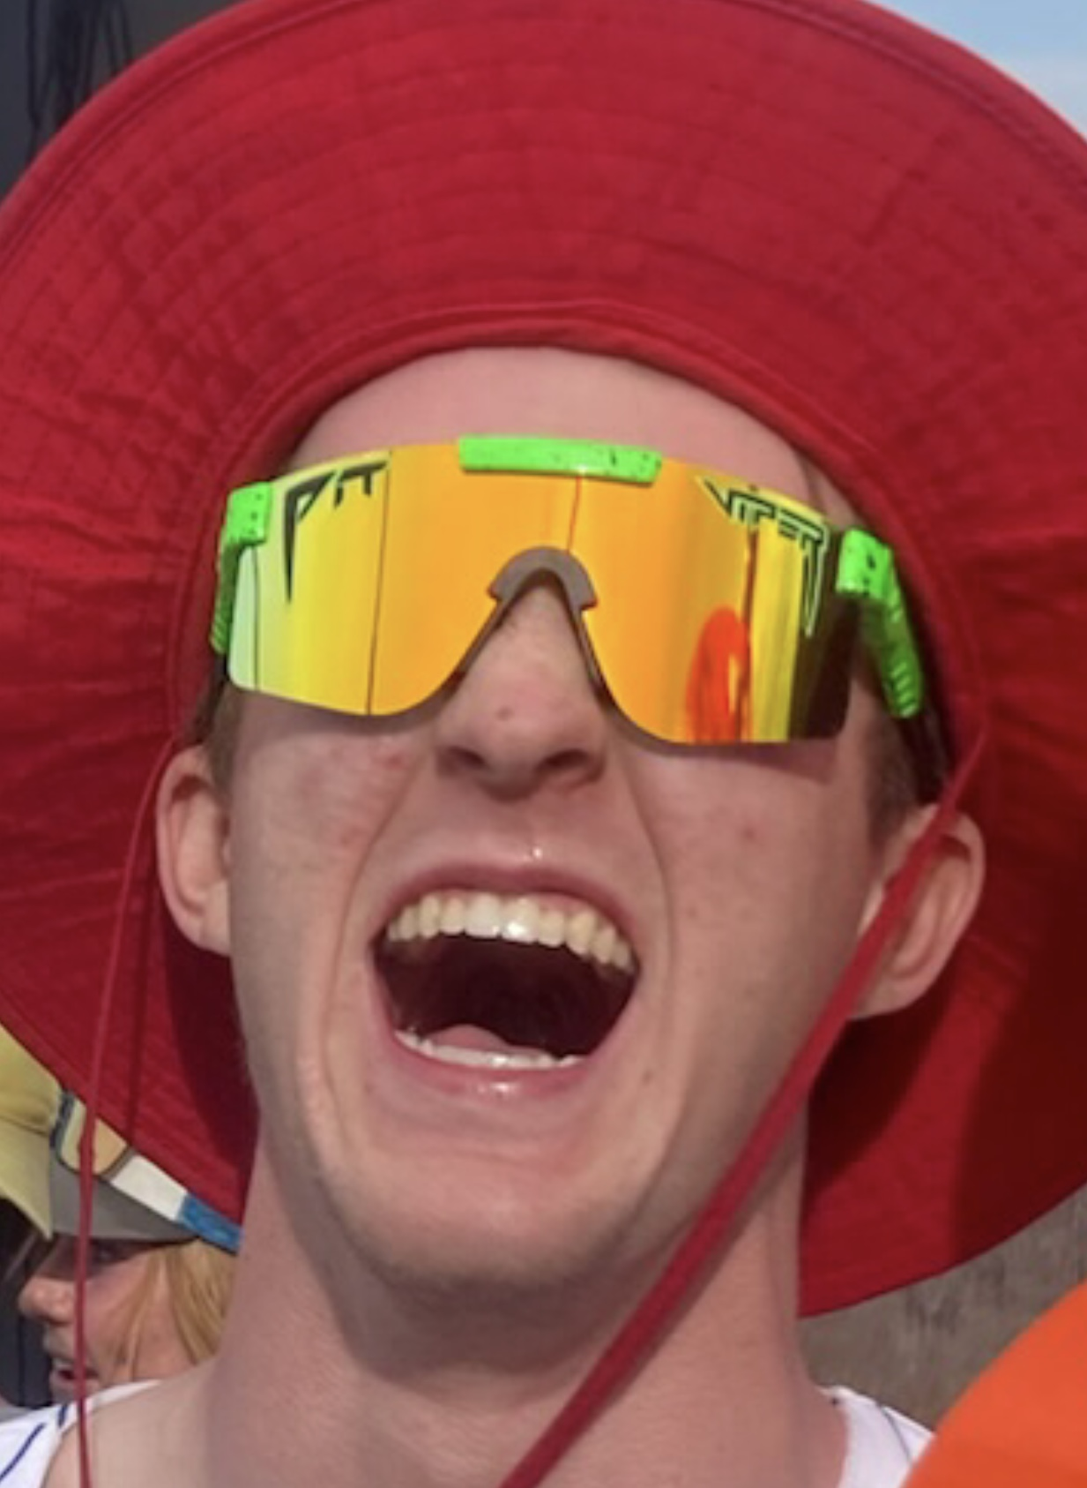
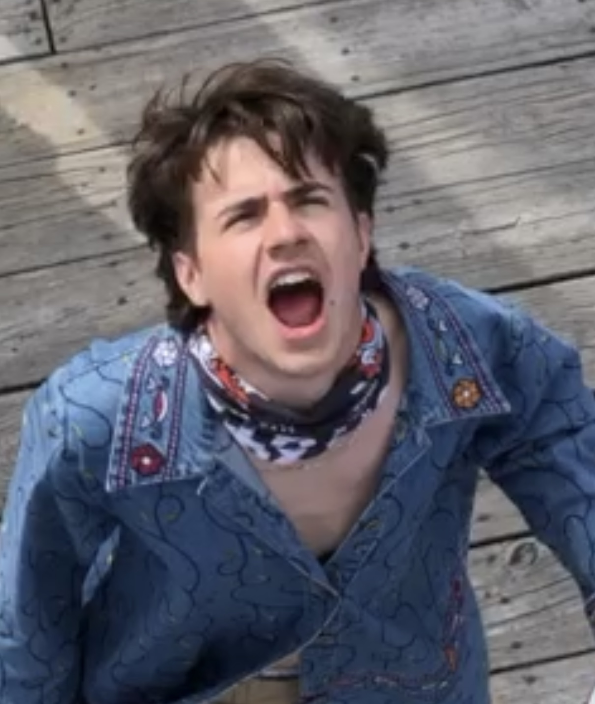
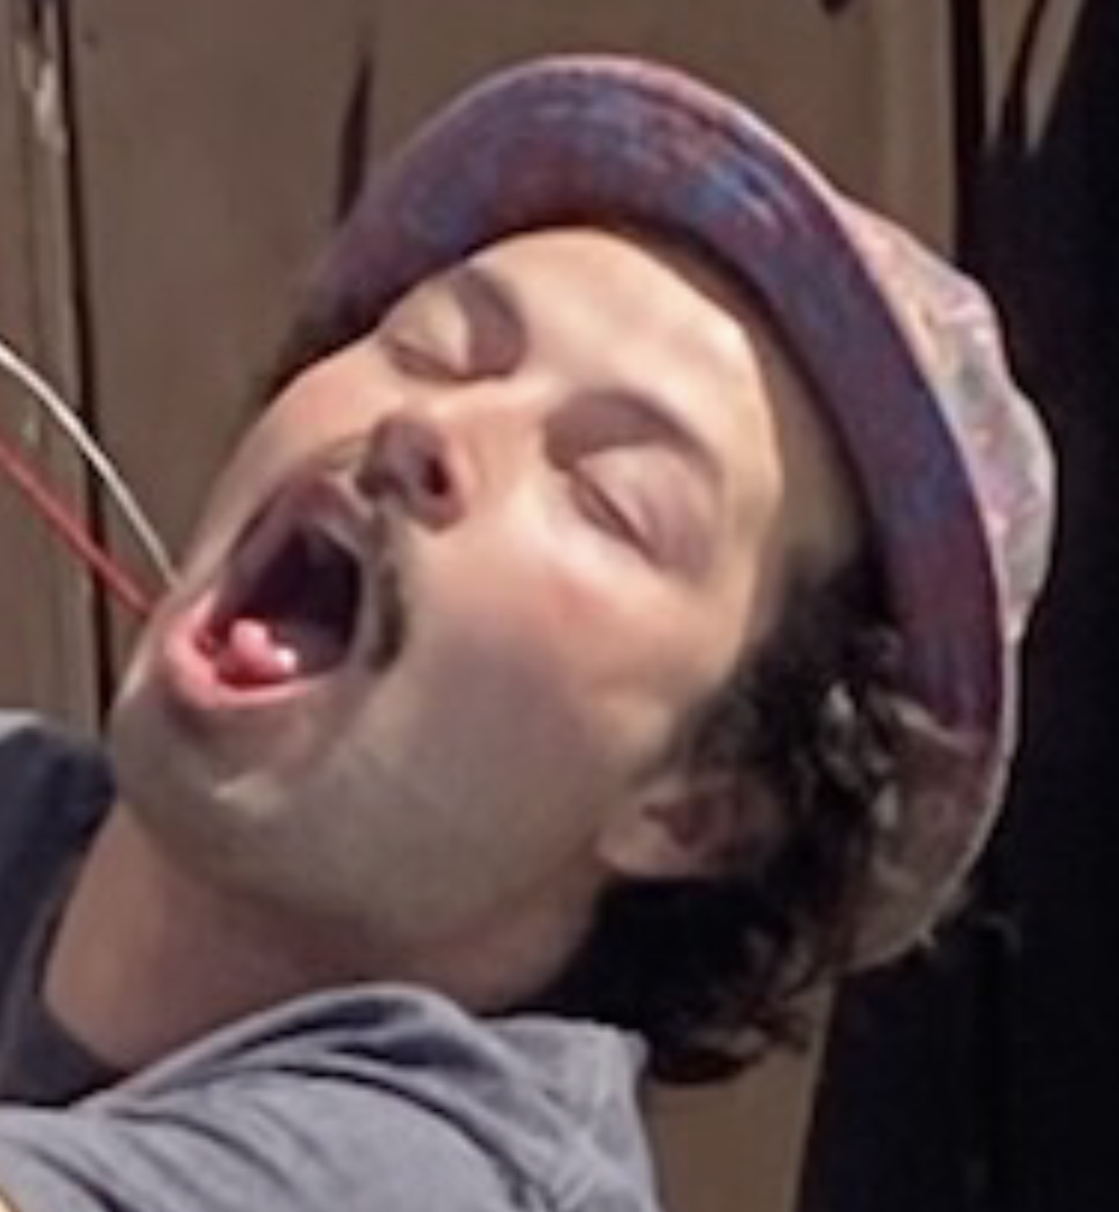
Opening Airway and Mouth
Head tilt chin lift
Jaw Thrust
Crossed finger method
Notes:
Slide 5:
-in an unresponsive patient, the airway muscles may relax and in certain body positions this may cause the tongue to fall back and block the airway
-the first step in airway management is to ensure that the airway is open and aligned

Slide 6
Head Tilt Chin Lift
Kneel beside patient’s head
Place one hand on the patient’s forehead
Place two fingers of your other hand under patient’s chin
Gently lift chin up while pushing down on forehead
Maintain position to ensure that airway stays open
NEVER USE FOR PATIENTS WITH SUSPECTED C-SPINE INJURY
Notes:
Slide 6:
-primary technique for opening a patient’s airway but should never be used on patient’s with a suspected c-spine injury
Kneel beside patient’s head
Place one hand on the patient’s forehead
Place two fingers of your other hand under patient’s chin
Gently lift chin up while pushing down on forehead
Maintain position to ensure that airway stays open

Slide 7
Jaw Thrust
Kneel down above the patient’s head
Using fingers on both hands, grasp the corner of patient’s mandible on each side of the jaw
Place your thumbs on either side of the patient’s mouth
Lift the mandible upward
Notes:
Slide 7:
-use jaw thrust if you suspect patient has sustained a head, neck, or spine trauma
-opens airway while allowing minimal movement of the cervical spine
-essential that neck is not moved and remains in an anatomically neutral position
Kneel down above the patient’s head with your knees stradling their head (you can use your knees to gently stabilize the head and c-spine)
Using fingers on both hands, grasp the corner of patient’s mandible on each side of the jaw
Place your thumbs on either side of the patient’s mouth
Lift the mandible upwards

Slide 8
Cross Finger Technique
Using your dominant hand, cross your index finger under your thumb
Place your thumb and index finger against the patient’s upper and lower teeth
Spread your thumb and finger apart to open the patient’s mouth
Notes:
Slide 8:
Crossed finger technique is the primary method of opening a patient’s mouth
Using your dominant hand, cross your index finger under your thumb
Place your thumb and index finger against the patient’s upper and lower teeth (be careful not to insert your fingers in between the patient’s teeth)
Spread your thumb and finger apart to open the patient’s mouth

Slide 9
Clearing the airway
Gravity
Finger Sweep
Suction
Notes:
Slide 9:
Effective breathing is difficult when any foreign material obstructs the airway
The methods we just went over prevent the tongue from blocking the airway but they are not effective in clearing other obstructions such as blood, mucus, fluids, broken teeth, foreign bodies, dirt, and food
We can remove obstructions from the airway using gravity, a finger sweep, or suction
Gravity: if patient is responsive have them lean forward and head down to allow obstruction to fall out of nose/mouth.
if patient is unresponsive: roll the person into the recovery position (which we will go over in a few slides)
If cspine injury is suspected, have patrollers stabilize head and neck while patient is rolled

Slide 10
Finger Sweep
Open the patient’s mouth using the crossed finger technique
Insert your gloved index finger into the patient’s mouth so that the tip of your finger is behind and/or beneath the foreign object
Curve your finger into a hook and remove the object
Repeat until airway is completely cleared
Notes:
Slide 10:
Finger sweep: vomit unchewed food, or other objects can become trapped in the airway if gravity is not effective in removing these objects use the finger sweep technique
-This technique is only for patients who are unresponsive
-placing a finger into the airway of a person who is responsive could stimulate their gag reflex and induce even more vomiting or it could cause the patient to bite down and injure the responder
Open the patient’s mouth using the crossed finger technique
Insert your gloved index finger into the patient’s mouth so that the tip of your finger is behind and/or beneath the foreign object
Never insert your finger further than you can see this might push the object in further which could further compromise the patient’s airway
Curve your finger into a hook and remove the object
Repeat until airway is completely cleared
WHAT IS WRONG WITH SAM’S FINGER SWEEP THAT HE IS PERFORMING ON DUNCAN?

Slide 11
Suction
Do not insert suction further than you can see
Suction in a side to side or circular motion
Do not suction for more than 10-15 seconds at a time (5-10 for a child)
Notes:
Slide 11:
We use a manual suction device
-open patients mouth and identify the fluid or object you need to use
Insert the tip of the suction catheter into the pharynx before starting to suction
-make sure not to insert the suction further than you can see
-suction in a side to side or circular motion
-remember to stabilize and proctect the cspine if you suspect any spinal trauma
-do not suction for more than 10-15 seconds at a time (5-10 for a child) because suctioning removes oxygen as well as the fluid and debris -repeat as needed until airway is clear
-when you pass the patient off to EMS you should give the ambulance the suction collection

Slide 12
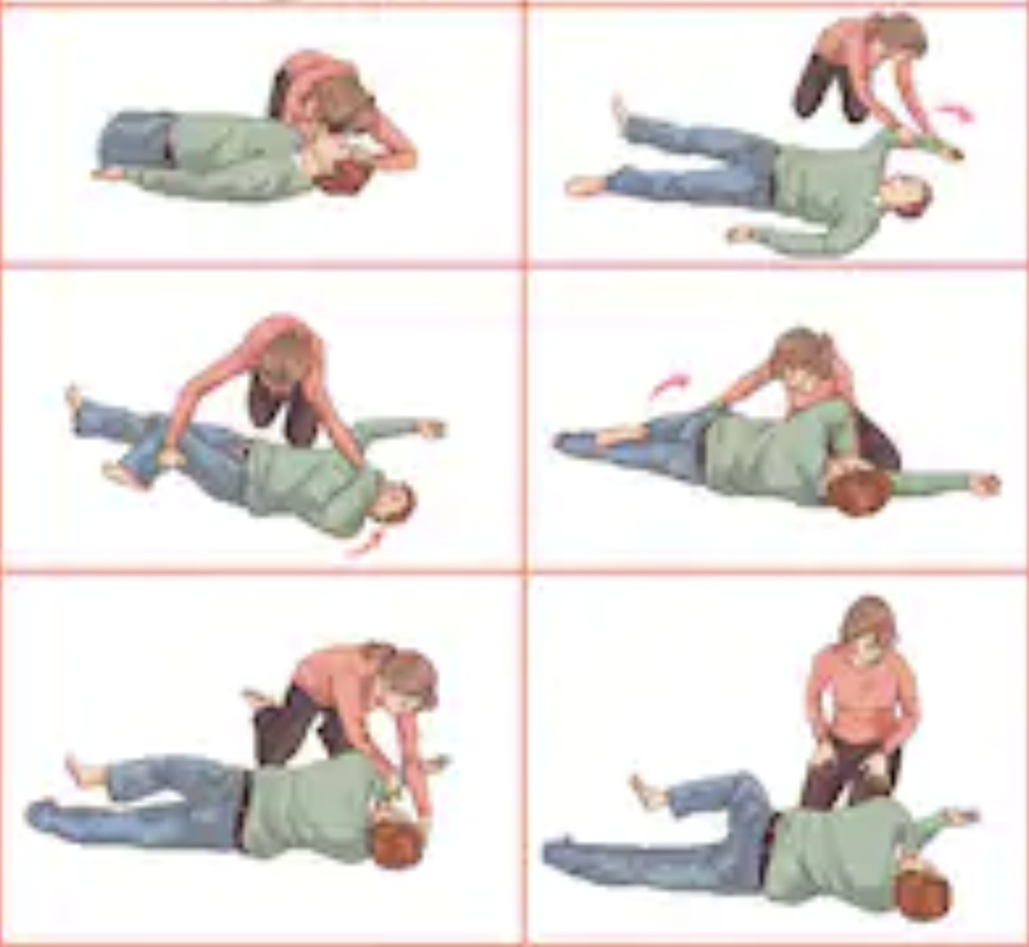
Keeping Airway Open and Clear
Recovery position
Airway adjuncts (good table on page 300 of textbook)
Nasopharyngeal Airway (NPA)
Oropharyngeal Airway (OPA)
Notes:
Slide 12:
-Recovery position
-extend patients left arm for that it extends over the patient’s head
-gently roll patient onto their left side so that their head rests on their straightened arm
-head should be tilted slightly down with the mouth open to allow stuff to flow out of the mouth if necessary
-flex the patient’s right knee at a right angle to anchor the patient into this position
-position the patient’s right arm so that it is in front of the patient and does not block rescuer’s access to the patient’s airway
-always make sure airway remains open
-Airway adjuncts (good table on page 300 of textbook that compares them)
Nasopharyngeal Airway (NPA)
Oropharyngeal Airway (OPA)

Slide 13
Nasopharyngeal Airway (NPA)
Flexible tube that is inserted into the nasopharynx
Can be used in responsive patients and patients with in-tact gag reflexes
Used for patients with oral injuries and airway compromise or are having a seizure
Do not use for patients with massive head injuries due to possible aggravation of the injury and/or damage to the nose
Notes:
Slide 13:
Flexible tube that is inserted into the nasopharynx (comes in different sizes)
Can be used in responsive patients and patients with in-tact gag reflexes
Indications for using an NPA are broad and include any patient that needs a mechanical airway in order to keep the airway open
Used for patients with oral injuries and airway compromise or are having a seizure
Do not use if theres a nose injury

Slide 14
Inserting an NPA
S: Size the NPA
L: Lubricate the NPA
I: Insert the NPA
C: Check the adjunct
Notes:
Slide 14:
SLIC is an accronymn for inserting an NPA
S: Size the NPA
-hold tube against the side of the patient’s face, the NPA should reach from the patient’s nostril to their lower earlobe
L: Lubricate the NPA
apply a small amount of water based lubricant along the entire length of the NPA (don’t want to use too much because it can aggravate the airway problem)
I: Insert the adjunct
-Hold tube between your thumb and first two fingers
-place the bevel side of the tube toward the nasal septum
-gently insert the tube into the nostril while rotating the tube between your fingers until the NPA is flush with the nostril when properly places the curvature of the NPA will follow the natural curvature of the nasal passage and lie in the distal portion of the nasopharynx
C: Check the adjunct
Confirm proper placement of the tube by listening to the patient breathe, you should be able to feel or hear air movement through the tube

Slide 15
Oropharyngeal Airway (OPA)
Hard plastic device
Inserted into the oropharynx to help keep the airway open
Displaces the tongue and prevents it from blocking the airway
Indicated for patients without an intact gag reflex that need a mechanical airway to keep their airway open (unresponsive)
Notes:
Slide 15:
Hard plastic device that comes in a variety of sizes
Inserted into the oropharynx to help keep the airway open
Displaces the tongue and prevents it from blocking the airway, when OPA is in place the tongue rests within the curvature of the device
Indicated for patients without an intact gag reflex that need a mechanical airway to keep their airway open (unresponsive patients)

Slide 16
Inserting OPA
S: Size the OPA
I: Insert the OPA
C: Check the OPA
Notes:
Slide 16:
Acronymm SIC
-Size the OPA: hold OPA to side of patient’s face, OPA should stretch from the corner of the patient’s mouth to the corner of their jaw
-Insert the OPA: open the patient’s mouth using the crossed finger technique, insert the OPA with the tip pointed up toward the roof of the patient’s mouth when it is half way into the mouth rotate the OPA 180 degrees so that the tip faces the patient’s tongue
-Check the OPA: listen for breaths watching chest rise and fall

Slide 17
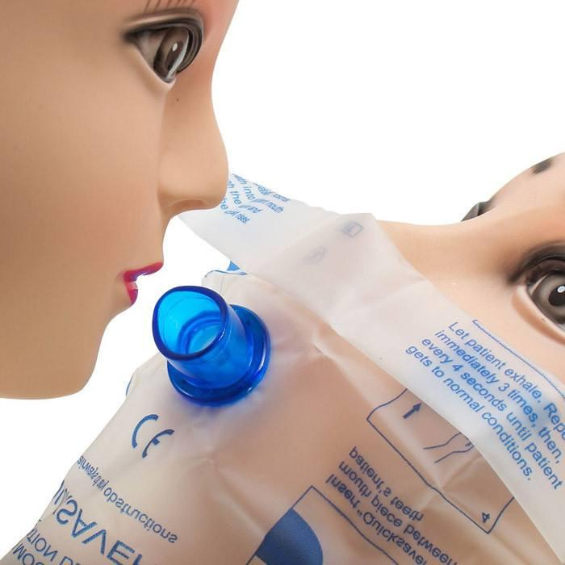
Barrier Devices
Face shield
Pocket Mask
Notes:
Slide 17:
-Barrier devices are a form of personal proctective equipment that provides a nonporous layer between you and the patient to prevent the transmission of communicable diseases
-A face shield is a clear plastic sheet with a mouthpiece through which to administer rescue breaths
-pocket mask: apex of the mask fits over the bridge of the patient’s nose, there is a one way valve on the mask that allows the patient to breath, the pocket mask provides a seal on the patient’s face and offers better protection from blood and secretions than the face shield

Slide 18
Oxygen Therapy
Regular air is 78% Nitrogen, 21% Oxygen, and 1% other gases
We give patients 100% oxygen
When to give patients oxygen?
Shortness of breath
Suspected cardiac or respiratory arrest
Cardiac-related chest pain
Stroke
Significant blood loss
Decreased LOR
Indicated by pulse oximeter <95%
At high altitudes
Suspected Shock
Notes:
We will go over how to set up the oxygen tank in the practical later tonight
Regular air is 78% Nitrogen, 21% Oxygen, and 1% other gases
We give patients 100% oxygen
When to give patients oxygen?
Shortness of breath
Suspected cardiac or respiratory arrest
Cardiac-related chest pain
Stroke
Significant blood loss
Decreased LOR
Indicated by pulse oximeter <95%
At high altitudes
Suspected Shock

Slide 19
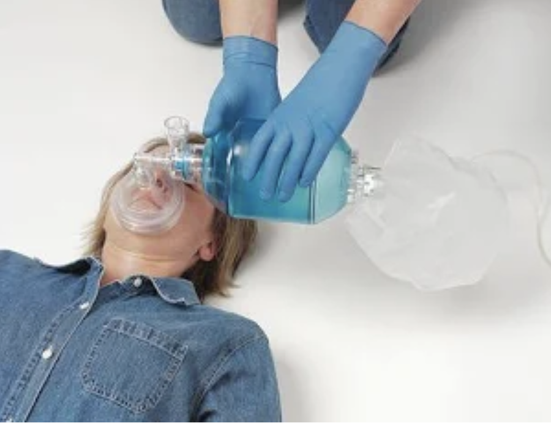
Oxygen Delivery
Nasal Cannula
“Low Flow” 4-6 LPM
Nonrebreather Mask
“High flow” 12-15 LPM
Bag Valve Mask
Used for patients that cannot breath on their own
“High Flow” 15 LPM
Be careful of gastric distention
Notes:
Slide 19:
Nasal Cannula
“Low Flow” 4-6 LPM
Less restrictive and not clostraphobic
Nonrebreather Mask
“High flow” 12-15 LPM
Bag Valve Mask
Used for patients that cannot breath on their own
“High Flow” 15 LPM
Be careful of gastric distention, means air is going into belly instead of lungs

Slide 20
Review Questions
You appropriately size a nasopharyngeal airway by measuring the:
distance from the patient’s mouth to the angle of the jaw.
diameter of the patient’s larger nostril.
distance from the patient’s nose to the earlobe.
diameter of the patient’s little finger.
What are the three ways to clear a patient’s airway?
Notes:
Slide 20: answer c
Answer: gravity, finger sweep, suction

