Slide 1
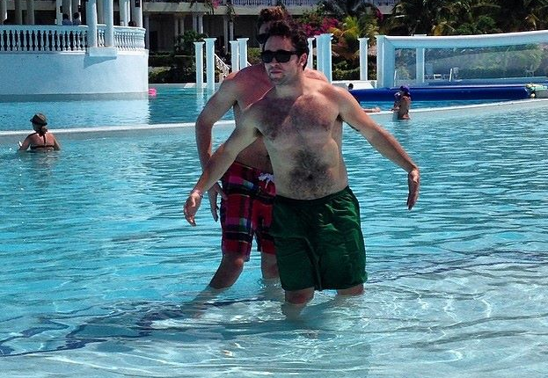
Water emergencies

Slide 2
Mammalian Diving Reflex
Submersion in cold water
Blood shunted to core
Metabolism & heart rate drop
Result: oxygen conserved

Slide 3
Gas Laws
Boyle’s Law: when pressure increases, the volume of a gas increases
Henry’s Law: at higher pressures, more gas will dissolve in a liquid
Dalton’s law: overall pressure of a gas made up of the sum of the pressures of each individual gas

Slide 4
Drowning
Submersion injury: any injury that occurs while a person is under water
Drowning: suffocation by submersion that results in death within 24 hours
Dry Drowning – small amounts of water enter the lungs but airway is tightly sealed by laryngospasm
Wet Drowning – airway muscles quickly relax and allow water to fill the lungs completely
Near-drowning: survival for at least 24 hours

Slide 5
Barotrauma: Rapid Ascent problems
Arterial gas embolism: air bubbles enter bloodstream from a ruptured alveolus and lodge in an artery
Decompression sickness: buildup of nitrogen bubbles in the body
Squeeze: too much pressure

Slide 6
Barotrauma S/S
Itching, rash, swelling, discoloration
Joint pain, low back pain
Nausea/vomiting, diziness, ringing in ears
Headache, numbness, extreme fatigue
Shortness of breath, cough
Chest pain, irregular pulse, shock, cardiac arrest

Slide 7
Prevention: 9 ways
Avoid alcohol
Safety equipment
Never swim alone
Monitor those in water
Never enter swiftly moving water
Don’t dive in shallow water
Check ice thickness
Scuba dive conservatively
Watch for rip currents

Slide 8
Patient Management
Make sure scene is safe
Swimmers in distress can often end up injuring their rescuer
Reach, Throw, Row, Then Go
Immobilize C-spine in all unwitnessed accidents
Always provide high-flow O2
They aren’t dead until they are warm and dead!

