Slide 1
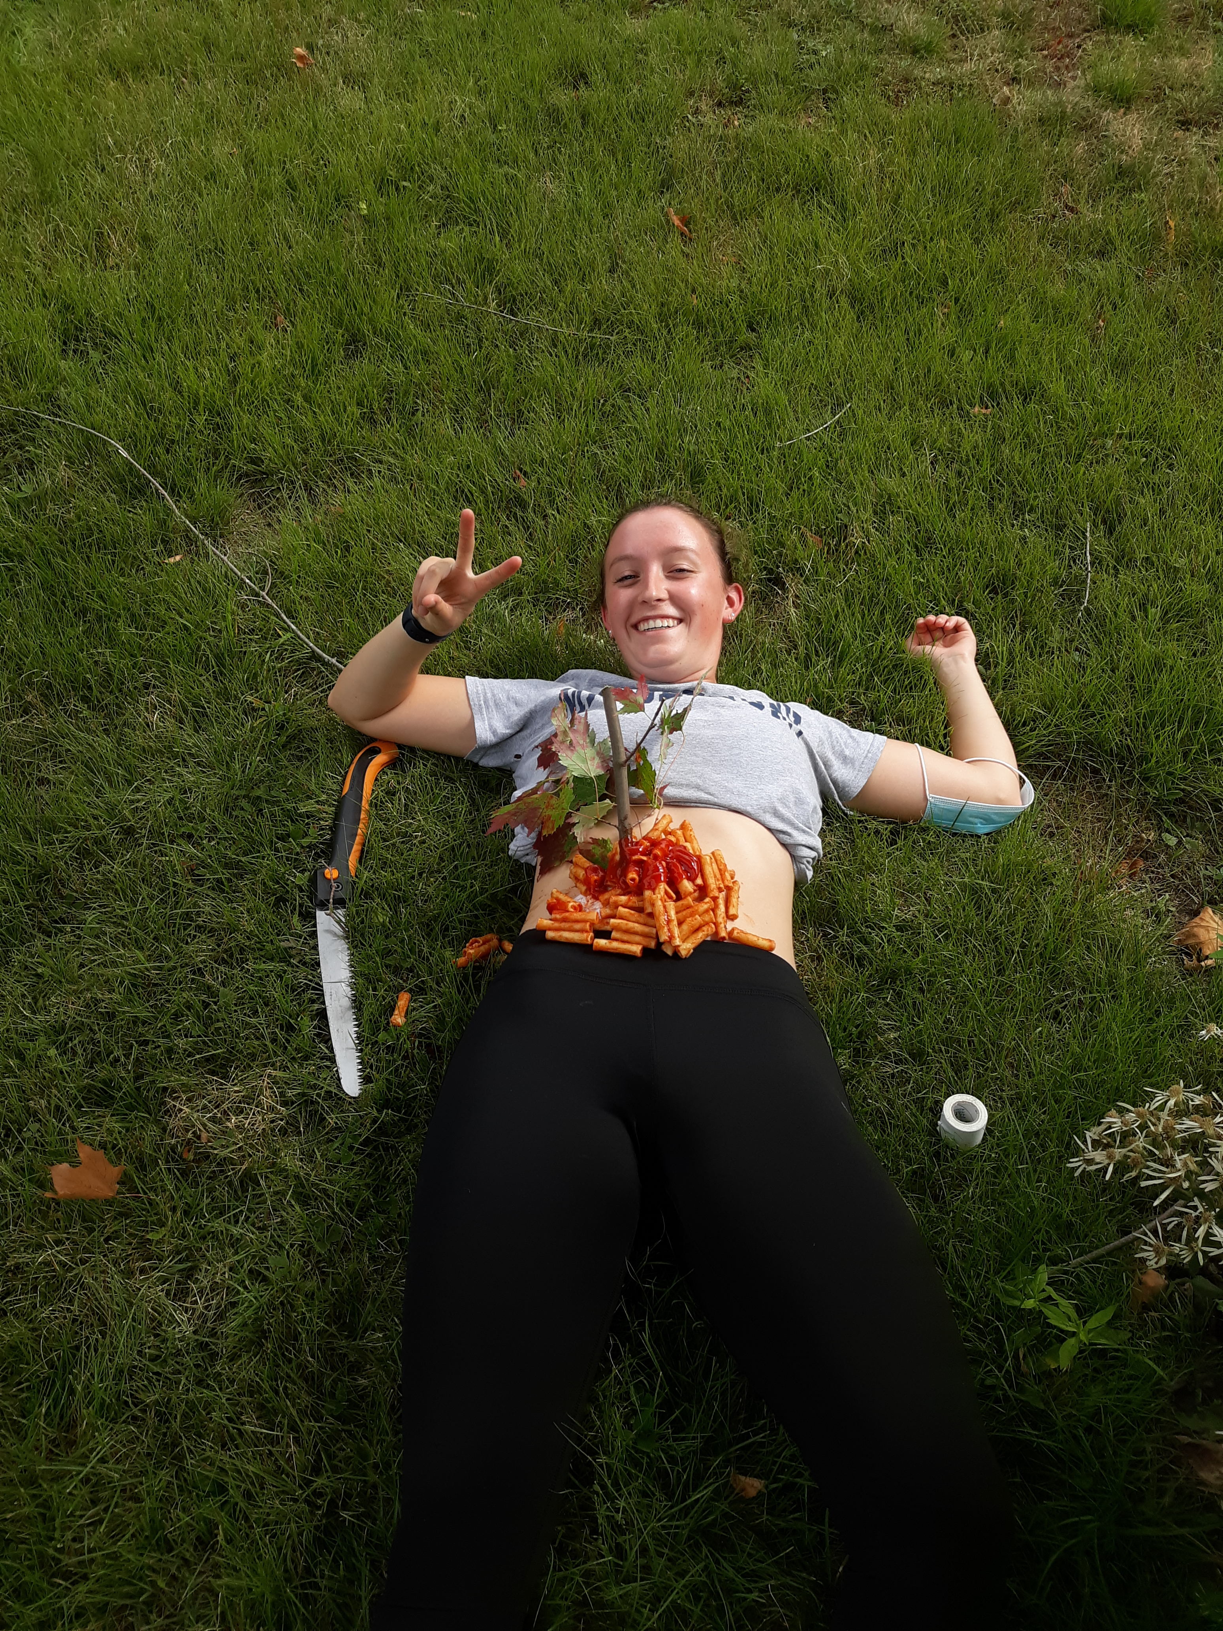
Chapter 17: Principles of Trauma

Slide 2
Objectives
Define key terms
Low vs. high velocity injuries
5 Mechanisms of Injury
Trauma Centers
Key terms:
Golden hour
Index of suspicion
Injury pattern
Kinematics
Kinetic energy
Trauma
Trauma center, surgeon

Slide 3
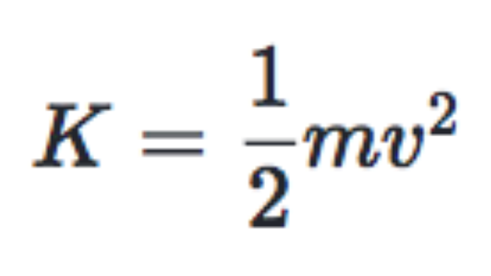
Kinematics is...
Kinetic Energy
Patterns of movements of body segments without consideration of outside forces
Newton’s laws
Common Injury Patterns
- Velocity is the largest contributor to K

Slide 4
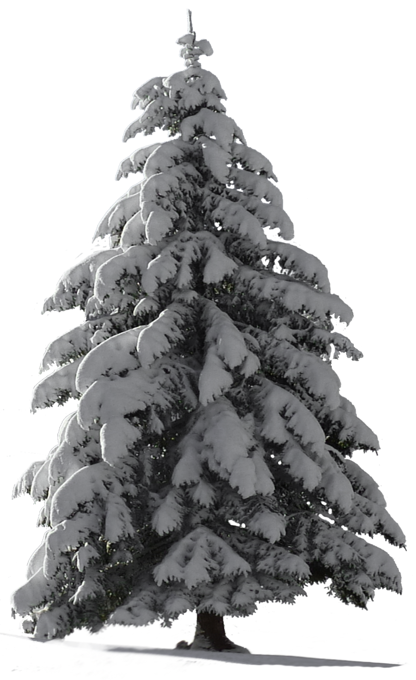
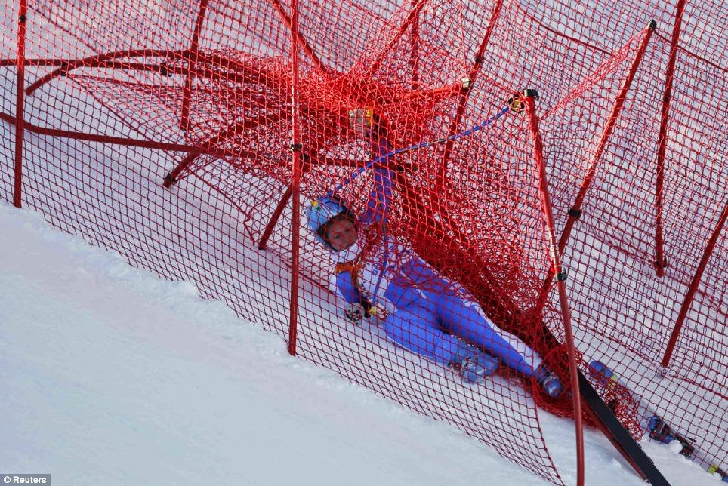
Stopping Distance
VS

Slide 5
Factors in Trauma
Threshold of injury
Density of organs
Hollow vs. Solid Organs
Mechanism of Injury
Direct
Twisting
Forced flexion/hyperextension
Indirect
Index of Suspicion

Slide 6
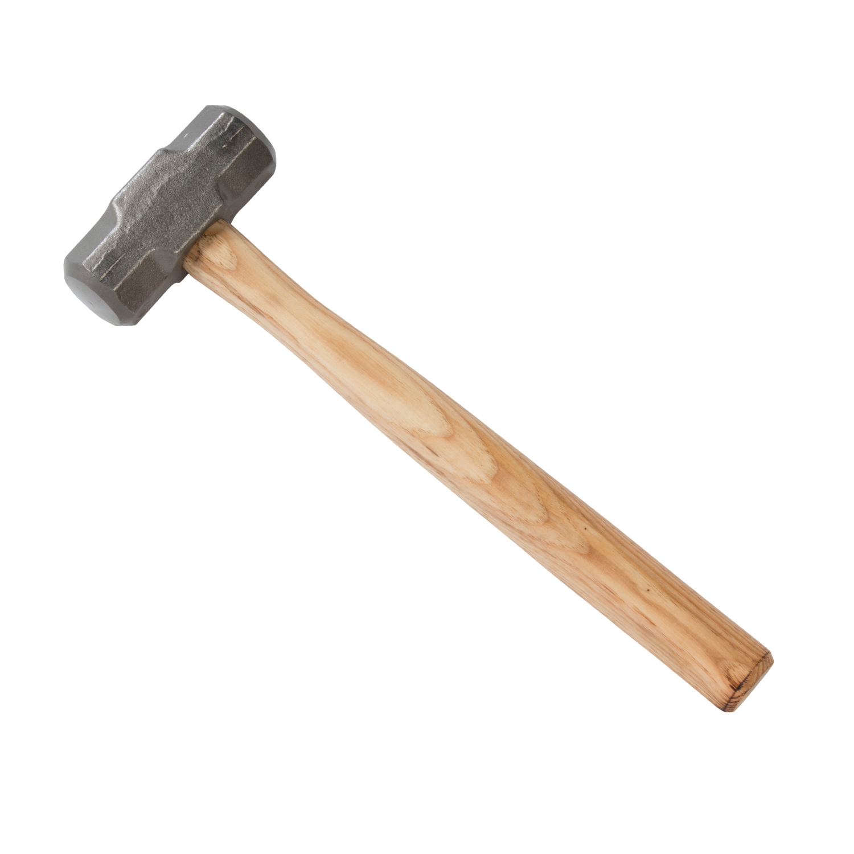
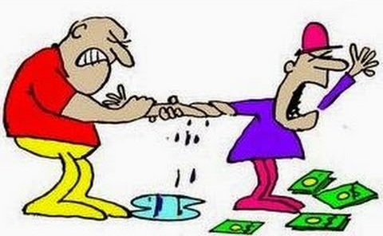
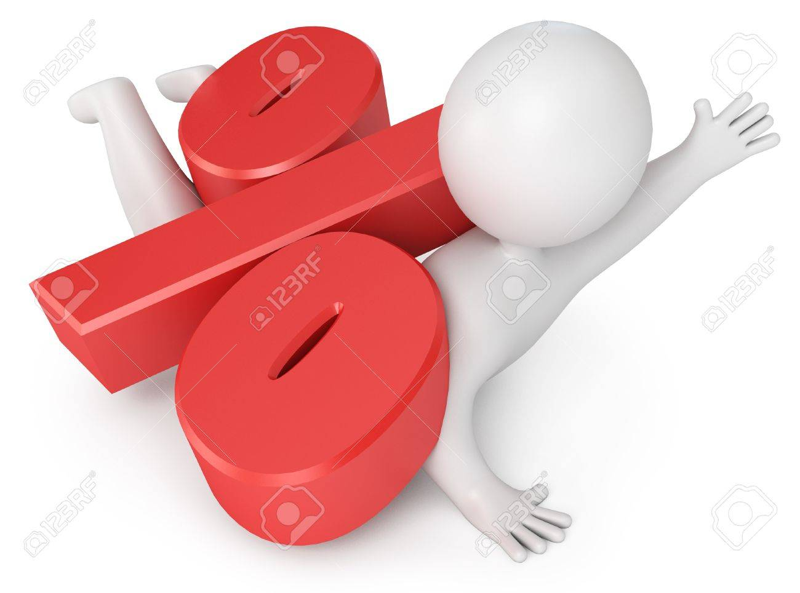
Five Types of Injury
Penetrating
Blunt
Blast
Rotational
Crush

Slide 7
Penetrating Wounds
Blast Injury
High Velocity
Greater than 2000 ft/s
Low Velocity
Less than 2000 ft/s
Primary
Pressure wave
Secondary
Blast Wave (projectiles, superheated gases, etc.)
Tertiary
Victim Displacement
Quaternary/Miscellaneous

Slide 8
Phases of Injury
Pre-Injury Phase
Injury prevention and proper safety equipment
Injury Phase
Index of Suspicion
Post-Injury Phase
3 peaks of traumatic death
First few seconds/minutes
“golden hour”
Days and weeks following (usually due to complications)

Slide 9
Trauma Centers
Level I: Comprehensive Service (Including an Education Program)
UVM Medical Center
Dartmouth Hitchcock
Albany Medical Center
Level II: Same As Level I but without Education Program
UVM Medical Center – Pediatrics
Dartmouth Hitchcock – Pediatrics
Albany Medical Center - Pediatrics
Level III: Has resources for most trauma situations, but does not have subspecialists available
Porter Hospital
Levels IV and V: Have trauma nurse available at all times and have access to a physician who can be called in. Usually in very rural areas

Slide 10
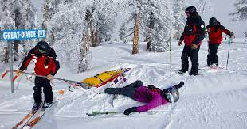
Assessment and Management
ABCDs
DCAP-BTLS
MOI and SAMPLE
OPQRST
Vitals (every 5m for critical, every 15m otherwise)
Continuous monitoring

Slide 11
Practice Questions!
Where would you send a patient who needed a level 1 trauma center? Other levels?
How often should you take vitals on a critical patient? A stable patient?
What is OPQRST?
Someone is ripping through the woods off of Kelton. They catch an edge, get spun around, hit a tree, and are impaled by a tree branch (rough day). What are the mechanisms of injury here?

