Slide 1
SHOCK!
OEC Ch 10
Charlotte Marks/Ella Roelofs

Slide 2
Objectives
Define shock
Describe the 3 primary causes of shock
Describe how the body compensates for shock
Define the two stages of shock
List the 4 major types of shock
List the classic signs and symptoms of shock
Describe and demonstrate the management of shock

Slide 3
Definition of Shock
“inadequate perfusion or flow of blood to the cells causing cellular and tissue hypoxia due to reduced oxygen delivery”

Slide 4
3 Primary Causes of Shock
Perfusion Triangle

Slide 5
Stages of Shock
Compensated Shock: body’s systems correct for the issue, activates compensatory mechanisms that help restore homeostasis,
Increase O₂ intake, increase heart output, send blood to vital organs
Can only maintain this for so long
Progresses to decompensated shock unless problem is corrected
Compensatory mechanisms can mask a serious injury
Decompensated Shock: once compensating mechanisms fail, patient can go into decompensated shock
Rapid deterioration of vitals, cellular hypoxia worsens
Irreversible
Notes:
decreased perfusion by increasing oxygen intake, increasing heart output, and pulling blood to vital organs.

Slide 6
Signs and Symptoms of Shock
Compensated Shock
Tachycardia (>100 bpm in adults)
Tachypnea (respirations >20 breaths per min in adults)
Delayed cap refill (>2 sec)
Cool, moist skin
Shallow, rapid breathing
Weak, rapid (thready) radial pulse
Anxiety, restlessness, agitation
Normal blood pressure (narrowing blood pressure)
Decompensated Shock
Systolic blood pressure drops, <90 mm Hg
Heart rate continues rising
Labored, irregular, shallow breathing
Significantly cap refill
Very pale, cyanotic skin
Thready or absent radial pulse
Decreased LOR

Slide 7
4 Major Types of Shock: Hypovolemic Cardiogenic Distributive Obstructive
Notes:
Hypovolemic: Caused by loss of circulating blood volume or body fluids
Cardiogenic: Caused by the heart not pumping correctly
Valve problems (heart doesn’t empty/fill properly), heart attack (heart muscle damage), fast or slow heart rate, medications, trauma
Distributive: Vessels not constricting properly, resulting in blood pooling in the blood vessels
Anaphylactic shock: from severe allergy
Septic shock: severe systemic infection (sepsis)
Neurogenic shock: central nervous systems disruption (often spinal cord injury) = messages to blood vessels to dilate are disrupted
Obstructive: Blockage prevents oxygenated blood from reaching vital organs
Tension pneumothorax, pericardial tamponade, pulmonary embolism

Slide 8
Hypovolemic Shock
Caused by loss of circulating blood volume or body fluids
Hemorrhagic: from internal or external bleeding (ie, trauma)
Nonhemorrhagic: excessive water or fluid loss (burns, dehydration, vomiting/diarrhea)
4.7- 5.5 liters of blood in body
<1 L lost = compensated shock
1-2 L lost = decompensated
Femur fracture: 1.5-3 L blood loss

Slide 9
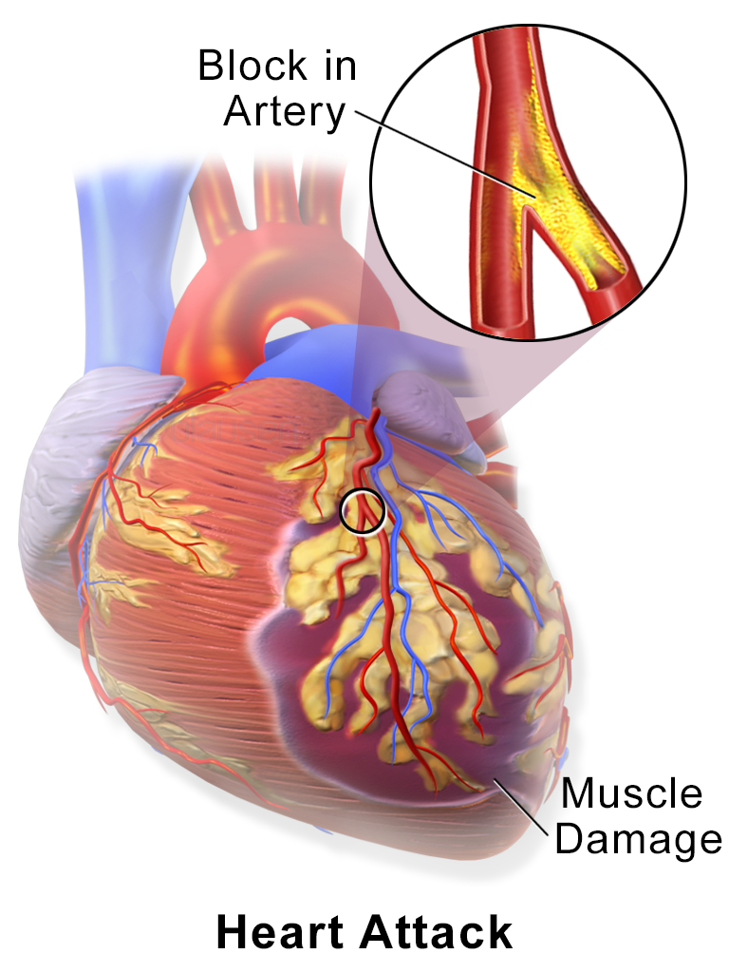
Cardiogenic Shock
Heart cannot adequately pump blood, resulting in poor cardiac output
Due to…
Heart attack (myocardial infarction)
Trauma to the heart
Fast or slow heart rate
Medications

Slide 10
Distributive Shock
Blood vessels lose their ability to constrict appropriately, resulting in blood pooling in the vessels and sudden drop in blood pressure
Types of distributive shock:
Anaphylactic Shock: systemic vasodilation in response to an allergen, leads to respiratory arrest
Septic Shock: systematic inflammatory response to infection
Neurogenic Shock: injury to CNS leads distrupts neurlogic inputs telling blood vessels to constrict

Slide 11
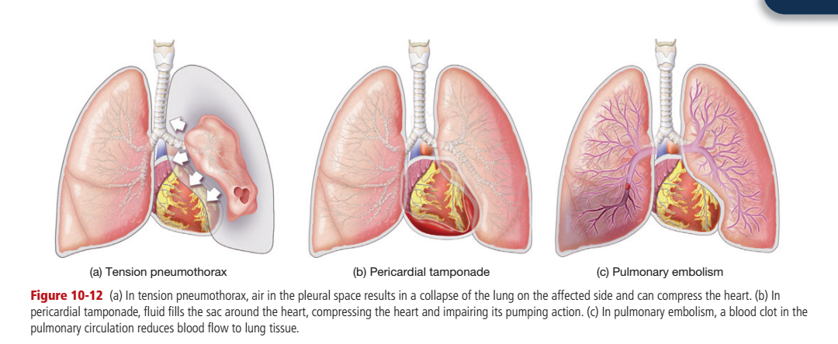
Obstructive Shock
A blockage of the heart prevents oxygenated blood from reaching vital organs

Slide 12
Shock Management
Treatment…
ABCDs
Give high flow O2
Elevate legs for blood flow to heart
Keep warm
RAPID TRANSPORT
Suspect shock with….
Massive external, or suspected internal bleeding
Multiple severe fractures
Abdominal or chest injury
Any major trauma
A severe infection
A major heart attack
Allergic reactions
Notes:
Note children and shock: compensate very well, but deteriorate rapidly when they cross into decompensated shock
Be sure to ask what medications patients are taking
- anticoagulants inhibit the body’s natural ability to clot which can prolong bleeding and worse hemorrhagic shock
- beta-blockers used to treat high blood pressure and heart disease limit the body’s ability to beat faster, limiting the body’s ability to compensate for shock

Slide 13
OEC Practice Questions
1. A patient with severe gastrointestinal bleeding is in shock. This type of shock is known as:
hypovolemic
cardiogenic
hemorrhagic
distributive
2. Which of the following lists of assessment findings indicates that a trauma patient may be in compensated shock?
Slightly confused, pulse 116, BP 90/60 mmHg, warm skin that is flushed
Confused and anxious, pulse 144, BP 82/palp, cool skin that is mottled
Confused, pulse 44, BP 110/68, cool and cyanotic skin
Anxious, pulse 104, BP 134/88 mmHg, pale and cool skin
3. The underlying cause of distributive shock is:
Poor fluid intake
Loss of blood volume
A damaged heart that has poor contractility
Dilation of blood vessels

Slide 14
OEC Practice Questions
1. A patient with severe gastrointestinal bleeding is in shock. This type of shock is known as:
hypovolemic
cardiogenic
hemorrhagic
distributive
2. Which of the following lists of assessment findings indicates that a trauma patient may be in compensated shock?
Slightly confused, pulse 116, BP 90/60 mmHg, warm skin that is flushed
Confused and anxious, pulse 144, BP 82/palp, cool skin that is mottled
Confused, pulse 44, BP 110/68, cool and cyanotic skin
Anxious, pulse 104, BP 134/88 mmHg, pale and cool skin
3. The underlying cause of distributive shock is:
Poor fluid intake
Loss of blood volume
A damaged heart that has poor contractility
Dilation of blood vessels

Slide 15
OEC Practice Questions
1. A patient with severe gastrointestinal bleeding is in shock. This type of shock is known as:
hypovolemic
cardiogenic
hemorrhagic
distributive
2. Which of the following lists of assessment findings indicates that a trauma patient may be in compensated shock?
Slightly confused, pulse 116, BP 90/60 mmHg, warm skin that is flushed
Confused and anxious, pulse 144, BP 82/palp, cool skin that is mottled
Confused, pulse 44, BP 110/68, cool and cyanotic skin
Anxious, pulse 104, BP 134/88 mmHg, pale and cool skin
3. The underlying cause of distributive shock is:
Poor fluid intake
Loss of blood volume
A damaged heart that has poor contractility
Dilation of blood vessels

Slide 16
OEC Practice Questions
1. A patient with severe gastrointestinal bleeding is in shock. This type of shock is known as:
hypovolemic
cardiogenic
hemorrhagic
distributive
2. Which of the following lists of assessment findings indicates that a trauma patient may be in compensated shock?
Slightly confused, pulse 116, BP 90/60 mmHg, warm skin that is flushed
Confused and anxious, pulse 144, BP 82/palp, cool skin that is mottled
Confused, pulse 44, BP 110/68, cool and cyanotic skin
Anxious, pulse 104, BP 134/88 mmHg, pale and cool skin
3. The underlying cause of distributive shock is:
Poor fluid intake
Loss of blood volume
A damaged heart that has poor contractility
Dilation of blood vessels

