Slide 1
Heat-Related Injuries
OEC Chapter 26
10/29/23

Slide 2
Objectives
26.1 Anatomy and Physiology
26.2 Heat-Related Illness Prevention
26.3 Common Heat-Related Emergencies
26.4 Assessment
26.5 Management
26.6 Review Exercises

Slide 3
Anatomy and Physiology
Key Terms
Core body temperature: 98.6°F (37°C)
Hyperthermia: elevated core body temperature, above 101°F
Ambient temperature: temperature of the surrounding environment
Thermoregulation: process of maintaining a stable internal temperature
Sweating, vein dilation, increased pulse rate

Slide 4
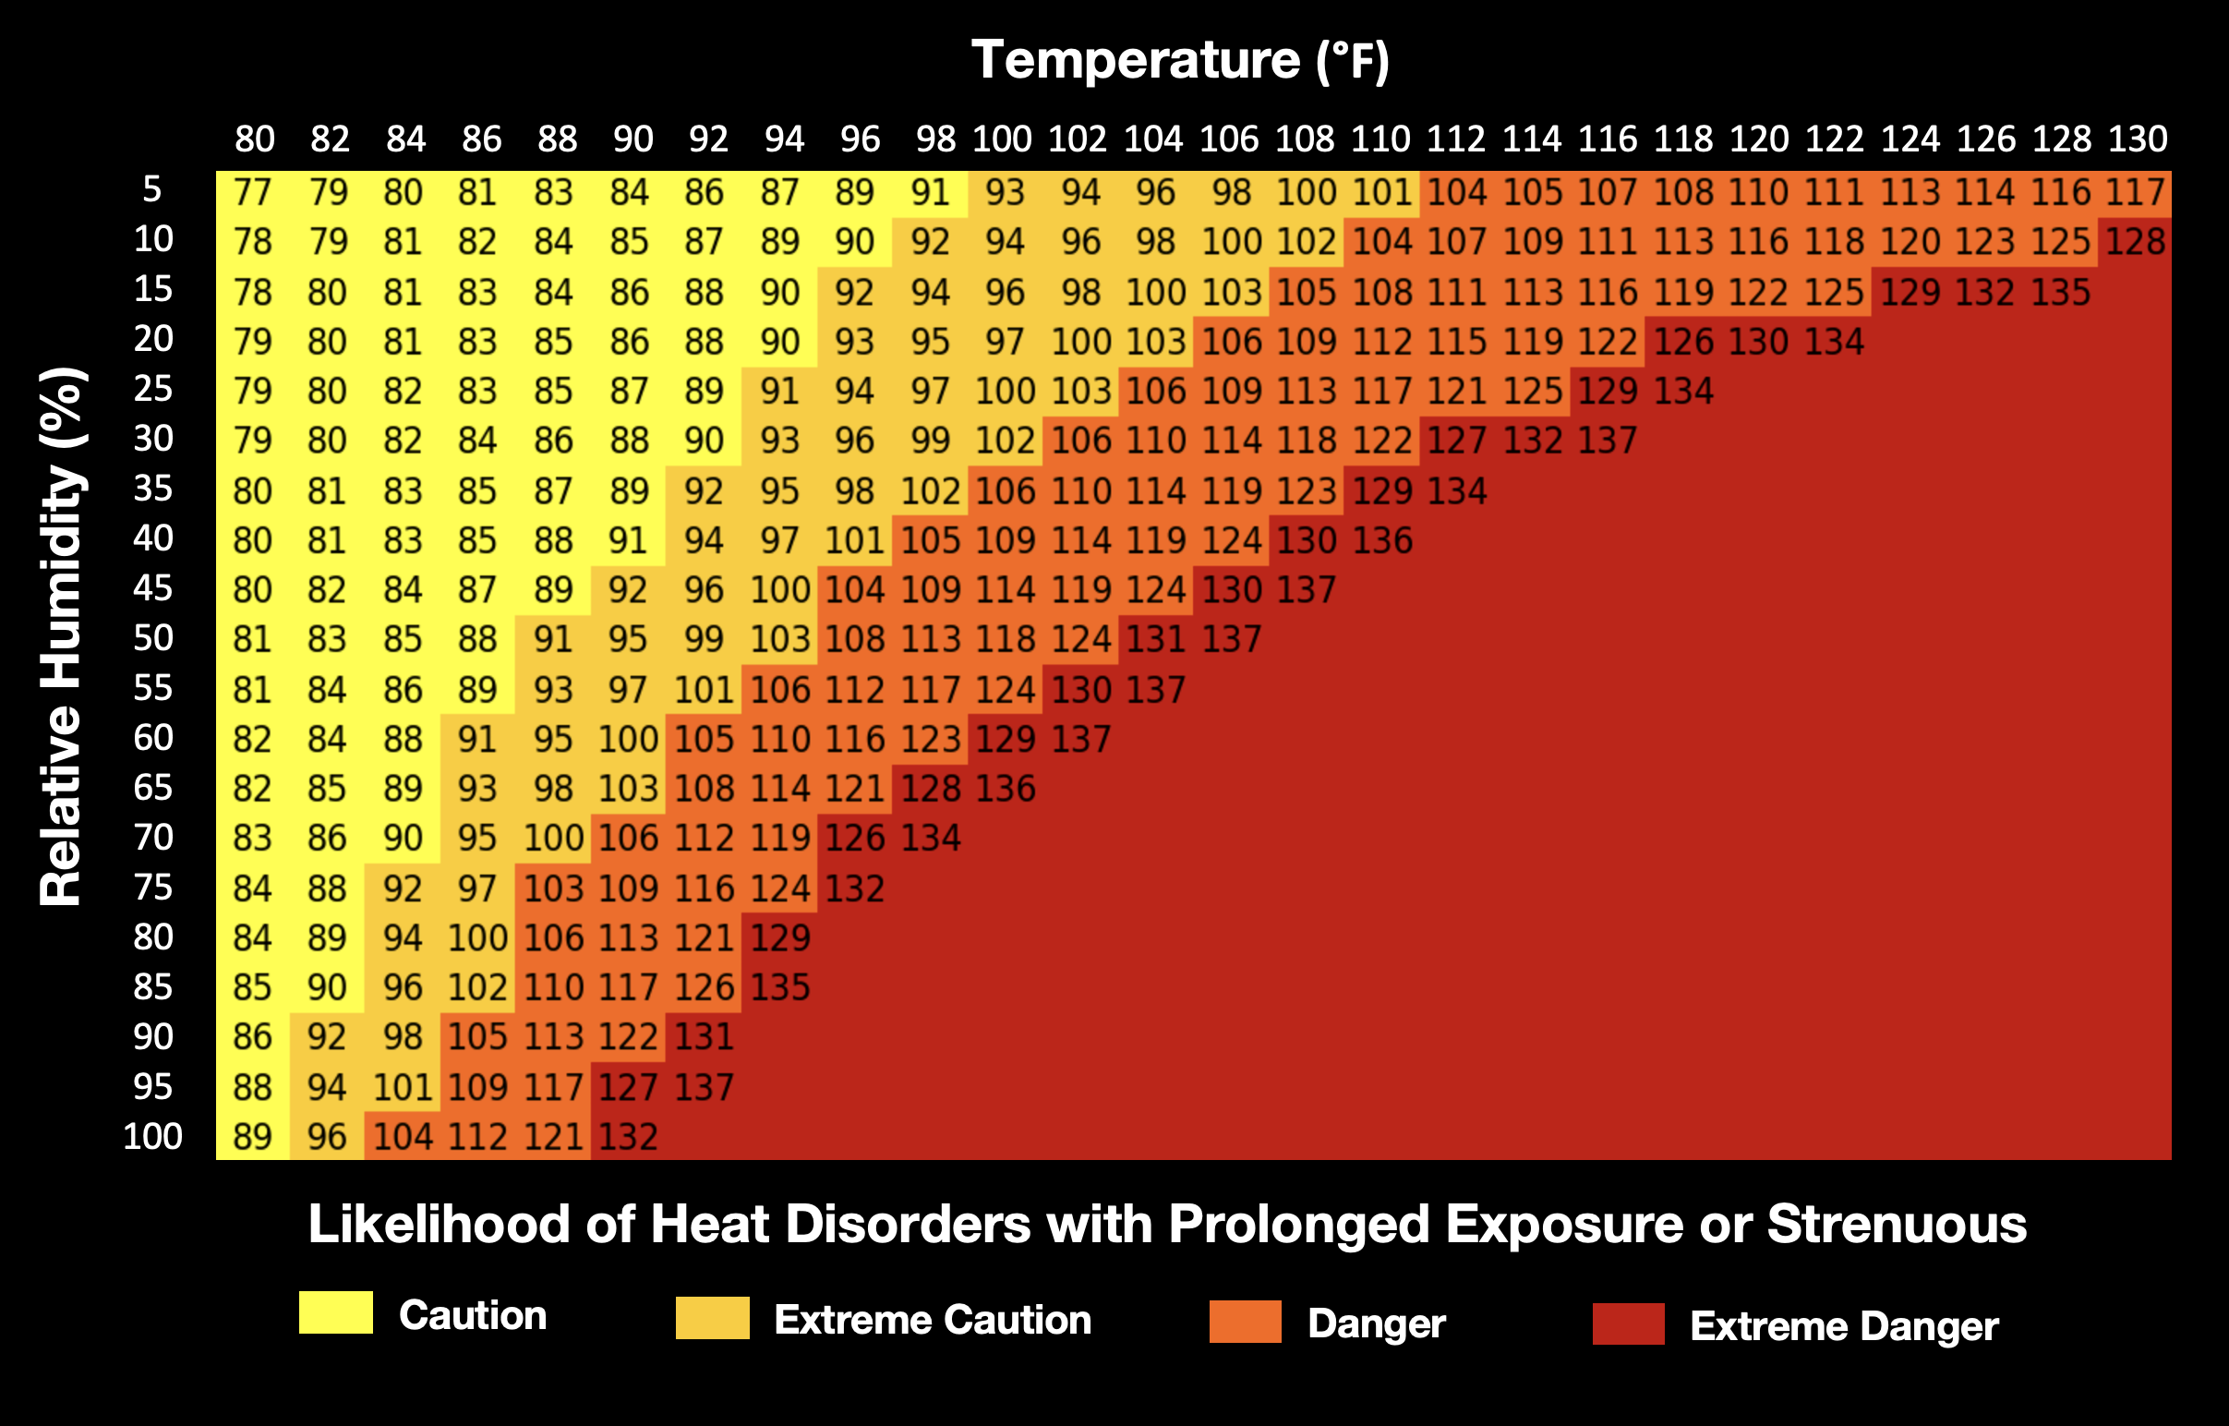
Heat Index

Slide 5
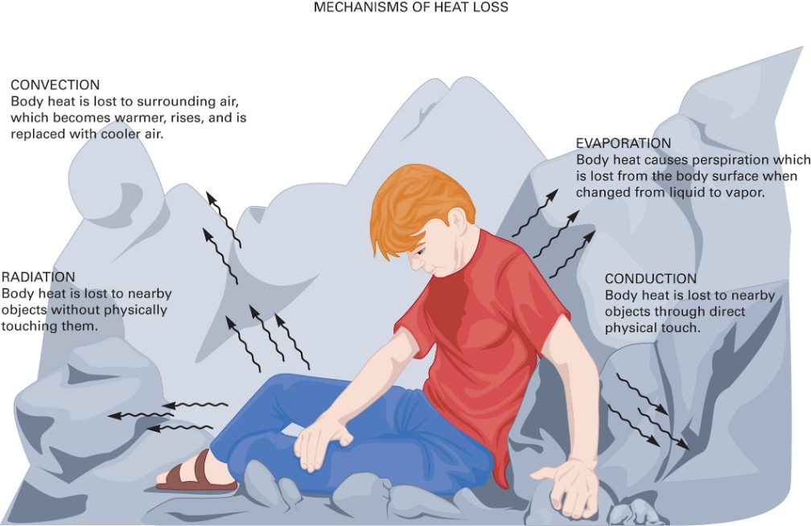
Thermoregulation
Affected by both your environment and physiology

Slide 6
Low Ambient Temperature
High Ambient Temperature

Slide 7
Heat-Related Illness Prevention
Heat acclimatization: exposing the body to hot environments to prepare for extended heat exposure
At least 1 hour per day for at least 1 week
During activity, hydrate frequently and increase sodium intake
Urine is a good indication of dehydration

Slide 8
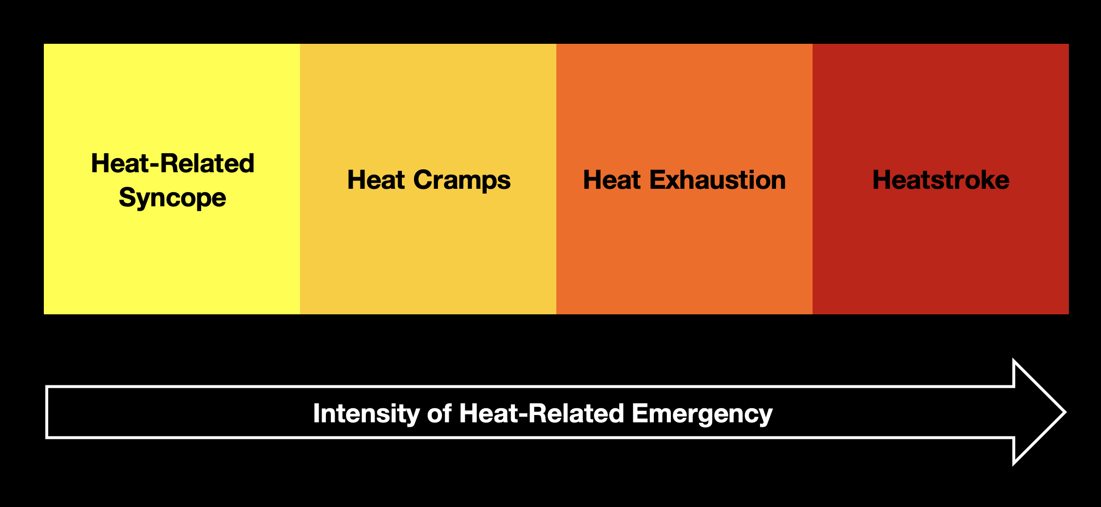
Heat-Related Emergencies
Heat illness is a “spectrum of injury”

Slide 9
Heat-Related Emergencies
Cardiovascular
Temporary loss of effective blood flow, improper perfusion to the brain leads to fainting
S&S: nausea and lightheadedness
Muscular
Caused by electrolyte disturbances in muscle tissue
S&S: sharp pain, muscular contraction

Slide 10
Heat-Related Emergencies
Low body fluid volume (hypovolemia) due to excessive sweating
S&S: exhaustion, dizziness, nausea, headache, excessive sweating, dehydration
Body systems overwhelmed, core temperature rises above 104°F
S&S: decreased LOR, high heart/respiratory rate, high blood pressure, shock may follow

Slide 11
Heat Exhaustion vs. Heatstroke
Body temperature between 101-104°F
No changes in mental status
Body can compensate
Body temperature above 104°F
Persistent changes in mental status
Hypotension/shock
Heat Exhaustion
Heatstroke
Heatstroke

Slide 12
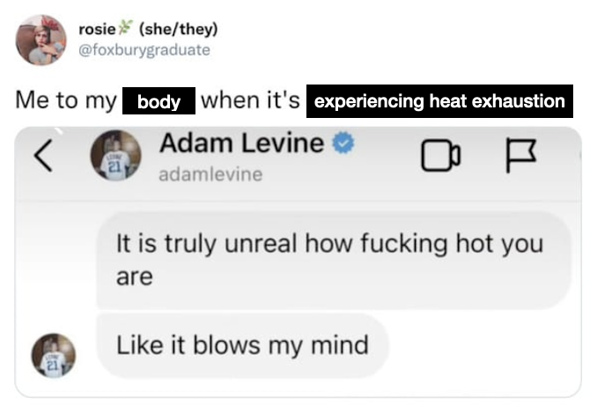

Slide 13
Assessment of Heat Illnesses
Standard assessment procedures to start – ABCDs and vitals
Check skin temperature and appearance
Check for muscle spasms / cramping
If necessary, determine core body temp
Note changes to LOR or behavior

Slide 14
Management of Heat Illnesses
Transport patients to a cooler location or shade from direct sun exposure
Heat-related syncope: supine position with legs elevated ~1 foot, provide liquids
Heat cramps: oral electrolyte solutions (Gatorade), stretch affected area
Heat exhaustion: remove clothing, cool by fanning, rehydrate if patient is tolerant, provide O2 if needed
Heatstroke: notify EMS, dampen skin and provide air circulation, apply ice packs to armpits and grin

Slide 15
Review
Your patient is a mountain bike rider who is complaining of nausea, headache, and weakness. She is sweating profusely. Your thermometer indicates that her core temperature is 102°F. You suspect that she is suffering from:
Heat-related syncope
Heat cramps
Heat exhaustion
Heatstroke

Slide 16
Review
The outside temperature is 90°F. Your patient is a trail builder who has been working in the sun on the mountain trails for 8 hours. When you gently shake him, he responds by mumbling. His skin is hot and dry. You suggest that he is suffering from:
Heat-related syncope
Heat cramps
Heat exhaustion
Heatstroke

