Slide 1
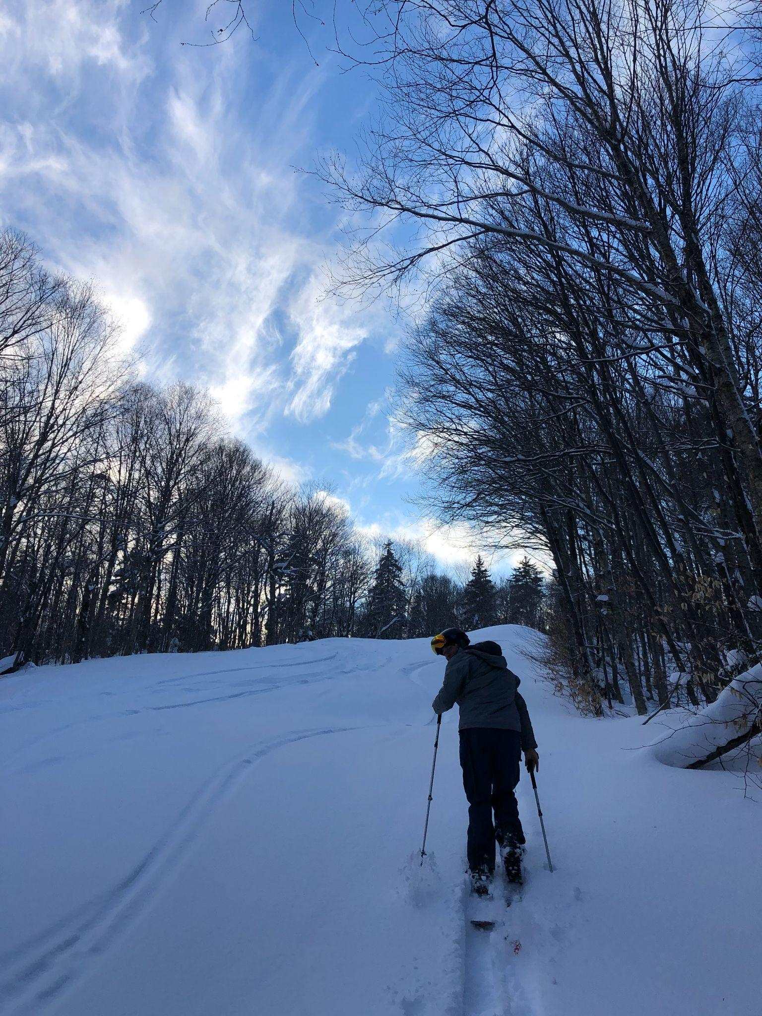
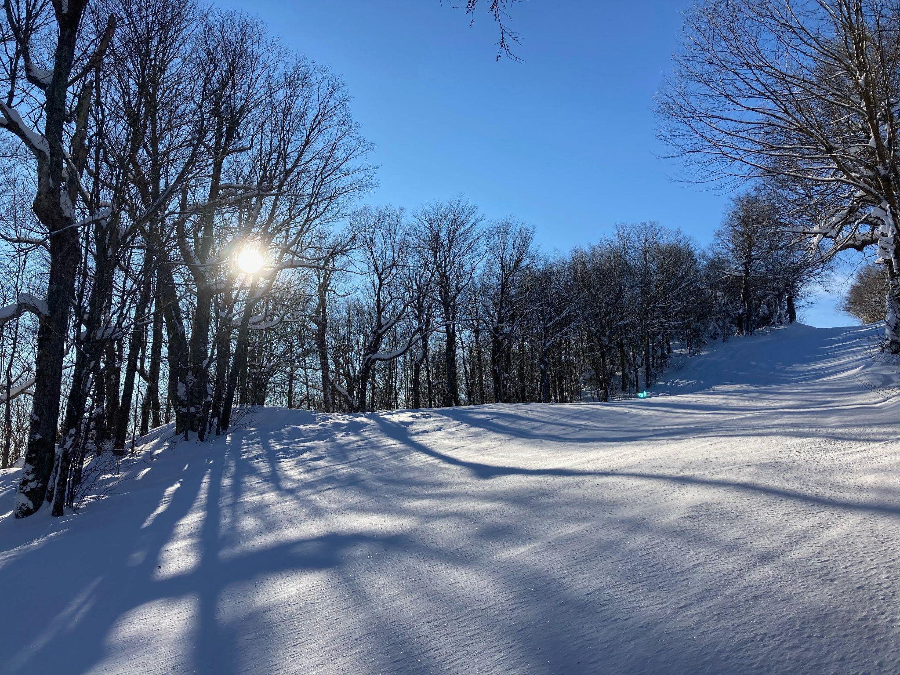
Chapter 7: Patient Assessment
Presented by Annie Lee

Slide 2
How we test you!
CPI - need to complete to pass. Make it easy for us and say the words out loud!
Tips: Practice on your friends! Practice on yourself! Write out steps! Say out loud in the shower!

Slide 3
The basics…
Scene size up
Primary patient assessment
History taking (SAMPLE, OPQRST)
Secondary patient assessment (physical exam, vitals)
Reassessment and shock management

Slide 4
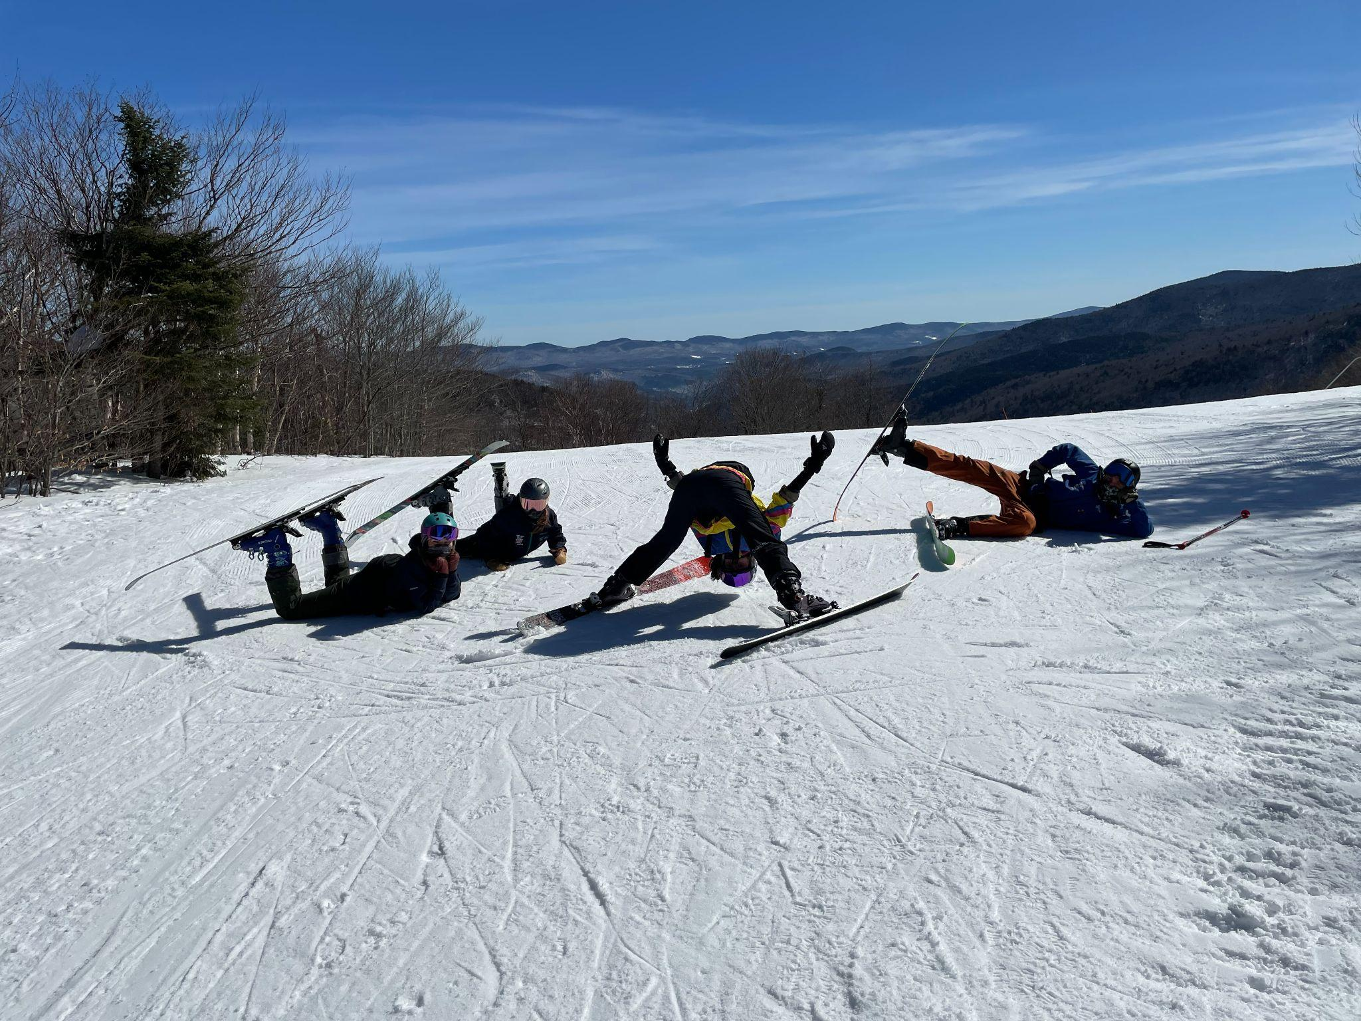
Size up the scene!
*scene safety
*universal precautions (gloves, goggles, mask etc.)
*determine number of patients and general LOR of each
*form general impression (MOI/NOI, consider c-spine immobilization)
*introduce self, obtain consent

Slide 5
2. Primary patient assessment
Control life threatening bleeding *in case of life threatening bleeding, follow CABD
Assess Airway, Breathing, Circulation, and Disability
Obtain chief complaint aka the main reason they need help, confirm NOI and MOI
Assess level of responsiveness (Alert, Verbal, Pain, Unresponsive)
Make a radio call! What do you need? Backboard? Oxygen? Extra patrollers? An ambulance? Helicopter?

Slide 6
3. Secondary assessment - patient history
Investigate chief complaint using SAMPLE
Signs/symptoms
Allergies
Medications
Pertinent past medical history
Last ins/outs
Events leading up to incident
Assess pain using OPQRST
Onset - when did symptoms begin?
Provocation and palliation - what makes it better? What makes it worse?
Quality - describe type of pain (sharp, dull, throbbing)
Radiation - Does the pain move from one area to another?
Severity - 0-10 scale
Time - how long has the patient had the problem?

Slide 7
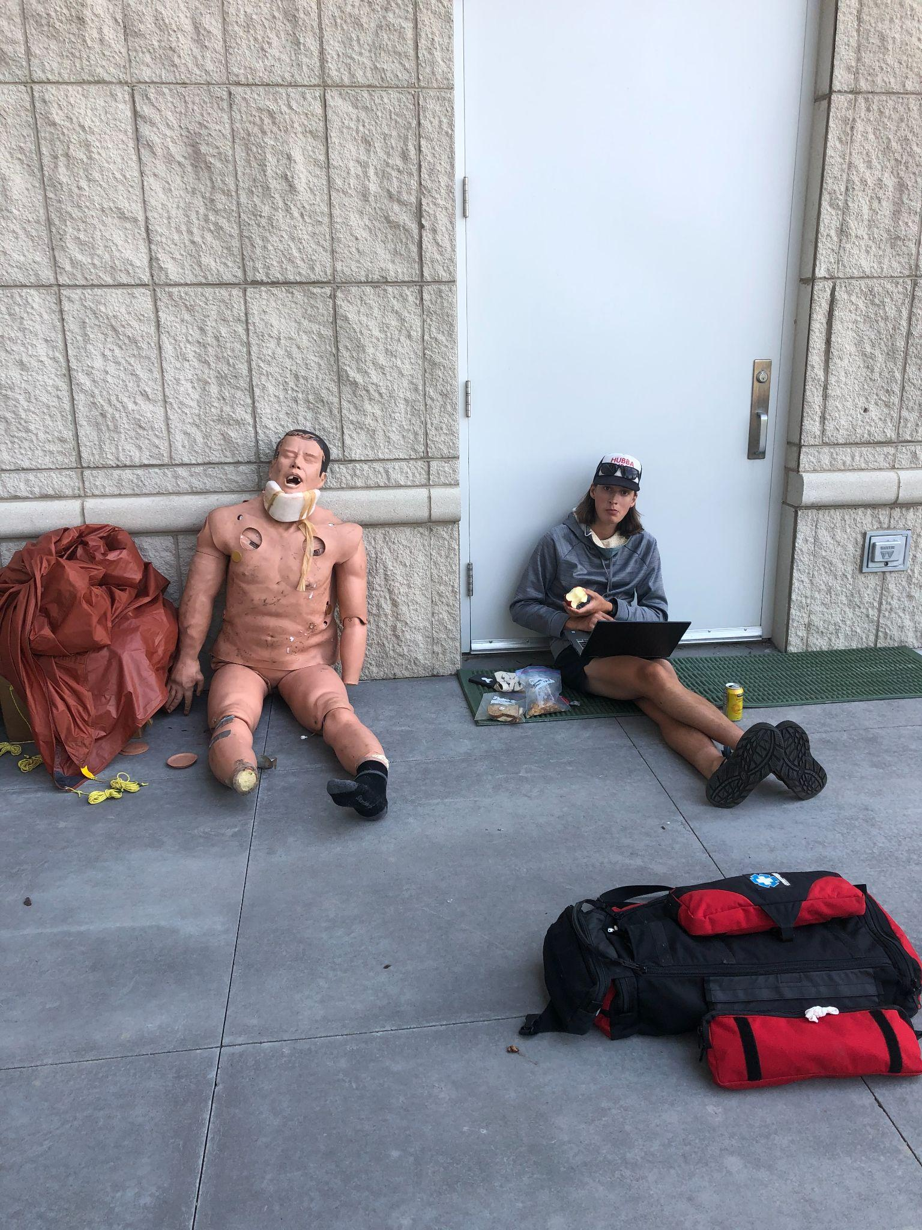
4. Secondary patient assessment - head to toe
Physical Exam - looking for DCAP-BTLS
Deformity
Contusions
Abrasions/avulsions
Punctures/penetrations
Burns/bleeding/bruises
Tenderness
Lacerations
Swelling

Slide 8
4. Secondary patient assessment - VITALS
Pulse
Respiration rate
Pupils
Blood Pressure (not on practical)
Temperature (not on practical)
Oxygen Saturation (not on practical)
Things to remember:
Strength/regularity of pulse
Rhythm, depth, effort and noise for respirations
PERRL - pupils equal, round, and reactive to light
Within normal limits for everything!!! Say the words!

Slide 9
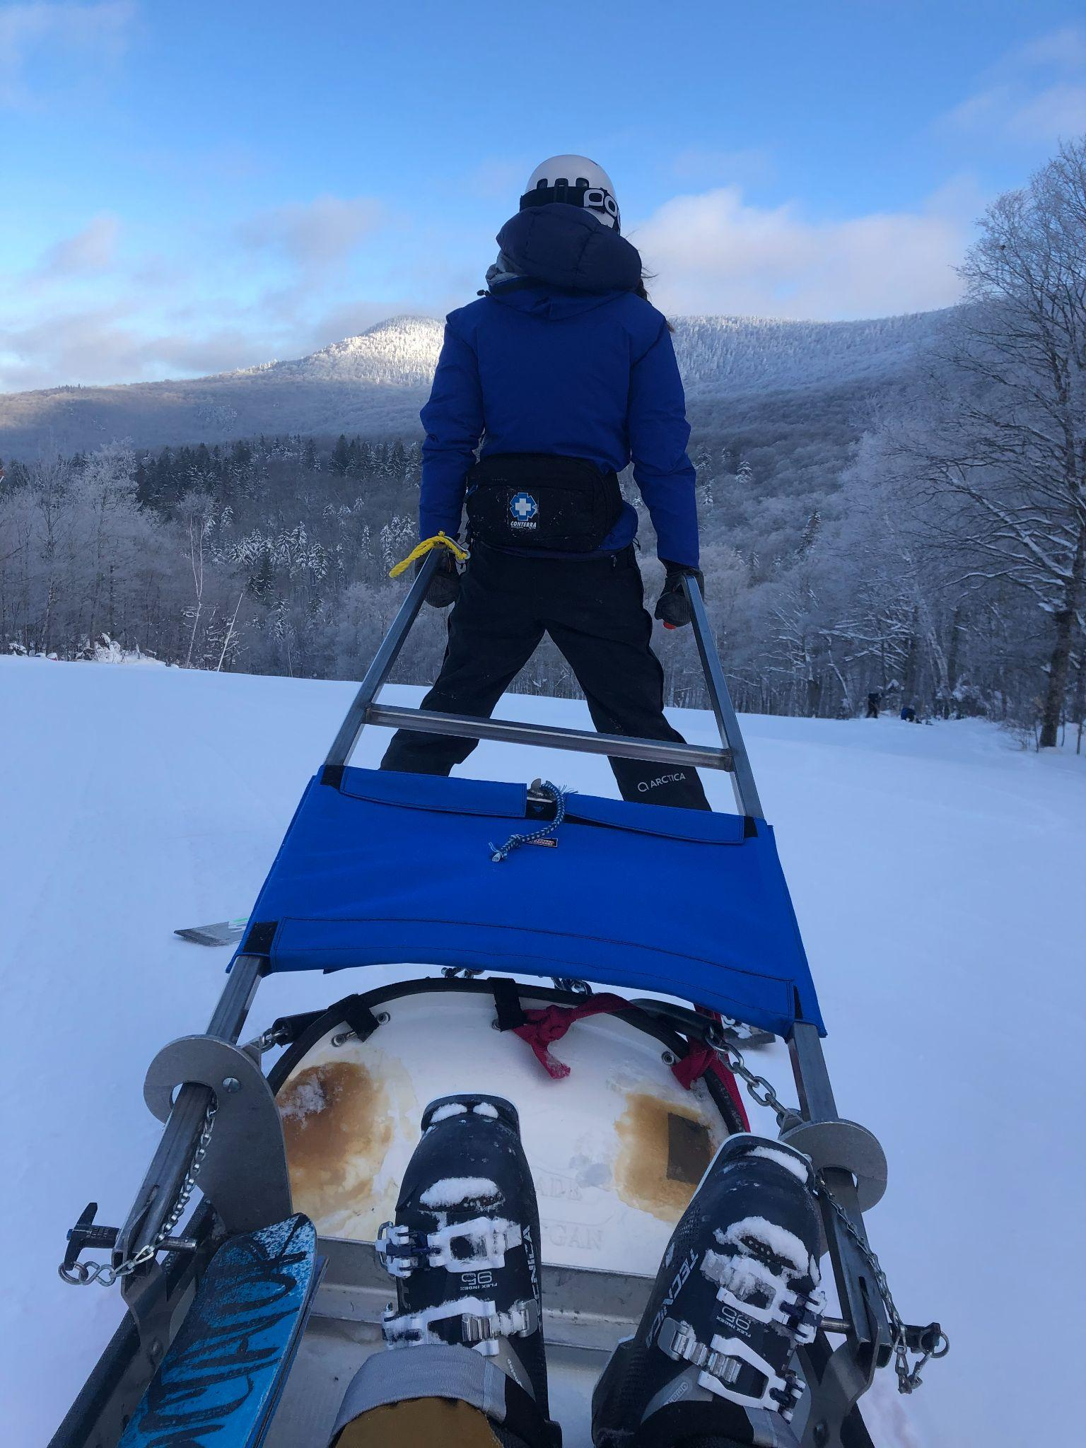
5. Reassessment
Prepare for rapid transport, provide O2 and treat for shock if needed.
Assess and manage ABCDs
High flow O2
Keep patient warm
Position patient with head lower than feet
Check vital signs every 5 minutes for critical patients, every 15 minutes for stable patients.
Continue to reassess vital signs and primary assessment.

Slide 10
Practice!
You have been dispatched to an 89 year old female with an unspecified complaint. When assessing this patient, which one of the following will the OEC Tech do as quickly as possible to develop a better understanding of the emergency?
Obtain the patient’s vital signs and current medications.
Gather a medical history, including information on allergies.
Contact medical direction for advice.
Determine if the chief complaint is medical or trauma related.

Slide 11
Practice!
You have been dispatched to an 89 year old female with an unspecified complaint. When assessing this patient, which one of the following will the OEC Tech do as quickly as possible to develop a better understanding of the emergency?
Obtain the patient’s vital signs and current medications.
Gather a medical history, including information on allergies.
Contact medical direction for advice.
Determine if the chief complaint is medical or trauma related.

Slide 12
Practice!
Which of the following statements would indicate that an OEC Technician is ready to begin the first phase of a patient assessment?
“I have placed an oral airway in the patient.”
“The scene is safe and appears to be free of hazards.”
“Blood pressure is 124/80 mmHg.”
“Can you tell me why you called for help?”

Slide 13
Practice!
Which of the following statements would indicate that an OEC Technician is ready to begin the first phase of a patient assessment?
“I have placed an oral airway in the patient.”
“The scene is safe and appears to be free of hazards.”
“Blood pressure is 124/80 mmHg.”
“Can you tell me why you called for help?”

