Slide 1
Ch 31: Geriatric Emergencies
OEC Class Fall 2022
Charlotte Marks

Slide 2
Objectives
Describe physical changes that occur to 6 body systems with aging
Describe effective methods for communicating with geriatric patients
Understand the effects of certain geriatric illnesses and diseases
Understand how medications can affect the results of an assessment of geriatric patients
Explain why certain traumatic conditions/injuries are different in geriatric patients
Explain how the management of geriatric patients is different than that of other patients

Slide 3
Physiological Changes of Aging
Cardiovascular Changes
Clinical Presentation
Thickening/stiffening of arterial walls; decreased elasticity and increased peripheral resistance
Decreased cardiac output
Increased risk of heart attack, stroke, and high blood pressure
Diminished physical activity, easily fatigued
Less effective responses to stress, illness or injury

Slide 4
Physiological Changes of Aging
Neurological Changes
Clinical Presentation
Shrinking of the brain
Decreased cerebral blood flow
Slower nerve impulses
Inner ear balance organs are less effective
Longer reaction times
Reduced perception of stimuli such as light, sound, and pain
Decreased balance; more susceptible to falls

Slide 5
Physiological Changes of Aging
Respiratory Changes
Clinical Presentation
Decreased elasticity and function of lungs
Decreased ability to clear foreign objects from lungs
Higher risk of pneumonia or other respiratory infections
Decreased vital capacity (50% of normal adult)

Slide 6
Physiological Changes of Aging
Renal Function Changes
Clinical Presentation
Kidneys become less effective at filtering waste products, toxins, etc out of blood
Altered water balance and electrolyte levels
Effects of medications last longer
Increased susceptibility to water loss and dehydration

Slide 7
Physiological Changes of Aging
Musculoskeletal Changes
Clinical Presentation
Decreased muscle mass
Loss of minerals from bones/decreased bone density
Osteoporosis
Scoliosis
Kyphosis (thoracic spine curvature)
Lordosis (lumbar spine inward curvature)
Susceptibility to ligament rupture
Increased susceptibility to fractures

Slide 8
Physiological Changes of Aging
Integumentary and Endocrine Changes
Clinical Presentation
Loss of skin elasticity and fat content
Shrinking of sweat glands
Decreased pancreatic function
Predisposition to bruising and tearing and hypothermia
Increased risk of hyperthermia
Higher incidence of diabetes

Slide 9
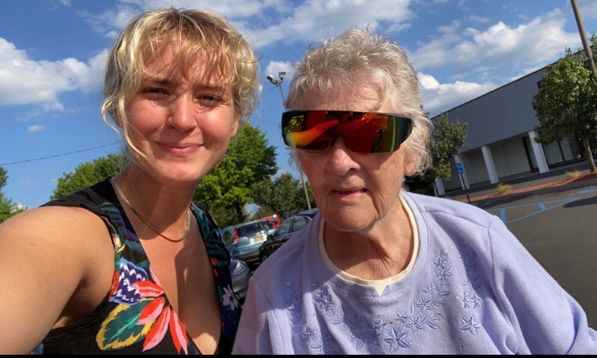
Common Geriatric Illnesses
Altered mental status
Hypertension (systolic bp over 140 or diastolic bp over 90)
Myocardial Infarction
Congestive Heart Failure
Syncope (ie. Fainting)
Stroke
Chronic obstructive pulmonary disease
Abdominal Emergencies

Slide 10
Medications
Older individuals are more likely to be on at least one medication
Polypharmacy – the concurrent use of multiple medications
Medication can significantly affect your assessment findings
Obtaining a thorough SAMPLE medical history is very important when treating a geriatric patient
Drug categories: beta-blockers, calcium-channel blockers, diuretics, blood thinners, etc.

Slide 11
Trauma Considerations
Assessing geriatric patients can be very tricky
They do not always present as you would expect to trauma or illness
Common sources of trauma: falls, hip/pelvis fractures
Traumatic brain injury
Decreased brain size increases the chance of TBI
Cervical Spine Injury
The threshold for considering c-spine immobilization is lower for elderly patients

Slide 12
Additional Considerations
Artificial Joints
Patient evaluation may need to be altered
Implantable devices/external ports
Some conditions require that individuals have therapeutic devices attached to their bodies
Failure of pacemakers can cause life-threatening arrhythmias or cardiac arrest and can override body’s natural compensatory mechanisms for shock
Malfunctions can lead to serious medical complications
Communication
Speak clearly and directly
Be respectful

Slide 13
Treatment
The assessment and treatment process is no different for geriatric patients
Proper patient management can be more difficult
Complex medical history
Use of different medications
Managing shock and controlling bleeding can take longer and be more difficult

Slide 14
Practice Questions
A geriatric patient’s cardiovascular response to stress, illness, and injury is different than that of younger patients. Which of the following statements is false?
a. As the heart ages, the ventricles become stiffer.
b. The volume of blood in the body decreases in geriatric patients.
c. The heart slows due to decreased electrical conductivity in geriatric patients.
d. Blood vessels become stiffer from atherosclerosis in geriatric patients.

Slide 15
Practice Questions
One group of drugs prescribed for geriatric patients is beta-blockers. This type of drug:
a. manages cardiac arrhythmias.
b. increases a patient’s pulse rate.
c. increases a patient’s cardiac preload.
d. thins a patient’s blood.

