Slide 1
OEC Chapter 21: Spine, Brain, And Nervous System Injuries
11/14/2021
Eli DiBari

Slide 2
OBJECTIVES
21-1 Identify and define the two major anatomic components of the central nervous system.
21-2 Define traumatic brain injury
21-3 Describe traumatic injuries involving the spine.
21-4 Describe the signs and symptoms of spinal injuries.
21-5 Describe how to properly assess a patient with a suspected brain and spinal cord injury.
21-6 List the signs and symptoms of a traumatic brain injury.
21-7 Demonstrate how to properly care for a patient with a brain and spinal cord injury.
21-8 Demonstrate how to maintain proper spinal alignment while placing a patient onto a long backboard from 1) supine and 2) sitting positions.
21-9 Explain and demonstrate how to perform neutral head alignment.
21-10 Demonstrate how to size and apply a cervical collar.
21-11 Demonstrate how to perform and axial drag.
21-12 Demonstrate how to secure a patient to a long backboard.
21-13 Demonstrate how to place a patient on a full-body vacuum mattress.
21-14 Describe and demonstrate how to remove a helmet.
21-15 Explain and demonstrate the principle of “jams and pretzels.”

Slide 3
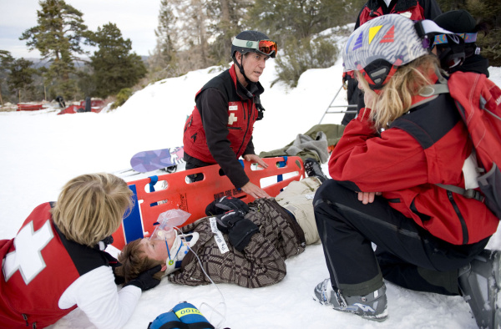
Overview
Spine, brain, and nervous system injuries are among the most serious that OEC technicians like ski patrollers encounter
From 2007-2011, hospital ERs treated 32,643 patients that received traumatic brain injuries (TBIs) from winter sports alone
Know your stuff!

Slide 4
Anatomy/Physiology
Spinal column contains 33 vertebrae
Cervical – 7 vertebrae
Thoracic – 12 vertebrae
Lumbar – 5 vertebrae
Sacrum – 5 vertebrae
Coccyx - 4 vertebrae
Body is wired by nervous system that sends electrical/chemical impulses
Central nervous system (CNS) – brain and spinal cord
Peripheral nervous system – nerves that stretch into extremities
Neurons are functional unit of nervous system w/ axons projecting electrical signals away from neuron

Slide 5
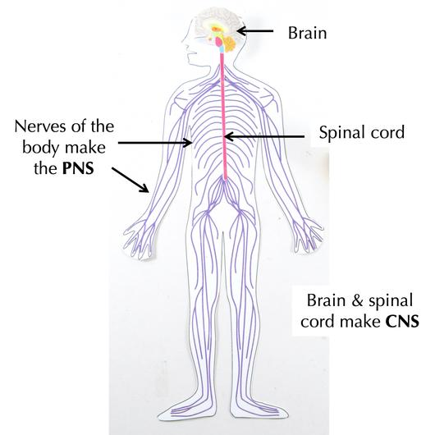
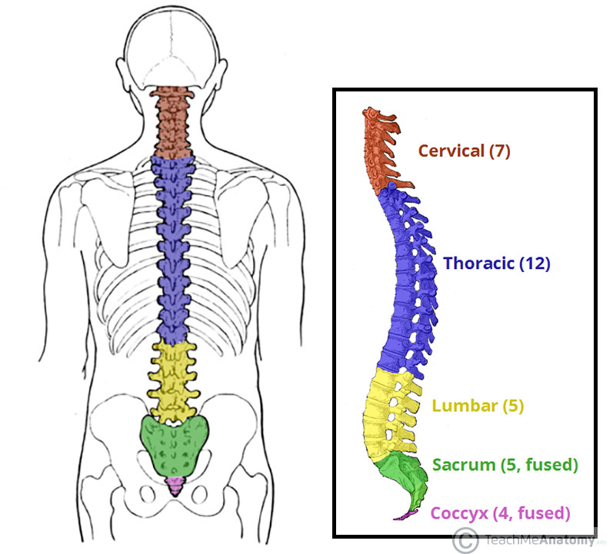

Slide 6
Anatomy/Physiology
Each region of spine contains same number of nerves as vertebrae
Cervical spine is exception… 7 vertebrae, 8 cervical nerves
Direct injuries to spinal cord will cause sensory/motor function below the injury to be lost
Sensory neurons in extremities sense position, hot/cold, pain
Sensory and motor neurons exist together in peripheral nerve pathways

Slide 7
Anatomy/Physiology
Brain makes up 2% of body weight but…
Receives 15% of blood supply
Consumes 20% of circulating oxygen, glucose
ESSENTIAL!
Brain and spinal cord protected by meninges
Dura mater – superficial
Arachnoid mater
Pia mater - deep
Cerebral spinal fluid (CSF) fills space around brain and spinal cord to act as cushion

Slide 8
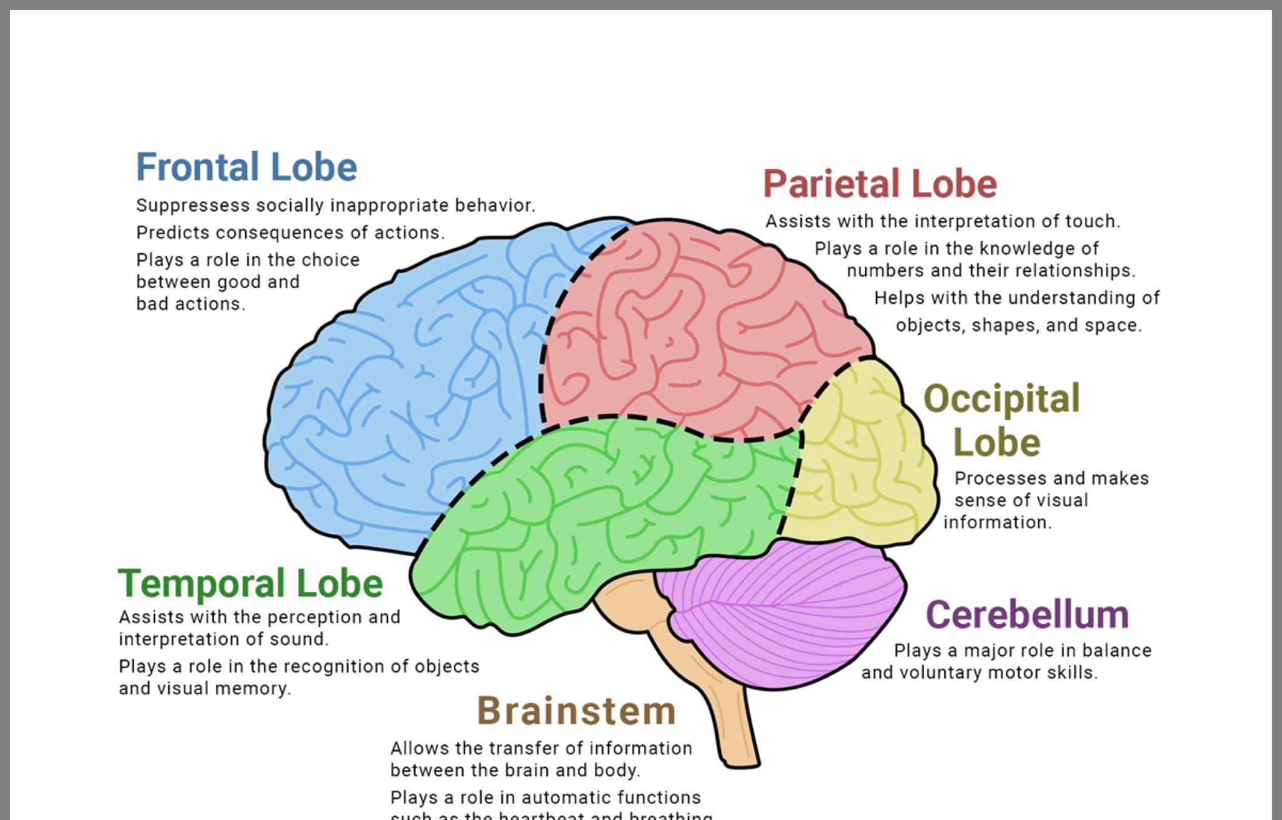

Slide 9
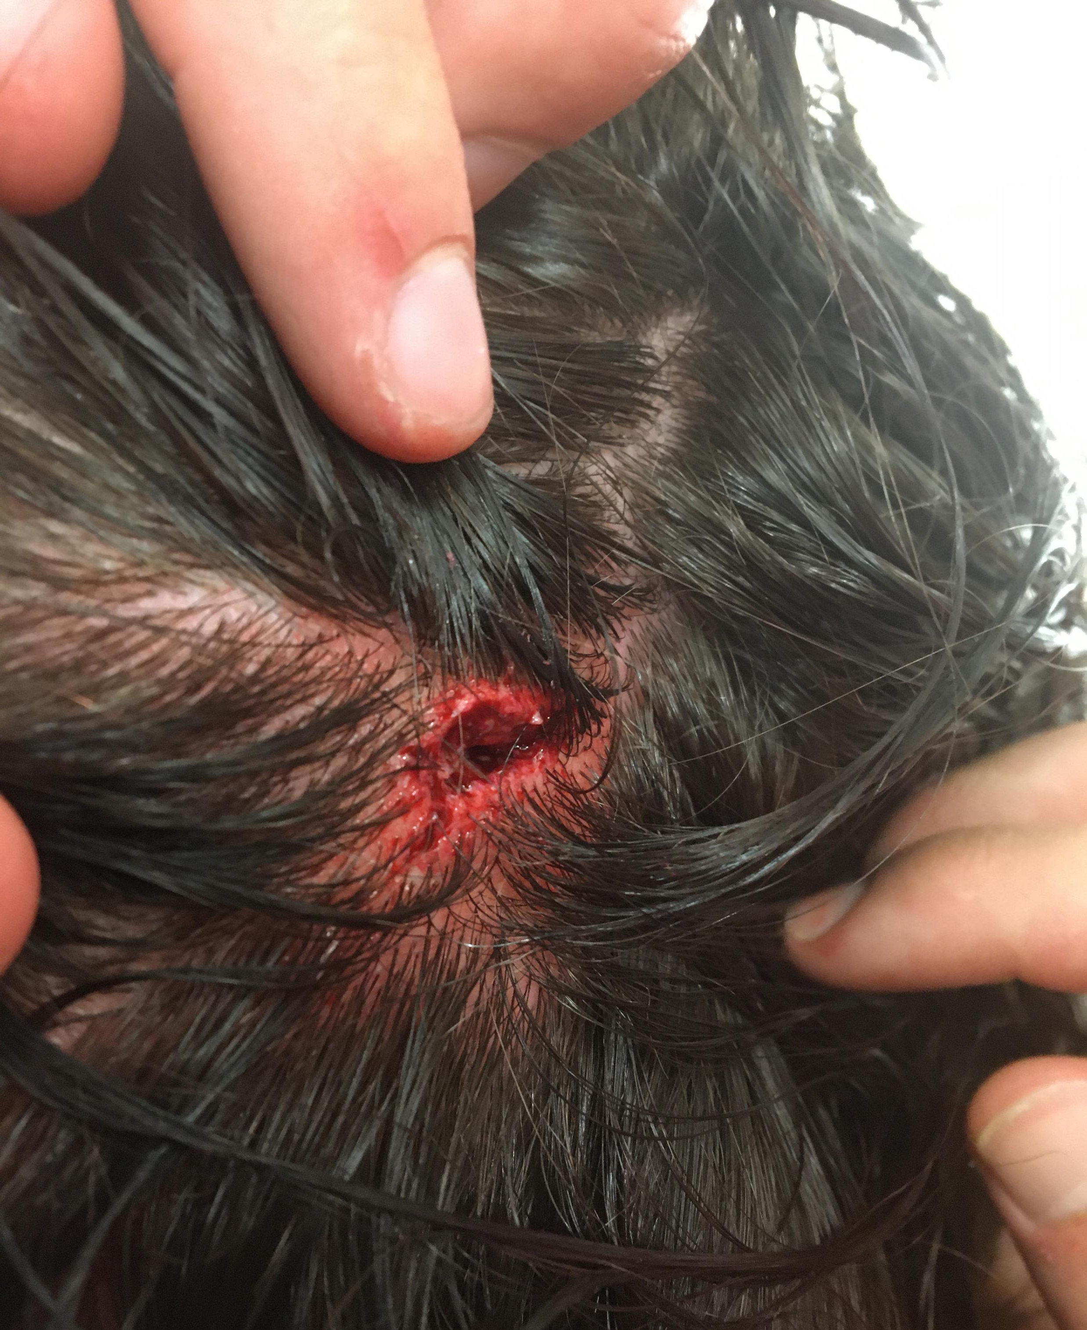
Head Injuries
Open wounds of scalp can occur
Often comes with significant bleeding (generous blood flow)
Skull fractures result from blunt or penetrating trauma
4 categories
Presents with significant swelling, tenderness (linear)
Look for “soft spot”/depression (compression)
Look for CSF coming out of nose and ears, raccoon eyes, Battle sign (basilar)
Look for open wounds (open)

Slide 10
Brain Injuries
Coup-Contrecoup Brain Injury
Rapid deceleration or impact
Brain keeps moving forward and strikes the front of the skull (coup)
Head stops and brain bounces back and strikes the back of the skull (contrecoup)
Can cause significant intracranial bleeding, swelling, compromises brain function
Varying timelines before signs/symptoms present
Intracranial pressure (ICP)
Caused by bleeding, swelling, etc.
Brain tissue is compressed, brain function is reduced, can lead to death

Slide 11
Brain Injuries
Traumatic brain injury (TBI) – mechanical injury to brain that results in short- or long-term neurologic deficit
Recurrent TBIs occur when patient receives another TBI before initial has not fully healed
Can lead to severe, cumulative, permanent neurologic damage known as chronic traumatic encephalopathy
Patients with TBIs should cease activity that caused the injury until cleared by medical professional
Concussion – TBI caused by temporary disruption of brain function by trauma
Mild – no LOR Moderate – LOR of <= 5 mins Severe – LOR of >= 5 mins
Can result in measurable memory loss
Retrograde amnesia – loss of memory BEFORE injury
Antegrade amnesia – loss of memory AFTER injury

Slide 12
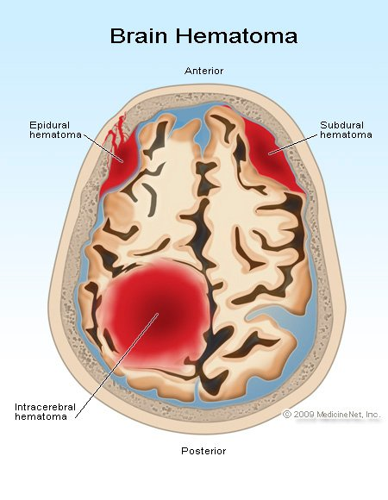
BRAIN INJURIES
Cerebral contusion – bruising of the brain; rupture of small blood vessels in a localized area.
Cerebral hematoma – accumulation of blood outside of vasculature within skull
Subdural hematoma – VENOUS bleeding between dura mater and brain; slower onset of signs/symptoms
Epidural hematoma – ARTERIAL bleeding between skull and dura mater; rapid onset of signs/symptoms
Lucid interval – patient decompensates from alert to unresponsive
Intracranial hematoma – rupture of vessel within brain; can occur spontaneously or from trauma
Diffuse axonal injury
Caused by high-velocity rotational/deceleration mechanisms
Patients are immediately, or quickly become unresponsive

Slide 13
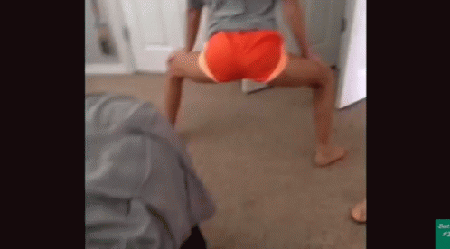
Spinal injuries
Fractures of spine occur from BLUNT, ROTATIONAL, PENETRATING, COMPRESSION, or DISTRACTION trauma
Fun (or not so fun) fact… 80% of spinal cord injuries occur in men
Cervical spine fractures can result in paralysis of arms and legs, loss of sensation below injury site
“C3, C4, C5, keep the diaphragm alive”
Phrenic nerves responsible for stimulating diaphragm and breathing
Lower-thoracic or lumbar fractures are most common
High velocity MOI, twisting forces lead to these injuries
Neurologic injuries result from spinal cord damage via spinal injuries
Direct – displaced vertebrae puts pressure on or lacerates spinal cord
Indirect – hematoma inside spinal canal puts pressure on spinal
cord or spinal cord swells
Watch for NEUROGENIC SHOCK!
Disruption of autonomic nervous system disrupted

Slide 14
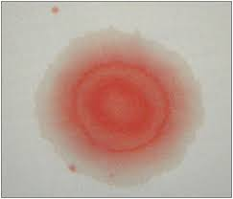
Assessment
Primary assessment remains constant… extra attention to c-spine precautions and LOR
Raccoon eyes, Battle sign
AVPU scale
Posturing (decerebrate/decorticate) and behavior
IMMEDIATELY hold manual spinal motion restriction! Until it can be ruled out…
Focus on head, neck, and spine during head-to-toe assessment
Deformities of head, soft spots/step offs on neck, spine
CSMs of extremities
PERRL - anisocoria
Examine ears/nose for CSF leakage – halo test
Vitals – Cushing's triad (increased ICP)
Hypertension, bradycardia, irregular breathing

Slide 15
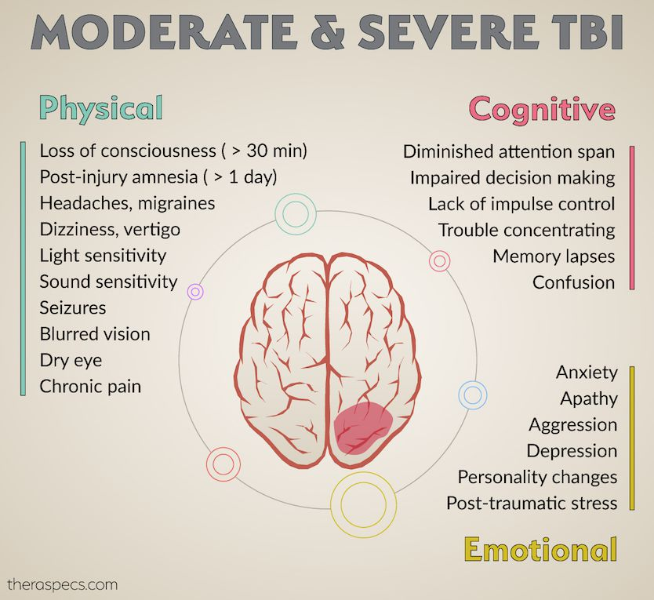

Slide 16
Management
When to stabilize patient on backboard/vacuum splint?
Potential MOI for spinal injury and reliable assessment that suggests spinal injury, along with A on AVPU
Potential MOI for spinal injury without reliable assessment, along with <A on AVPU
Unresponsive patient in unwitnessed traumatic event
Positive findings during assessment
When to NOT stabilize patient on backboard/vacuum splint?
Low-energy incidents
“Just-in-case” situations
Headache, brief loss of LOR, but are currently A on AVPU
Patient up + walking around on scene after significant MOI

Slide 17
REVIEW!
A person is exhibiting loss of movement and loss of sensation in all four extremities has injured what part of the spine?
a) Cervical b) Thoracic c) Lumbar d) Sacral
The following is NOT a sign of a traumatic brain injury:
a) Incontinence b) Seizures c) Abdominal pain d) Posturing
Ski patrol is called to the cafeteria to evaluate an 85-year-old man who is “not acting right” according to his family. he tells you he has a headache. Upon exam you note a healing bruise on the right side of his head. His family states that he struck his head on a kitchen cabinet a few days ago. Based on your findings, what type of injury is most likely to have occurred?
a) Diffuse axonal injury b) Subdural hematoma c) Intercranial hemorrhage d) Spinal cord injury

