Slide 1
MUSCULOSKELETAL INJURIES (CHAPTER 20)
ANNIE LIT & CHELSEA SMITH

Slide 2
OBJECTIVES
01
02
03
04
05
IDENTIFY AND DEFINE THE FUNCTIONS OF THE FOLLOWING STRUCTURES: BONES, CARTILAGE, JOINTS, MUSCLES, SYNOVIUM, TENDONS, LIGAMENTS.
DESCRIBE HOW MUSCULOSKELETAL TISSUES HEAL.
EXPLAIN THE DIFFERENCE BETWEEN A SPRAIN AND STRAIN.
DESCRIBE AND DEMONSTRATE THE GENERAL ASSESSMENT OF MUSCULOSKELETAL INJURIES.
LIST THE SIGNS AND SYMPTOMS OF SPRAINS, STRAINS, RUPTURED TENDONS, DISLOCATIONS, AND FRACTURES.

Slide 3
THE MUSCULOSKELETAL SYSTEM
THE VOLUNTARY MUSCLES AND OTHER SUPPORTING STRUCTURES THAT GIVE THE BODY FORM AND ENABLE MOVEMENT

Slide 4
THE SKELETON
Skeletal Functions
Rigid framework to protect the internal organs
Produces blood cells
Consists of:
Bones
Connective tissue
Cartilage
Axial Skeleton: the central core of the bony skeleton (skull, spine, and supporting thoracic bones)
Appendicular Skeleton: the periphery of the skeleton; the bones of the arms and legs
Notes:
Skeleton has 7 areas= (1) head, skull, facial bones, (2) spine, (3) shoulder, (4) upper extremities (arms), (5) rib cage (thorax), (6) pelvis, (7) lower extremities (legs)
Cartilage: firm but flexible connective tissue; more widespread in the infant skeleton, being replaced by bone in growth

Slide 5
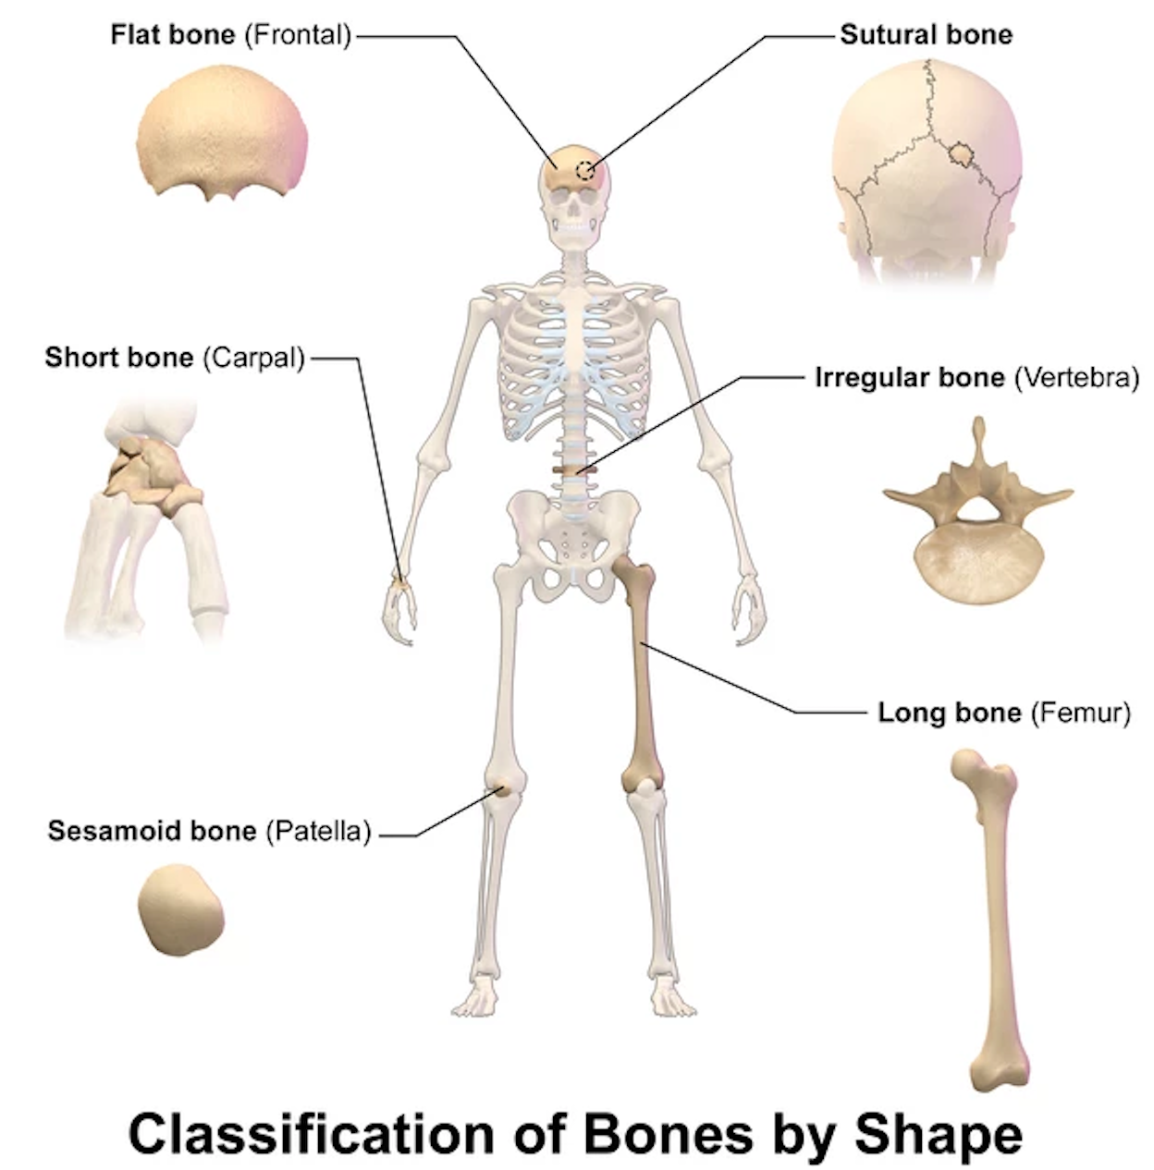
BONES
LONG BONES | Function: support body and facilitate movement Upper Extremities- humerus, radius, and ulna Lower Extremities- femur, tibia, and fibula
FLAT BONES | Function: Protect internal organs The skull, scapula, ribs, sternum, pelvic bones
IRREGULAR BONES | Function: Multiple functions, supporting nervous tissues Vertebrae, bones in the wrists, hands, ankles, and feet

Slide 6
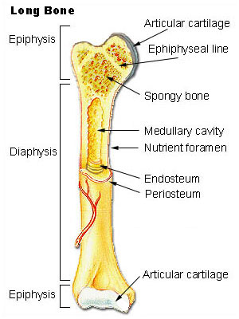
PARTS OF THE LONG BONE
Articular Cartilage: the cartilage that is affixed to the end of the bone within a joint
Fractures along articular cartilage during childhood can affect growth and development
Periosteum: the thin outer covering of the bone
Cortex: the hard layer below the periosteum; contains the bone marrow
If the cortex of a bone breaks, the highly vascular marrow may bleed severely
Notes:
Articular cartilage provides a nearly friction-free surface

Slide 7
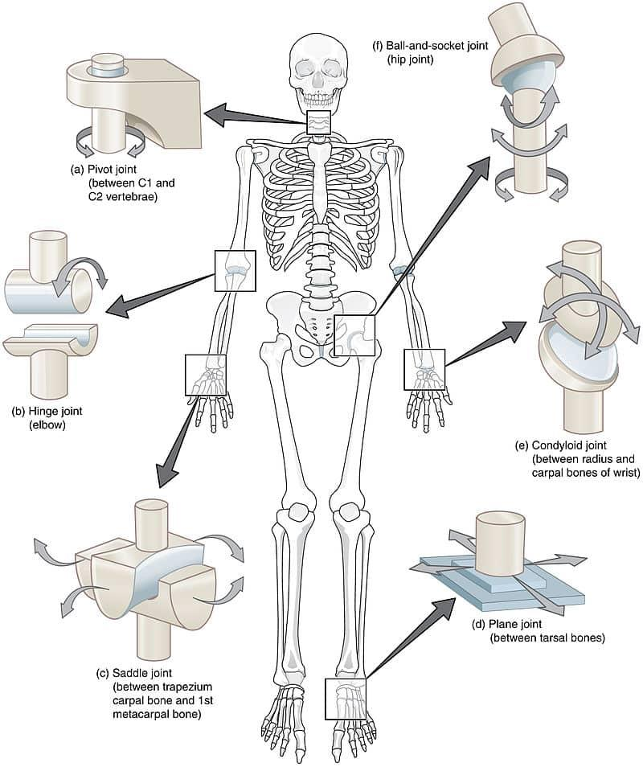
JOINTS
Joints: the site at which two bones are attached usually with the purpose of allowing body parts to move
Joint Capsule: a sheet of fibrous connective tissue enclosing a synovial joint
Synovium: the inner layer of the joint capsule whose cells make a viscous fluid that lubricates joints
Types of Joints
Ball and socket
Hinge joints
Gliding joints
Pivot joints
Suture joints
Notes:
-The joint capsule contains synovial fluid (made by the synovium), which helps the bones move freely within the joint capsule
-Freely movable: include the hip, knee, elbow, and shoulder joints
-Slightly movable: joints between vertebrae
-Minimal movement: joints that permit little movement due to thickened fibrous ligaments
-Ball and socket: allow for extension, flexion, abduction, and adduction (shoulder and hip)
-Hinge: only allow extension and flexion (elbow, knee, and finger)
-Gliding: allow bones to slide over one another (wrist, ankle)
-Pivot: allow one bone to rotate on another (joint at base of thumb)
-Suture: permit little to no motion (joints in the skull that close)

Slide 8
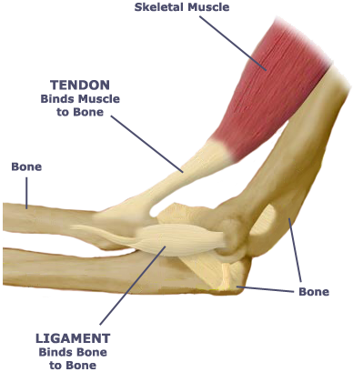
LIGAMENTS & TENDONS
LIGAMENTS
Thick bands of tissue that connect two bones together (LIKE TO LIKE)
TENDONS
Non contractile tissue that connects muscle to bone (TWO DIFFERENT THINGS)
Notes:
Ligaments: composed of strong connective tissue, ligaments resist stretching, thereby restricting joint movement to the range of normal motion
-Provide structure and stabilize the skeleton
-The extent to which a joint can move is determined by the degree of tightness or laxity of the ligaments and capsule that hold the bone ends together, and by the orientation of the bone ends to each other
-There are ligaments located on each side of the knee that connect the femur to tibia medially and the femur to the tibia and fibula laterally
-This forms a hinge joint with motion only in the anterior/posterior plane
-Shoulder
-Only has a few restrictive ligaments so it is able to move in almost all directions
Tendons
-Damage to tendons through overstretching/tearing
-Damage to tendon can affect muscle

Slide 9
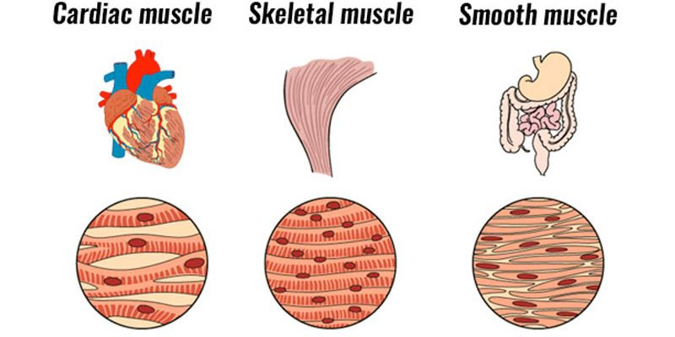
MUSCLE
Muscle: is a type of tissue that has the ability to contract
Skeletal Muscle: under direct voluntary control of the brain
Smooth Muscle: used in actions that are not controlled by conscious thought (control of blood pressure and movement of digestive system structures)
Cardiac Muscle: unique type of involuntary muscle that is found only in the heart
Notes:
-Muscle tissue shortens when two proteins, actin and myosin, “ratchet” on each other during the active phase of contraction
-After a muscle has contracted, it passively returns to its original length during the relaxation phase
-The combination of contraction and relaxation enables the body to move the extremities, walk, and perform normal daily activities
Skeletal
-Generous blood supply
-Controlled by nerves
-Muscles cannot continue to function without this ongoing cycle of energy supply and waste removal
Smooth
-Found in the walls of the gastrointestinal tract, the urinary system, blood vessels, and the bronchi of the lungs
-Contraction and relaxation of smooth muscle pushes the contents of these tubular structures along their course
-Smooth muscle can alter the diameter of blood vessels or bronchi in response to nervous stimuli
-Controlling the blood flow
Cardiac
-Is associated with an internal electrical system and receives an abundant blood supply

Slide 10
PHYSIOLOGY OF MOVEMENT
● Body movement: skeletal muscles receive brain signals to contract
● This signal may be involuntary or voluntary
● Muscles are paired… when one relaxes another one contracts
● When repeated this process results in sustained body movement
Notes:
Voluntary- e.g., lift an object
Involuntary- e.g., when you quickly pull your hand away from an open flame

Slide 11
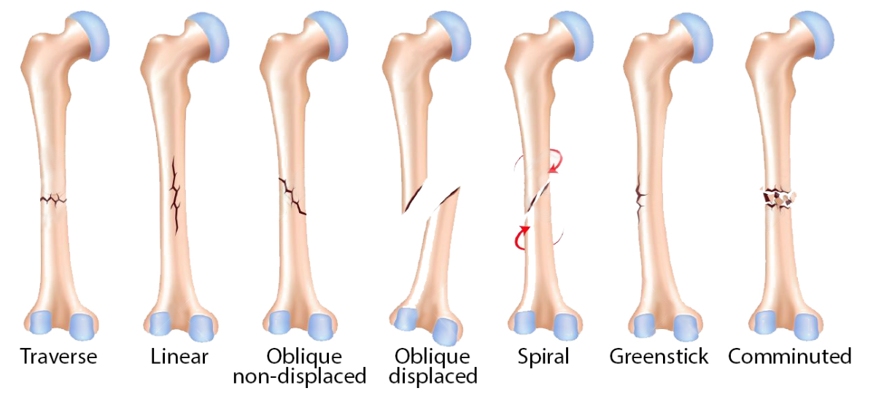
TYPES OF BONE FRACTURES
Notes:
-zone of injury: area close to or surrounding an injury of an extremity (includes damaged soft tissue, nerves, blood vessels)
Sprains/strains
-Mild sprains heal quickly; more serious sprains require surgery
-May occur with other musculoskeletal injuries
-Wrist, knee, ankle
-Common strains include hamstring and biceps
Fractures: a site of a break in bone
-Closed: overlying skin surface is not disrupted
-Open: overlying skin has been opened
-Nondisplaced: ends of the bone remain in alignment
-Displaced: Causes affected extremity to appear crooked or bent
-Complete: bone surfaces are completely separated
-Incomplete: fracture line does not penetrate the entire bone
-Joints can be either subluxed (partial dislocation) or completely dislocated and locked

Slide 12
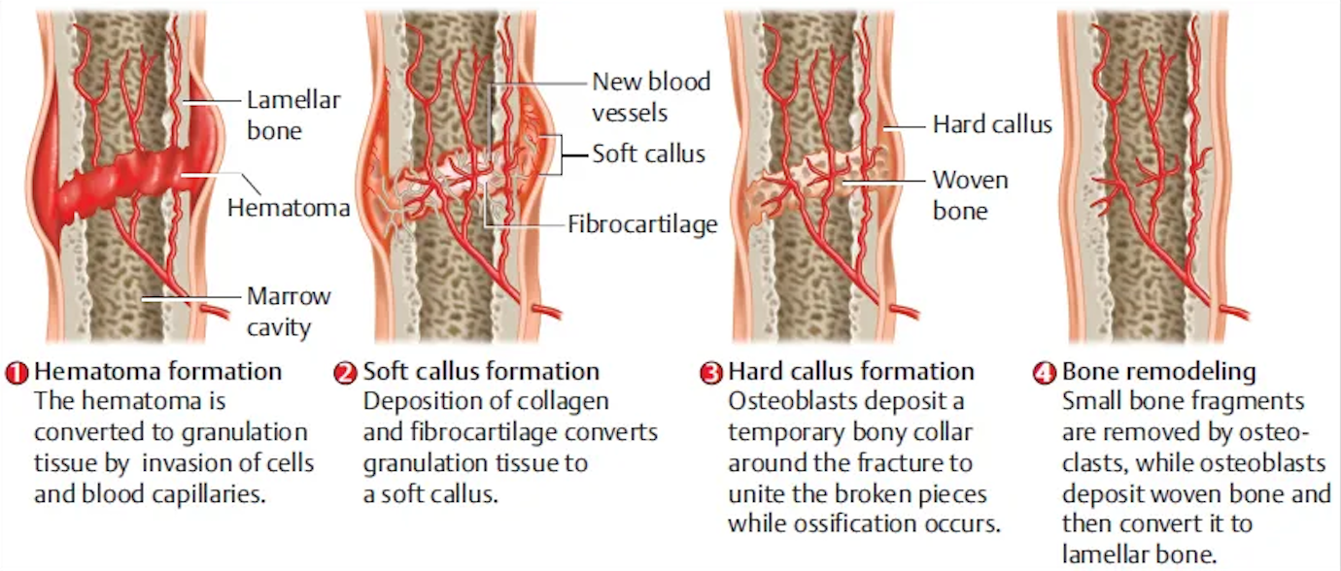
THE HEALING PROCESS
Hematoma formation and inflammation happen first
Notes:
-Healing process depends on factors including extent of damage, age, nutritional status, and overall health
-Bones and other musculoskeletal tissues are able to generate new tissue
-Breaks causes bleeding and a hematoma forms around the fracture site
-Callus: over the couple weeks after the break the bone starts to form a callus → calcium is later deposited
-Immobilization: the process of holding an object in place
-Muscles: healing slow (SLOWER TO HEAL THAN BONE) and generally involves fibrous scar tissue
-Ligament and tendon: slow healing; always heal w/ some scar tissue
-Cartilage does not heal b/c little blood supply (if injured, usually removed)

Slide 13
SIGNS & SYMPTOMS
SPRAINS (LIGAMENTS)
STRAINS (MUSCLES & TENDONS)
RUPTURED TENDONS
FRACTURES
DISLOCATIONS
Notes:
Sprains: involve the stretching or tearing of a ligament
-Point tenderness over the injured ligaments
-Swelling and bruising within the zone of injury
-Joint instability (abnormal motion of the affected joints)
-Decreased motion due to pain, swelling, and/or ligament instability
-Difficulty bearing weight on the injured joint (in the lower extremities)
Strains: a stretched or torn muscle
-Point tenderness over a muscle or a portion of a muscle
-Pain when using the injured muscle to flex or extend an extremity
-Bruising over a muscle
-Swelling or hematoma over a muscle
Ruptured Tendons
-A noticeable “gap” under the skin where the tendon has ruptured
-Minimal pain due to minimal nerve involvement
-Little bruising or swelling
-Lack of joint movement
Fractures
-Pain at the fracture site that worsens upon movement of the affected bone
-Tenderness to palpation
-Swelling due to internal bleeding from the fracture site
-Ecchymosis
-Decreased motion due to pain, and lack of bone continuity
-Deformity due to bone misalignment
-Bone crepitus: a noise or palpable feeling of crackling when fractured bone ends rub together
Dislocations: a separation or displacement of the bones of a joint
-subluxation: a joint partially dislocates and then returns to its normal anatomic position
-Pain
-Swelling
-Deformity
-Reduced joint motion
-Joint “locking” or “freezing”

Slide 14
DCAP-BTLS
D | DEFORMITIES
C | CONTUSIONS
A | ABRASIONS/AVULSIONS
P | PUNCTURES/PENETRATIONS
B | BURNS/BLEEDING/BRUISES
T | TENDERNESS
L | LACERATIONS
S | SWELLING
Notes:
Used to understand an injury even more.

Slide 15
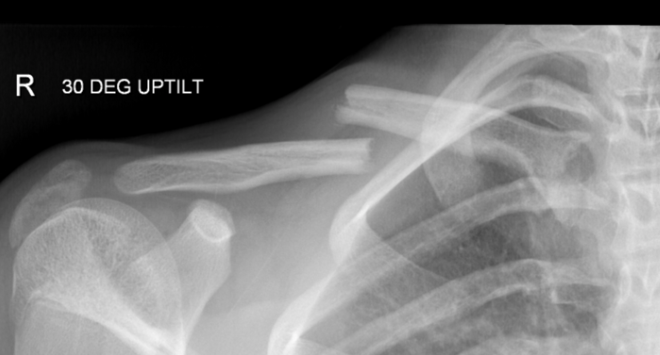
CLAVICLE & SHOULDER INJURIES
The clavicle is the most commonly fractured bone in the body
Clavicle commonly fractures in the middle or distal portion of the bone
The shoulder has a very lax capsule
Shoulder ligaments are not very strong
Dislocations commonly occur
Varying presentation based on the dislocation
Notes:
-Skin may “tent” over the fracture site due to the fractured end protruding up, resulting in a deformity
-Injury painful with any movement
-swelling , tenting, bruising, and point tenderness are hallmarks of a clavicle fracture
-The shoulder can easily dislocate, especially if forces are applied from certain directions
-Over 95 percent of shoulder dislocations are anterior
-If a patroller suspects a shoulder dislocation, the mechanism of injury may help identify the direction in which the humeral head is dislocated
-The mechanism for anterior dislocation is forceful abduction and external rotation of the arm at the shoulder
Posterior dislocations are rare and are most commonly seen in vehicle collisions
Acromioclavicular (A/C) joint: located at the tip of the shoulder where the shoulder blade (scapula) and collarbone (clavicle) come together at a point on the upper prut of the shoulder blade called the acromion
-Patients with A/C/ injuries, clavicle fractures, scapular fractures, and humeral head and neck fractures generally hold their arm against their abdomen and will not let you bring the arm away from the abdomen.
-Patients with anterior dislocated shoulders hold their arm out and up.
Also think of humerus fractures and elbow injuries
Angulation: deviation from straight (angulation between shoulder and elbow is a sign of a humerus fracture)
Also point tenderness and swelling

Slide 16
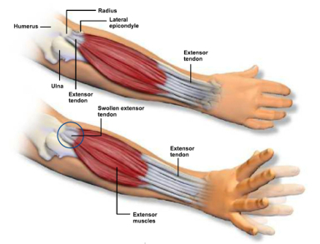
FOREARM INJURIES
Fractures of the shaft of the radius and/or ulna can occur from direct trauma or when an individual falls onto an outstretched hand
1
Swelling, point tenderness, and deformity may also be seen
2
Notes:
False movement: motion that occurs at the site of a fracture of a long bone that is not present when the bone is intact
-may be exhibited alongside angulation for a radius and/or ulna fracture

Slide 17
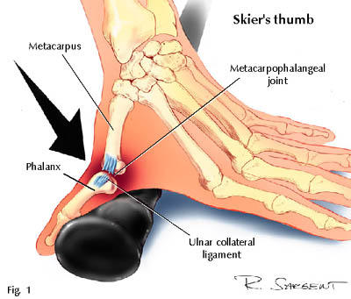
HAND, FINGER & WRIST INJURIES
Skier’s thumb: sprain of the ulnar collateral ligament of the thumb
Wrist injuries: Pain in the “snuff box”
Distal to the end of the radius and proximal to the base of the thumb metacarpal
Symptoms: pain, swelling, and loss of motion
Notes:
Skier's thumb: occurs when a ski pole catches on the snow and bends the thumb laterally and dorsally, disrupting the ligament at the base of the thumb next to the web between the thumb and index finger
-thumb bends laterally and dorsally
-Dorsal: toward the back and top of head

Slide 18
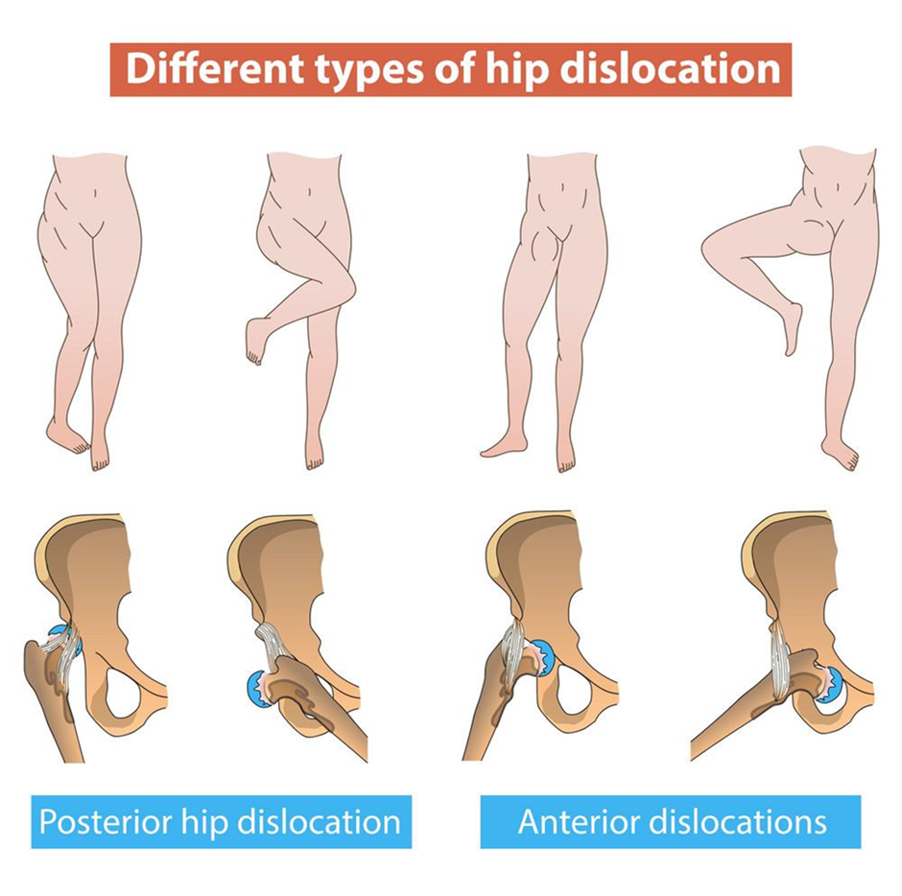
HIP & PELVIS INJURIES
Signs of an anterior hip dislocation include abduction of the thigh and external rotation of the knee
Over 90 percent of hip dislocations are posterior dislocations
Signs of a posterior hip dislocation include internal rotation of the knee and shortening of the affected leg
Concern for blood loss and shock!
** GORY PHOTOS NEXT SLIDE
Notes:
The mechanism of injury for this hip dislocation is a significant force applied to the knee of a person who is sitting
-In this position the flexed hip is pushed out of the back of the socket
-Seen in an unrestrained person in a car collision
-Sciatic nerve can be injured in a dislocated hip, possibly resulting in temporary partial paralysis or complete paralysis of the ankle and foot
-The longer the hip remains dislocated, the more damage can occur to the head of the femur
-If blood does not reach the femoral head for some time (usually several hours), the bone cells in the femoral head die, resulting in very painful arthritis later in life
General tip = do not log roll an individual with a pelvic injury

Slide 19
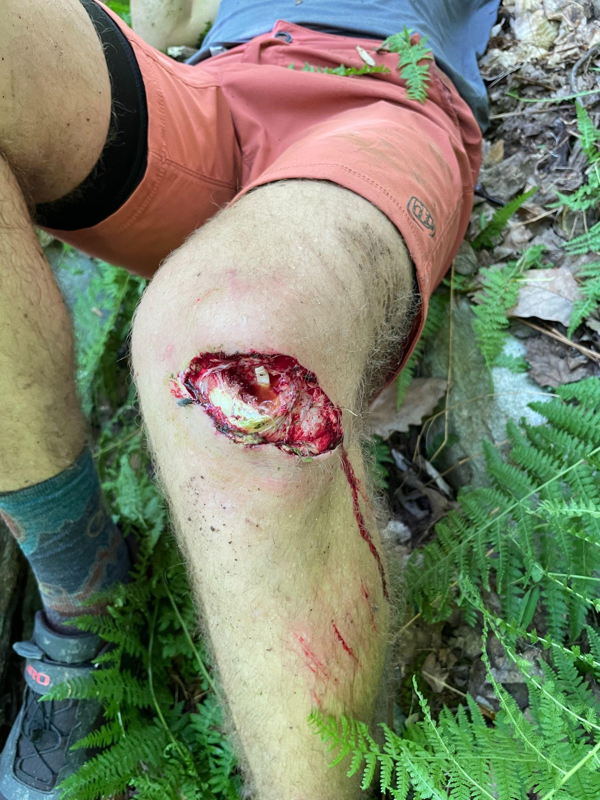
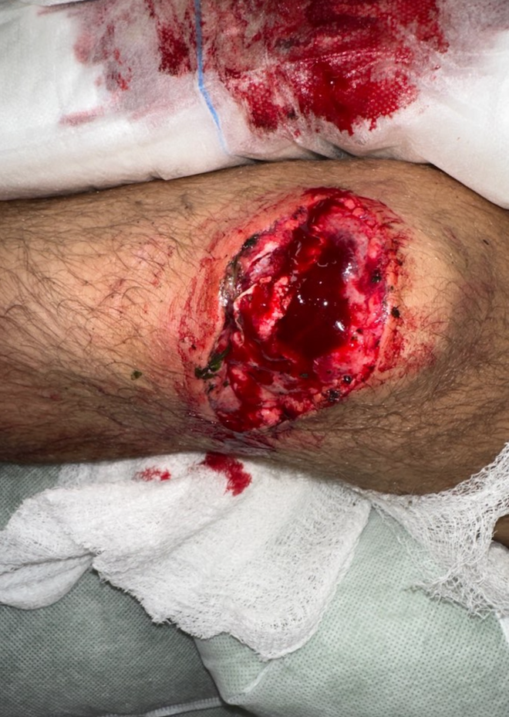
FEMUR FRACTURES & KNEE INJURIES
Femur fractures can be anywhere along its length
Can affect the knee or hip
Significant risk of blood loss
Most knee injuries are sprains involving the four main ligaments that support the knee joint
Usually caused by twisting motion
Notes:
Fractures involving the proximal femur are commonly referred to as “hip fractures”
-Signs similar to posterior hip fracture
-Affected leg is shortened and externally rotated
-Pain is extreme and generally in the groin
Fracture in the middle of the femur are caused by direct and forceful trauma to the thigh, a fall, or intense twisting of the thigh
-Signs and symptoms include intense pain, deformity, thigh swelling, and false movement
Fractures of the distal end of the femur result in severe pain and swelling just above the knee, deformity, inability to move the knee, and spasm of the thigh muscle
Knee injuries commonly occur from rotation and when the knee is forced into unnatural positions
-Assessment of a knee injury at the accident scene should be brief you dont have to diagnosis this in the field but rather try and determine the MOI and try and isolate and immobilize
Meniscus: c-shaped cartilage on the medial side of the knee
Articulation: ability to bend and straighten a limb
Popliteal fossa: neurovascular structure that is often damaged with knee dislocations (damage to the related popliteal artery may lead to a pulseless, pale, and cold foot)

Slide 20
TIB-FIB AND ANKLE INJURIES
Boot top fractures
Common with skiers
Stiff ski and snowboard boots help prevent ankle injuries
Increased likelihood of tib-fib and knee injuries
Notes:
Foot and toe injuries are also possible.
Axial skeleton injuries are also of course possible but will be discussed further in a different presentation in a few weeks.

Slide 21
TREATMENT
1
OUTCOME
Scene size-up, standard precautions, & primary patient assessment
Assess MOI
Secondary patient assessment (pain = OPQRST, deformity = DCAP-BTLS)
Focus on obvious musculoskeltal injury only AFTER doing a full-body assessment of other areas
Manual stabilization of injury (assess CSM’s distal to injury both before and after)
Transport
Reassess
Notes:
Most common symptom of a musculoskeletal injury is pain.
Guarding: e.g., a person with a sprained wrist or a broken radius bone will typically hold the forearm close to the body and be reluctant to move it
Look for bleeding.
CSMs in feet- move toes up (dorsiflex) and down (plantarflex)
Immobilization: important to promote optimal bone healing; implanted surgical hardware, cast, other restrictive devices
Early plan of action
MAKE SURE TO EXPOSE THE INJURY.
Bandage any wounds appropriately
Use correct splint or other immobilization device
Immobilize above and below injury (check CSMs)
Cooling method can be used to treat pain
Make sure patient is comfortable for transport
Provide oxygen if needed
Transport to higher level of care
Splint: a piece of equipment that is used to safely immobilize an extremity or other body part
Goals of assessment and treatment/splinting:
-decreases movement (patients are often quite sensitive to movement; be attentive and always careful with your palpations as well, while still providing enough pressure to further understand the injury)
-decreases pain
-improves anatomical alignment
-prevents further damage
-facilitates transport
Sling and swathe: made from two triangle-shaped cravats
-Used for upper extremity injuries, including clavicle, shoulder separations, humerus and elbow injuries
-Holds the arm close to the body and immobilizes movement
-SAM splint also used
Blanket Roll/ pillow splint
-Effective for injuries in which patients will not allow their arm to be brought to their side such as a shoulder dislocations
Rigid or Semi-Rigid Splints
-Used at the bowl for wrists and lower leg (e.g., cardboard splints)
Quick Splints
Traction Splints: a device that applies longitudinal traction to a fractured femur
-Used for femur fractures
-Traction: a safe mechanism for immobilizing a broken bone; in-line force to a fractured long bone in the direction of its normal alignment
Pelvic sling and even the vacuum splint backboard may be used for pelvic fractures.

Slide 22
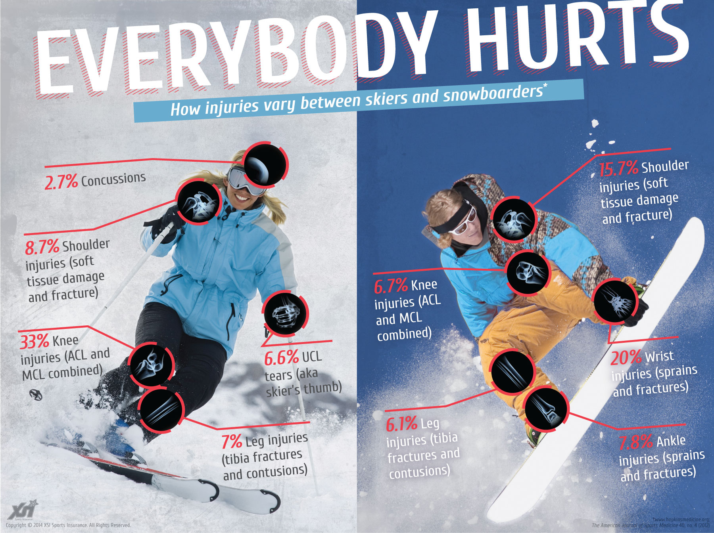
QUESTIONS?

Slide 23
QUESTIONS FOR YOU!
You offer to help another OEC technician with a patient. She tells you that during her assessment she found that a fractured tibia bone has broken the skin. You identify this as a(n):
a) nondisplaced fracture.
b) open fracture.
c) closed fracture.
d) displaced fracture.
Notes:
b

Slide 24
QUESTIONS FOR YOU!
You offer to help another OEC technician with a patient. She tells you that during her assessment she found that a fractured tibia bone has broken the skin. You identify this as a(n):
a) nondisplaced fracture.
b) open fracture.
c) closed fracture.
d) displaced fracture.

Slide 25
QUESTIONS FOR YOU!
You are on scene caring for a patient with a knee injury. As you gather information during your survey, you find out this patient has chronic knee pain from an old injury. Your next step is to:
a) not splint since this problem has happened many times before.
b) splint in a position of comfort and transport.
c) use a traction splint to safely secure the leg.
d) backboard and transport to the local hospital for X-ray imaging.
Notes:
b

Slide 26
QUESTIONS FOR YOU!
You are on scene caring for a patient with a knee injury. As you gather information during your survey, you find out this patient has chronic knee pain from an old injury. Your next step is to:
a) not splint since this problem has happened many times before.
b) splint in a position of comfort and transport.
c) use a traction splint to safely secure the leg.
d) backboard and transport to the local hospital for X-ray imaging.

Slide 27
QUESTIONS FOR YOU!
Which of the following are the four main types of splints used by OEC technicians?
a) gauze, cravats, bandages, and improvised
b) traction, tension, improvised, and rigid
c) soft, rigid/semi-rigid, traction, and improvised
d) soft, traction, block, and improvised
Notes:
c

Slide 28
QUESTIONS FOR YOU!
Which of the following are the four main types of splints used by OEC technicians?
a) gauze, cravats, bandages, and improvised
b) traction, tension, improvised, and rigid
c) soft, rigid/semi-rigid, traction, and improvised
d) soft, traction, block, and improvised

