Slide 1
Face, Neck and Eye Trauma
OEC Chapter 22
Sydney Rogers

Slide 2
Objectives
Describe and demonstrate how to assess eye injuries.
Describe and demonstrate the management of a patient with a penetrating injury to the eyeball.
Identify the important structures of the anterior and posterior neck.
List the signs and symptoms of emergencies of the neck and upper airway.
List the signs and symptoms of emergent injuries to the face, eyes, and neck and upper airway
Describe and demonstrate how to assess and care for face, eye, and neck injuries

Slide 3
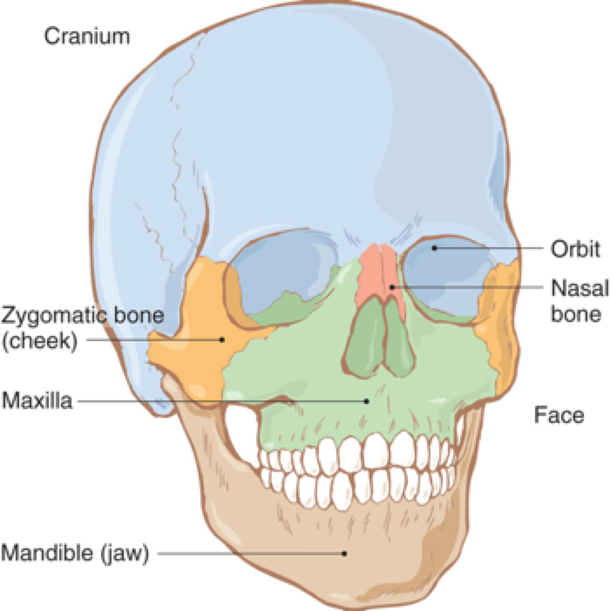
Anatomy and Physiology- Facial Structures
Notes:
Cranium and Facial bones
This anatomy consists of the anterior portion of the head, including elements of the upper airway.
The face and mouth are highly vascular, and injuries to these structures may involve significant bleeding.
The face consists of bones, muscles and cartilage that are crucial to maintaining the structure of the face.

Slide 4
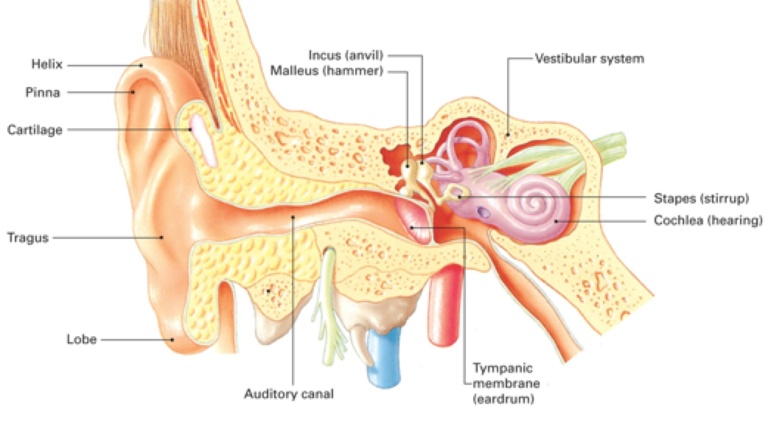
Anatomy and Physiology- Auditory and Balance System
Notes:
Anatomy of the Inner Ear
Sound waves pass through the temporal bones entering the auditory canal and cause the thin membrane to vibrate, transmitting sounds signals to the ears inner structures such as the Malleus, icnus, and stapes – convert sound waves into signals that go to the cochlea.
Structures inside the inner ear, called the vestibular system, control balance.

Slide 5
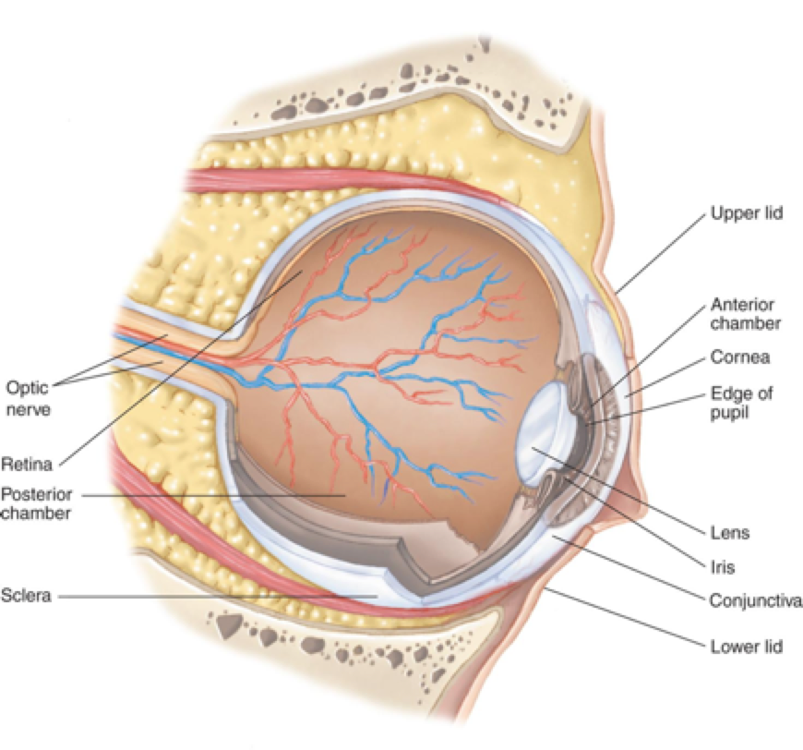
Anatomy and Physiology- Visual System
Notes:
The socket that holds the eyeball is called the orbit.
The eye itself is similar to a fluid-filled sac with some important structures. The orbit is a bony structure that requires significant force to injure, but they eyeball is relatively susceptible to injury.
The eye captures light images that are sent to the brain via the optic nerve
The cornea bends or refracts light as it enters the eye.
The iris works like a camera shutter to adjust the amount of light entering the eye. Under normal conditions, the pupil becomes small in response to bright light.
Anisocoria (unequal pupil size) can be caused by either brain injury or direct insult to the eye.
Fluid lost from the posterior chamber of the eye cannot be replaced, if an eye is popped and fluid is lost the person will be blind. Damage to the optic nerve (ie from light), pupil, lens and iris does not cause pain! Look instead for symptoms like blurred vision, floaters in vision, partial or complete loss of vision.
Orbital and nose injuries can affect the eye.
What is the lacrimal gland? –positioned above each eye and provide constant irrigation in the form of tears-

Slide 6
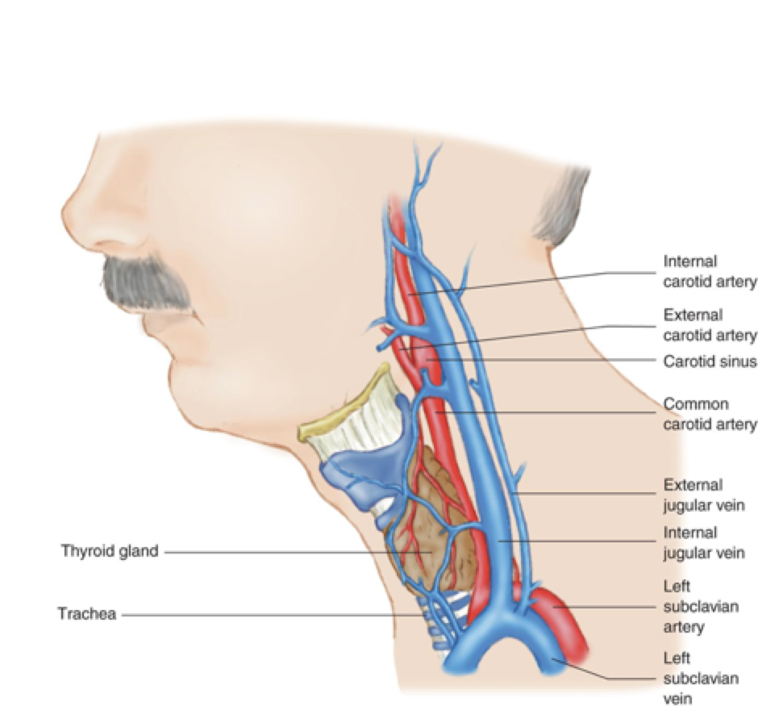
Anatomy and Physiology- Neck
Notes:
The anterior part of the neck contains a number of relatively unprotected vital structures such as the carotid arteries, jugular veins, esophagus, trachea, and thyroid gland.
Trauma to these structures may result in loss of support to the airway
In the posterior of the neck, there are the cervical vertebrae (C1-C7), and the spinal cord within these vertebrae (as previously discussed)

Slide 7
Common Face, Eye and Neck Injuries
Trauma related
Soft tissue
Penetrating or impaled objects
Blunt injuries
Fractures
Crushing injuries
Airway concerns
Name one way of dealing with a blocked airway
C-Spine issues
Notes:
• this slide is an overview of face, eye, and neck injuries. The next few slides will go into further detail on each.
Because the areas discussed here are small, even a minor trauma can have a significant effect on a patient’s well being.
Highlight AIRWAY

Slide 8
Face Injuries
Blowout Fractures
Fractures involving the bony socket of the eye
Epistaxis
Bleeding from the nose often due to direct trauma.
Damage to teeth
Watch for airway obstruction if a loose tooth becomes dislodged!
Soft tissue injuries, bleeding
Airway concerns
Blood
Swelling
Notes:
Blowout fractures may cause direct eye injuries or injury to the area around the eye. Impede the eyes ability to move
Epistaxis- (NOSE BLEED), may be due to the fracture of the nasal bone due to direct trauma. Can also occur due to dry mucous membranes and cold air. Bleeding and swelling may result in a compromised airway.
Teeth injuries- chipped tooth is most common, complete avulsion (knocked out tooth) is the most serious.

Slide 9
Ear Injuries
Foreign body
Lacerations
Contusions
Injure or rupture of tympanic membrane from loud noises

Slide 10
Eye Injuries
Light related injuries (exposure to UV rays)
Can range from a superficial burn to permanent damage to the cornea
Eyes are vulnerable to abrasive and penetrating injuries, including impaled objects (ski poles, tree branches)
Hyphema
In blunt and penetrating injuries blood can accumulate in the anterior chamber of the eye

Slide 11
Neck Injuries
Life threatening
Closed
Swelling can compromise airway
Crushing of larynx or trachea
Open
Damage multiple structures
Profuse bleeding
Air enters blood system
C-spine may be involved
Notes:
These injuries are frequently associated with severe swelling, or the formation of a hematoma that can compromise the airway.
Blunt trauma is the leading cause of neck and throat injuries, which can damage internal structures and cervical spine
We also see deep lacerations and open wounds
Open neck injuries may be one of the most serious injuries you may encounter, because they may involve the carotid artery or jugular vein. This results in profuse bleeding and shock if not treated. Air can also pass through these damaged vessels and cause cardiac air embolism (air lodged in the heart) or pulmonary air embolism (air lodged in the lungs)

Slide 12
Assessment and Management of These Injuries
Overall Assessment:
Expect anxiety, C-spine involvement, and airway/breathing concerns
Bleeding can be significant, may be disproportionate to size of wound
Continuously monitor for changes in status
Notes:
Now that we have introduced these structures and possible injuries you may encounter, we’re going to look at how to assess and treat them

Slide 13
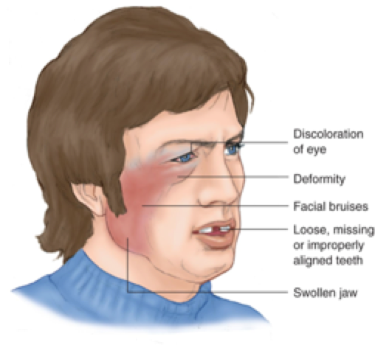
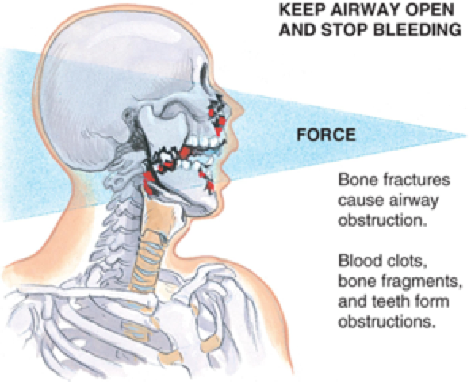
Signs of Facial Injuries
Notes:
• Signs of a facial fracture.
• Monitor the airway when treating facial fractures.
Facial and neck asymmetry is a clue to traumatic injury. Facial fractures require a significant mechanism of injury, so associated closed head or cervical-spine injuries must be considered as well.
Facial and neck injuries are likely to increase your chance of exposure to the patient’s bodily fluids.
Face and neck injuries require frequent assessment. Any significant face, neck, or head injury requires cervical (and spinal) immobilization.

Slide 14
Assessment of Facial Injuries
Mid-Face and Nose:
Examine nose for asymmetry, obstruction and bleeding. Assess cheeks. Assess bone stability by pressing down on both sides of the face and nose.
Mouth:
Examine lips and inside of mouth for bleeding. Also look for pale/bluish lips (signs of hypothermia or significant blood loss). Check for missing or loose teeth. Palpate jaw and neck for tenderness or crepitus.

Slide 15
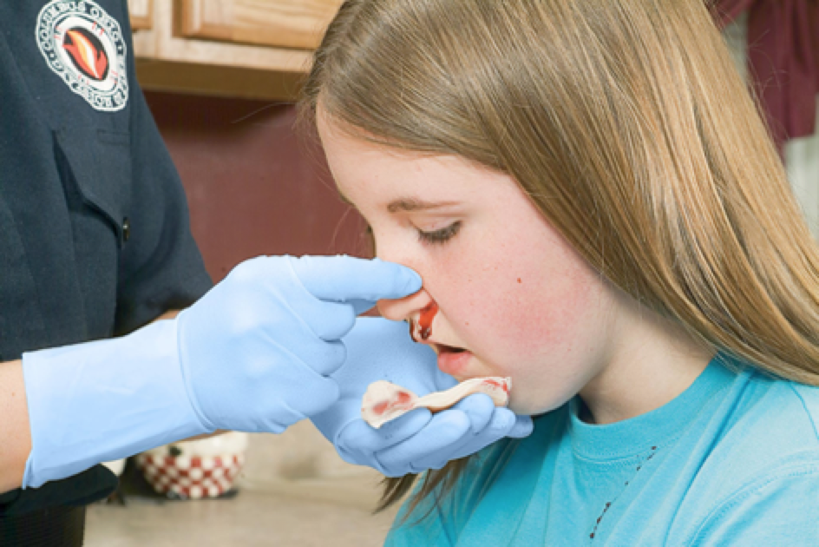
Management of Facial Injuries
Airway is main concern!
Aggressive management, including positioning, suction, oxygen and possibly ventilation
Epistaxis
Direct pressure to the bridge of the nose
Lean patient forward
Can use gauze to collect blood
Mouth Injuries
Remove any broken teeth present
Collect any teeth that have been knocked out. Do not touch the root, do not wash!
Can place tooth in sterile solution for transport, send with patient

Slide 16
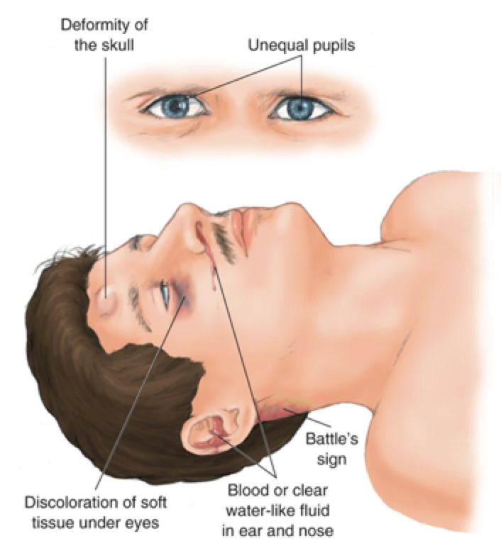
Assessment of Ear Injuries
External structures
Look for obvious signs of trauma. Determine source of bleeding. Look for clear fluid coming out of ear, which may be cerebrospinal fluid, a sign of skull fracture. Also look for swelling in bruising behind the ears (Battle’s Sign), which indicates head trauma
Evaluate patient’s hearing

Slide 17
Management of Ear Injuries
Control bleeding
If ear is amputated, preserve as you would a finger
Rinse with water/sterile solution, wrap in saline moistened gauze, and place in plastic bag. Keep cool
Do not try and remove an object lodged in a patient’s ear- they need a higher level of care

Slide 18
Assessment of Neck Injuries
Symmetry
Midline shift
Swelling
Subcutaneous emphysema
Filled bubbles palpable under the skin, indicate airway injury
Airway compromise
C-spine involvement
Bleeding
Jugular distention
Assess CSMs!
Notes:
Perform DCAP- BTLS inspection of the anterior and posterior aspects
Observe results of swallowing as well as the patient breathing and talking
Gently palpate larynx and trachea for stability and look for abnormalities such as distention of the jugular vein
Subcutaneous emphysema = air bubbles that are palpable underneath the skin;; indicating an injury to an airway structure

Slide 19
Management of Neck Injuries
Manage ABCD’s and spine accordingly
C-spine stabilization!
Severe bleeds can be controlled with occlusive dressing and direct pressure
Keep patients with severe neck bleeding laying down to reduce chances of air embolism
Don’t apply direct pressure to both sides of neck simultaneously (reduces airway) and do not wrap bandages around the neck
Do not remove impaled objects unless airway is compromised

Slide 20
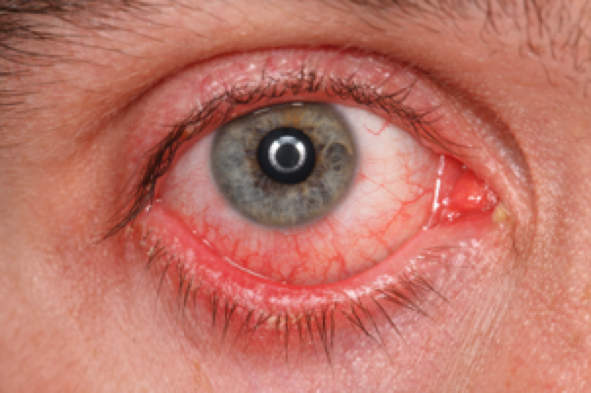
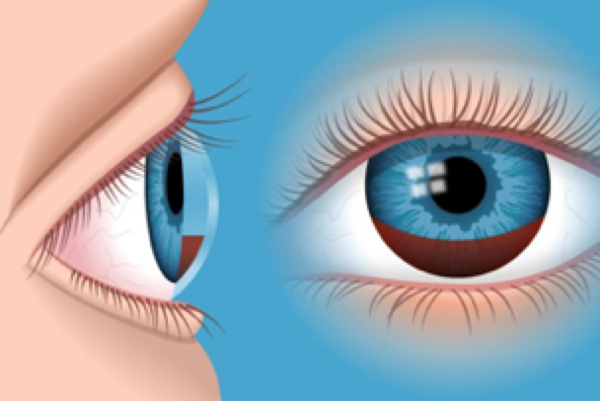
Assessment of Eye Injuries
Inquire about vision
Lens, retina, structural involvement, glaucoma, contacts etc.
Double vision?
Pupils – Equal? Reactive?
Movement
To examine extraocular motions:
Face the patient, have the patient focus on your finger and follow your finger with both eyes. Ensure eyes follow in a coordinated manner.
Blood and color
Bloodshot Sclera
Hyphema
Notes:
Hyphema is blood in the eye chamber

Slide 21
Management of Eye Injuries
Eyeball/Eyelid lacerations
Do not apply pressure to the eye itself
Retinal detachment (separation of the retina from the inside wall of the eyeball)
Symptoms include seeing specks, flashing lights, floaters in the visual field
May be caused by blunt trauma
Cover both eyes without pressure and transport
Chemical burns
Immediately irrigate with sterile saline for at least 5 minutes
Thermal burns
Cover both eyes with a moist sterile dressing
Small foreign bodies can be gently removed with a cotton-tipped swab
Notes:
Eye injuries can lead to blindness, so any patient with an eye injury should be directed to a physician
Ask patient if they wear contact lenses! Only attempt to remove these if a patient has suffered a chemical burn to the eye
●Don’t apply pressure to eye itself – cause leakage of the vitreous humor
●If out of socket cover with a moistened sterile dressing to prevent drying – do not attempt to put it back in

Slide 22
Practice Questions
#1. An eyelid laceration…
Is superficial and warrants little or no follow up
Requires medical follow up
Is serious only if it involves the eye itself
Can ultimately cause a permanent loss of vision
#2. Anisocoria is…
A hearing deficit
Vitreous or aqueous humor leaking from the eye
Unequal pupils
Teeth and jaws that do not align properly
Notes:
#1. B
#2. C

Slide 23
More Practice
#3. Under what circumstances are OEC technicians permitted to pack a nostril to control a nosebleed?
An OEC Technician may not pack a nostril under any circumstance
When the oec technician cannot control the bleed with direct pressure and ALS is more than 60 minutes away
Any time the OEC technician feels packing is the appropriate course of action
If a fracture prevents applying direct pressure
Notes:
A

