Slide 1
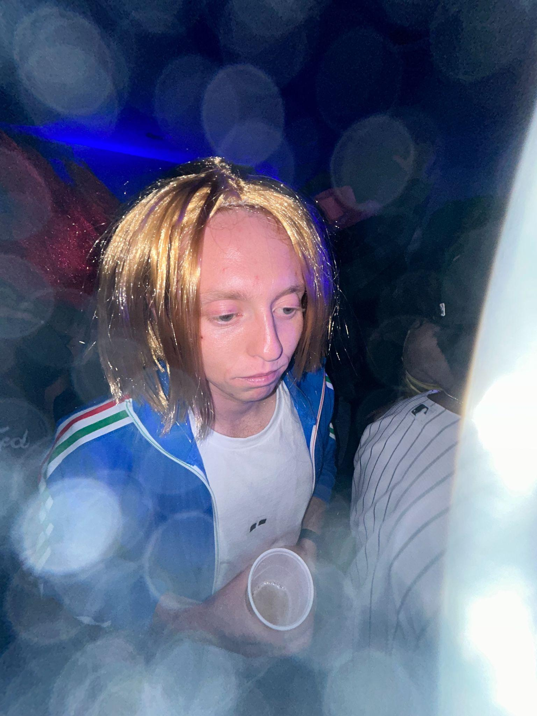
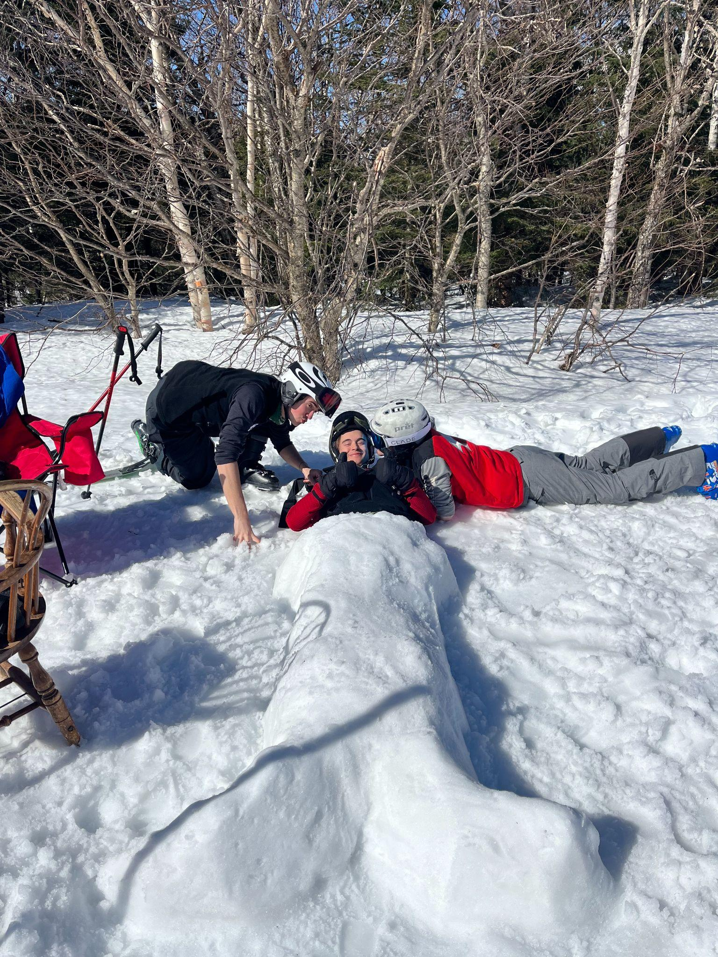
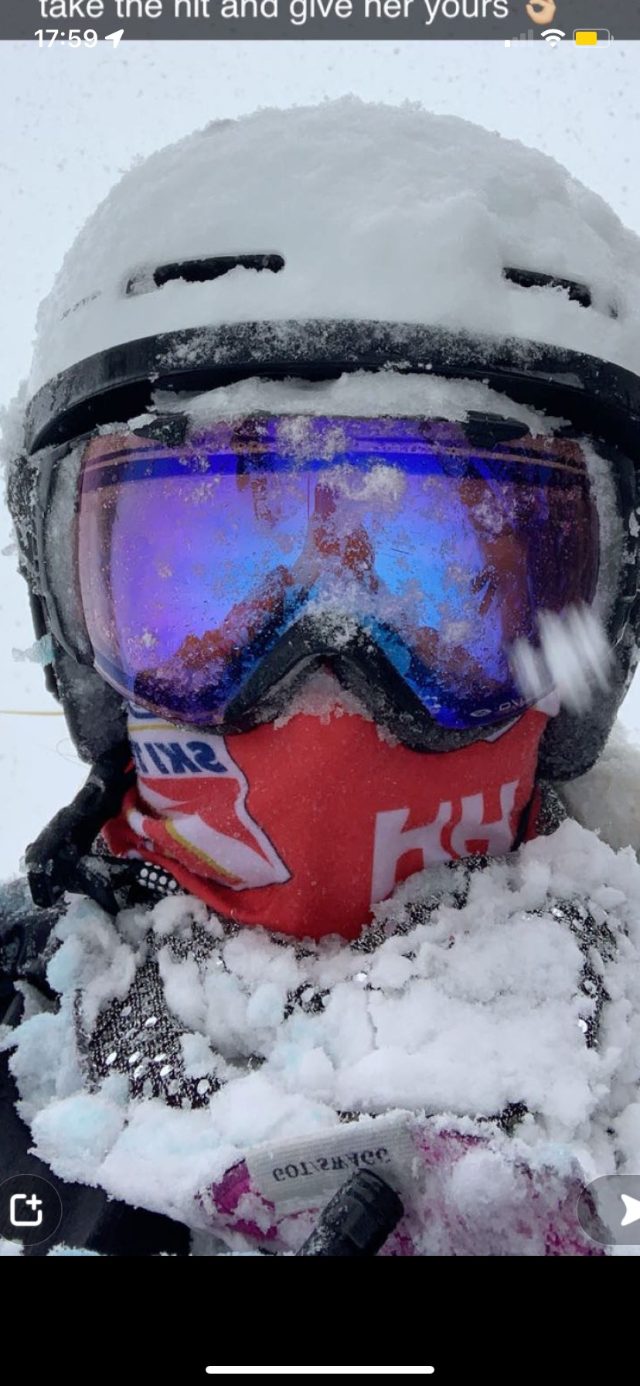
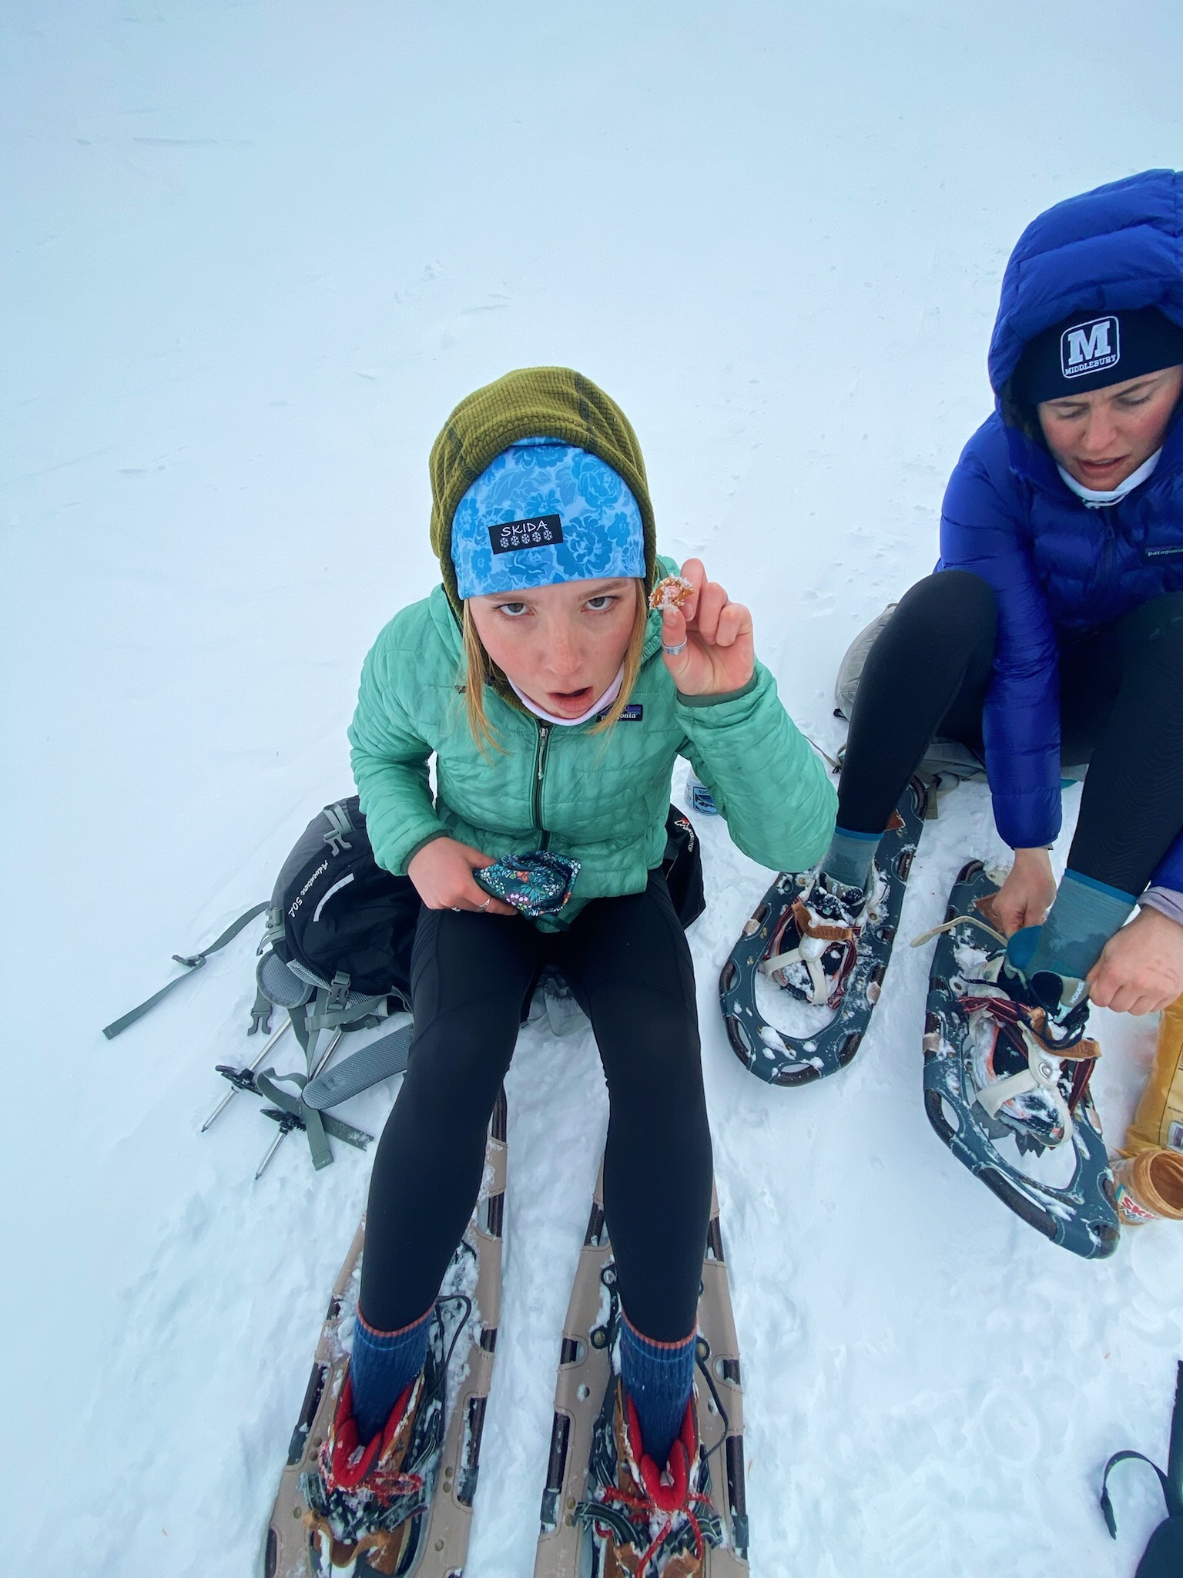
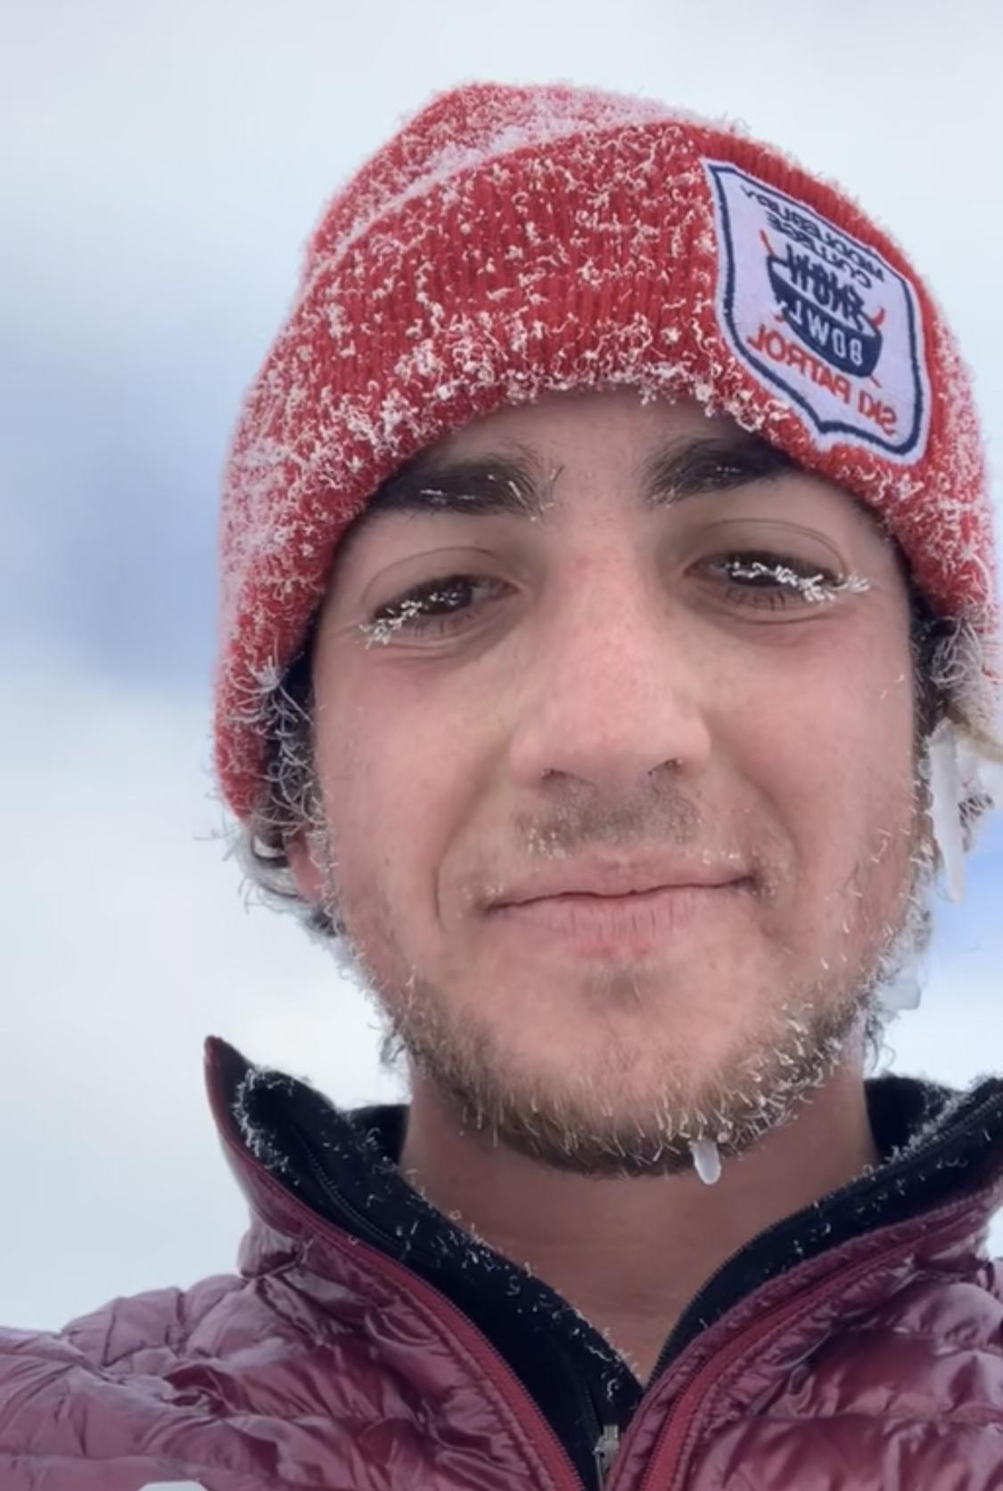
Cold-Related Emergencies
Chapter 25

Slide 2
Objectives
Understand the wind chill index and how it applies to temperature
List the signs and symptoms of frostnip and frostbite
Explain the two types of hypothermia
Define afterdrop
Describe the assessment of a patient with cold injuries
Describe the four categories of cold exposure
Demonstrate the management of a patient with cold injuries
Describe and demonstrate the emergency care of an avalanche victim

Slide 3
Overview
Thermoregulation: the process of maintaining normal body temperature
Controlled by the hypothalamus (located above the brainstem)
Initial response to cold: constrict peripheral blood vessels, surface temp of skin gets colder, sweat production stops, body hair stands on end
shivering to generate heat (involuntary)
Repeated muscle contraction
Stops when core temp drops significantly or serious injury or drugs prevent
Body loses heat through conduction, convection, evaporation, and radiation
Wind chill: apparent temperature felt to exposed skin (function of air temp and wind speed)

Slide 4
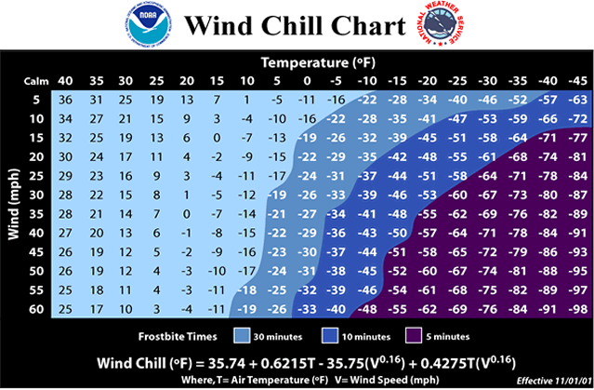

Slide 5
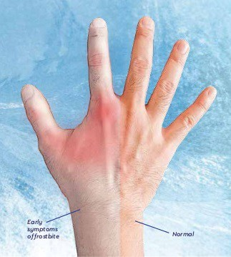
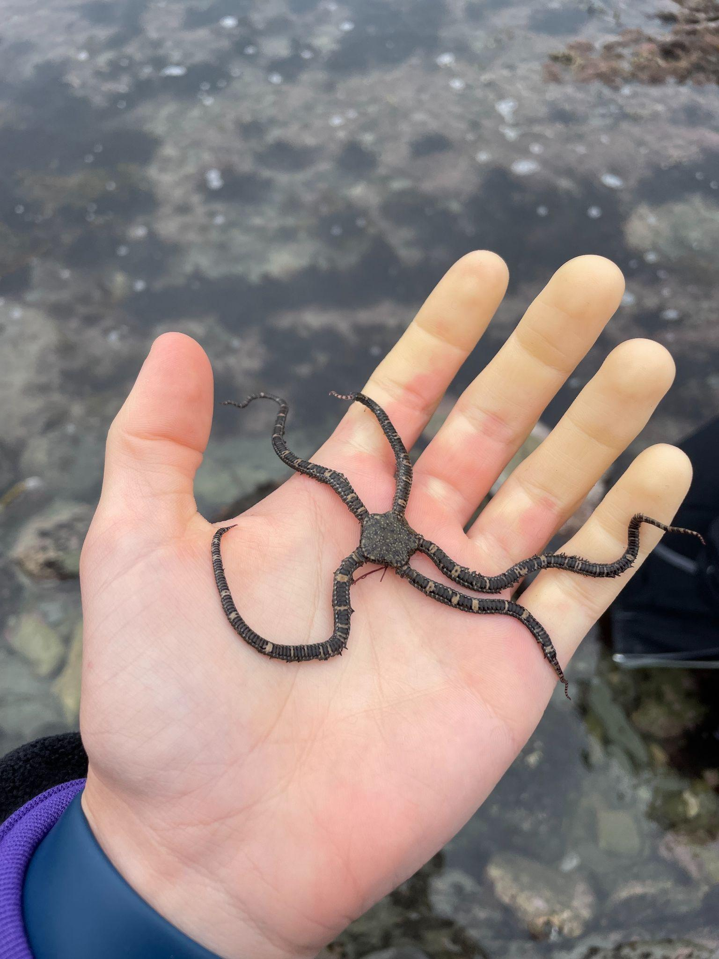
Frostnip
Frostnip: relatively minor, local cold injury that results from local vasoconstriction of blood vessels in response to cold (superficial)
Doesn’t involve permanent damage to tissue, first or top layer of skin, no permanent damage
Most often on ears, nose, fingers/toes
Can cause itching, red patches, swelling, and blistering (will clear up in 1-3 weeks)

Slide 6
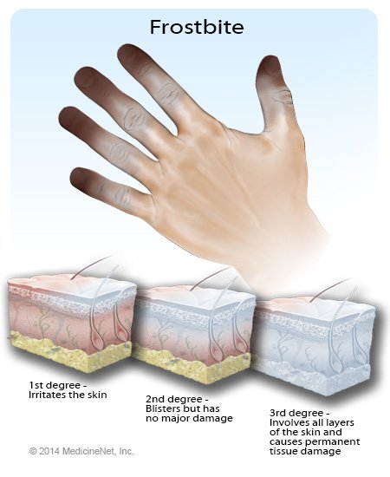
Frostbite
Frostbite: actual freezing of body tissue
Same parts of body are most susceptible in addition to cheeks and male genitalia
Usually involves superficial tissue but can include deep tissue and bones in severe cases
Water in cells freezes or loss of blood supply after capillaries are damaged
Partial thickness: affects upper layers of skin, minor damage to the tissues
Full thickness: affects all layers of skin plus muscle or bone, severe damage to tissues
Severity determined by extent and duration of tissue freezing, not absolute temperature

Slide 7
Severity of Tissue | Signs and Symptoms
Superficial (frostnip) | Cool, pale, painful skin, remains intact and pliable
Partial Thickness (frostbite) | Skin is white/gray colored patches, not painful, tissue may indent if pressed
Full Thickness (frostbite) | Skin is cold, feels hard or woody, tissue is white or gray and will not rebound when pressed, numb, no pulse detected in area

Slide 8
Hypothermia
Hypothermia: an abnormally low body temperature (below 95ºF)
Occurs when heat loss exceeds metabolic heat production and heat conservation (can happen above freezing temps, especially if in flowing cold water or wind)
Mild: metabolism initially increases and shivering as way to warm body
Moderate to severe: body systems slow, causing clumsiness, stumbling, mental confusion, removal of clothing, and unresponsiveness

Slide 9
Severity of Cold Exposure | Patient Presentation | Core Body Temperature
Cold stressed | Alert, starting to shiver, can help themselves | 95-97ºF
Mild Hypothermia | Alert but may be confused, shivering | 90-95ºF
Moderate Hypothermia | Drowsy, decreased LOR, not shivering | 82-90ºF
Severe Hypothermia | Unresponsive, may not be breathing | <82ºF

Slide 10
Primary and Secondary Hypothermia
Primary
Immersion Hypothermia: occurs when body is submerged in water
Takes more than 30 minutes to become hypothermic after falling into water while wearing winter clothing
Muscle function lost after 10-15 minutes → drowning without a flotation device
Non-immersion Hypothermia: occurs more slowly but may be accelerated by wind, rain, or snow
Does not involve immersion in water
Secondary
Systematic disorders and is frequently associated with traumatized or critically ill patients
Hypothermia is considered a secondary concern, can still be severe or life threatening

Slide 11
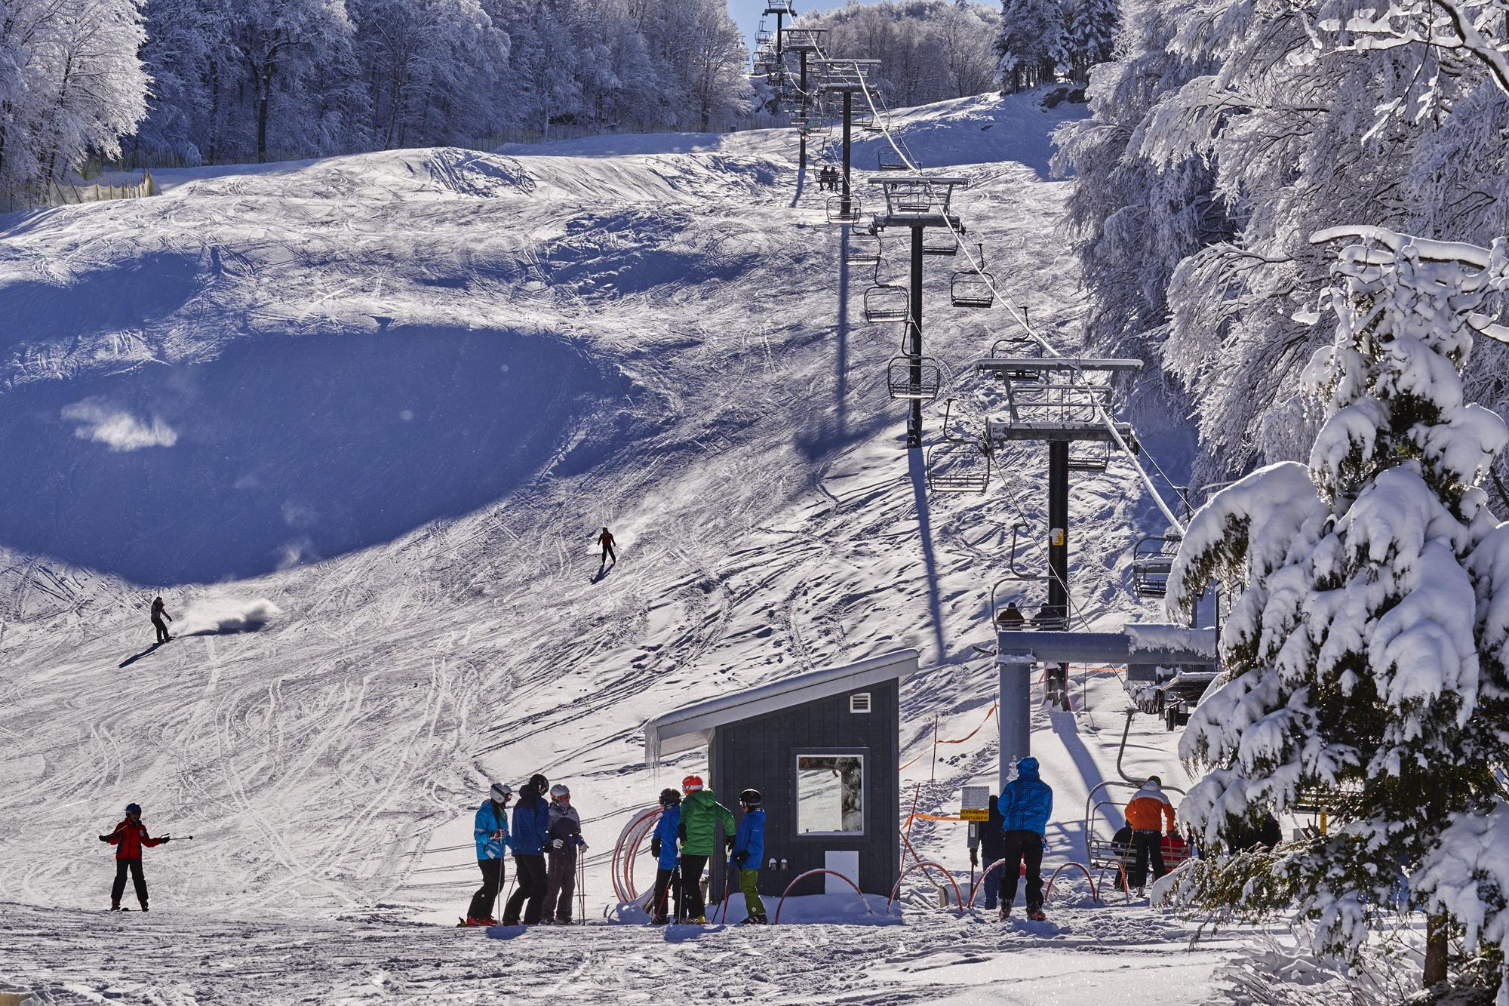
Afterdrop and Windburn
Afterdrop: continued drop in core body temperature after removal from exposure to cold
Occurs for a limited time even after warming measured initiated
Caused by return of cold blood from extremities to the heart
Severe cases can result in shock and cardiac arrest
Windburn: irritation of skin that resembles superficial sunburn
Not a cold injury but can compound cold-related injuries, especially frostbite
Can be prevented by covering skin or appling greasy sunscreen

Slide 12
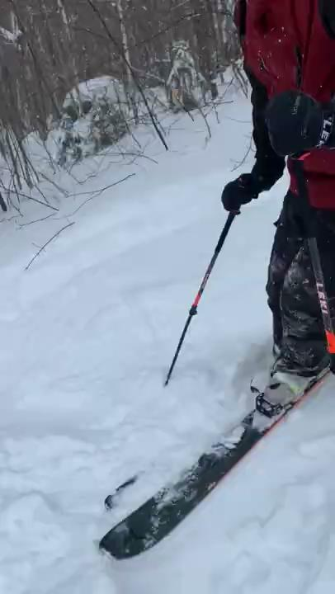
Patient Care

Slide 13
On-Scene
Do not become a victim
Dress properly (adequate layering, nutrition and hydration, stay dry, avoid restrictive clothing and boots, change socks…)
Do not offer your jacket or layers to a patient, this will jeopardize you both, fast transport is the best option
Blanket as first method of warming while still on the hill
Scene safety, ABCDs, take vitals (can be difficult to detect in cold patient), often other injury that caused them to be stuck in cold, perform secondary assessment to address injuries (DCAP-BTLS), in physical evaluation look for signs of cold injury, SAMPLE history, radio call and fast transport

Slide 14
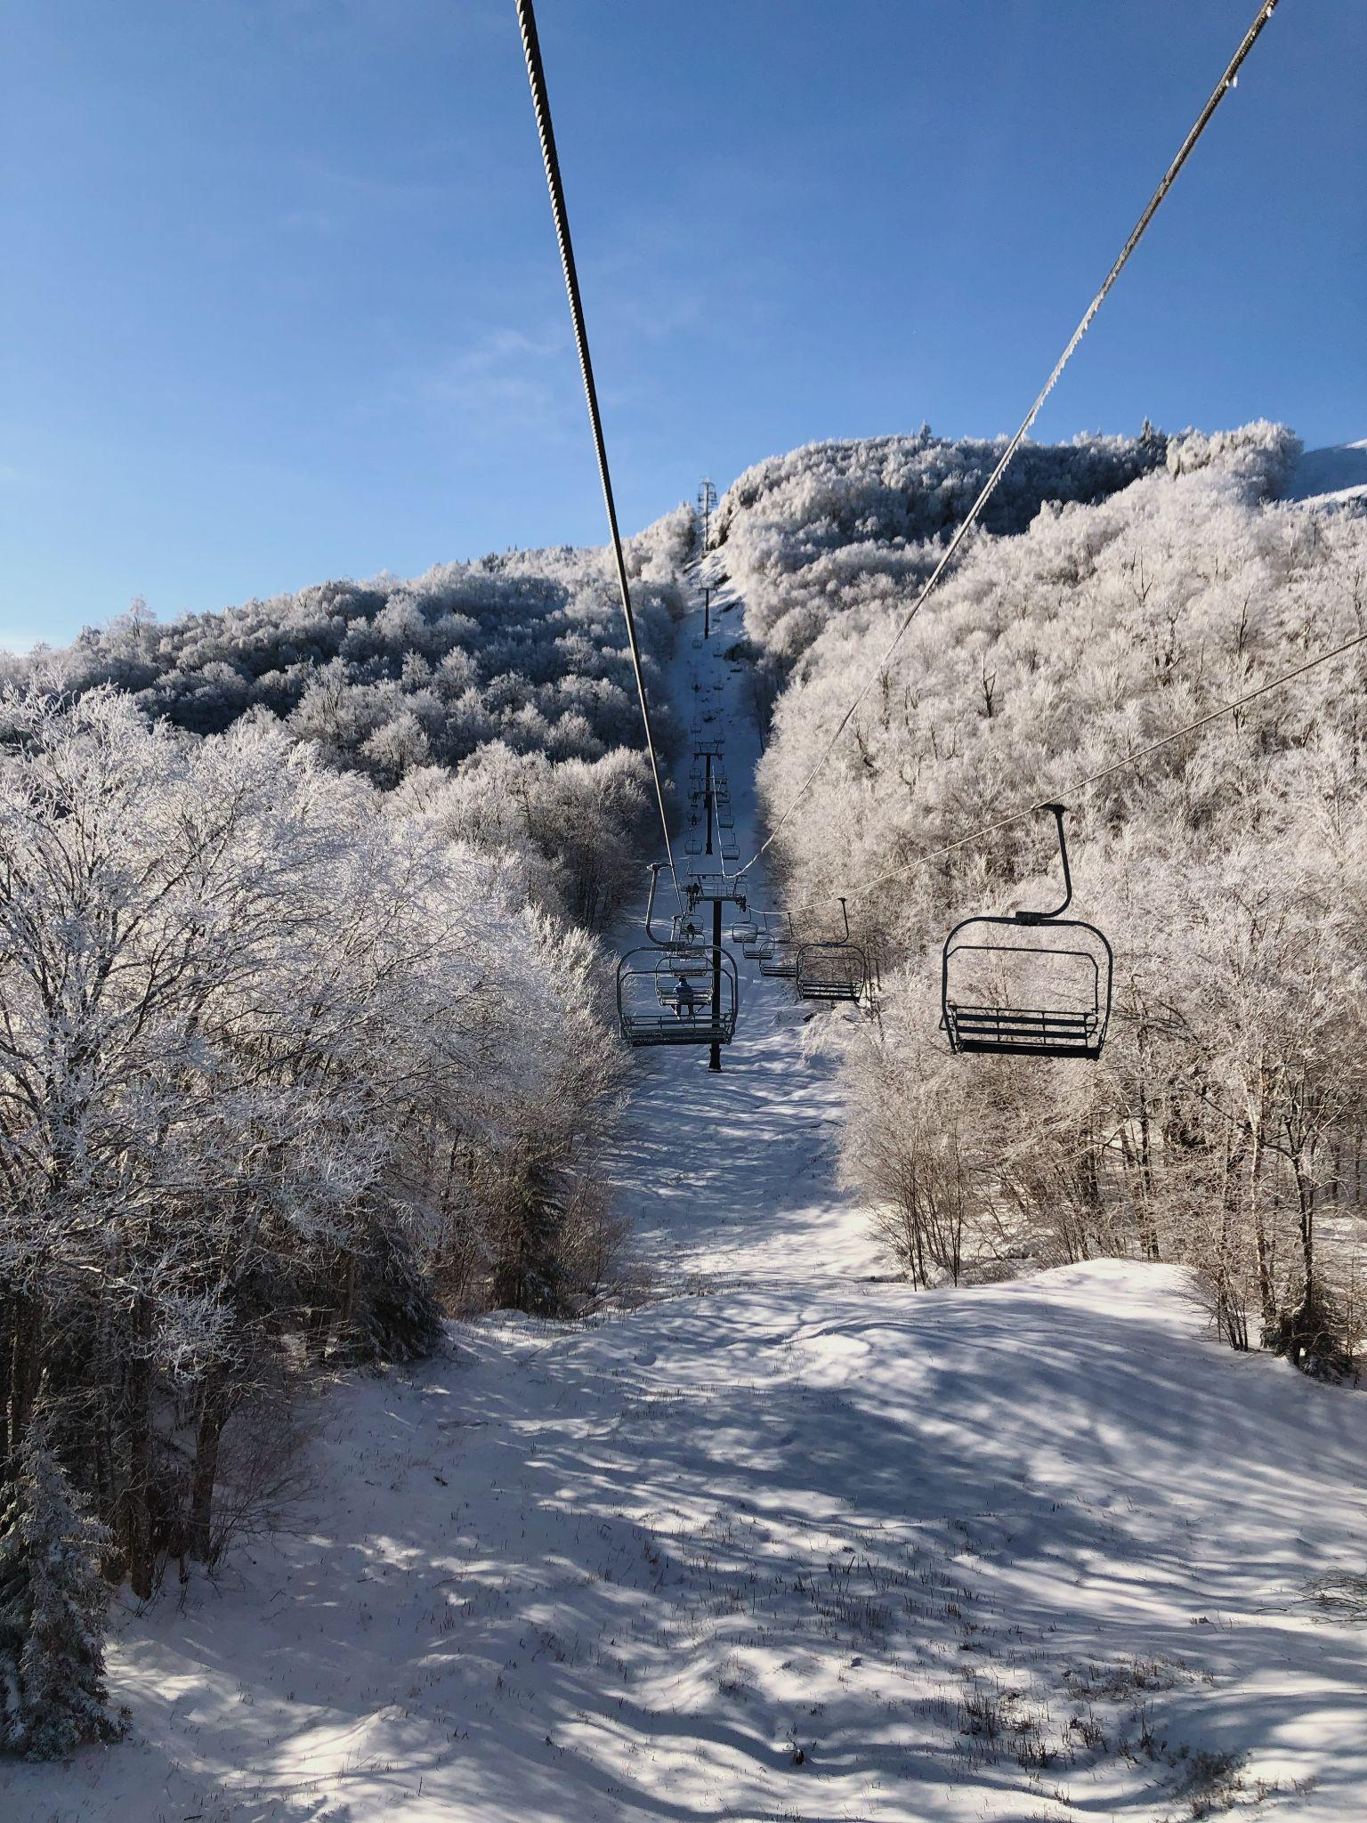
Frostnip and Frostbite
Frostnip
Easily treated by seeking shelter and warming affected area
Frostbite
Rapid warming (this will be very painful and should be made clear to the patient)
Warming should start as soon as possible after discovery
Do not warm if there is risk of tissue re-freezing (this will cause gangrene)
Remove constrictive clothes and jewelry, place affected body part in center of warm water (102-104ºF) for 20-30 minutes trying to keep constant water temp
Do not rub tissue to dry, apply aloe vera and dressing, elevate to level of heart
In coming days/weeks extent of damage will be made evident, tissue may self-amputate

Slide 15
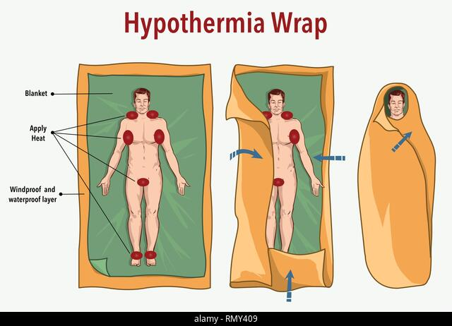
Cold Stress and Hypothermia
Prevent further heat loss, get patient inside
Use insulating pads below patient and blanket on top, leaving space for airway management
Passive warming: insulating layers, body shivering, retaining body’s own heat
Active warming: hot packs to superficial arterial sites, heated blanket, warm drinks, high energy foods

Slide 16
Mild-Severe Hypothermia
For severe-moderate hypothermia: transport to higher level of care, if not showing signs of life, begin treatment
May appear lifeless but still have faint and slow heartbeat
Not dead until warm and dead
Check pulse and breathing for up to one minute (not 15-30 sec)
CPR should be conferred with medical advisor
Do not perform compressions on anyone with any signs of life (can cause v-fib), is frozen (ice in airways), or chest wall so stiff that is is impossible
AED can be beneficial
If adequately warmed and metal status returns no transport necessary
If patient doesn’t respond to warming or has severe frostbite should be transported
Monitor vitals, check skin under heat sources (for burns) and distal circulation

Slide 17
Avalanche Burial Victim

Slide 18
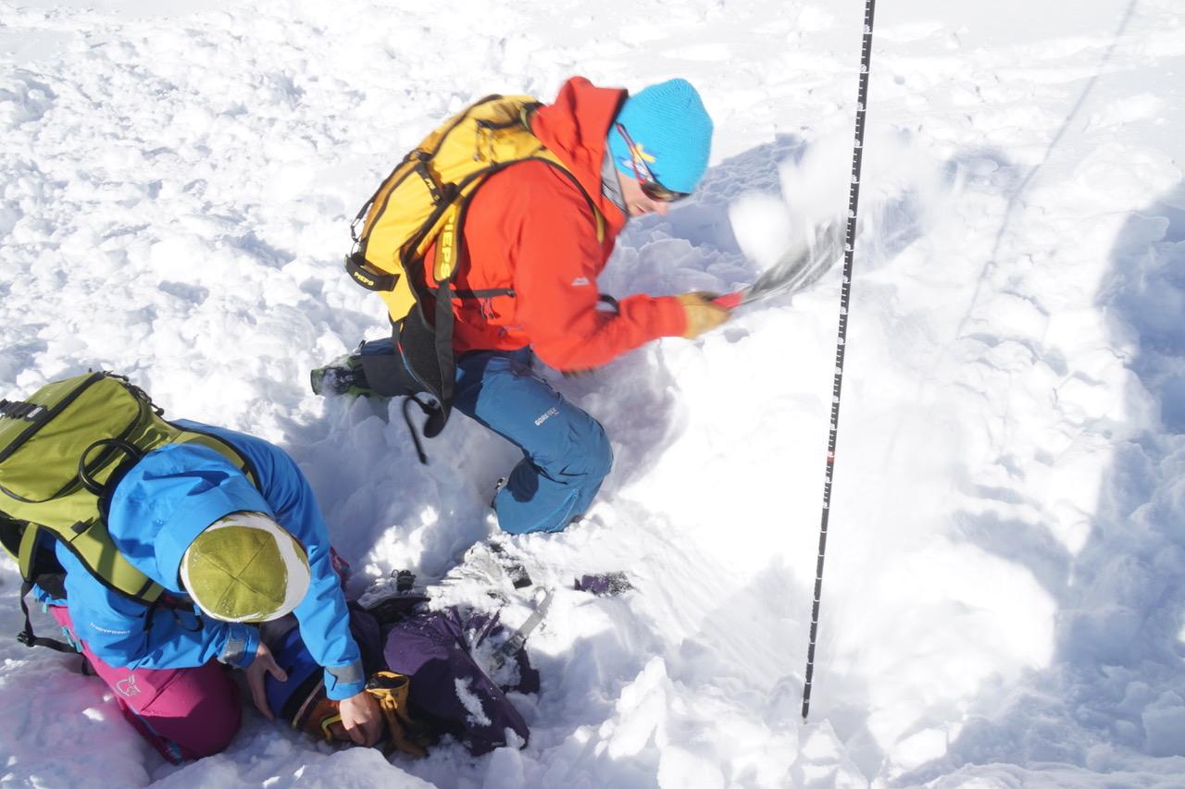
Management
Asphyxiation is major cause of death during avalanche burial
Patients who are extricated within 15 minutes have 90% chance of surviving
Open airway, control bleeding, provide O₂, check pulse and respirations for 1 minute (may have severe hypothermia)
Hypothermia will depend on duration of burial
Avalanche cause of death
Asphyxiation: at least 75%
Trauma: up to 25%
Hypothermia: very rarely

Slide 19
Questions

Slide 20
Afterdrop is defined as:
Onset of pain during rewarming of an extremity
Continued lowering of core temperature even after rewarming has begun
Drooling
All of the above

Slide 21
Your patient is drowsy, with a decreased LOR, and is not shivering. What category of cold exposure are they?
Mild hypothermia
Cold stressed
Severe hypothermia
Moderate hypothermia

