Slide 1
Chapter 23: Chest Trauma
By Anna Weisel and Emma McMahan
Woohoooo

Slide 2
Objectives
1 List the major anatomic structures of the chest cavity.
2 Define and list the signs and symptoms of the following chest injuries:
Contusions
Fractures
Rib fractures
Flail chest
Sternum fracture
Aortic dissection and rupture
Lower rib cage injury
Pneumothorax
Open pneumothorax (sucking chest wound)
Tension pneumothorax
Hemothorax
Pericardial tamponade
Commotio cordis
Traumatic asphyxia
3 Describe and demonstrate how to assess the chest for trauma, including using the LAP method
4 Describe the management of chest injuries

Slide 3
Key Terminology
Aneurysm: ballooning of the less dense outer layer of the wall of the aorta
Aortic rupture: development of a leak in the largest blood vessel in the body; results in massive bleeding that is usually fatal
Closed chest injury: chest without penetration of the chest cavity/wall; typically caused by blunt trauma
Commotio cordis: sudden cardiac death due to blunt chest trauma without any observable chest or cardiac damage
Flail chest: fractures of two or more adjacent ribs, each of which is fractured in two or more places
Hemoptysis: coughing up blood
Hemothorax: an accumulation of blood in the pleural space
Myocardial contusion: also called a cardiac contusion; a bruise involving the heart that may cause heart contractions to become less effective

Slide 4
Key Terminology Continued
Open chest injury (sucking chest wound): caused by physical penetration of the chest cavity/wall by a foreign object
Paradoxical motion: inward movement of a flail chest segment upon inhalation
Pericardial tamponade: the accumulation of blood or other fluid within the pericardial sac
Pulmonary contusion: a bruise of the lung tissue that causes the alveoli to become filled with fluid and blood
Tension pneumothorax: the accumulation of pressurized air within the pleural space; causes the displacement of the great vessels, tracheal deviation, distention of the jugular veins, and compression of the other lung
Traumatic asphyxia: the inability to breathe and hypoxia that results from the inability of the chest wall to expand due to external pressure or massive crushing trauma

Slide 5
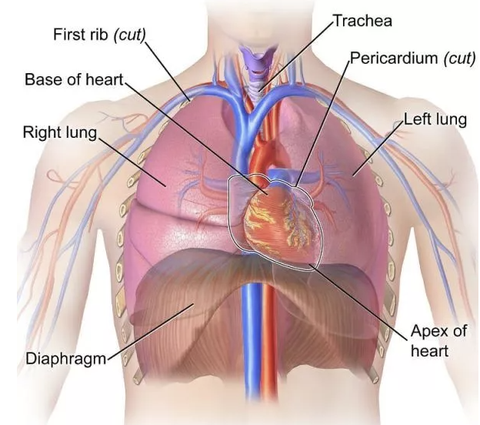
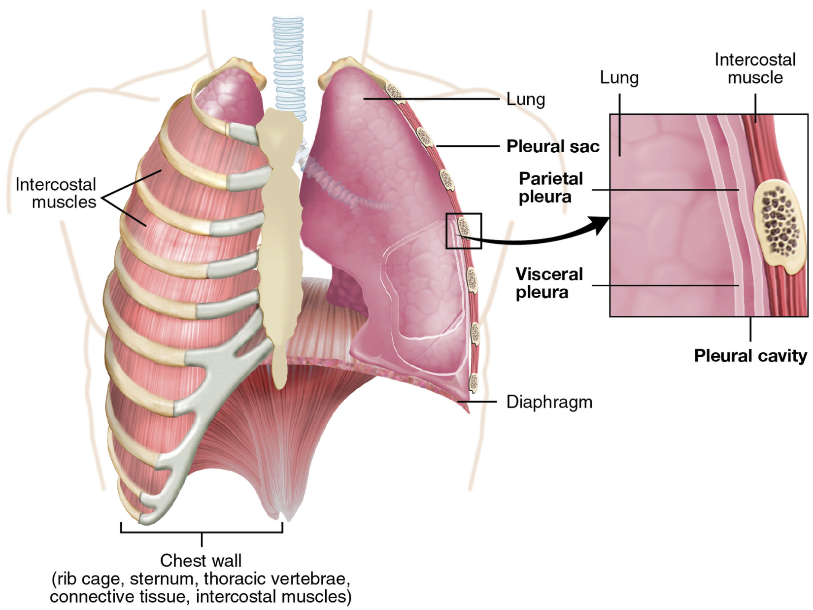
Anatomy

Slide 6
CHESTS
Real Life Examples for Conceptualization YAY

Slide 7
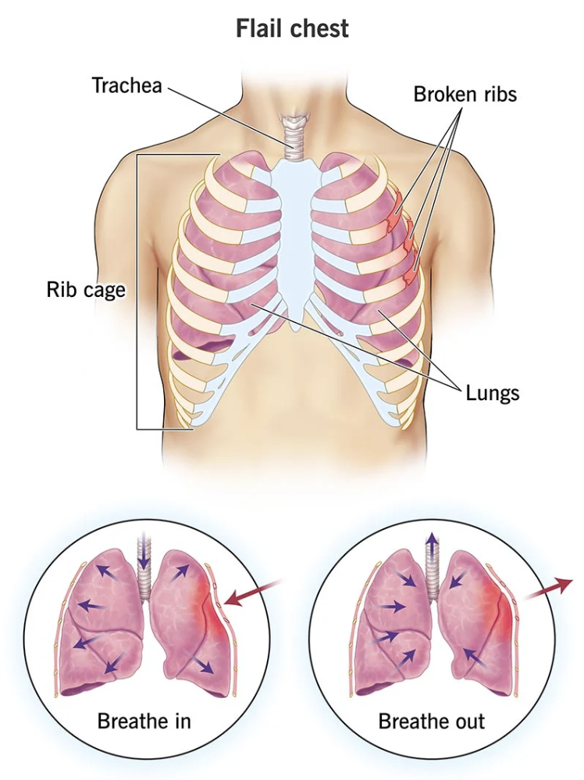
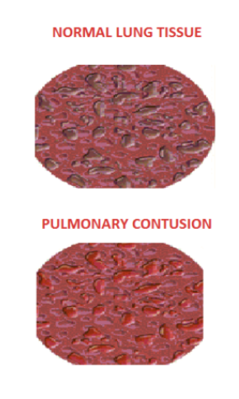
Contusions and Fractures
Pulmonary contusion
Myocardial contusion
Rib fractures
Flail chest (paradoxical motion)
Sternum fracture (really bad)
Notes:
Contusions of the chest walls are often accompanied by more serious trauma due to blunt force to the chest or rapid deceleration (hitting a tree)
Pulmonary contusions are bruises of the lung tissue and cause alveoli to fill with fluid and blood often caused by rib fractures (gas exchange compromised, can cause hypoxia)
Myocardial contusion - bruise to the heart muscle, can cause arrhythmia, or even cardiogenic shock if cardiac output insufficient
Fractures normally from impact or crushing injuries - chest can withstand high amounts of energy - clavicle and rib are the most common
Cartilage along the bottom of the anterior chest cavity can be torn and patient may mimic signs and symptoms of rib fracture (painful and may hinder breathing but relatively minor)
Flail chest - two or more fractures to the same rib cause a detached segment that exhibits paradoxical motion when patient is asked to breath in or out
Sternum fracture caused by extremely high impact

Slide 8
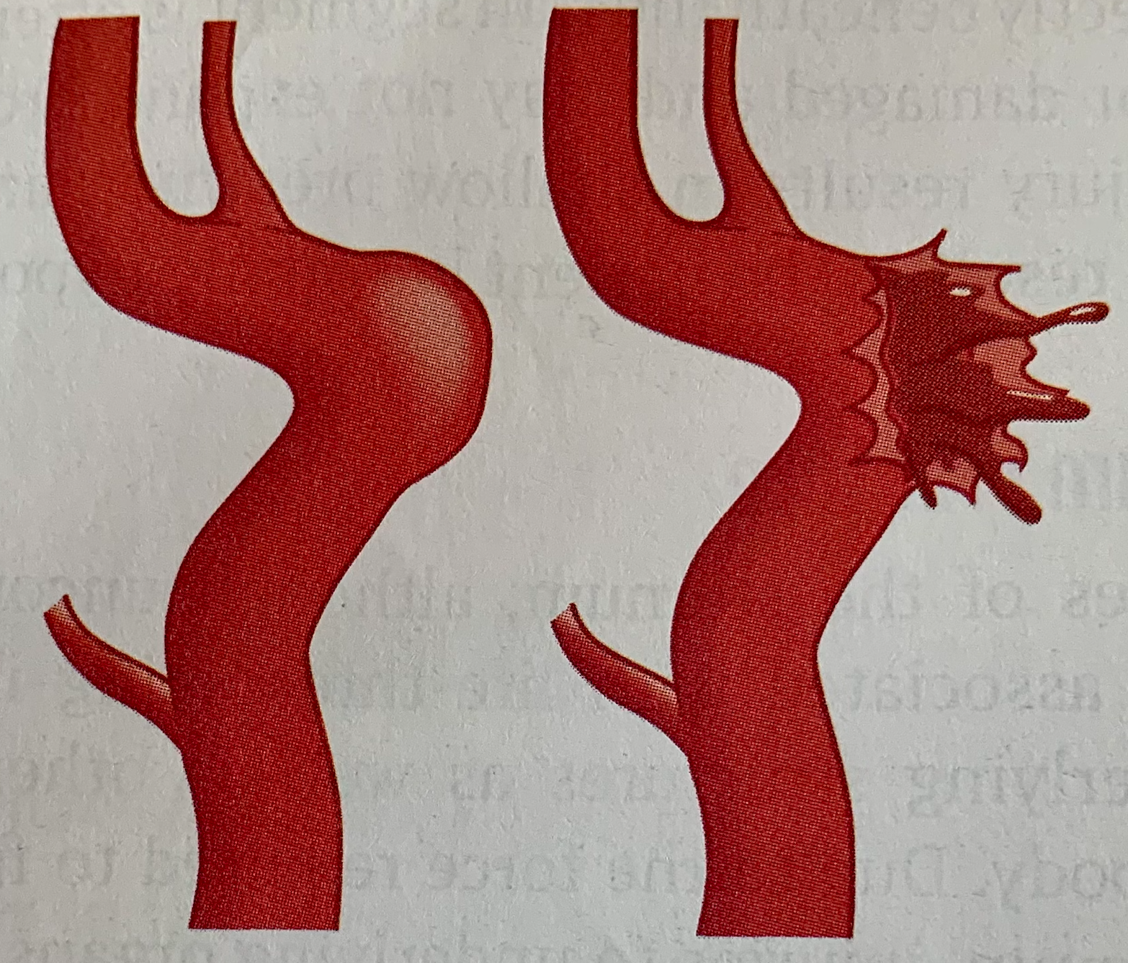
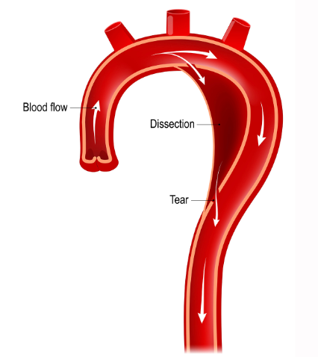
Aortic Dissection and Rupture
Aortic rupture = most dangerous
Culminates in a complete tear in all 3 layers of the aorta
Usually followed by rapid internal hemorrhage, hypovolemic shock, and then death
Rapid deceleration can cause the aorta to tear where aorta attaches to tissue near the heart
When part of the aorta’s wall is torn -
Not immediately fatal
Can cause an aneurysm or aortic dissection
aortic dissection (can) → aneurysm (can) → aortic rupture
Presentation = severe acute chest pain or back pain, a tearing or stabbing pain, gravely ill appearance, possible signs of profound shock
Notes:
Rapid deceleration injuries such as hitting a tree while skiing are common sources of injury and cause some super serious problems that aren’t immediately present.
The aorta is attached to tissue near the heart
When the body slows/stops rapidly and the chest hits a fixed object, the structures within the chest remain in motion for a short period. The inertia and sudden stop inflict a tremendous shearing force on the internal organs and on the tissues holding them in place.
The upper aorta is especially vulnerable to deceleration injuries
Aortic rupture: development of a leak in the largest blood vessel in the body; results in massive bleeding that is usually fatal
The resulting rupture/tear usually is followed by rapid internal hemorrhage, hypovolemic shock, and then death
Aneurysm: ballooning of the less dense outer layer of the wall of the aorta
Aortic dissection: condition where blood leaks out between the layers of the wall of the aorta
Aortic dissection, if left untreated, can eventually cause the vessel to rupture, causing the same massive and rapid internal bleeding to death
Patients present with severe acute chest or back pain, or a tearing or stabbing pain that radiates from the chest to the back between the shoulder blades; appear gravely ill; if aorta has ruptured, will exhibit signs of profound shock; if aortic tear is between the large arteries that go to each arm, blood pressure may differ in the 2 arms
Rapid transport is an extreme priority and definitely necessary for these injuries

Slide 9
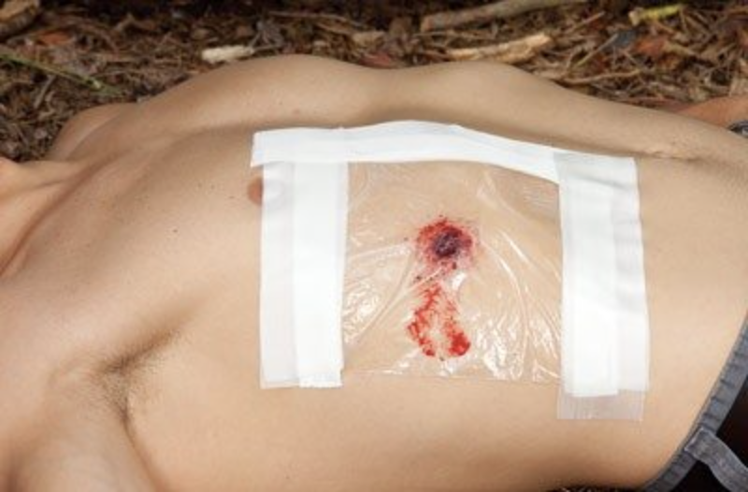
Pneumothorax
Signs and symptoms
Shortness of breath or hypoxia because the lung cannot fully expand
Causes
Blunt or penetrating trauma
Underlying disease like asthma
Sudden changes in altitude
Open pneumothorax
Caused by penetration into the chest cavity allowing air to enter the pleural space
Treat “sucking chest wound” with occlusive dressing
Notes:
Pneumo means air, thorax means chest (air outside the lung within the pleural cavity)
Seal open pneumothorax with occlusive dressing taped on three sides so that air can escape chest cavity but not enter

Slide 10
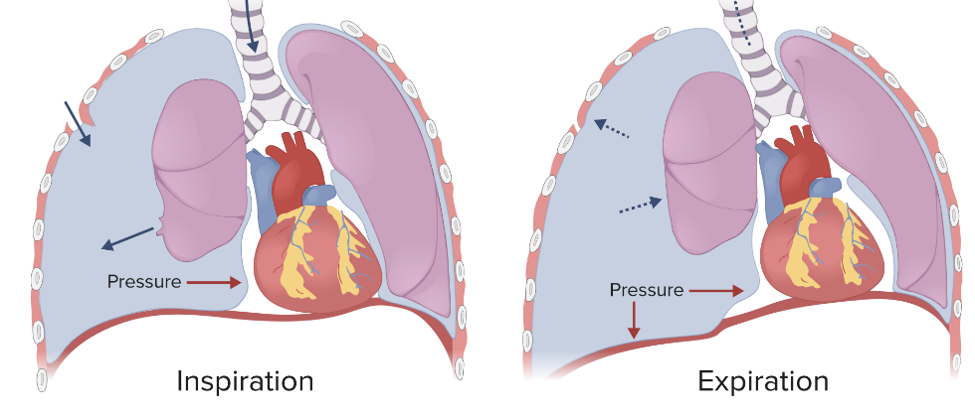
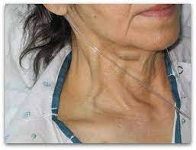
Pneumothorax Continued
Tension pneumothorax
Pressurized air within the chest cavity causes the lung to collapse or partially collapse
Air cannot escape the chest cavity
Can be caused by fractured rib puncturing lung tissue in a closed pneumothorax
DO NOT USE BVM
Hemothorax
Blood collects in the pleural cavity due to disruption of blood vessels in the chest
Signs and symptoms
Distended neck veins (JVD jugular venous distention)
Tracheal deviation
Shortness of breath
Tachycardia, low blood pressure, cyanosis
Subcutaneous emphysema
Sharp pain in chest and back
Notes:
Tension pneumothorax caused by pneumothorax in which air cannot escape and continues to collect in pleural space, putting pressure on the lung and the rest of the chest cavity
If left untreated, pressure will continue to build causing severe respiratory distress and damage to other organs (can cause other lung to collapse which is rapidly fatal)
Addition of positive pressure from rescue breathing can cause or worsen a tension pneumothorax
Tension pneumothorax can develop minutes to hours after initial injury and worsen rapidly
Hemothorax - similar traumatic causes, pleural space can hold 3-4 liters of blood so can lead to hypovolemic shock
Hemopneumothorax - blood and air leaking into pleural space simulatenously
Subcutaneous Emphysema - Air escapes the pleural space but gets trapped under the skin - rice krispie crackling to the touch around neck, shoulders, chest or back (air rises)

Slide 11
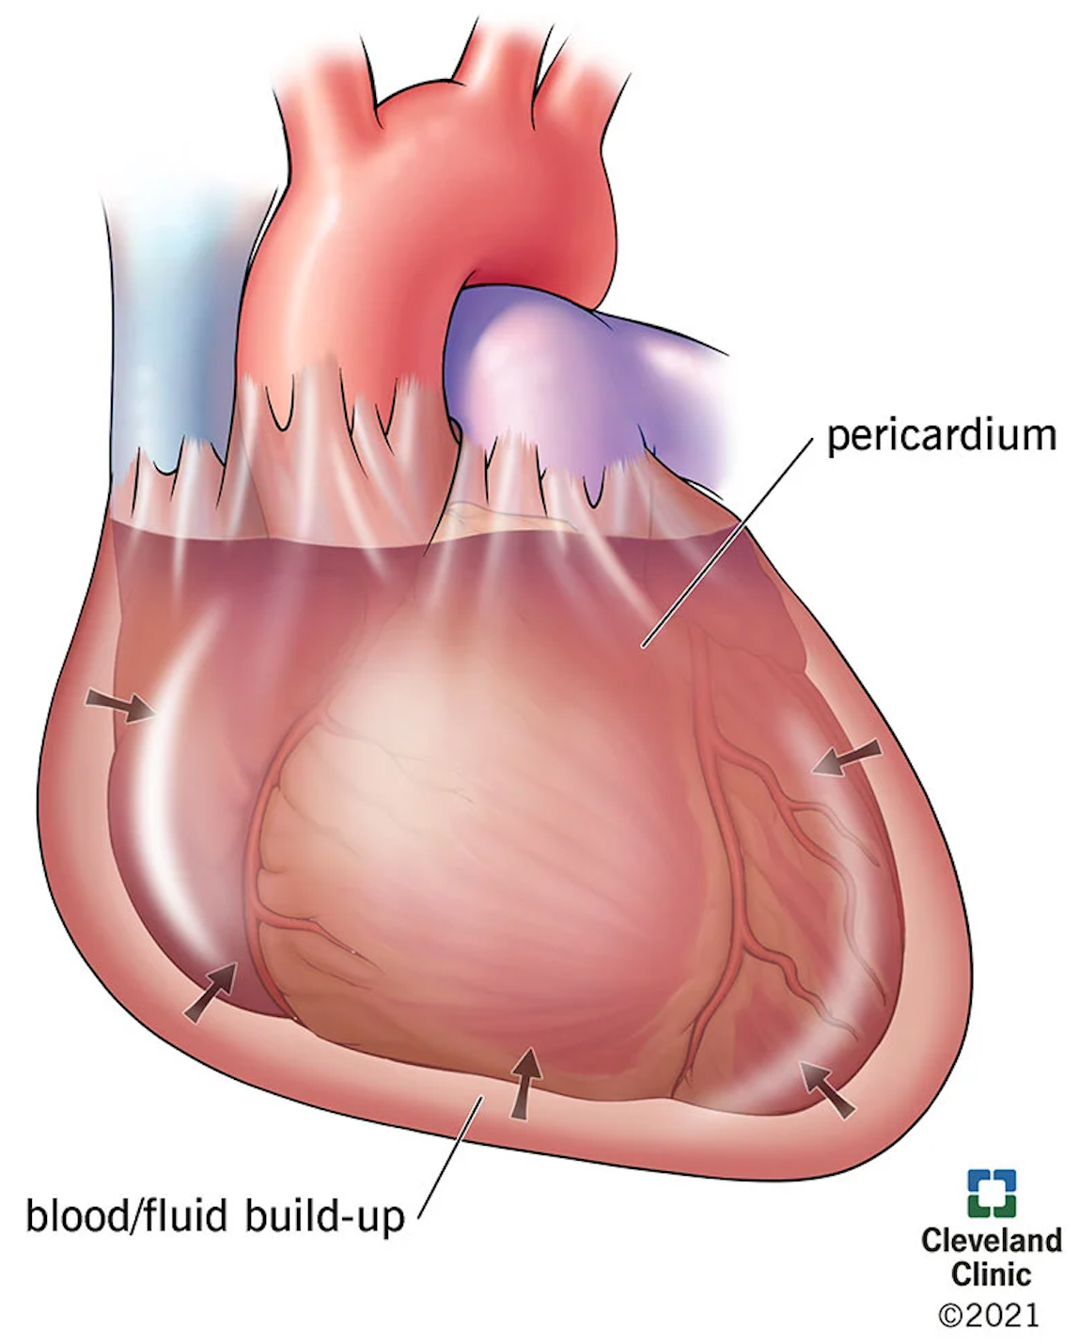
Pericardial Tamponade
Causes
Internal bleeding into the pericardial sac from blunt/penetrating chest trauma
Rupture of a cardiac blood vessel on the heart’s wall
Some nontraumatic medical conditions (e.g., bacterial sepsis, viral infections)
Accumulation of fluid in the sac leads to pressure constricting the heart from filling properly
Signs
Pain, shortness of breath, distended neck veins (early)
Muffled heart sounds and decrease in the pulse pressure (later)
Systolic and diastolic BP readings become close together
The Beck triad: distended neck veins, muffled heart sounds, and a pulsus paradoxus
Notes:
Blunt or penetrating chest trauma can cause internal bleeding into the pericardial sac from a hole in the heart’s muscular wall or the great vessels (causes pericardial tamponade)
Left ventricular wall = thicker than the right = causes right ventricle compresses first; prevents the walls of the heart’s ride side from expanding = impairs venous return of blood; blood backs up into the jugular veins causing them to bulge; less blood being pumped to the lungs for oxygenation, so cardiogenic shock and death occur rapidly
Pulse pressure: difference between the systolic and diastolic blood pressure readings
Pulsus paradoxus: decrease in systolic blood pressure of 10 mm Hg or more during inspiration

Slide 12
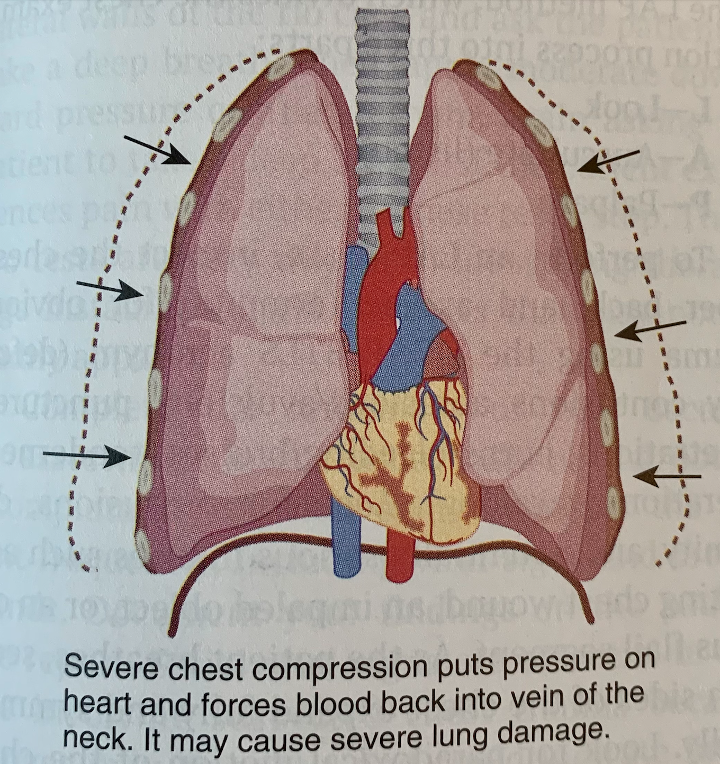
Commotio Cordis and Traumatic Asphyxia
Blunt trauma to the chest can cause lethal disruptions in the heart’s electrical rhythm.
Commotio cordis: sudden cardiac death due to blunt chest trauma without observable chest or cardiac damage
Traumatic asphyxia (crush asphyxia): injury where external pressure on the chest wall prevents normal chest expansion for breathing; results in profound hypoxia or anoxia
May result in ruptured blood vessels, particularly in the face and neck, causing bulging eyes, ruptured vessels in the eyes, and an overall purplish discoloration of the face
Notes:
Commotio cordis most commonly occurs following a direct blow to the chest that interrupts the heart’s electrical activity causing ventricular tachycardia or fibrillation and most often affects young, healthy individuals
Traumatic asphyxia typically caused by entrapment under a heavy object but may also be caused by massive thoracic cage fractures that render the chest wall unable to expand. In the case of avalanches, snow can also be packed into the airway, leading to the inability to exchange gas and thus inability to breathe

Slide 13
Patient Assessment
Scene size-up
Standard precautions and primary assessment
A patient with a chest injury may exhibit rapid breathing or other signs of respiratory distress (look for those!)
Check pulse, LOR, mental status, neurologic condition
Secondary assessment
Note patient’s overall appearance and skin color
Ask patient to take a deep breath
Observe chest movements
Utilize a stethoscope
LAP method: look, auscultate, palpate
Vital signs (close attention to pulse pressure)
Notes:
Some environmental factors such as high altitude can complicate a chest injury and you should definitely be considering these when going into treatment and patient care.
Secondary assessment questions = does the person appear anxious? Is the patient pale or cyanotic? Do their eyes appear bloodshot or are bulging? Are the neck veins distended? Is the trachea deviated to one side? Is there hemoptysis?

Slide 14
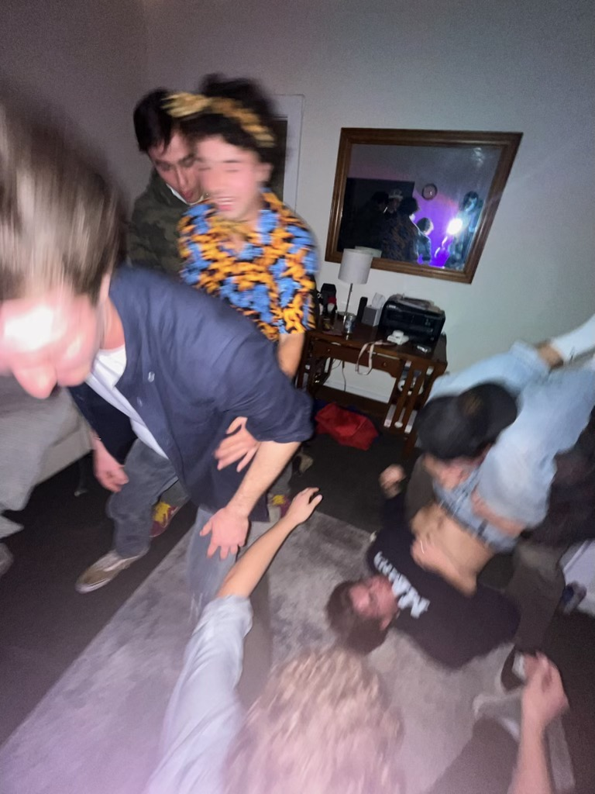
Management of Chest Injuries
Correct ABCDs, provide high-flow oxygen, monitor oxygen saturation level, call for ALS transport
Consider transport in the sitting position (ease of breathing)
Treat soft-tissue injuries of the chest normally (bandages and dressings)
With rib fractures, DO NOT SPLINT CHEST (impairs breathing).
You can splint flail segments and individual, isolated rib fractures
Consider damage to internal organs (e.g., pneumothorax)
Chest injuries often associated with multisystem trauma and can progress very quickly.
Any chest injury with respiratory distress is a load-and-go situation
Commotio cordis treatment- aggressive cardiopulmonary resuscitation techniques (defibrillation)
Traumatic asphyxia treatment- immediate removal of external pressure and ventilatory support
Pneumothorax treatment- remember occlusive dressings!
Notes:
Load-and-go situation: correct any life-threatening conditions, provide O2, immobilize spine if necessary, and rapidly evacuate the patient to a definitive-care facility
To provide O2, use a nonrebreather mask; if necessary a BVM can be used
If patient condition worsens while bagging, think of a tension pneumothorax
Always monitor patient, look for worsening conditions, and get them to higher-levels of care, careful consideration of patient positioning for transport, look for shock and treat as necessary
Consider air medical transport

Slide 15
Practice Questions
A 42-year-old patient skied off a trail at a high speed and struck his anterior chest on a large tree. Which of the following findings would cause you to suspect the patient may have pericardial tamponade?
Narrowing pulse pressure (systolic and diastolic readings getting closer together)
Tracheal deviation toward the affected side
Distended neck veins (jugular venous distention) and shortness of breath
Both a and c
Notes:
Correct answer is D

Slide 16
Practice Questions
Management of a patient with a sucking chest wound includes:
Immediately covering the open wound with an ungloved hand
Applying an occlusive dressing taped on three sides
Applying a nonocclusive dressing taped on three sides
Both a and c
Notes:
Correct answer is B

