Slide 1
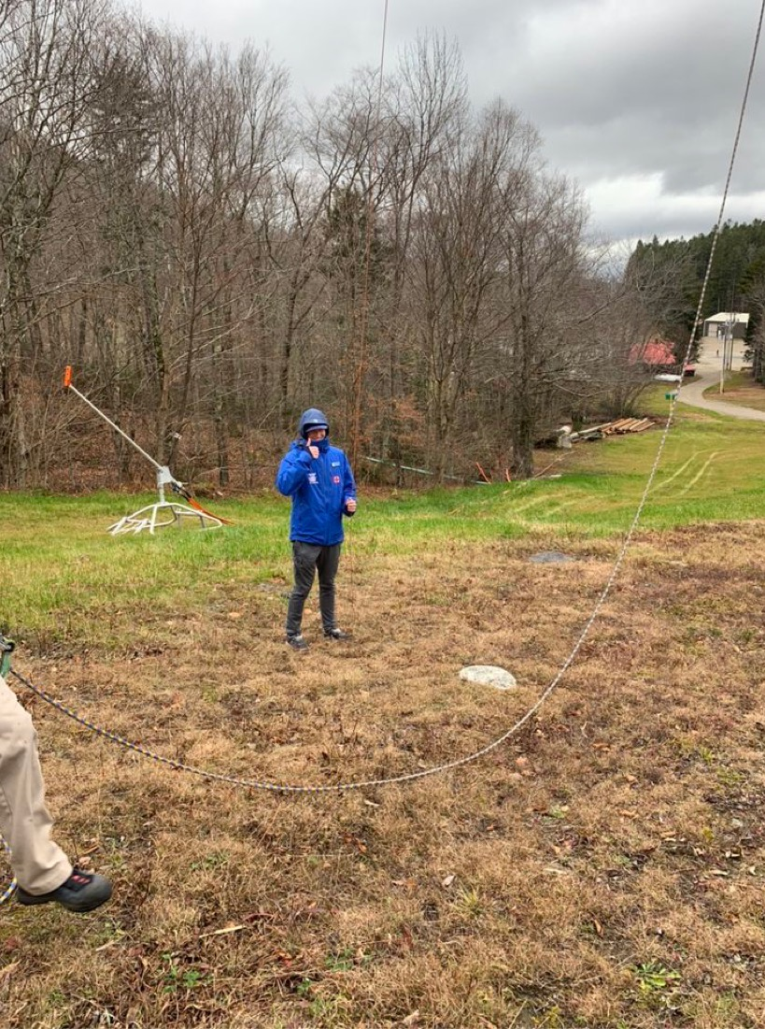
CHAPTER 5: MOVING, LIFTING, AND TRANSPORTING PATIENTS
By Ryan Heinzerling

Slide 2
Important Objectives
Explain how to use good body mechanics
Understand the power grip and lift
Know what moves are appropriate when you don’t suspect a spinal injury versus the ones that are appropriate for a spinal injury
Know the difference between urgent and nonurgent moves
Be able to describe devices to move patients
Be able to explain proper toboggan packaging
Understand helicopter safety

Slide 3
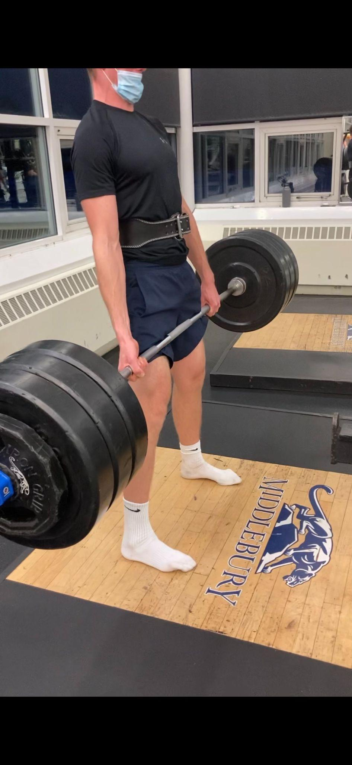
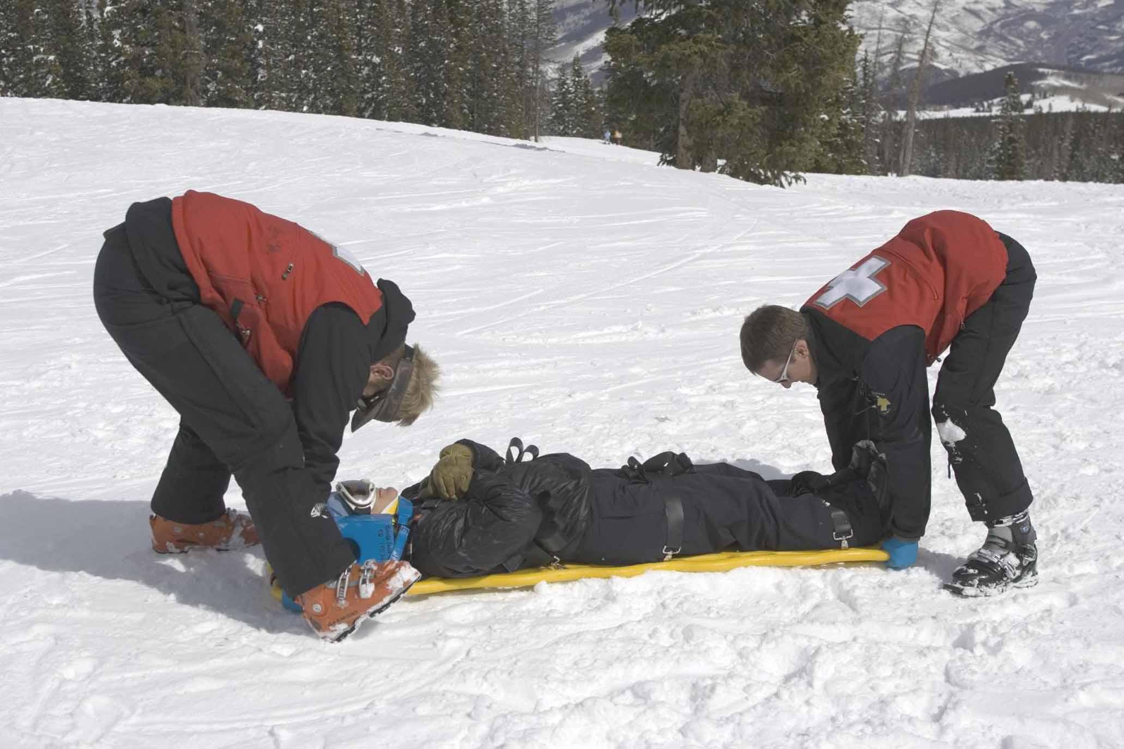
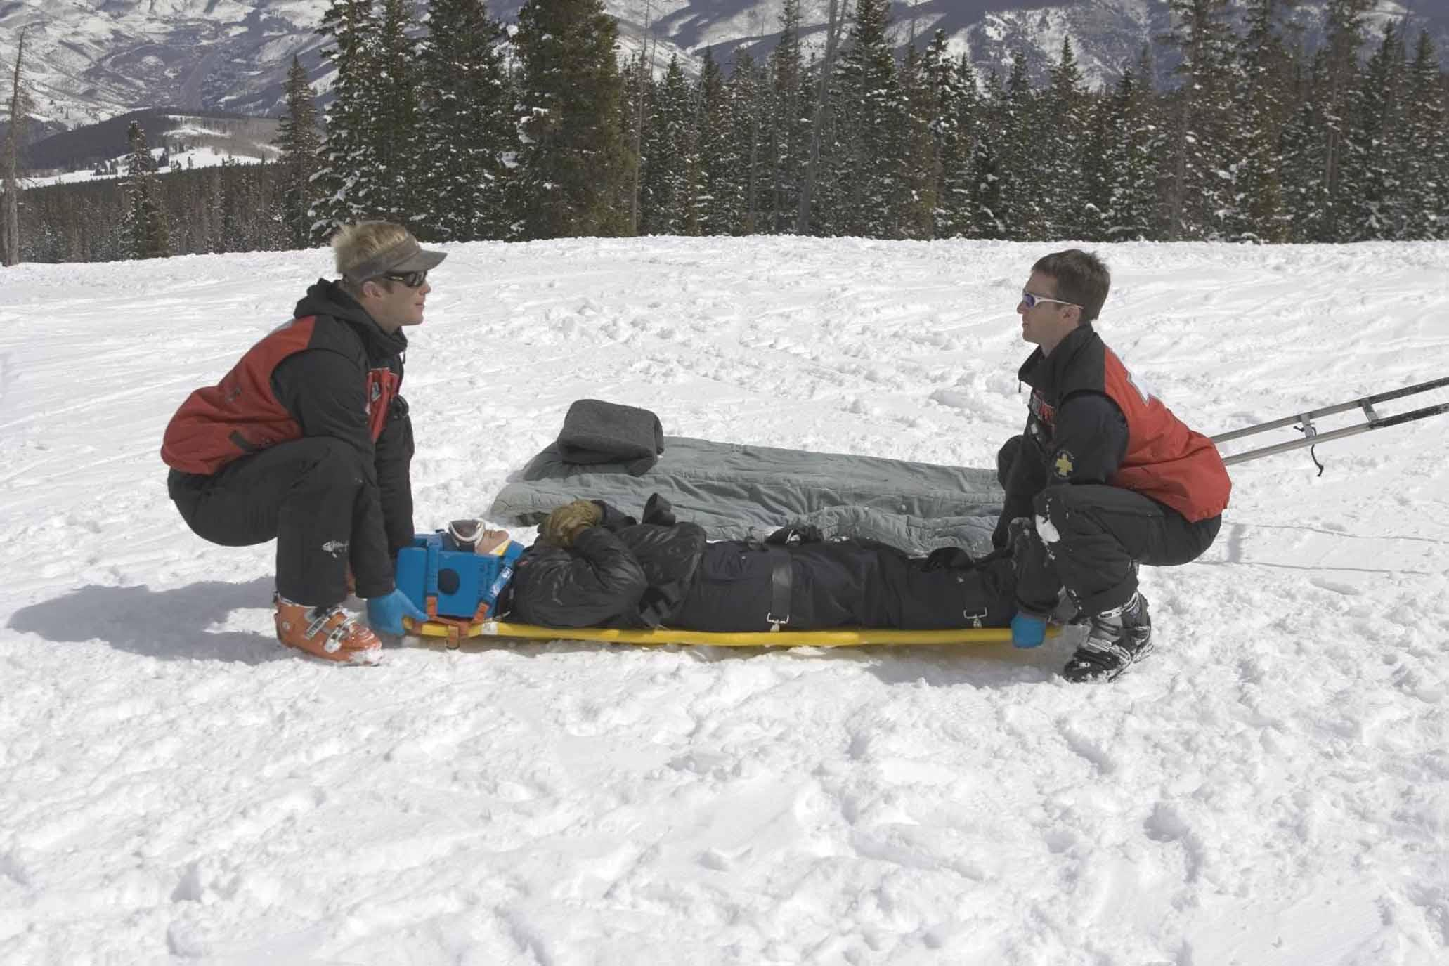
Body Mechanics
Use a power grip
Keep back straight
Lift with legs with knees bent
Keep shoulders centered over spine
In which scenario are the patrollers demonstrating proper body mechanics?
Look at ben, he’s using perfect body mechanics while lifting 365 pounds, which is 2.2 times duncan’s bodyweight

Slide 4
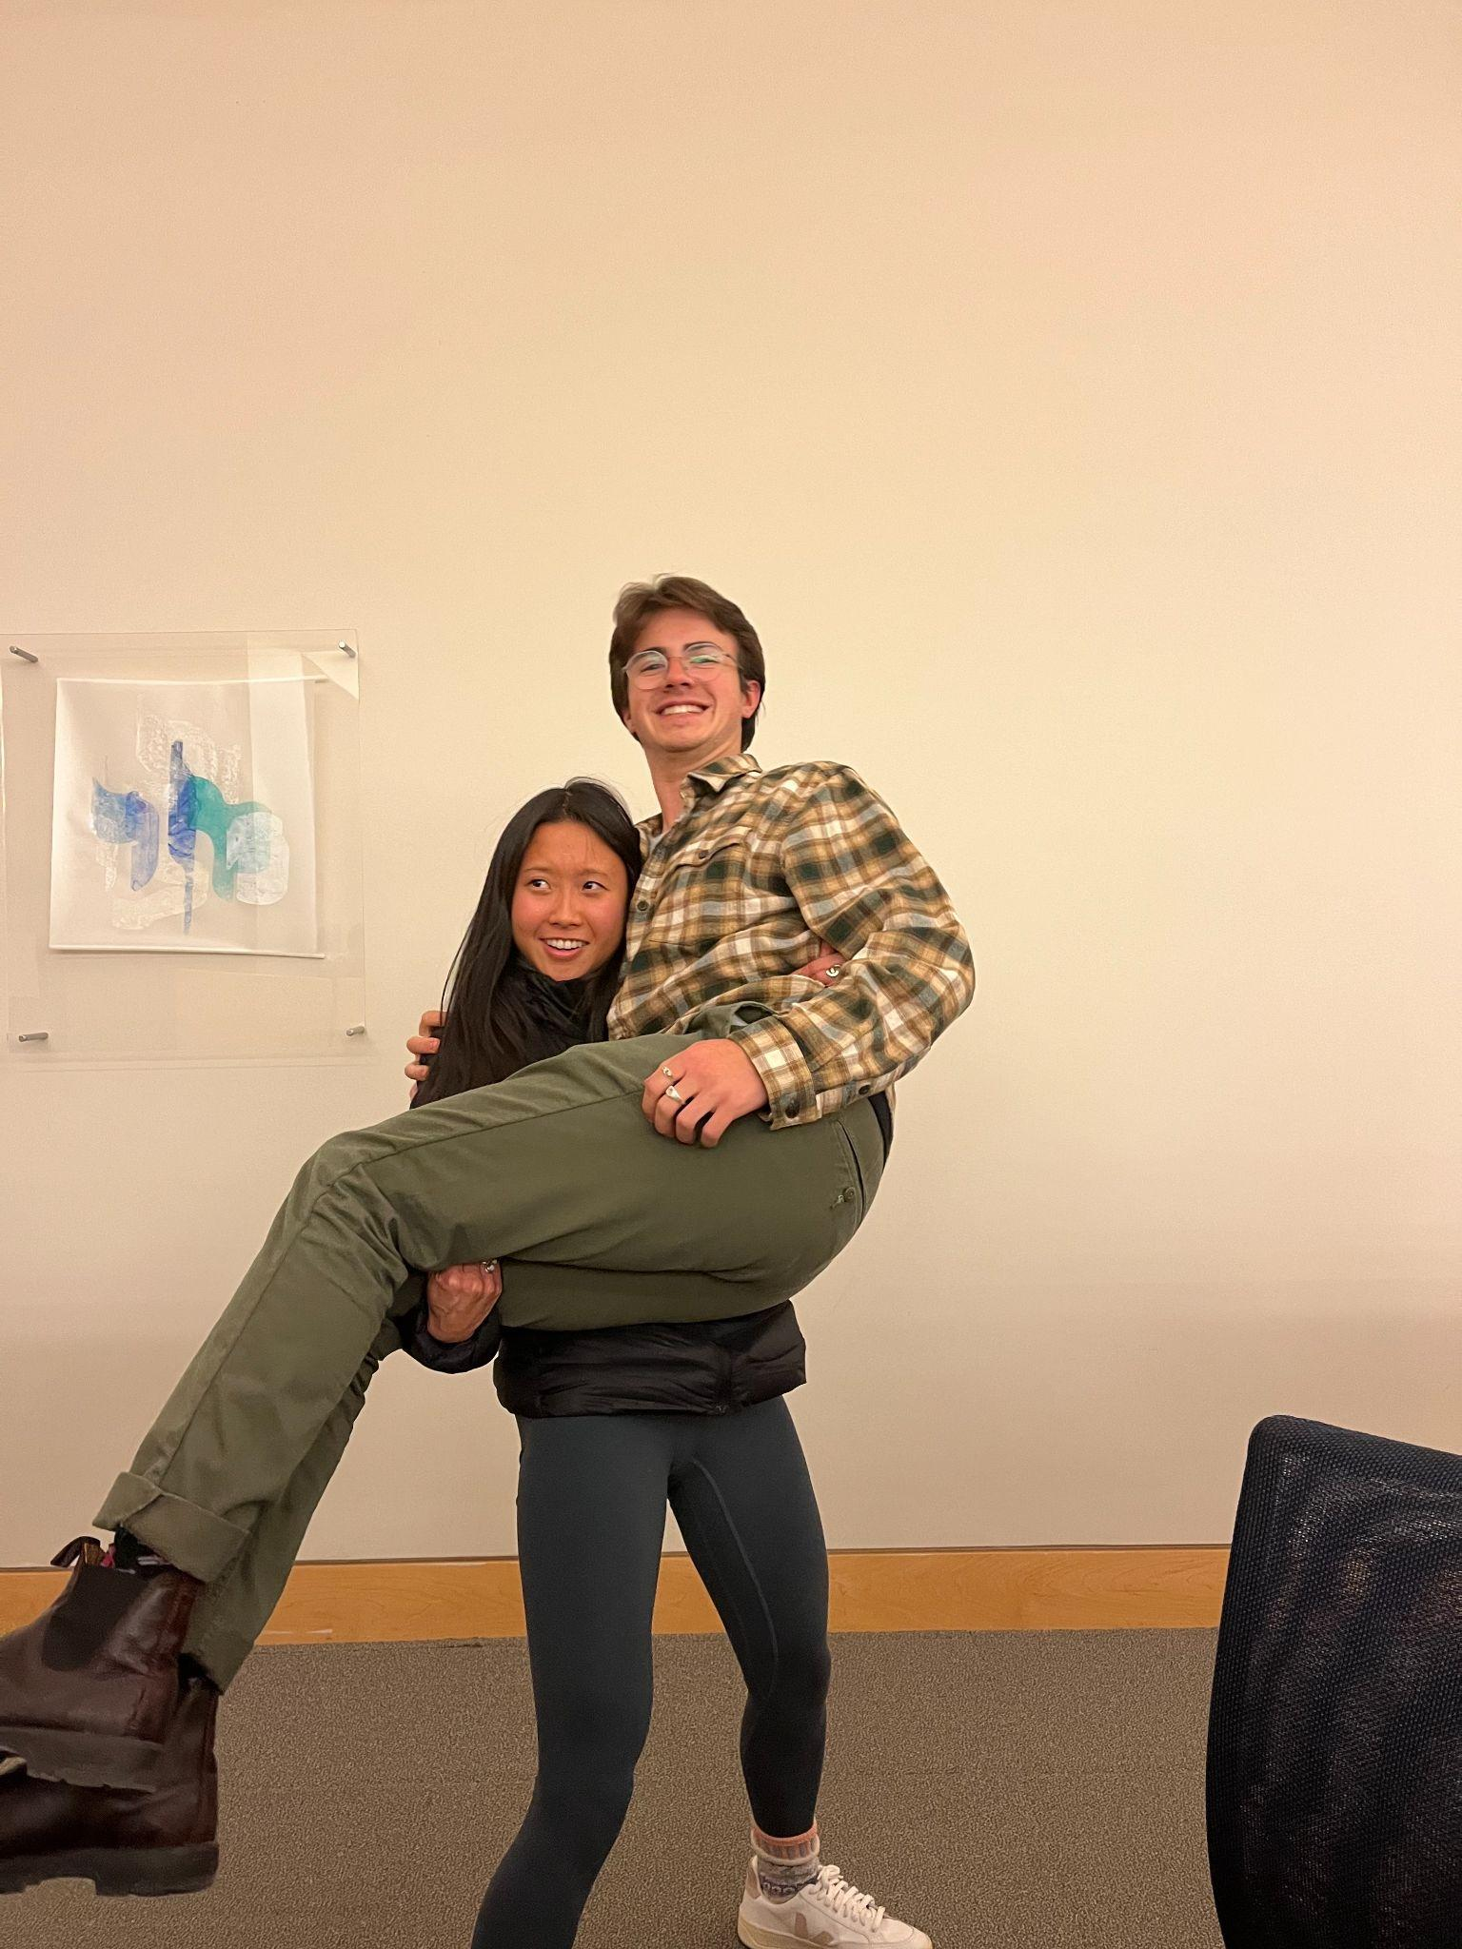
Moving a Patient
Urgent Move: Hazard is present or patient position prevents urgent care
Usually moved less than 100 feet
Usually a drag (Shoulder drag, Under-arm wrist drag, blanket-drag, feet drag)
Non-Urgent Move: Patient is moved in a controlled fashion
Human Crutch
Two-Person assist
Chair-carry
Fore and aft carry
Back carries
Improvised carries
Spinal restriction vs. no spinal restriction

Slide 5
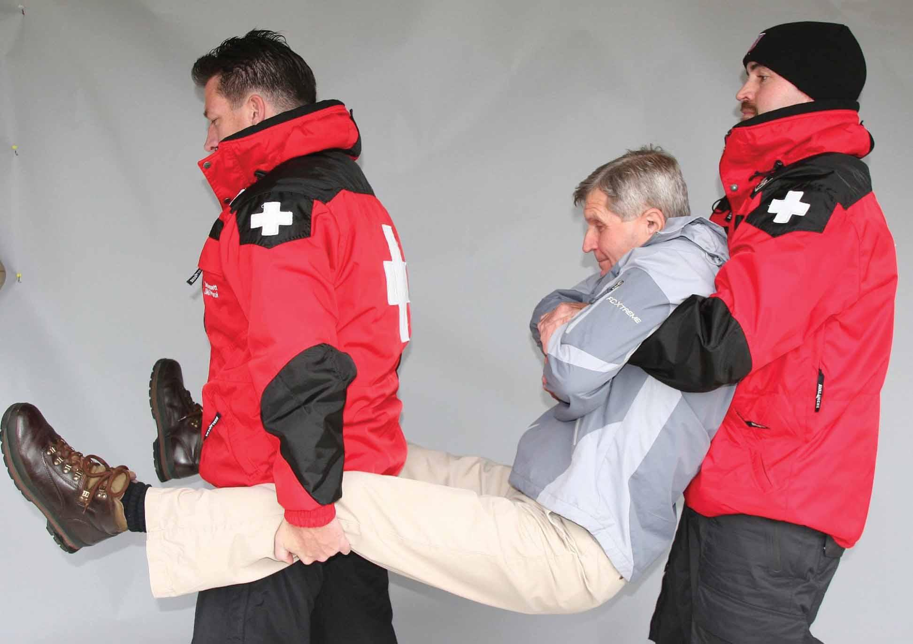
A move that does not restrict ze spine
Extremity Lift:

Slide 6
Another move that ignores the spine
Direct-ground Lift:

Slide 7
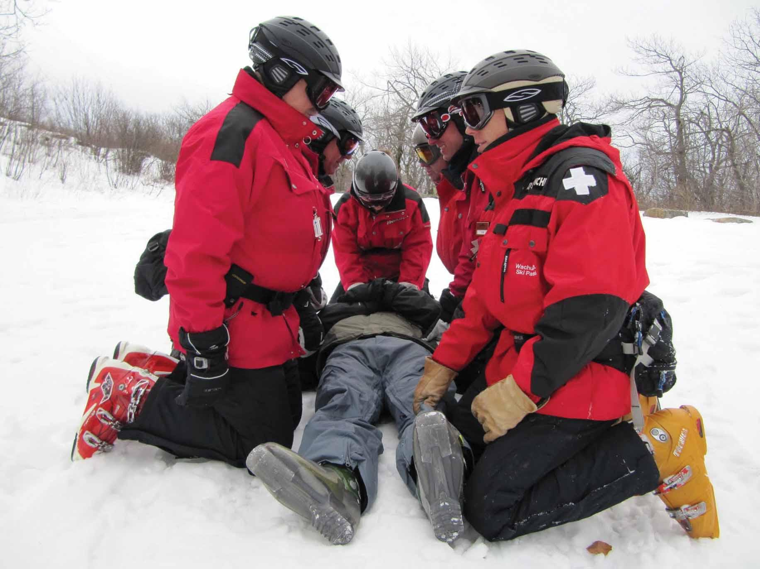
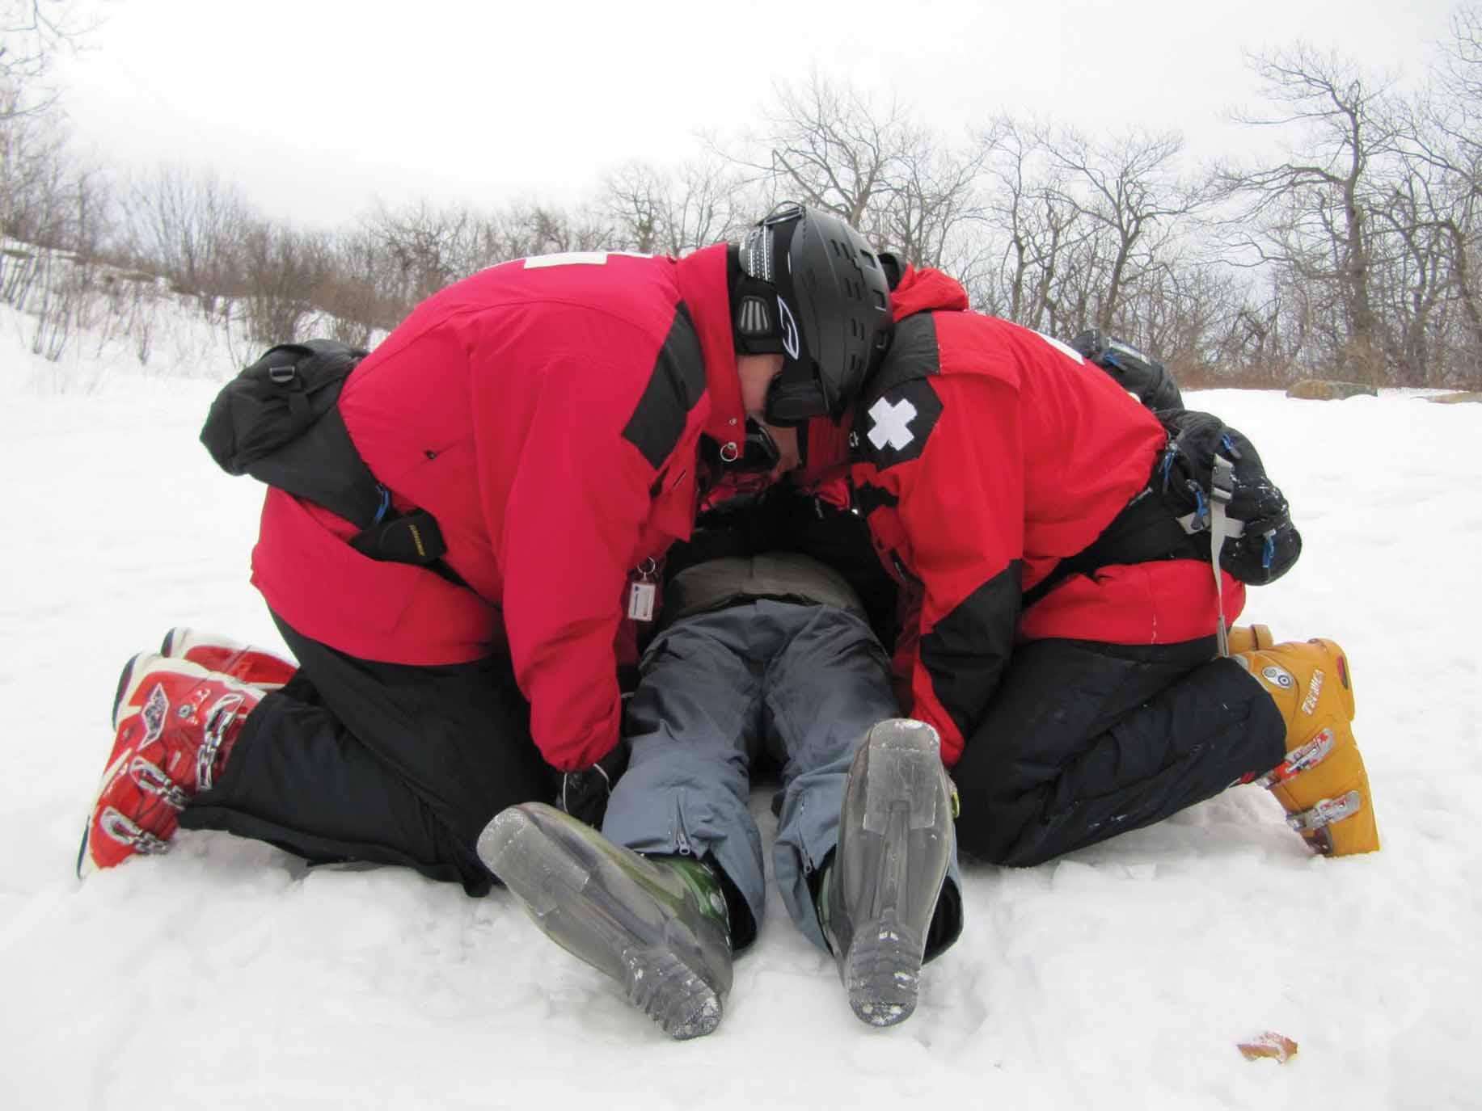
Yet a third move that cares little for the spine
BEAN/BEAM Lift:

Slide 8
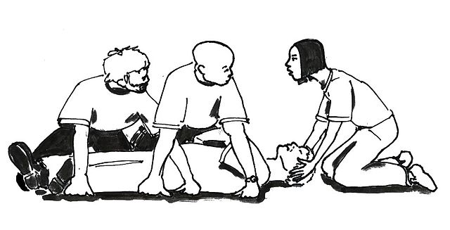
Moves that finally do care about Spinal Restriction
Draw-Sheet Lift:
Position a sheet underneath the patient
Lift the patient using the sheet
Logrolling:
Important for getting patients onto a backboard or other immobilization device
four rescuers pulling or “rolling” someone onto their side so that a backboard may be placed under the patient

Slide 9
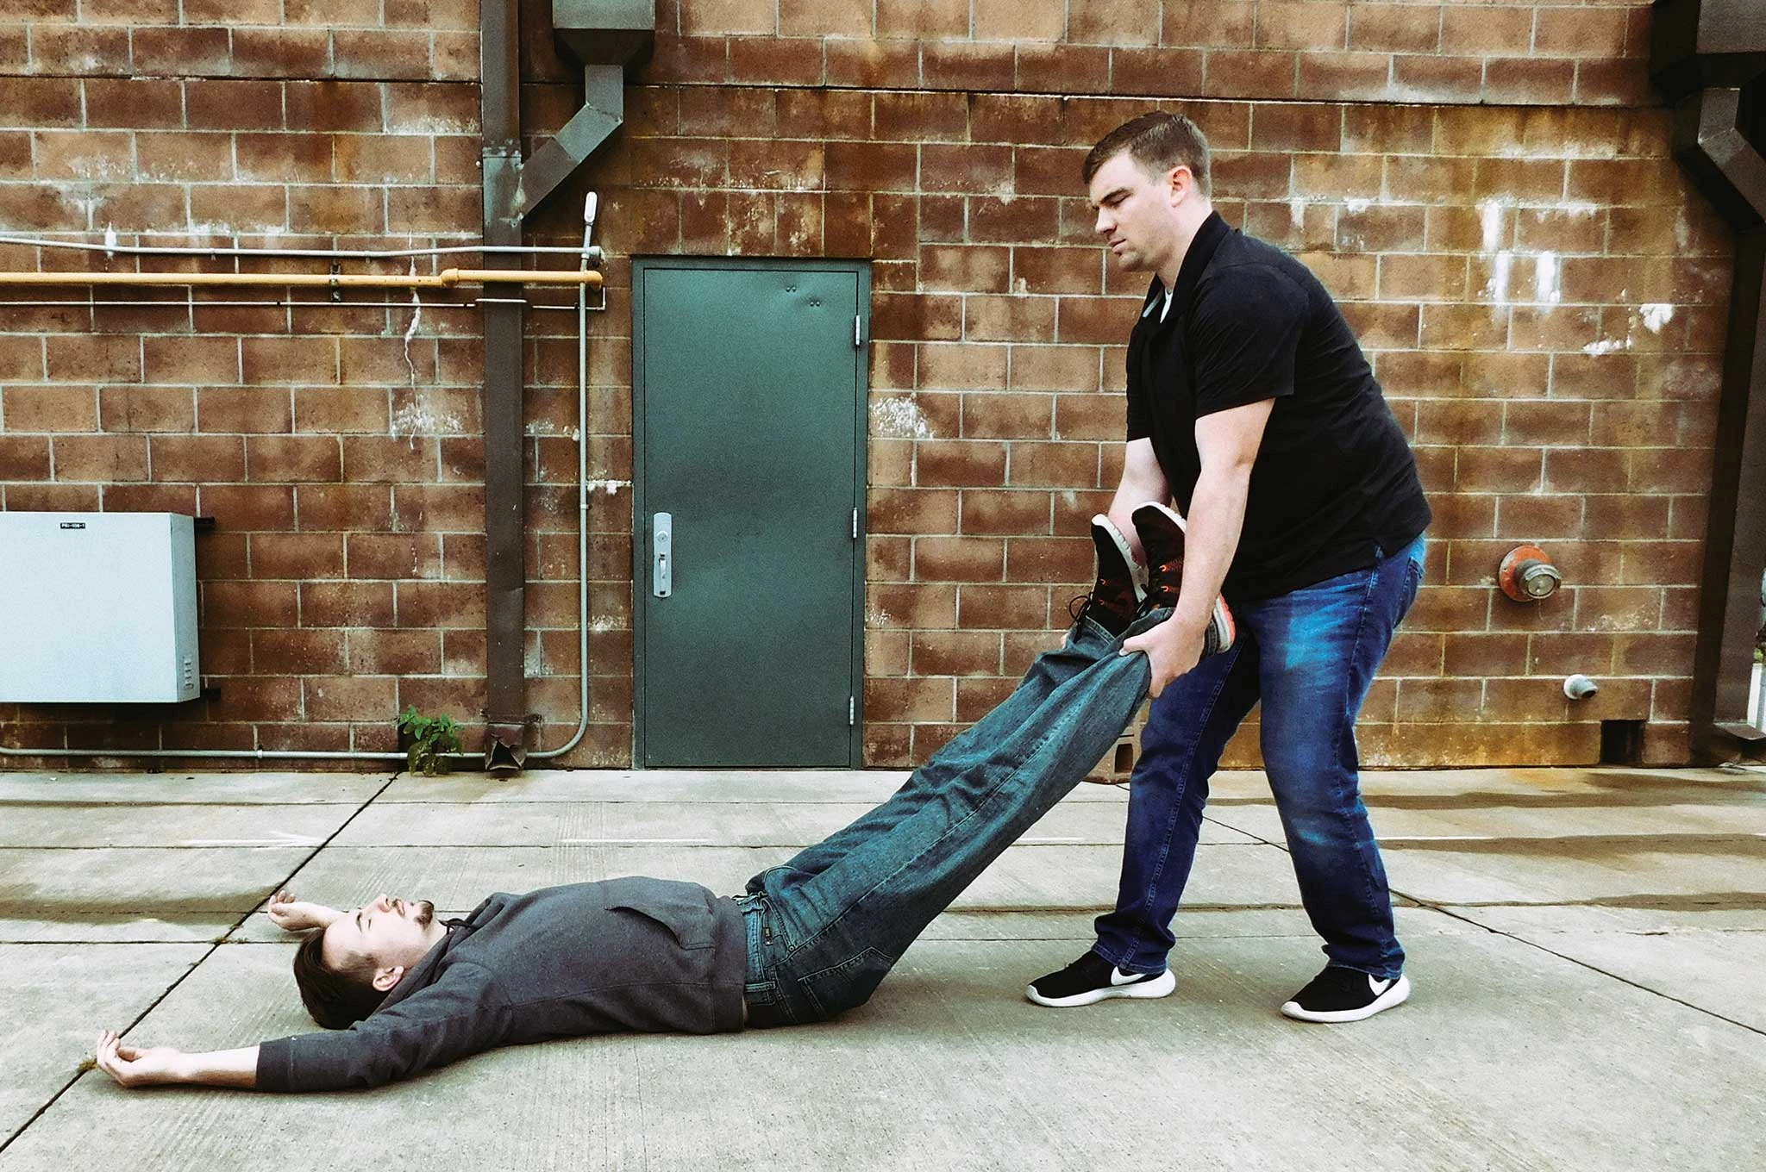
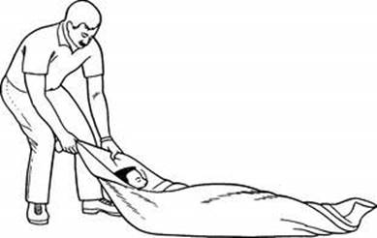
Urgent moves (drags)
Shoulder (or clothes) drag
Feet drag
Blanket drag
Underarm-wrist drag

Slide 10
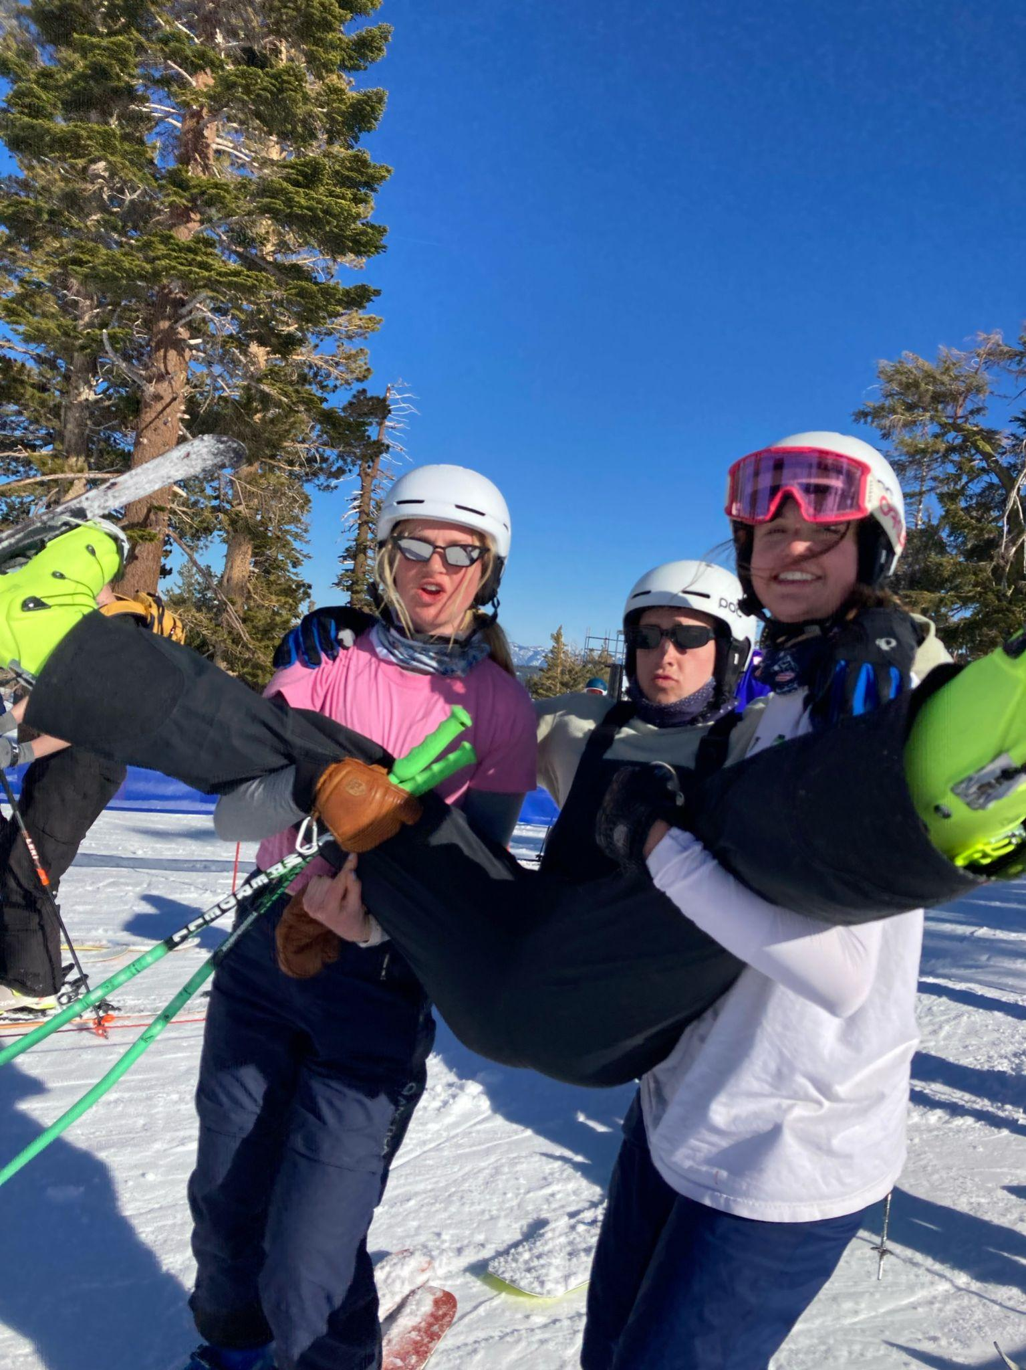
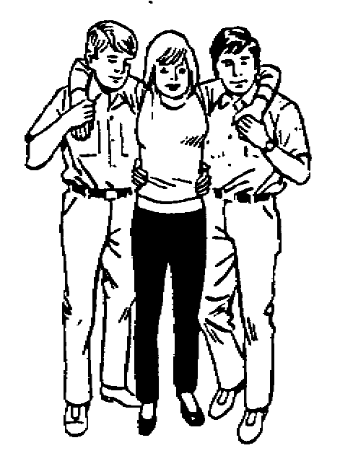
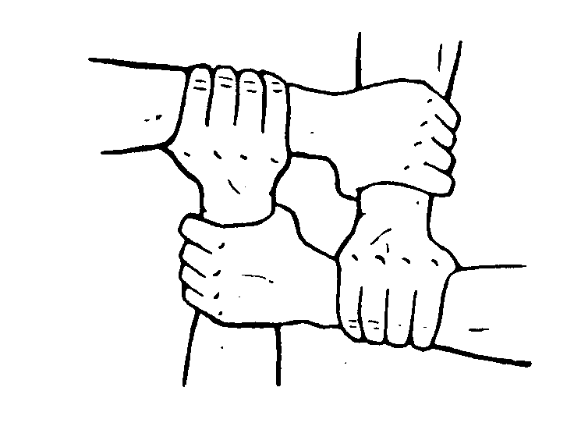
Non-urgent moves (non-drags)
Human Crutch
2 Person assist
Chair Carry
Fore and Aft Carry

Slide 11
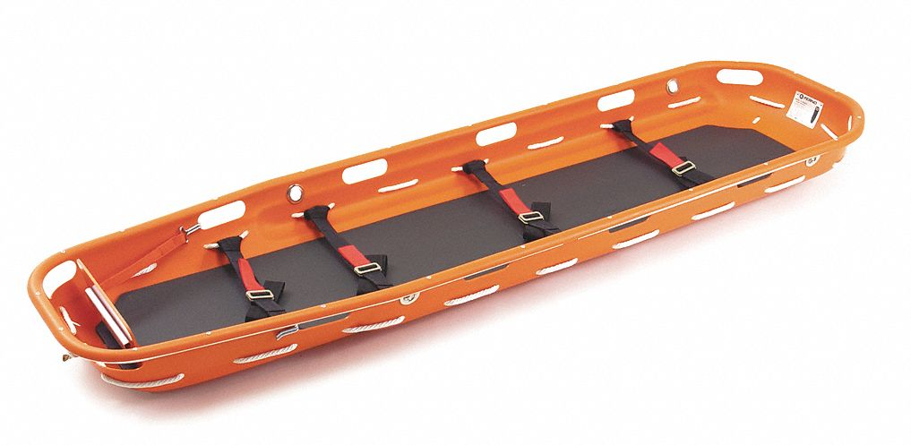
Devices and Equipment
Transfer Flat
Long spine board
Orthopedic stretcher
Portable stretcher
Basket stretcher
Short spine board
Sitting lifting device
Vacuum splint (this one is the best one)

Slide 12
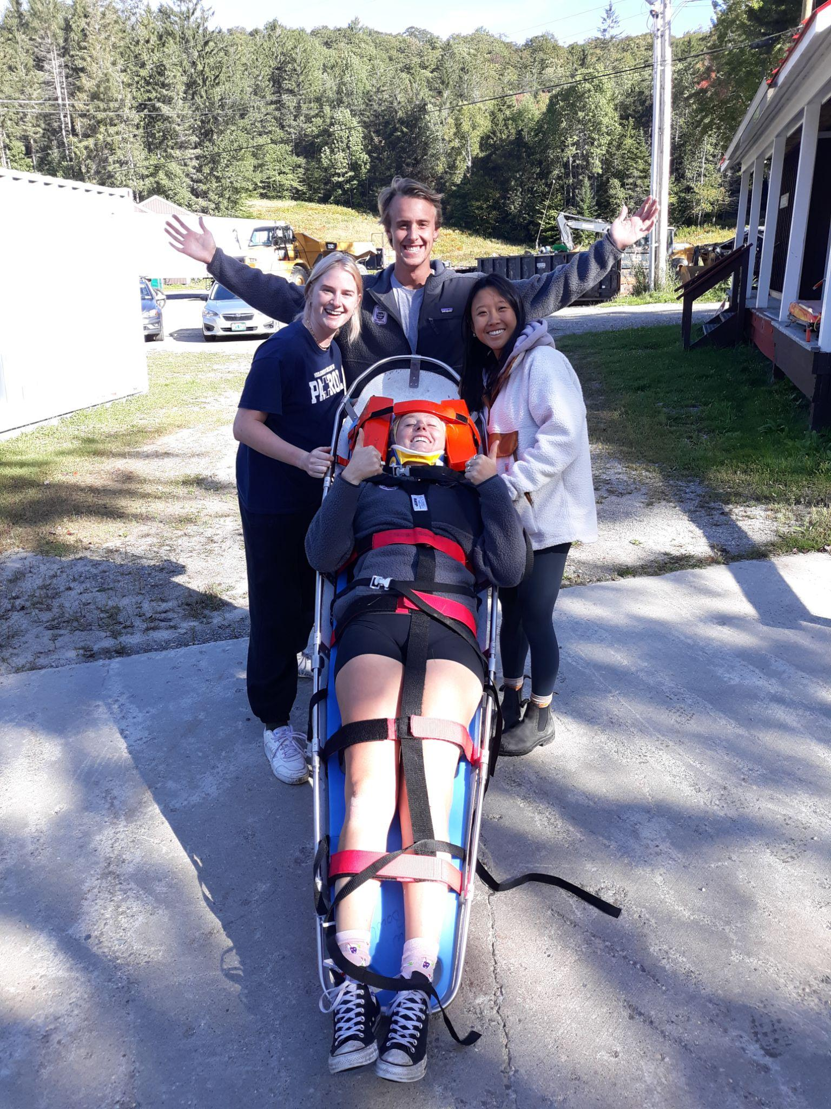
Packaging a Patient
Patient is properly positioned in transport device
Patient is securely fastened into the device
All necessary medical equipment is transported with the patient
Usually transport with injury uphill
Exceptions:
Patient is having trouble breathing (head uphill)
Patient is in shock (head downhill)
Patient with serious head injury (head uphill)
Final Transport
Ground or air transport

Slide 13
Helicopter Safety
Landing zone (LZ) selection:
100ft x 100ft
Flat, no more than 8° slope
Control access by pedestrians
Never approach from rear or front
Approach from downhill side
***DHART (Dartmouth-Hitchcock Advanced Response Team)

Slide 14
Practice Q’s
A power grip is when you:
a grab someone’s shirt to perform an urgent move, getting the patient out of danger
place your hands, palms down, approx. 10 inches apart
place your hands, palms up, approx. 10 inches apart
bend your knees and squat, keeping your back straight and your shoulders over the spine

Slide 15
Another practice Q
2. What moves can be used when there is a suspected spinal injury and spinal motion restriction/protection is necessary?
extremity lift, direct ground lift, bridge lift
draw sheet/plastic slider/flat transfer lift, logroll, BEAN lift
draw sheet/plastic slider/flat transfer lift, bridge lift
draw sheet/plastic slider/flat transfer lift, logroll

