Slide 1

SOAP notes
Subjective: Contains all non-objective, qualitative information that the patient describes, including the chief complaint, the history of the present illness, and the past medical history.
Objective: Contains all observable, quantitative findings that you discover during the scene size-up and physical exam.
Assessment: Your general impression of what the medical problem is.
Plan: Includes all aspects of treatment that has been rendered to patient.
Notes:
SOAP notes - Used for written communication and as an overall recap of the scenario. This is usually taken care of after the patient has received adequate care. Why are SOAP notes important? When might they be used? ambulance → transfer of information

Slide 2
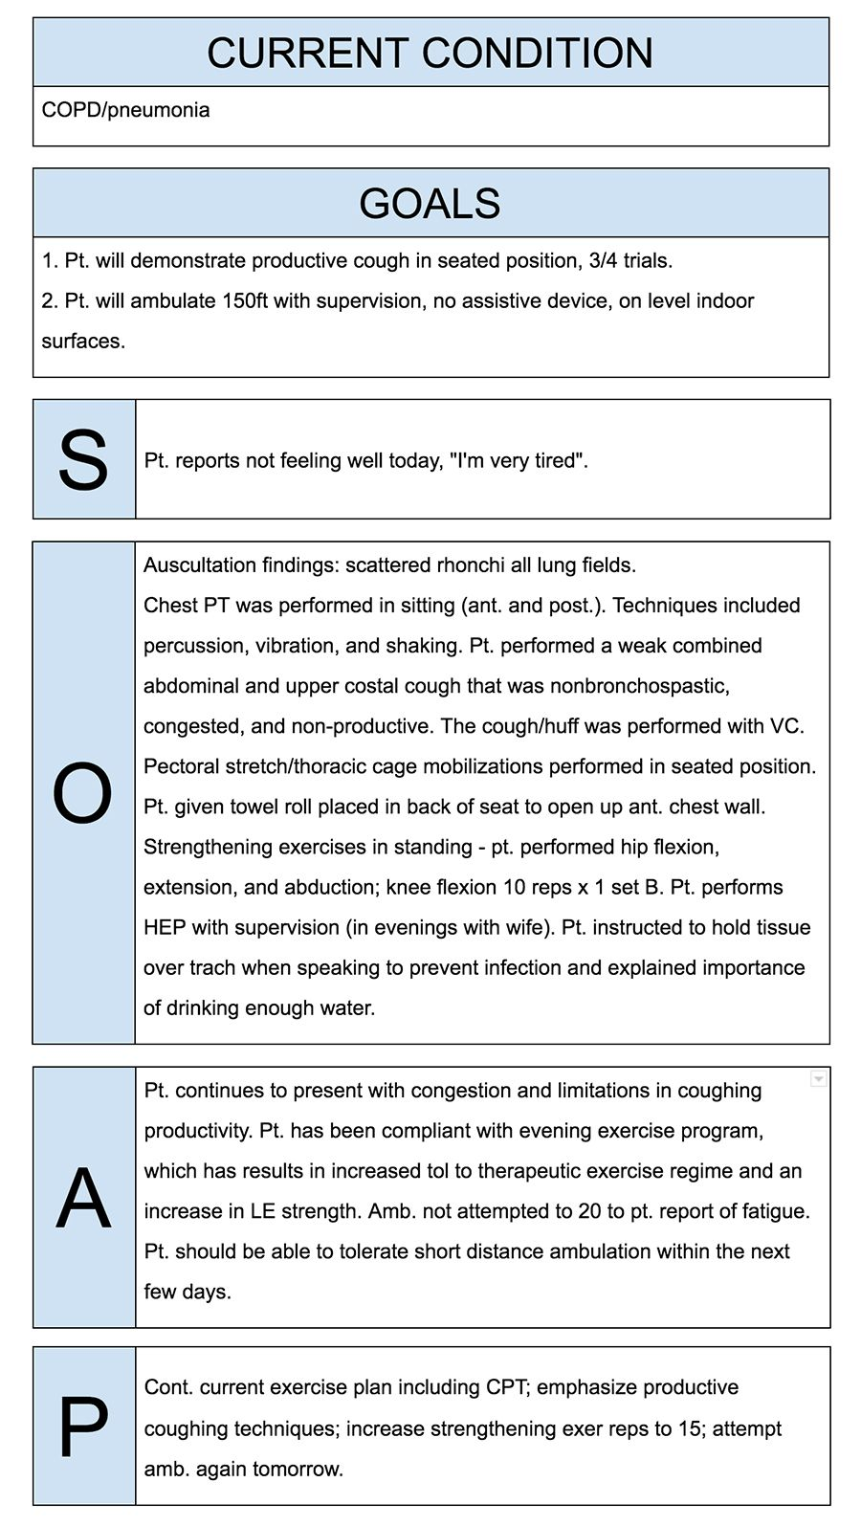

Slide 3

CHEATED
Chief complaint: The patient’s primary problem
History: SAMPLE history of the present illness and past medical history
Examination: Physical exam
Assessment: General impression of a patient
Treatment: All aspects of the treatment rendered
Evaluation: Changes in the patient’s condition over time, and how they responded to treatment
Disposition: Information indicating whether the patient refused treatment, was treated and release of was taken to a higher level of care such as a hospital
Notes:
This is a good way to remember the main things you will need to record the incident after treatment has been given. We have our own system of this at the bowl

Slide 4
SAMPLE
We will be using this on the practical today
Signs and Symptoms
Allergies
Medications
Past medical history
Last ins and outs
Events leading up to the incident

Slide 5
Mandated Reporter
An individual who is required to report to the appropriate authorities certain types of injuries or the suspicion of specific crimes
Abuse
Assault
Domestic violence
Gunshot wounds
Stab wounds
Animal bites
Communicable diseases
Any incident resulting in death

Slide 6
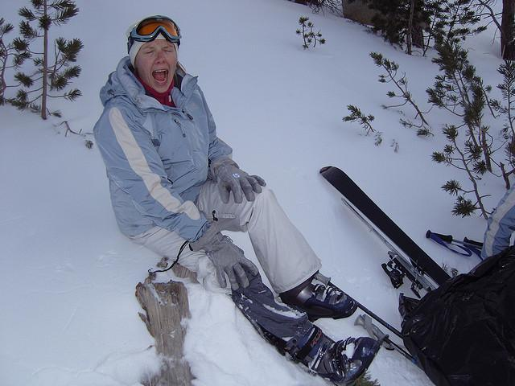


Who wants to try making a SAILER call?
Notes:
Ask someone to make a sailer call

