Slide 1
Chapter 5: Moving, Lifting, and Transporting Patients
By Trevor Hopkins and Sam Scatchard

Slide 2
Important Objectives
Define body mechanics
Introduce proper patient positioning during transport
Describe and demonstrate a power lift
Describe guidelines for safely moving a patient
Describe methods of moving patients (urgent vs. non-urgent moves)

Slide 3
Semi-Fowler Position
Used for: Patients who are conscious with no serious injury

Slide 4
High-Fowler Position
Used for: Patients with severe breathing problems

Slide 5
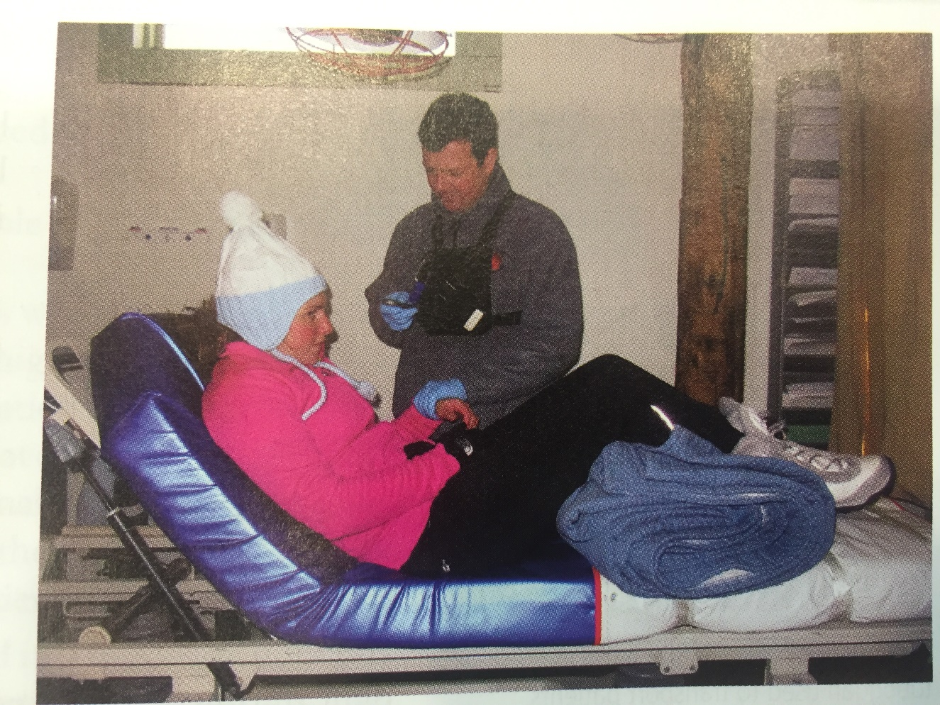
Rothberg Position
Upper body at 45° and legs raised with flexion at knees and hip
Used for: Patients with chest pain or heart attack

Slide 6
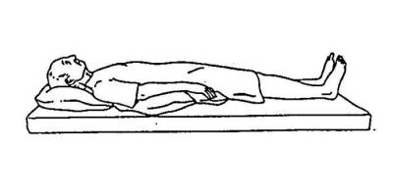
Supine Position
Used for: Patients who have suspected spinal injury

Slide 7
Trendelenberg Position
Used for: Patients in shock

Slide 8
Moving a Patient
Urgent Move: Hazard is present or patient position prevents urgent care
Usually moved less than 100 feet
Usually a drag (Shoulder drag, Under-arm wrist drag, blanket-drag, feet drag)
Non-Urgent Move: Patient is moved in a controlled fashion
Human Crutch
Two-Person assist
Chair-carry
Fore and aft carry
Back carries
Improvised carries

Slide 9
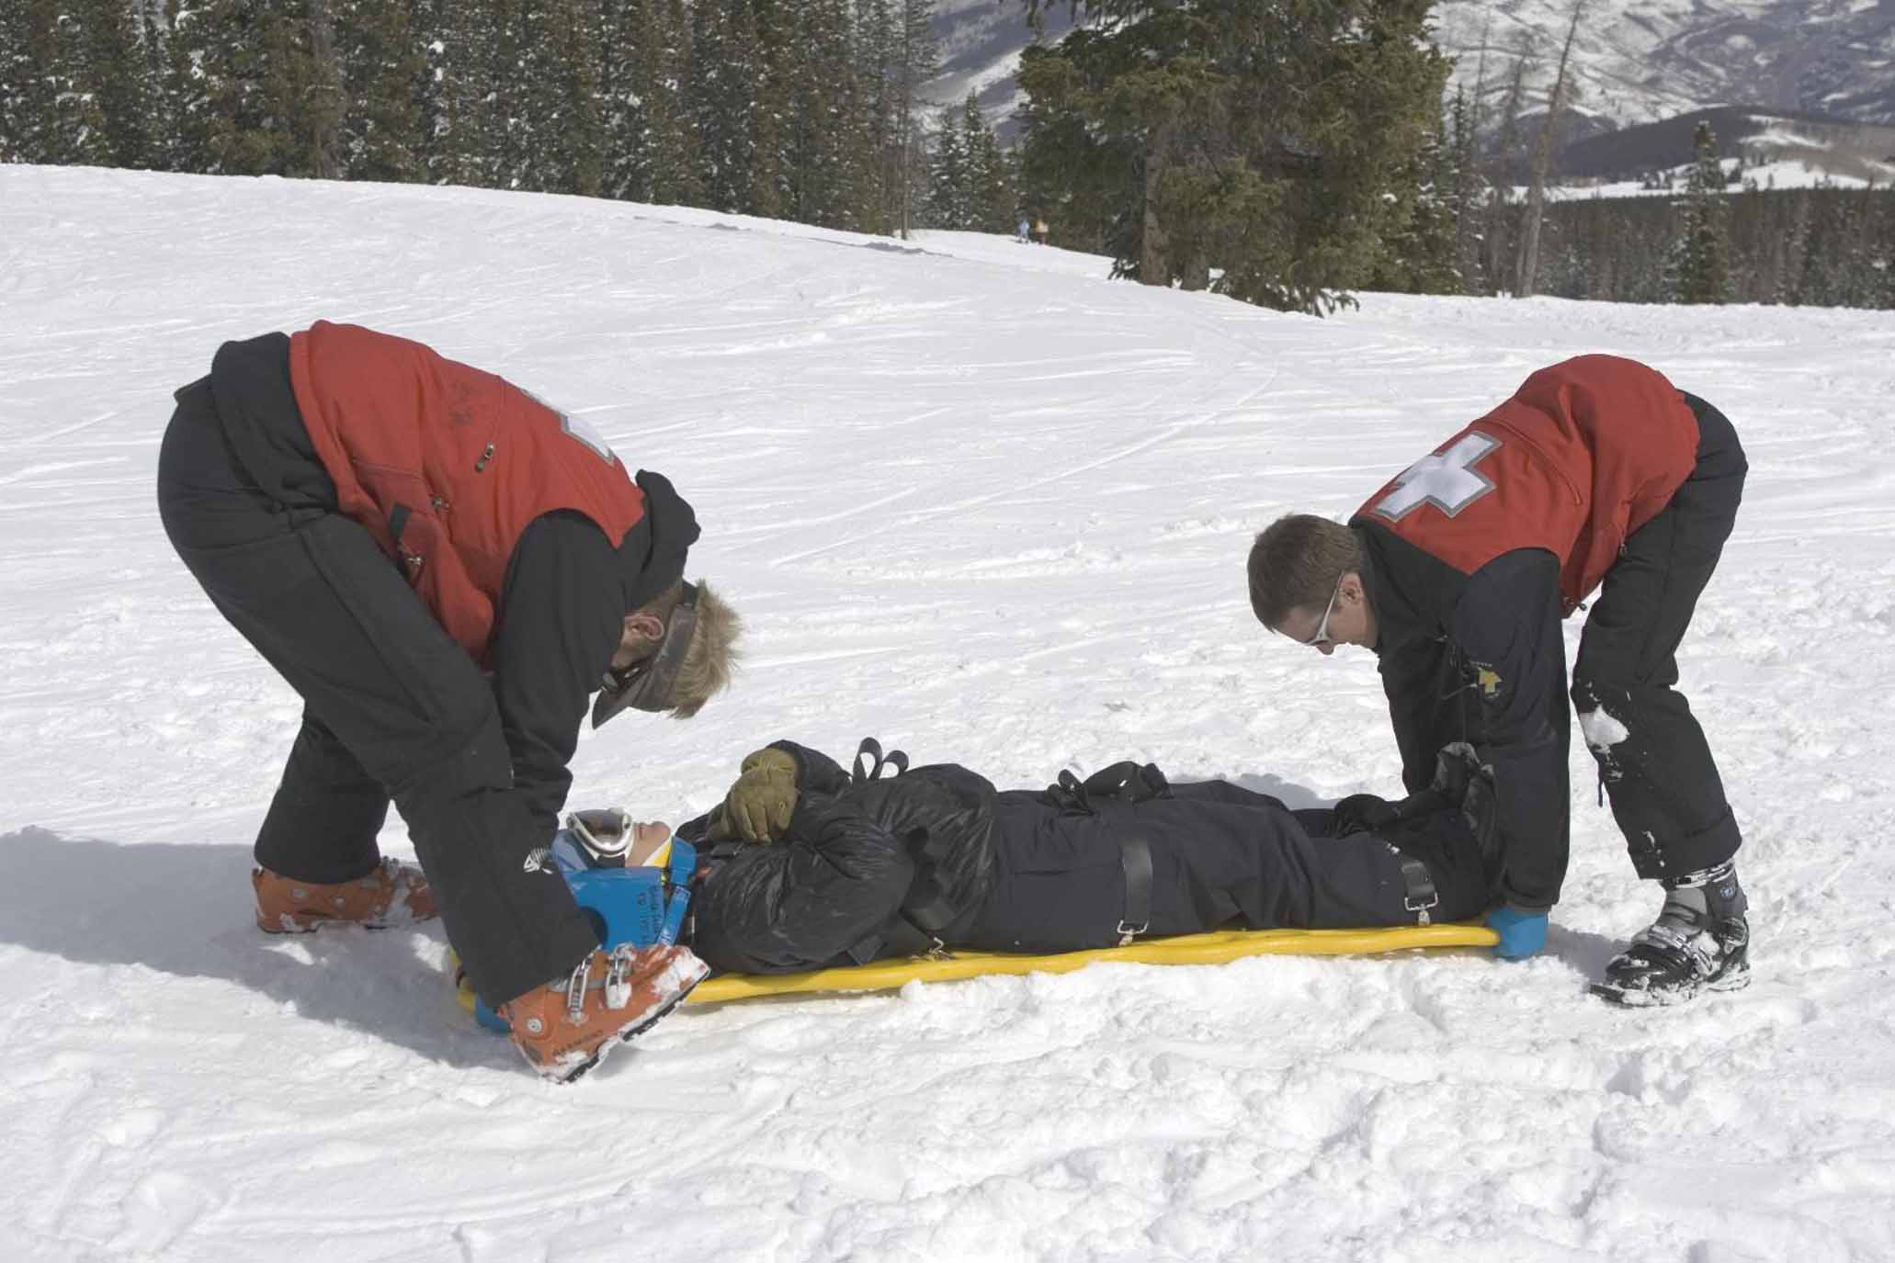
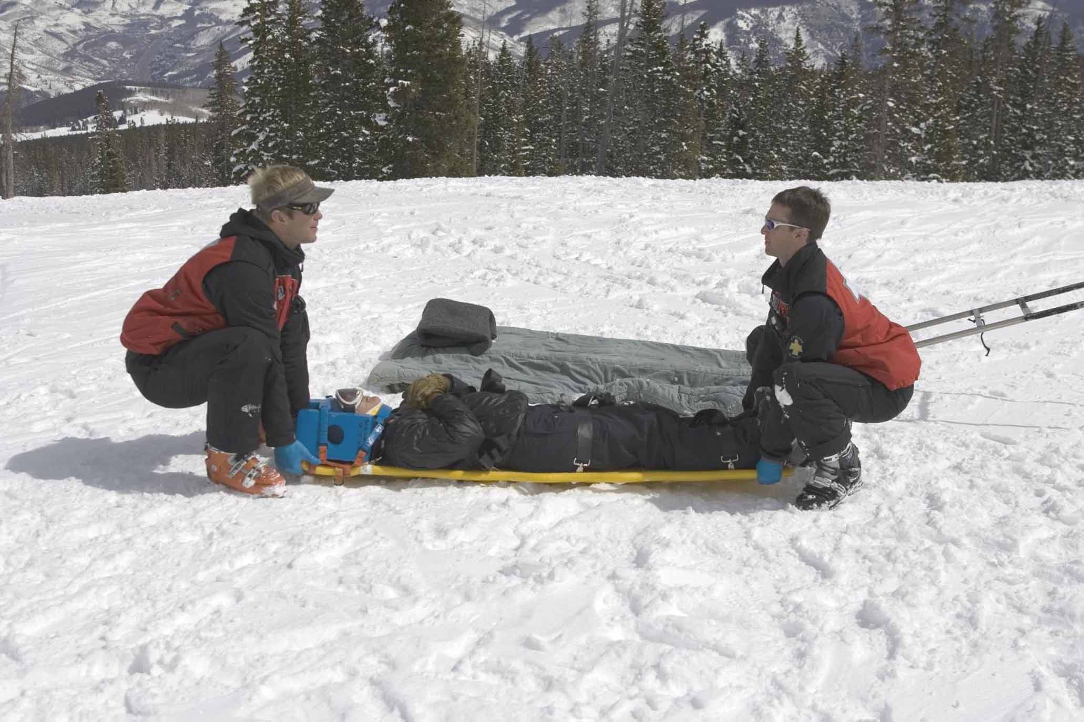
Body Mechanics
Use a power grip
Keep back straight
Lift with legs with knees bent
Keep shoulders centered over spine
In which scenario are the patrollers demonstrating proper body mechanics?

Slide 11
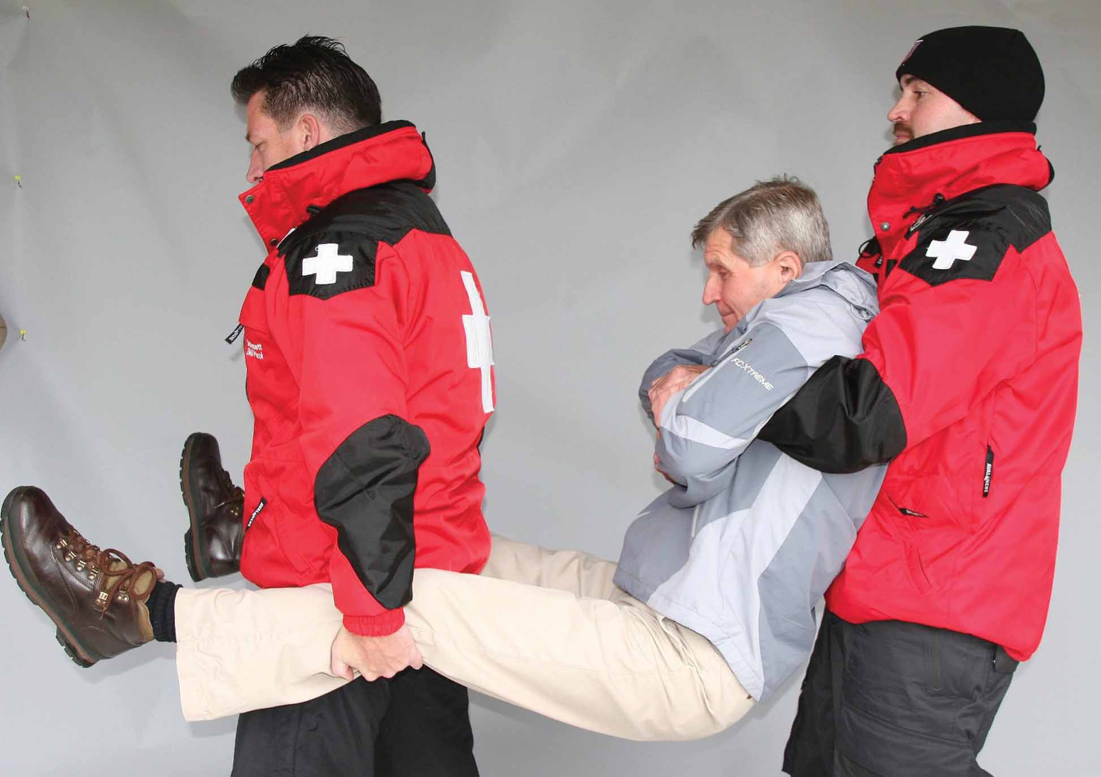
Types of Lifts
Extremity Lift:

Slide 12
Types of Lifts
Direct-ground Lift:

Slide 13
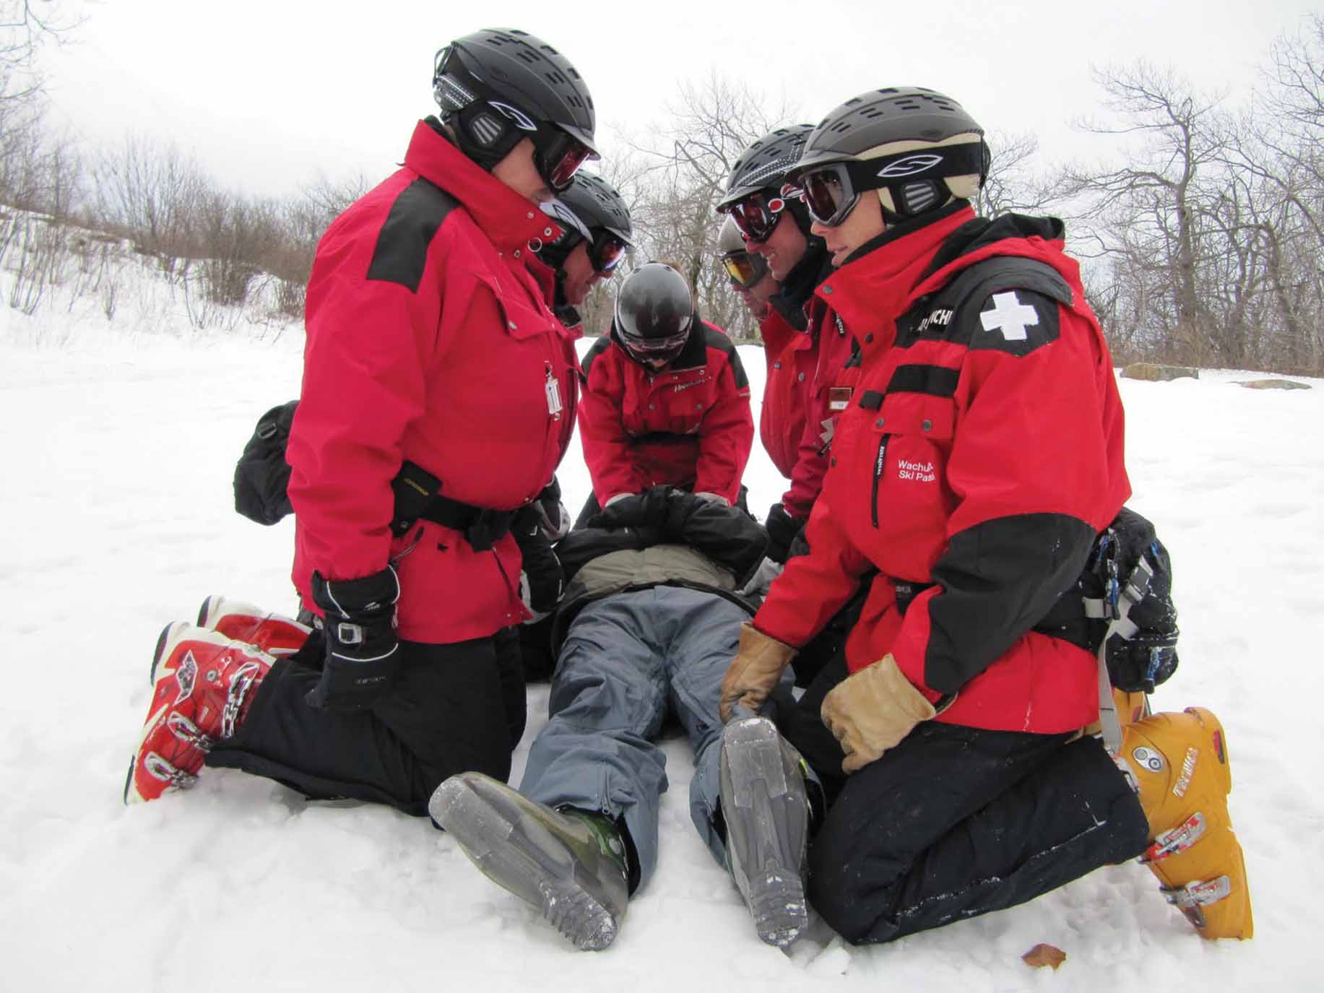
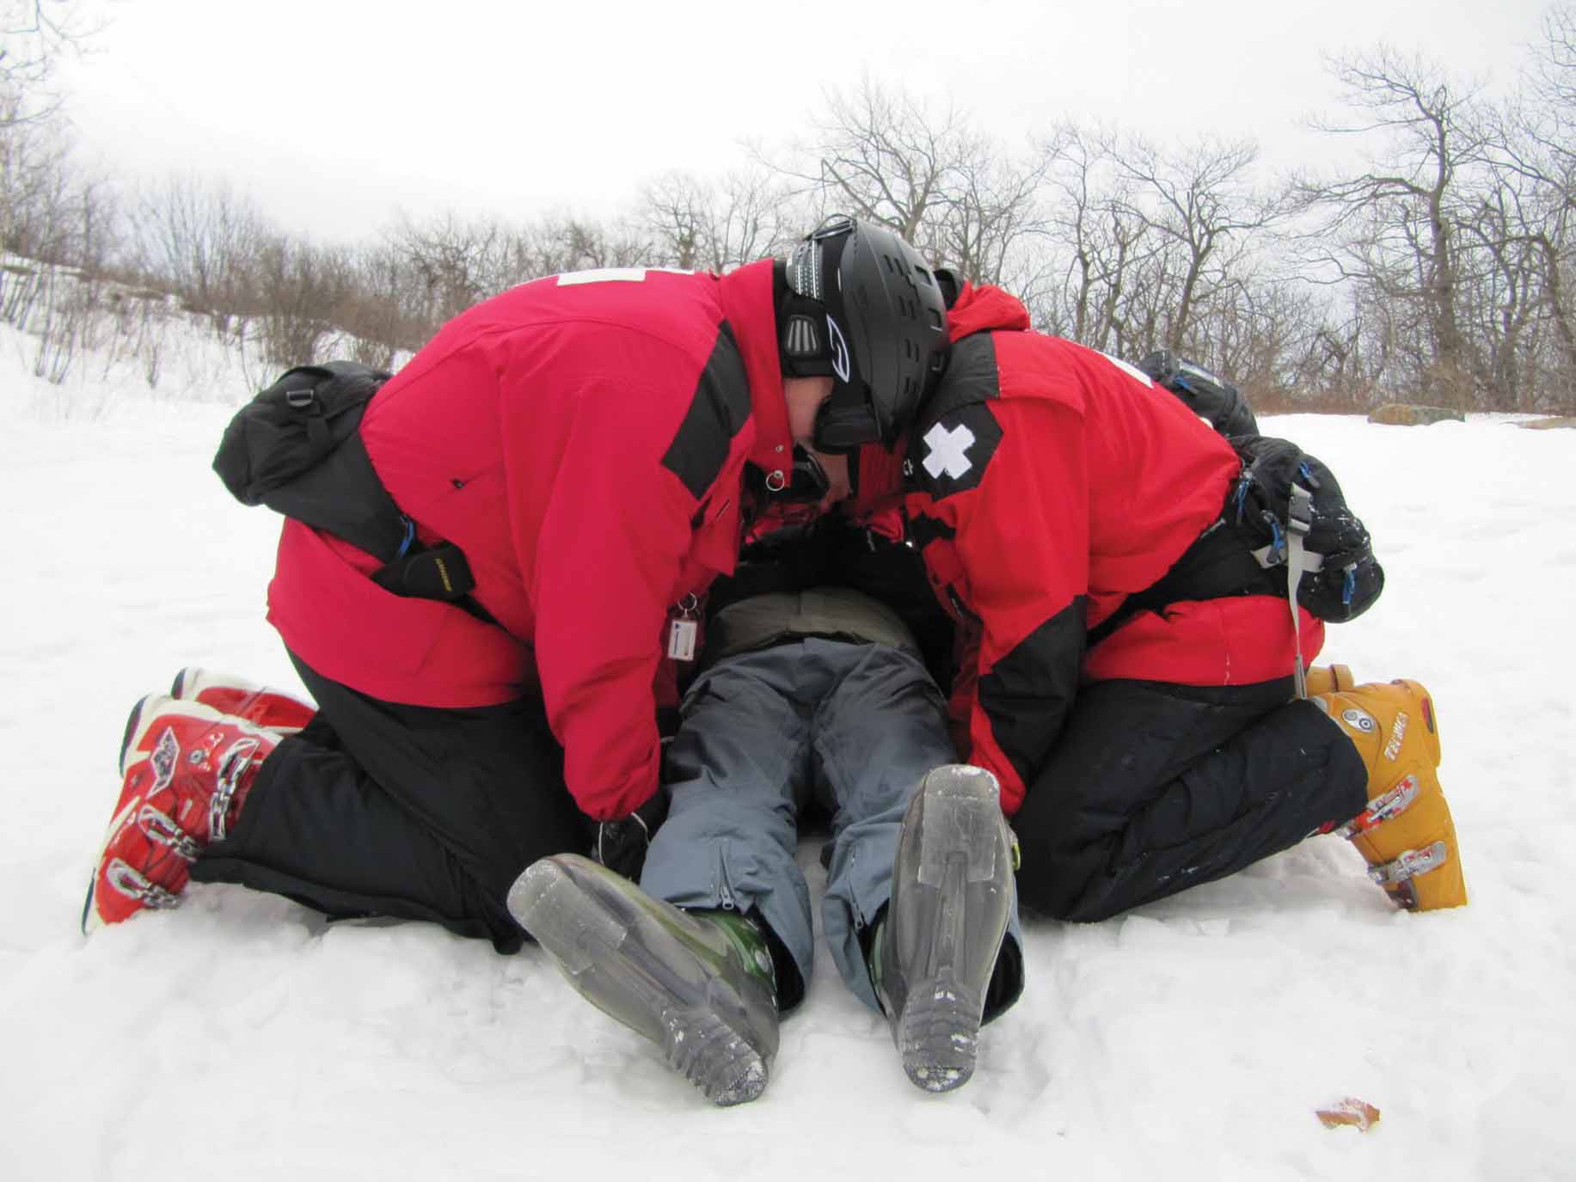
Types of Lifts
BEAN/BEAM Lift:

Slide 14
Types of Lifts
Draw-Sheet Lift:
Position a sheet underneath the patient
Lift the patient using the sheet

Slide 15
Packaging a Patient
Patient is properly positioned in transport device
Patient is securely fastened into the device
All necessary medical equipment is transported with the patient
Usually transport with injury uphill
Exceptions:
Patient is having trouble breathing (head uphill)
Patient is in shock (head downhill)
Patient with serious head injury (head uphill)

Slide 16
Devices and Equipment
Transfer Flat
Long spine board
Orthopedic stretcher
Portable stretcher
Basket stretcher
Short spine board
Sitting lifting device

Slide 17
Helicopter Safety
Landing zone (LZ) selection:
100ft x 100ft
Flat, no more than 8° slope
Control access by pedestrians
Never approach from rear or front
Approach from downhill side
***DHART (Dartmouth-Hitchcock Advanced Response Team)

