Slide 1

Walking
  Ask those who can walk to move to a specific location and reassess later (minimal/green)
Respirations
  No respirations? (Expectant/Black)
  Greater than 30/min (Immediate/Red)
  Less than 30/min →#3
Pulse
  Cap Refill Greater than 2 seconds (Immediate/Red)
  Warm skin, cap refill less than two seconds → #4
Mental Status
  Unresponsive? Can they follow simple commands?
    If no (Immediate/Red)
    If yes (Delayed/Yellow)

Slide 2
30-2 Can Do
Walking…
Heart Rate: 30 bpm
Cap Refill: 2 Seconds
Mental Status: “Can do”
Notes:
RPM- respiration, perfusion, mental status

Slide 3
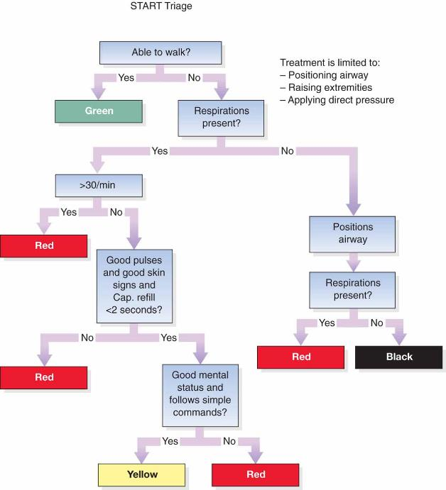

Slide 4
Examples
MCI quiz!
Notes:
https://www.ems1.com/mass-casualty-incidents-mci/articles/160756048-Quiz-How-accurately-can-you-triage-10-MCI-patients/

Slide 5
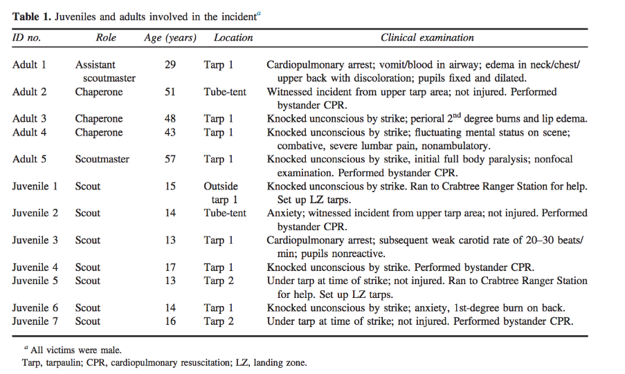
Case Study

Slide 6
