Slide 1

Triage
Triage is the process of prioritizing patients for treatment and transportation based on their clinical signs and symptoms
Triage is performed during a Multiple Casualty Incident (MCI)
“Do the most good for the most people.”
Notes:
Prioritize patients for treatment according to severity and likelihood to survive (Primary triage)
Provide minimal care (open the airway, control life-threatening bleeding)
Move patients to the treatment area
Identify, collect, and sort patients
“make sure that the scene is safe, so you do not create more casualties

Slide 2
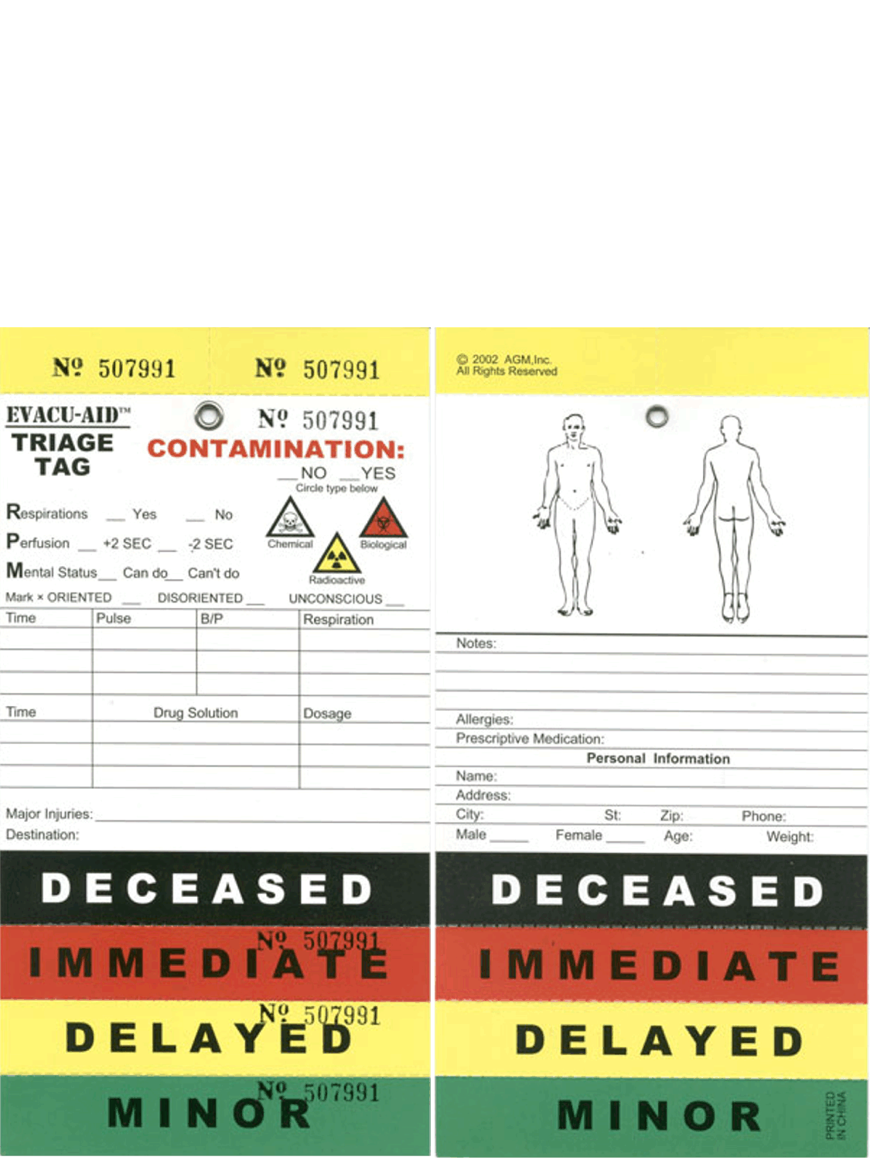
ID-ME
Notes:
Immediate Delayed Minimal Expectant
-triage system that separate people based off injury severity

Slide 3
Immediate- RED
Vital signs and injuries so severe that the patient will die unless they receive medical treatment within two hours
  A head injury with AMS
  Severe Respiratory distress
  Tension pneumothorax
  Extensive 2nd or 3rd degree burns
  Uncontrolled bleeding
  Decompensated shock
  Extensive thoracic, abdominal, or pelvic injuries
  Amputation above elbow or knee

Slide 4
Delayed- YELLOW
Needs medical attention but will not rapidly deteriorate if treatment is delayed up to 4 hours
  Moderate shortness of breath
  Compensated shock
  Moderate to severe bleeding that is controlled
  Penetrating injury without compromised airway
  Open fractures
  Uncomplicated cervical spine injury
  Severe abdominal pain with stable vital signs
  Unable to walk
Notes:
Uncomplicated c-spine = not presenting neurological symptoms

Slide 5
Minimal- GREEN
Could potentially go untreated for days
  Mild respiratory distress
  Closed fractures or dislocation with accompanying shock
  Minor to moderate bleeding
  Burns involving less than 20% of the body and not involving the head, face, or joints
  Isolated penetrating injury
  Frostbite
  Strains and sprains
  Minor head injury

Slide 6
Expectant- BLACK
Already dead or expected to die
  Cardiac Arrest
  Severe head or brain injury
  2nd or 3rd degree burn involving more than 70% of the body (recall rule of nines)
  Irreversible Shock
  Gunshot wound to the head

Slide 7
START Triage
Simple
Triage
And
Rapid
Transport
Notes:
Separate seriously injured patients from non seriously injured patient
30-2-can do

