Slide 1

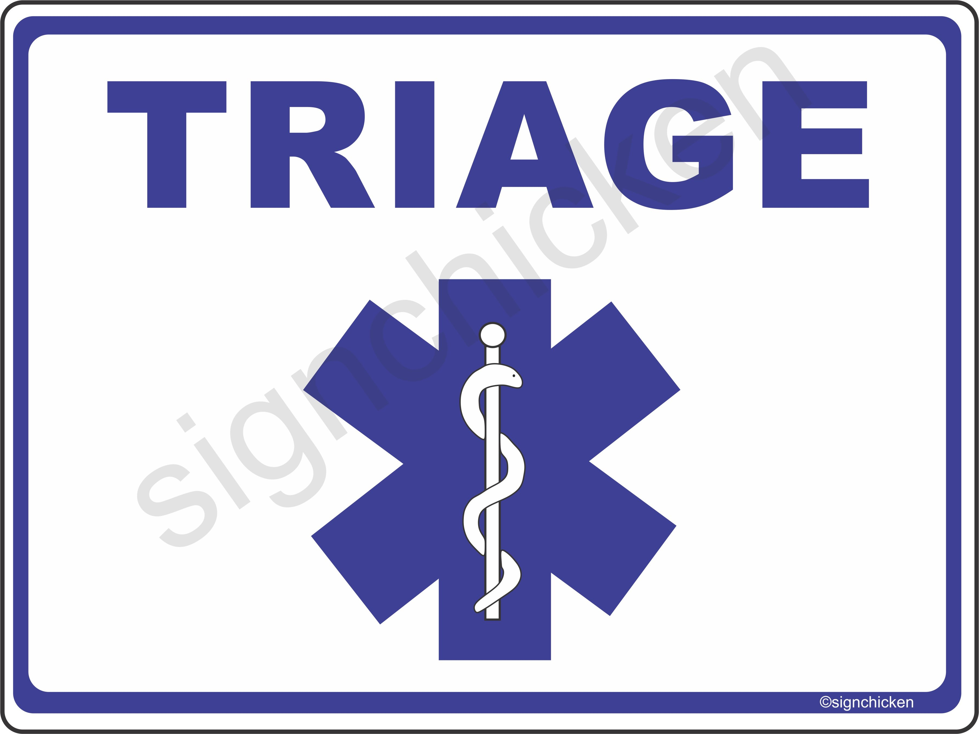
Incident Command and Triage

Slide 2
Objectives
Describe Incident Command System
Describe primary responsibilities of five functional areas of the incident command system
Describe and demonstrate how to use ID-ME system
Describe and demonstrate how to use the START system of triage

Slide 3
    National Incident Management System: Created by a 2003 federal mandate to create :
      “a consistent nationwide approach for federal, state, tribal, and local governments to work effectively and efficiently together to prepare for, prevent, respond to, and recover from domestic incidents, regardless of cause, size, or complexity”
    Incident: Anything out of the ordinary from day-to-day activities that necessitates a response
Incident Command System (ICS): A formal, organized method for managing an incident, regardless of its cause, size, scope, or complexity.
Notes:
-Created in a response to 9/11 terrorist attacks
-Let recuers from different agencies respond in a coordinated fashion after an incident
-sets up a heirarchy of response and standardization of roles

Slide 4
Five Functional Areas of the ICS
Incident Command
Operations Section
Planning Section
Logistics Section
Finance/Administration Section
Notes:
-all rescue organizations in the US have to adhere to
-method for managing an incident, regardless of its cause, size, scope, or complexity

Slide 5
Incident Command
Managed by the Incident Commander
  Provides overall leadership
  Typically the most senior person among the initial responders.
Primary tasks of Incident Commander
  Assume command of incident
  Establishes Command Post
  Provides overall management
  Determine incident objectives and strategies
  Determine and develop organizational structure
Notes:
Incident Command Staff
If needed, Incident Command can be expanded to include up to three additional positions that can assist the IC. These positions include:
Public Information Officer, who serves as the primary source for incident-related information and media relations.
Safety Officer, who is responsible for the health and safety of all incident workers and for assessing incident hazards.
Liaison Officer, who serves as the primary contact with all rescue organizations that are assisting on the incident. This includes coordinating efforts with local, state, and federal organizations and officials.

Slide 6
Operations
Headed by Operations Chief
Responsibilities include:
Participating in the planning process
Reducing immediate hazards
Saving lives and property
Establishing situational control
Restoring the scene to normalcy
Notes:
A strike team consists of resources of the same type (e.g., a group of Nordic Patrollers or river guides) and is managed by a strike team leader.
A task force is a combination of different resources (e.g., a sheriff’s deputy, an NSP alpine patrol, and a search & rescue team) with common communications and is managed by a task force leader.

Slide 7
Planning, Logistics, Finance
Make sure you’re prepared for an incident
  Determine resource needs
  Obtain resources and supplies
  Documentation and track costs
Notes:
So as OEC, we can either be assigned command chief or operations

