Slide 1
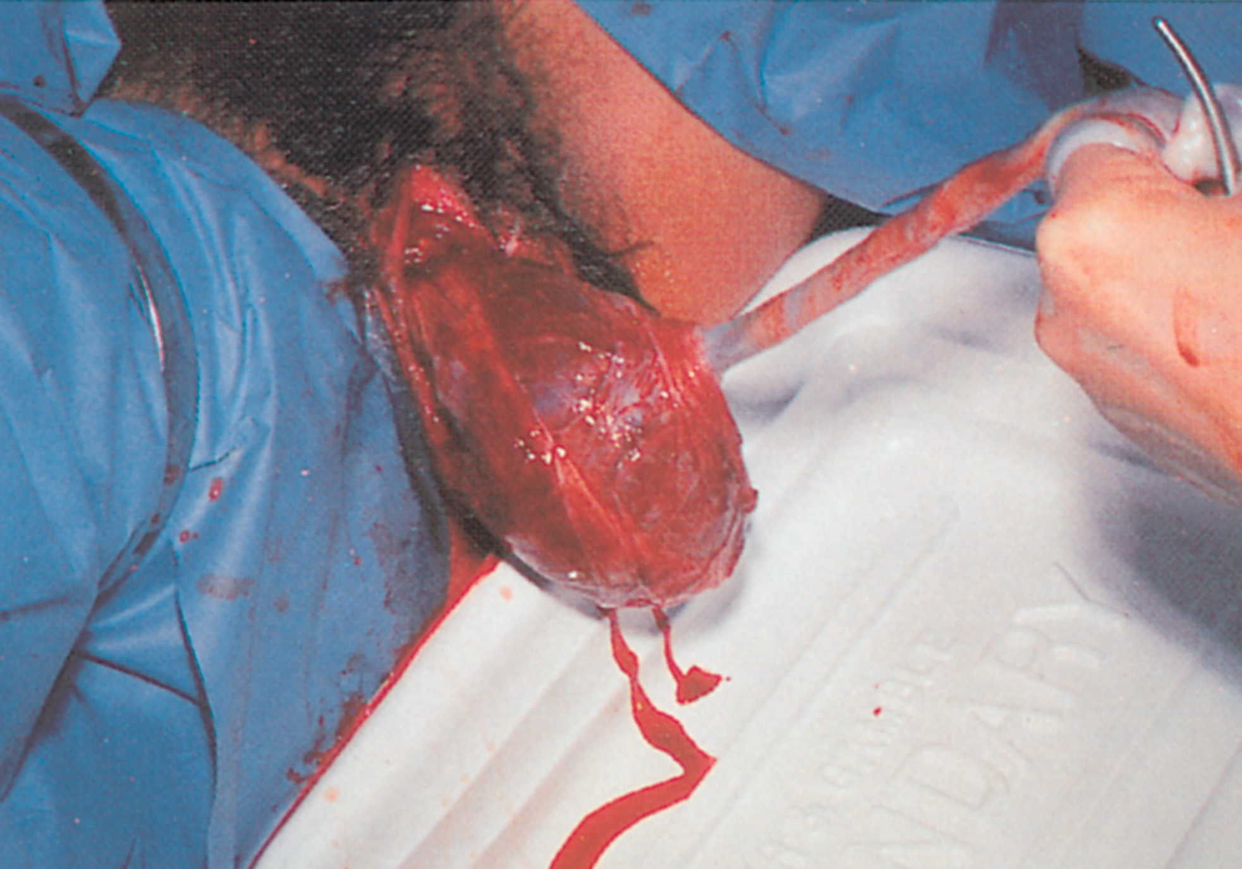
Pregnancy
continued

Slide 2

Pregnancy
Childbirth
  Should transport to an EMS
  3rd stage of labor- delivery of placenta
Care of the newborn (APGAR)
  Appearance
  Pulse
  Grimace or irritability
  Activity or muscle tone
  Respirations
continued
Notes:
Discussion Points:
What is the purpose of the APGAR score?
Ask students about a newborn’s pulse rate.

Slide 3
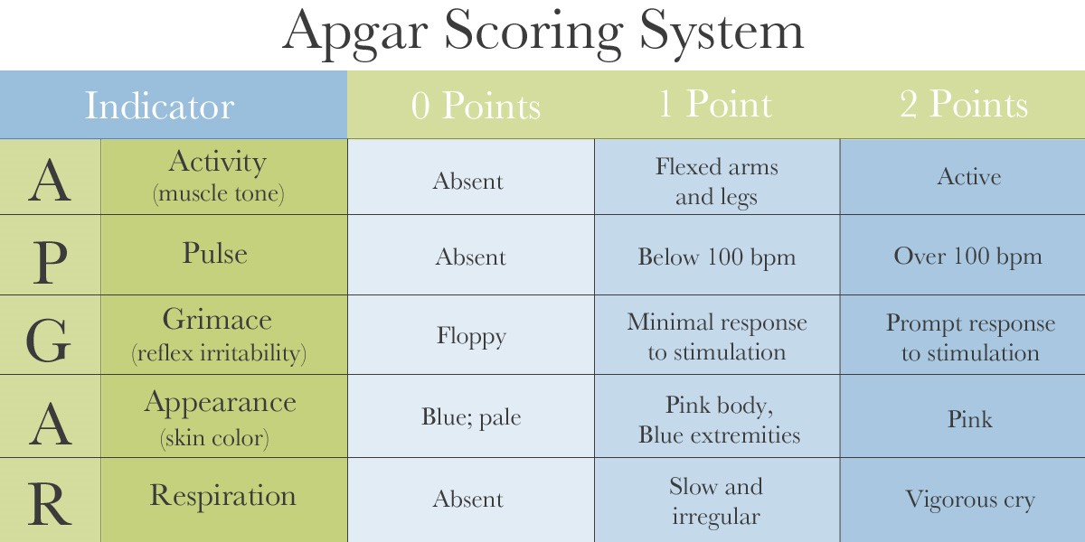
APGAR Scale

Slide 4
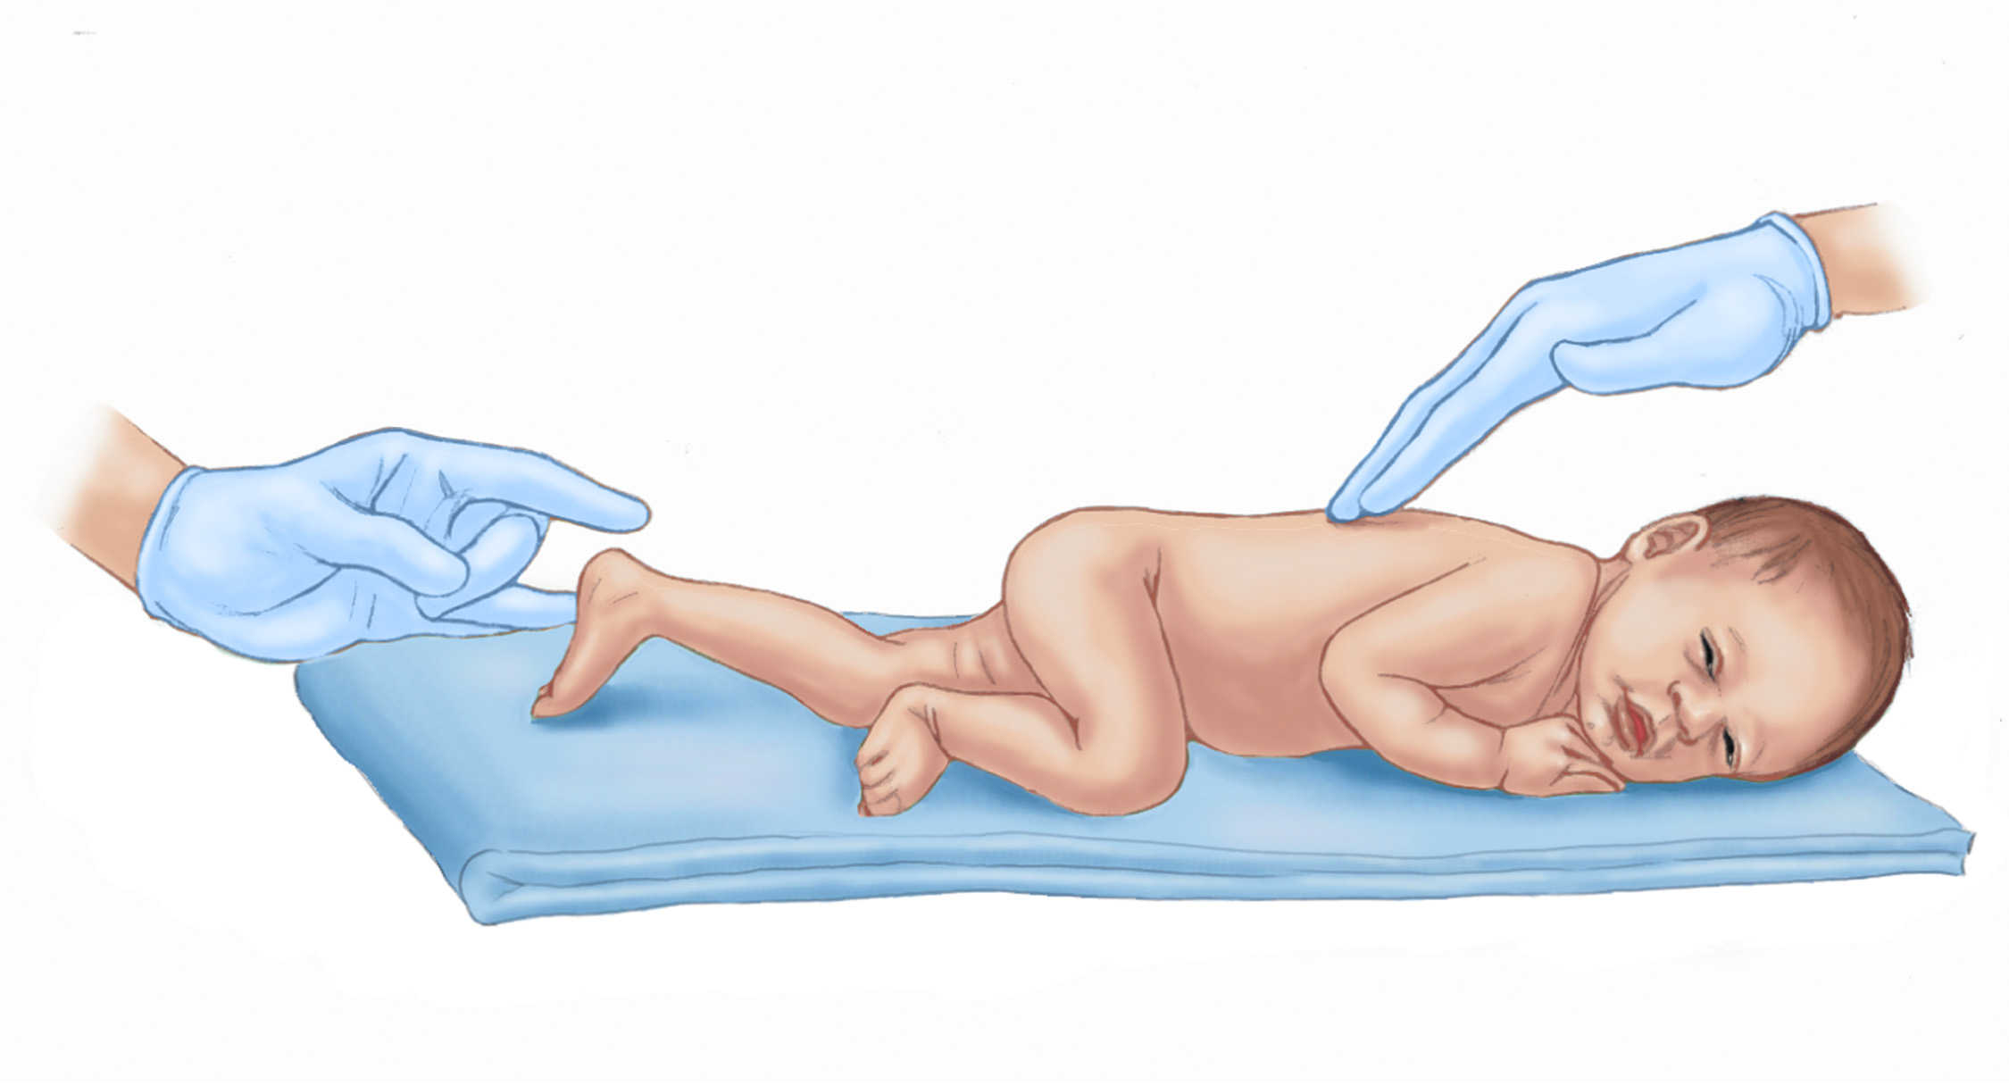
Pregnancy
continued

Slide 5
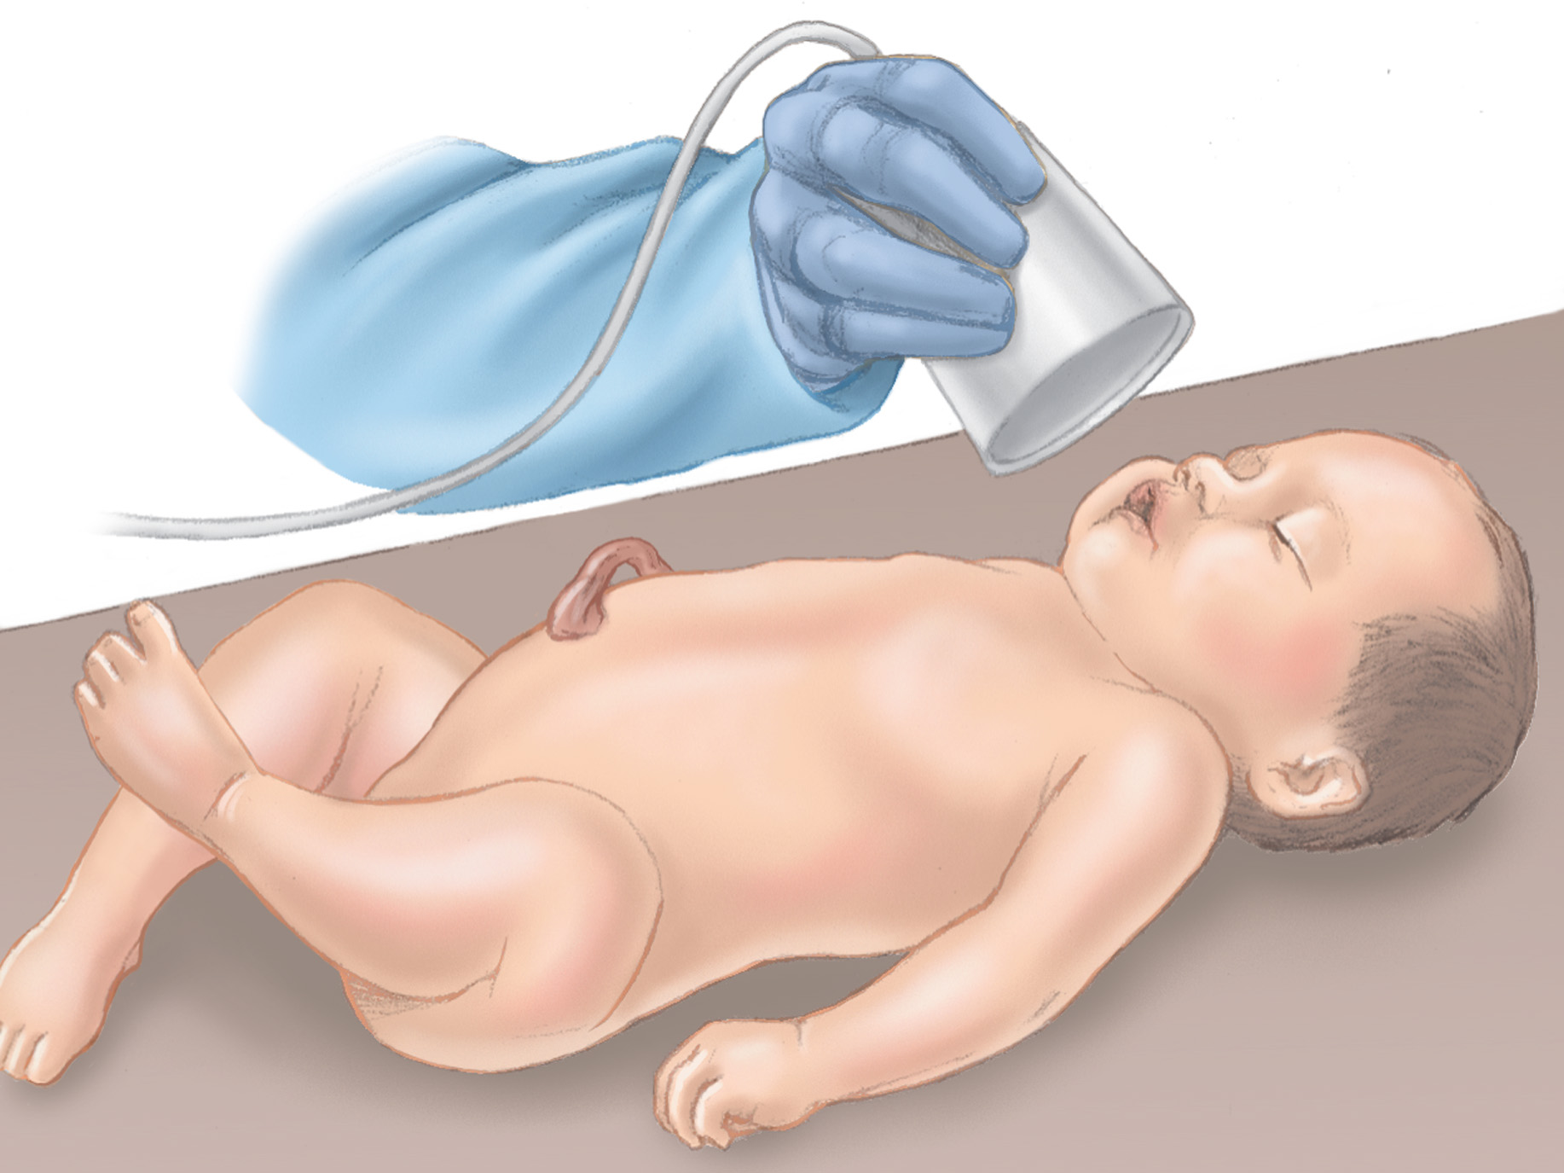
Pregnancy
continued

Slide 6
Pregnancy
Trauma with pregnancy
  Ruptured uterus
  Abruptio placenta and premature labor
  Rupture of membranes
continued
Notes:
Discussion Point:
What symptoms would you have in a patient with possible trauma who is pregnant?

Slide 7
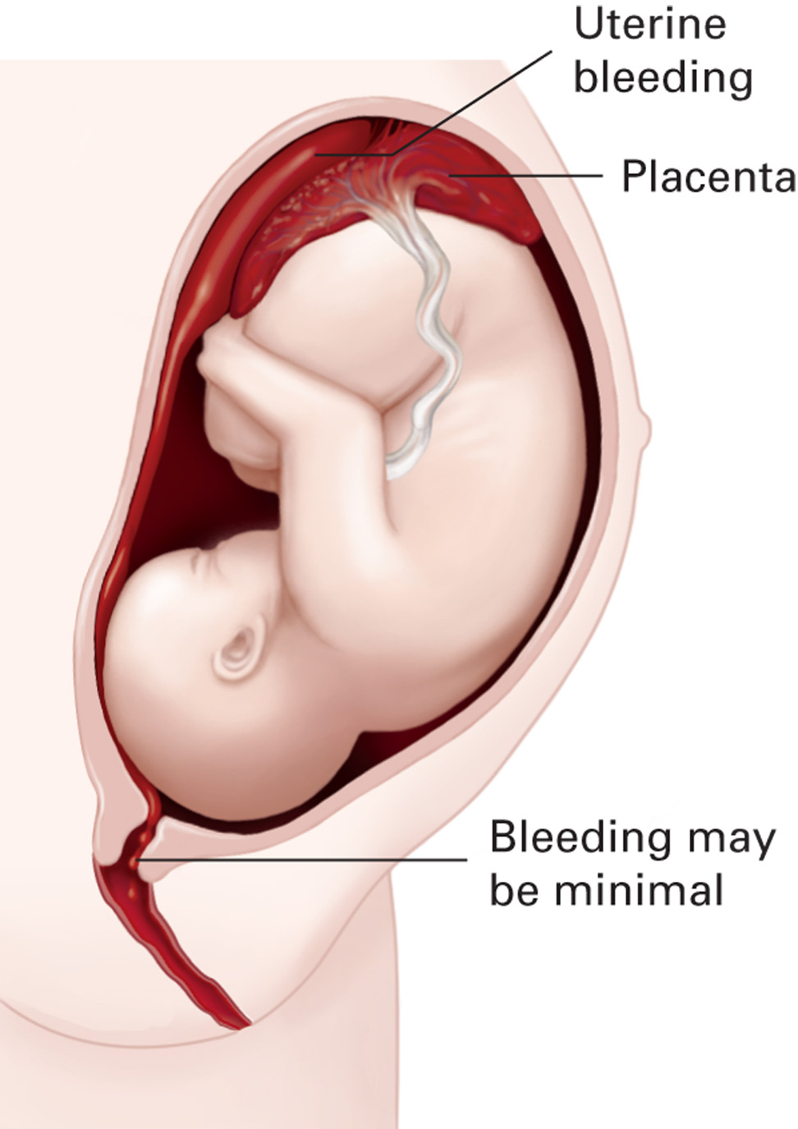
Pregnancy
continued

Slide 8
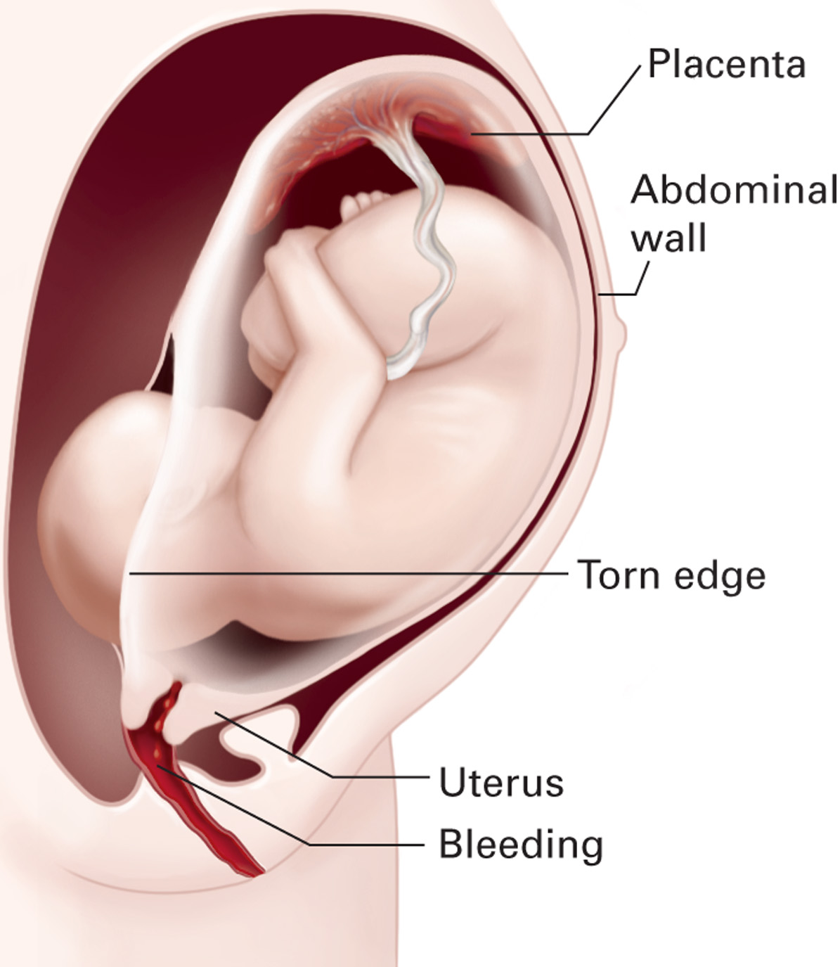
Pregnancy

Slide 9
Case Update
Recognizing that this 34-week pregnant woman has sustained blunt abdominal trauma, you assess the patient looking for additional trauma. You note that the patient’s abdomen is diffusely tender. The uterus rises to about 5 finger breaths above the umbilicus and is very firm to touch. You assist in positioning the patient onto her left side and obtain vital signs. The blood pressure is 90/60; pulse 110 and respirations are 20 and shallow.
Notes:
Discussion Points:
What are the potential consequences of blunt abdominal trauma during pregnancy?
What should you do next?
9

Slide 10
Assessment
ABCD’s
SAMPLE
OPQRST
continued

Slide 11
Assessment
If abdominal pain is present in a pregnant woman
  Determine the quality
  Location
  Timing
  If back pain is present
  Privacy
continued
Notes:
Discussion Points:
What questions would you ask if:
If the complaint is related to vaginal bleeding?
If the complaint is related to abdominal pain?
If the patient is known to be pregnant?

Slide 12
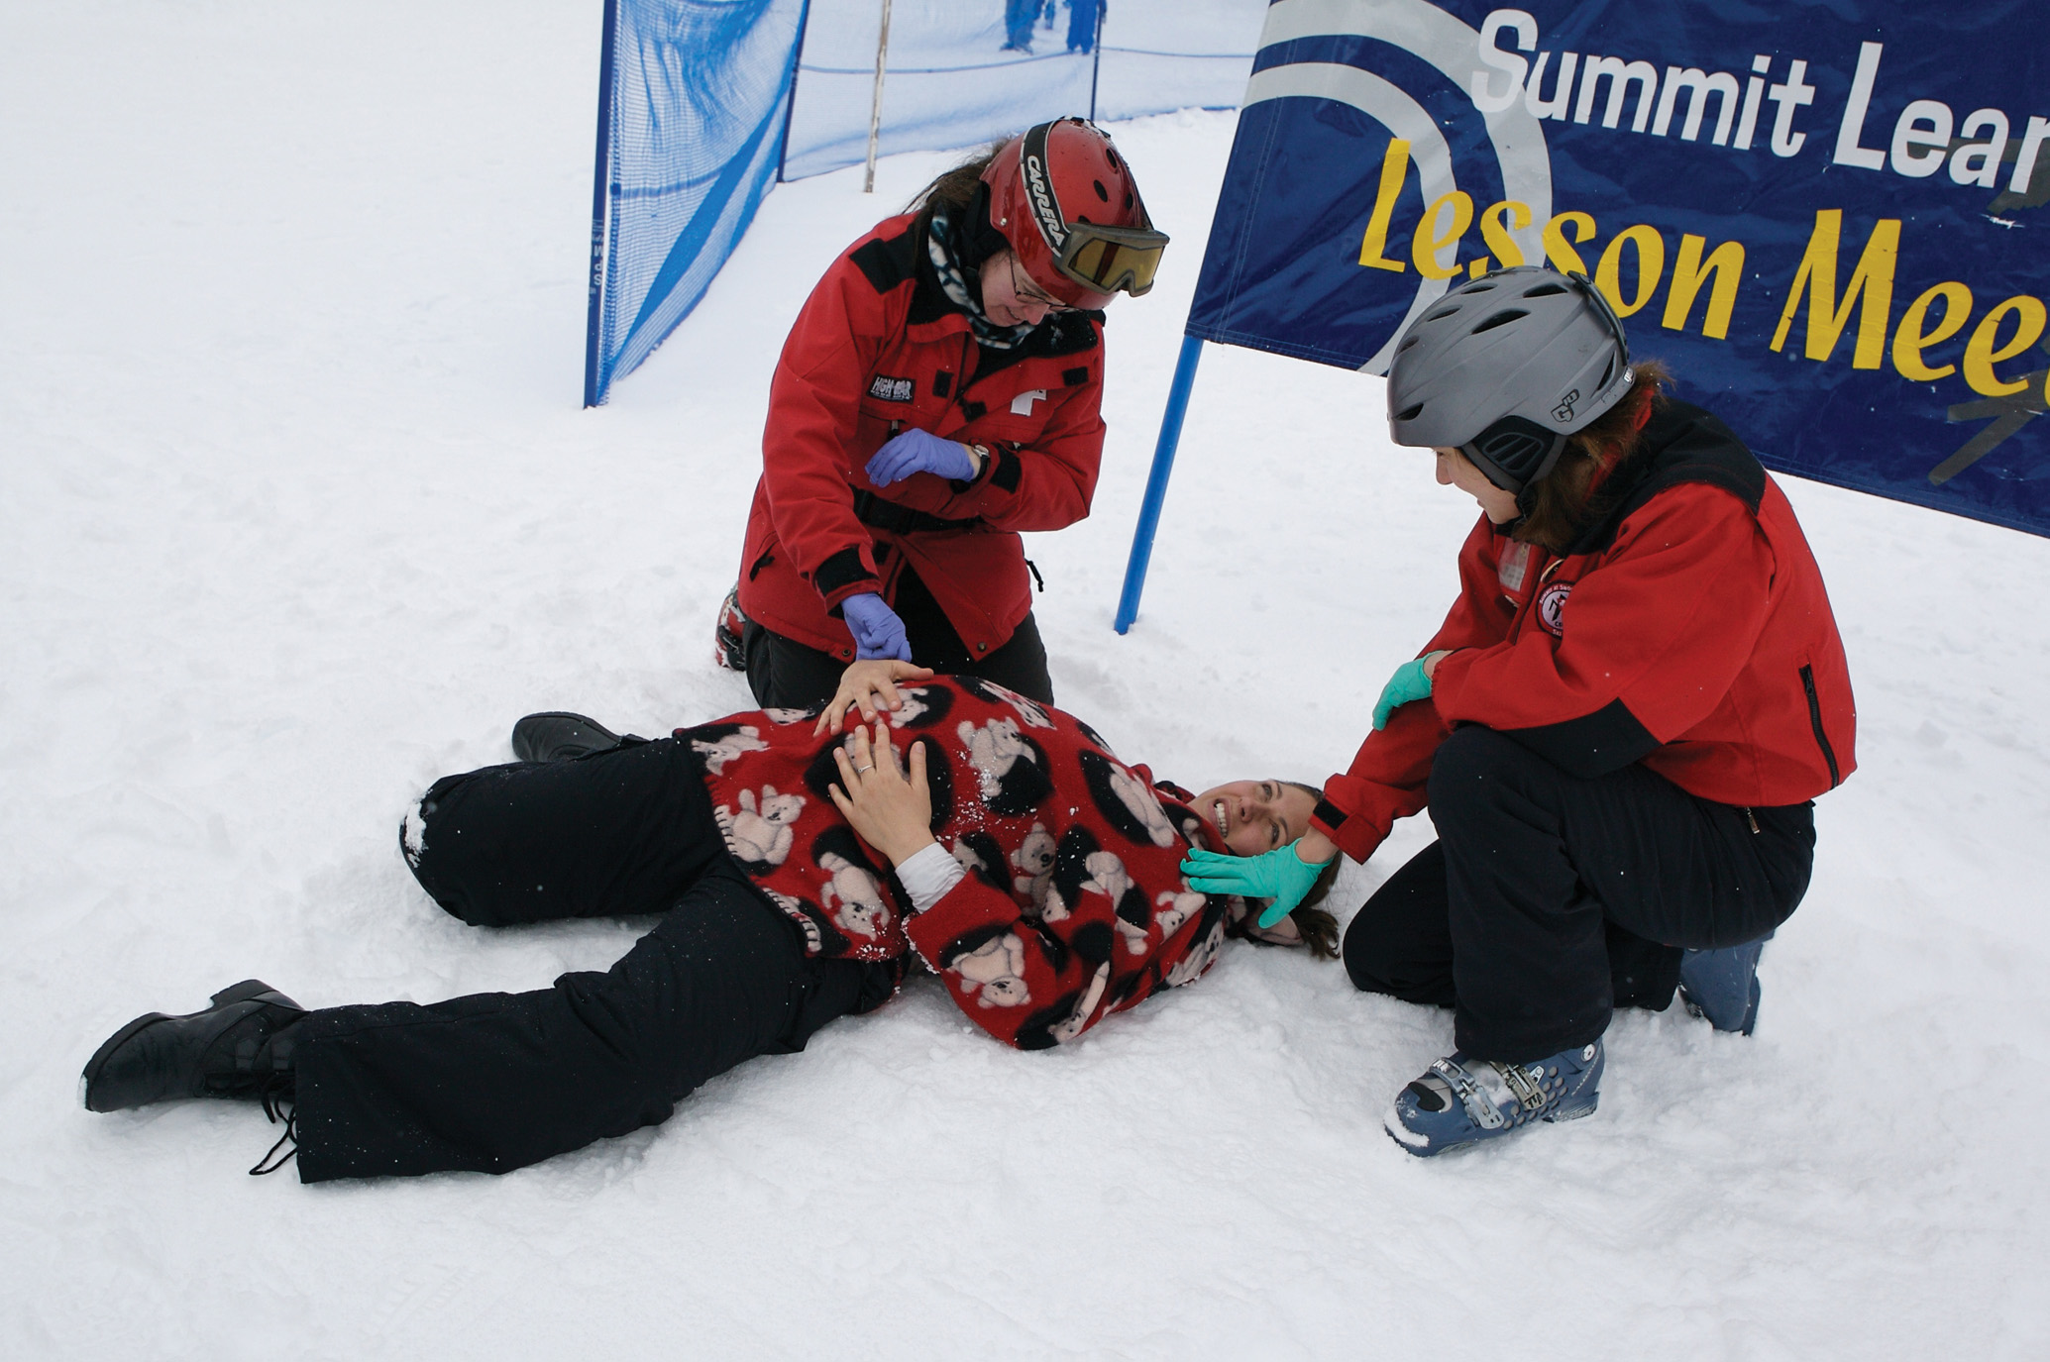
Assessment
continued

Slide 13
Management
Initial management
  Scene safe
  ABCDs
  SAMPLE
  OPQRST
  DCAP-BTLS
  ALS if needed
Management following trauma
Notes:
Discussion Point:
Describe the management of a pregnant patient with abdominal trauma.

Slide 14
Case Disposition
After placing your patient on her left side, her pulse rate remains at 110 but is much stronger, and a repeat blood pressure is now 105/70. She continues to complain of severe abdominal pain and reassessment shows her uterus to be continuously firm. You place the patient on high-flow oxygen by non-rebreather mask while arranging emergency transportation to the hospital. She is transported by toboggan lying on her left side to the patrol facility where an ALS ambulance crew is awaiting her arrival.
Notes:
Discussion Points:
What symptoms in this case would make you react quickly?
What do you think was the diagnosis?
Two days later, the patient’s husband stops by the patrol room to thank you and the other patrollers. He reports that his wife was diagnosed at the hospital with abruptio placenta. She underwent emergency caesarian section with delivery of a 3 pound baby boy who was in the neonatal intensive care unit on a ventilator but is doing well. He tearfully notes that without the prompt care of the patrollers involved and rapid evacuation, that he could have lost not just his wife but his newborn son as well!
14

Slide 15
Chapter Summary
Gynecologic emergencies are related to a woman’s reproductive organs.
Always consider the possibility of pregnancy in a female of reproductive age.
The goals for managing OB/GYN emergencies are rapid identification of a potentially serious or life-threatening condition, immediate care, and evacuation to definitive care.
continued
Notes:
Discussion Points:
What unique situations do you have when providing care for a female in each of these scenarios?
vaginal bleeding
normal and abnormal pregnancies

Slide 16
Chapter Summary
A pregnant woman may lose 30–35 % of her blood volume from hemorrhage before showing signs of shock.
Maternal hemorrhage places the fetus at high risk for shock.
Treat all pregnant trauma patients for shock.
Prevent maternal hypotension by placing the patient on her left side.
Always respect a woman’s privacy.

