Slide 1

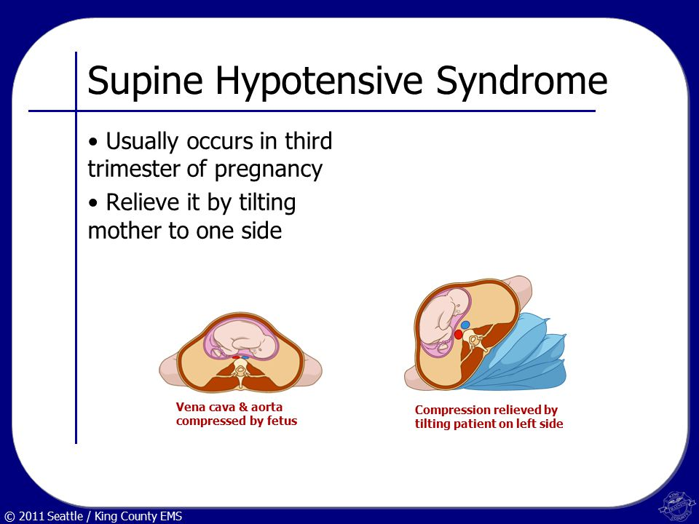
Pregnancy
Normal physiologic changes
Complications of pregnancy
  Hemorrhage
  Pregnancy-Induced Hypertension (PIH)
  Miscarriage
Supine Hypotensive Syndrome
continued
Notes:
Discussion Points:
In what situations would you consider evacuation to a location that can be accessed by EMS.
The access point can be reached within 20 minutes.
The umbilical cord or a part other than the baby’s head is visible in the vaginal opening.
The mother has been informed that she has a breech presentation or will require a cesarean section.
The baby’s head is not visible on inspection of the perineum during a contraction. If this is a first time deliver.

Slide 2
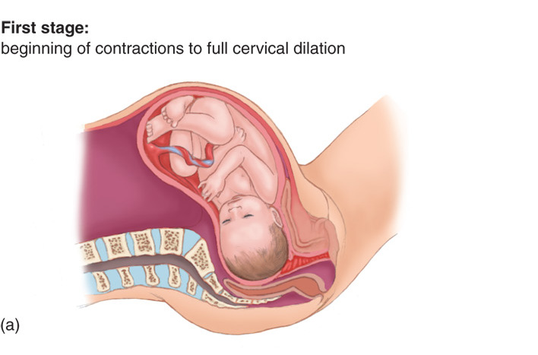
Pregnancy
continued

Slide 3
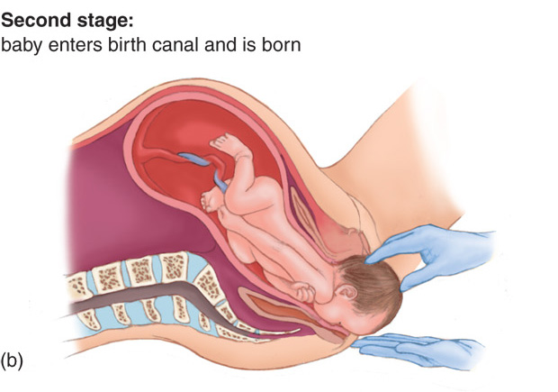
Pregnancy
continued

Slide 4
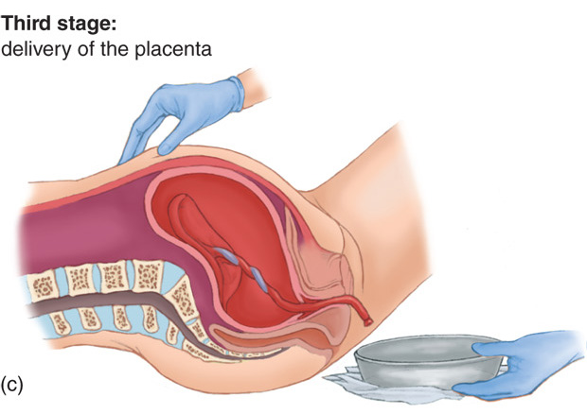
Pregnancy
continued

Slide 5
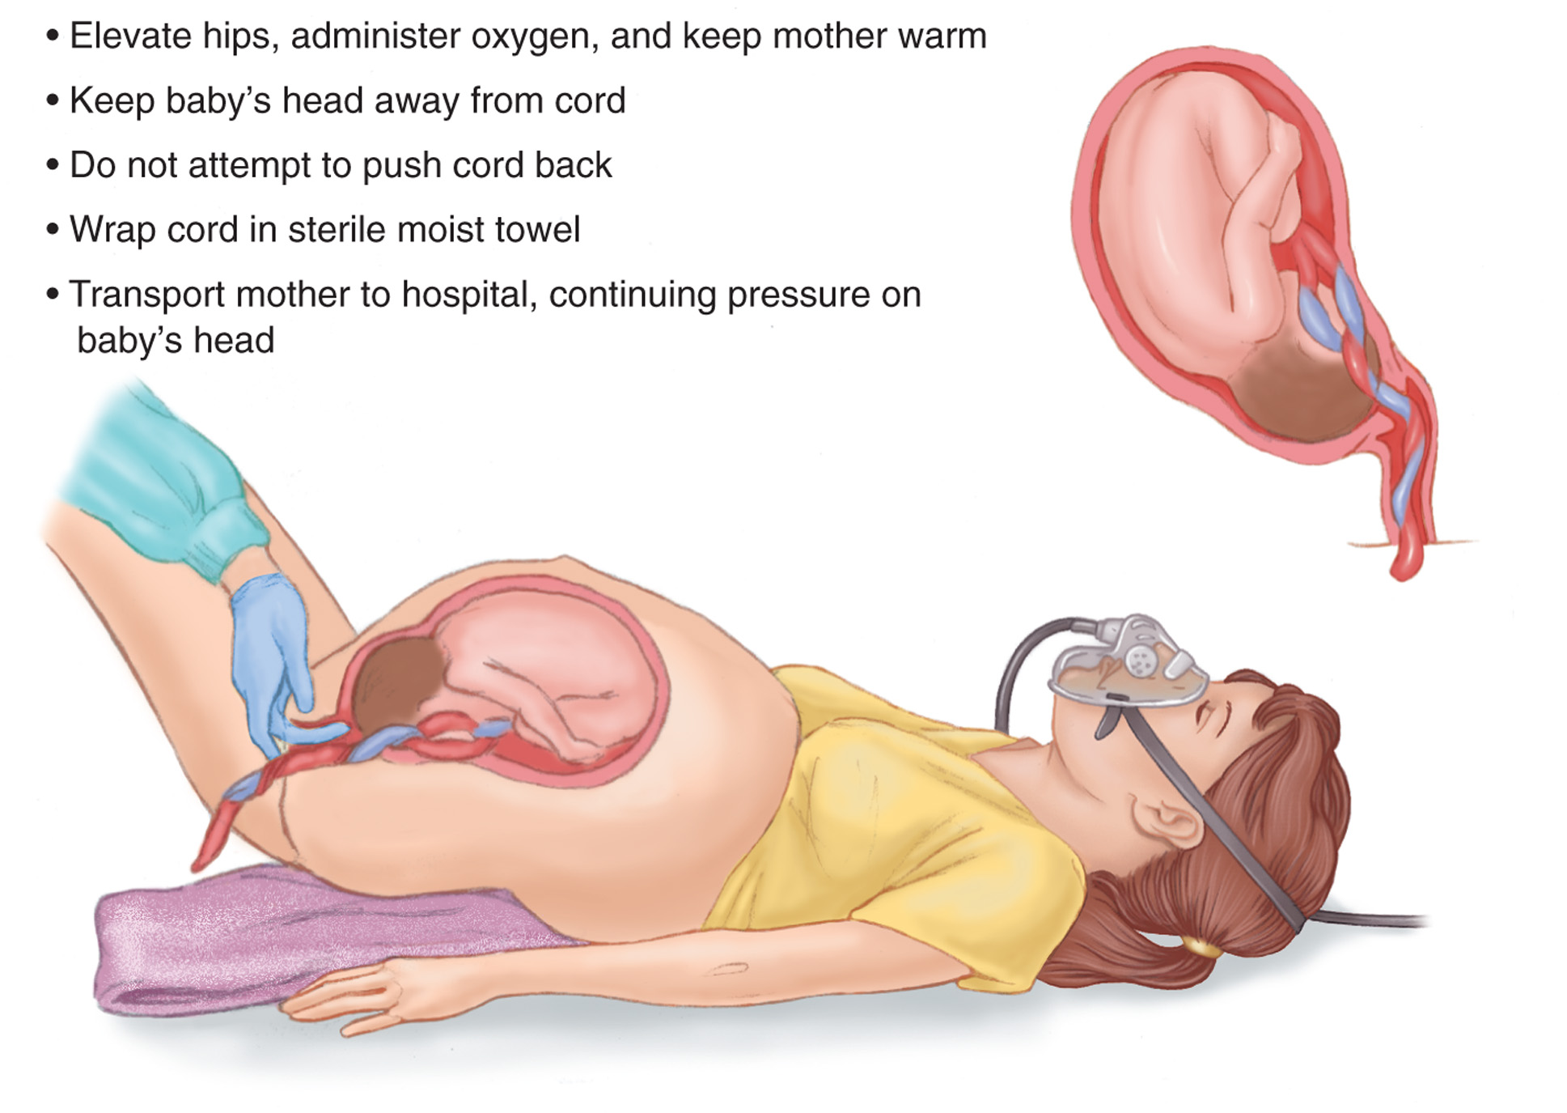
Pregnancy
continued

Slide 6
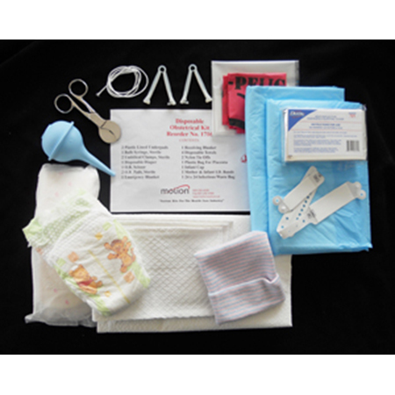
Pregnancy
Childbirth
  Use a disposable sterile OB delivery kit
  Assist the mother, if necessary, in removing her clothing and place in fowler’s position
  Time the contractions
continued

Slide 7
Pregnancy
Childbirth
  Once the baby is crowning, allow the mother to push
  After delivering the head, you should see the baby’s upper shoulder
continued
Notes:
Discussion Point:
If a newborn does not cry 15-20 seconds after delivery, what should you do?

Slide 8
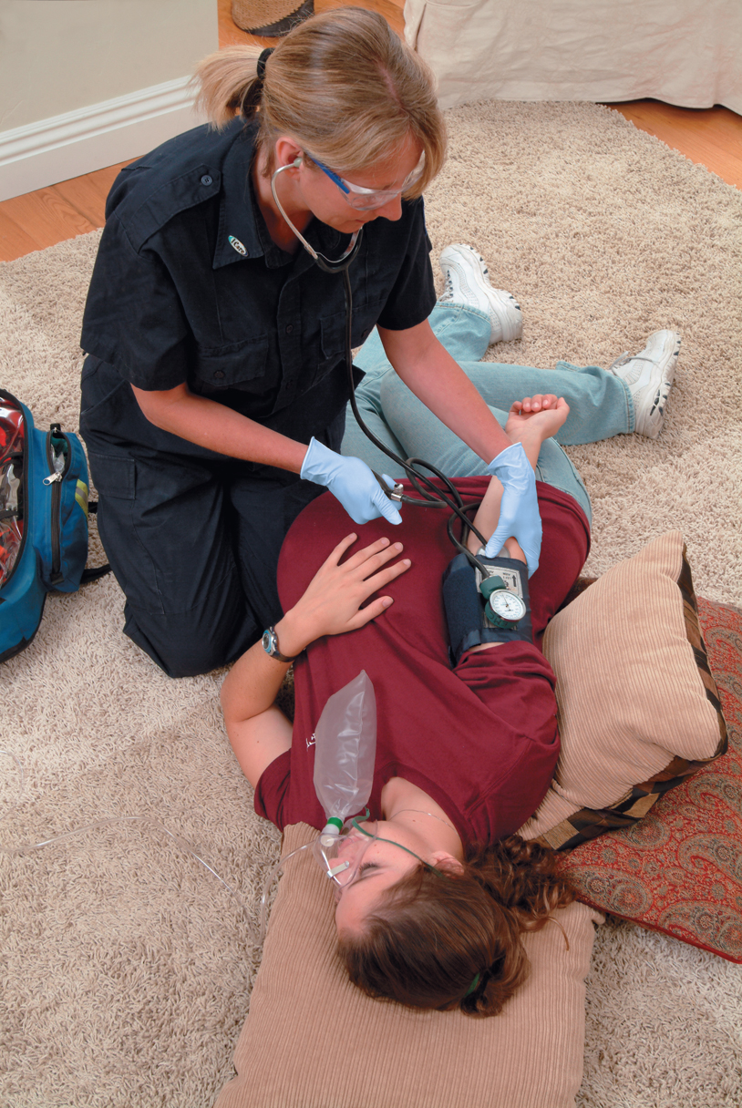
Pregnancy
continued

Slide 9
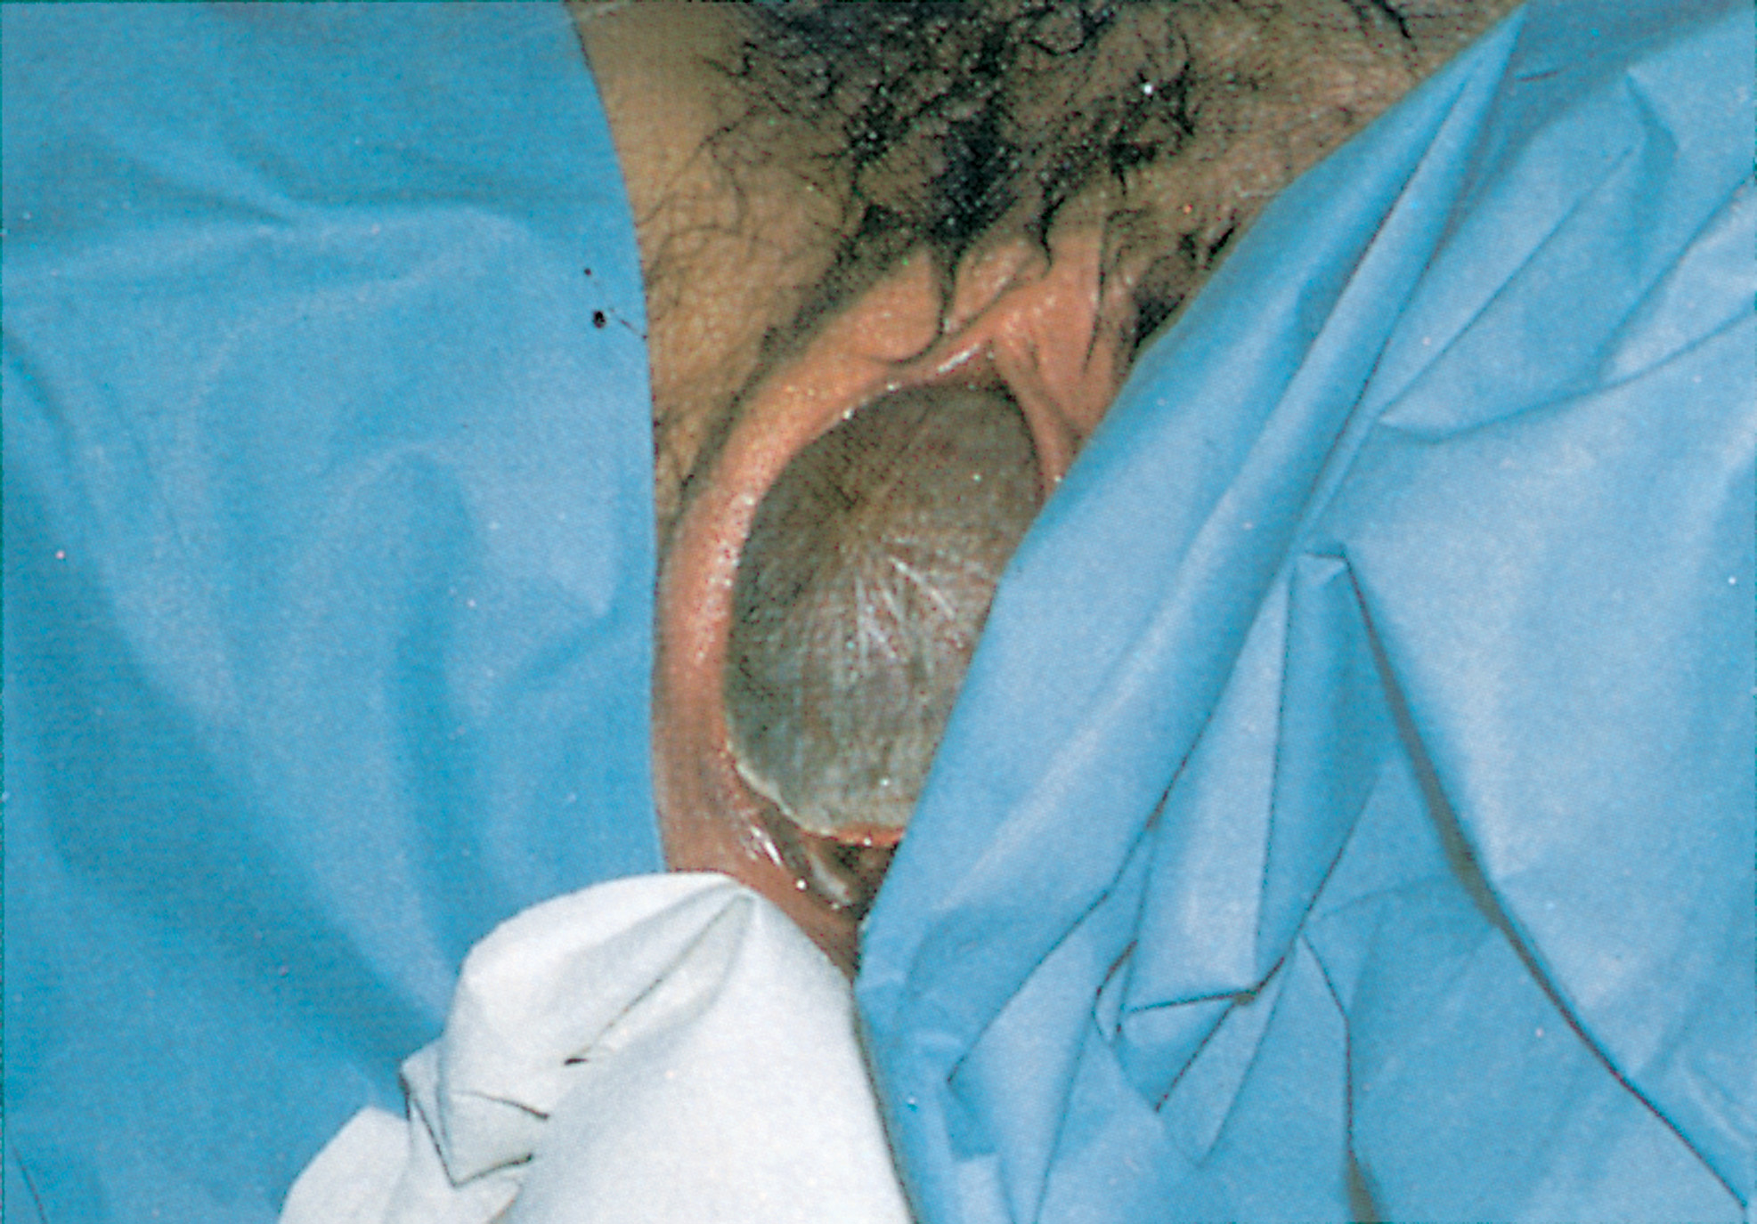
Pregnancy
continued

Slide 10
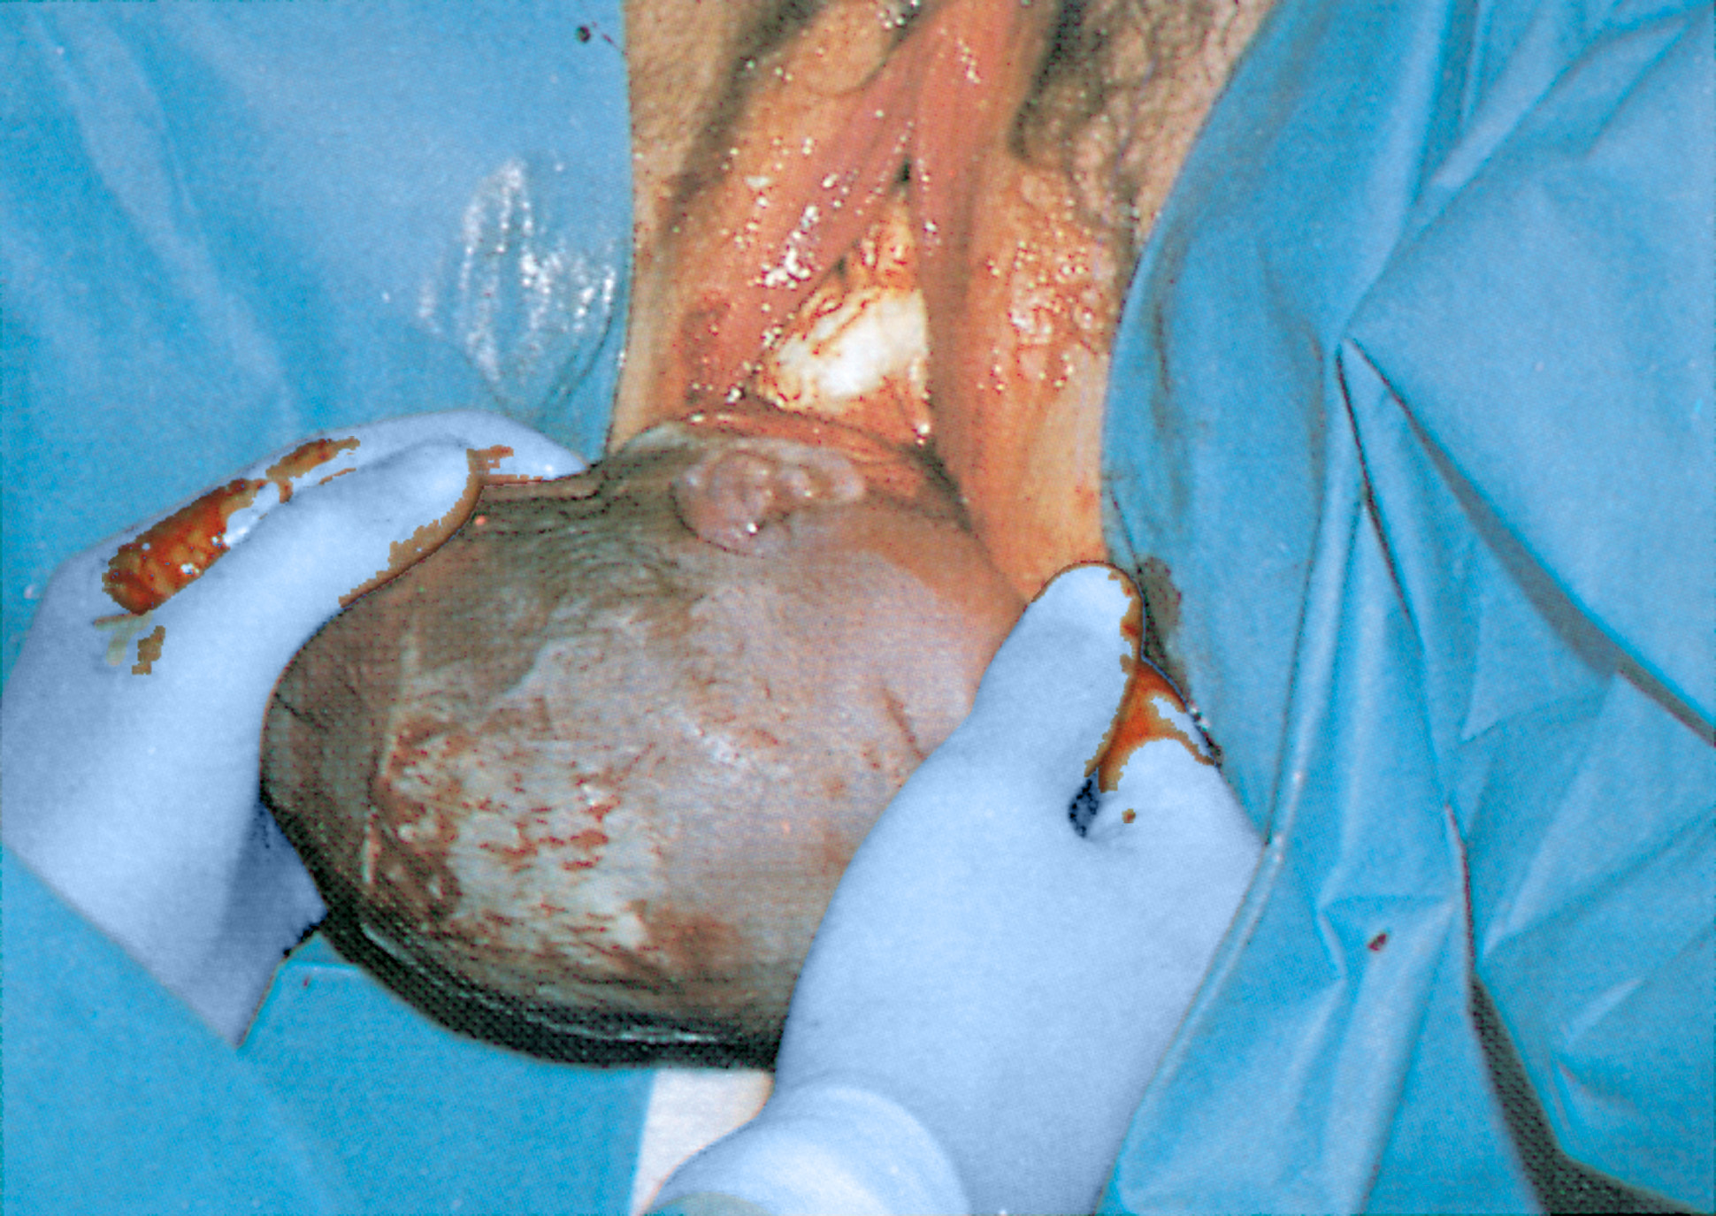
Pregnancy
continued

Slide 11
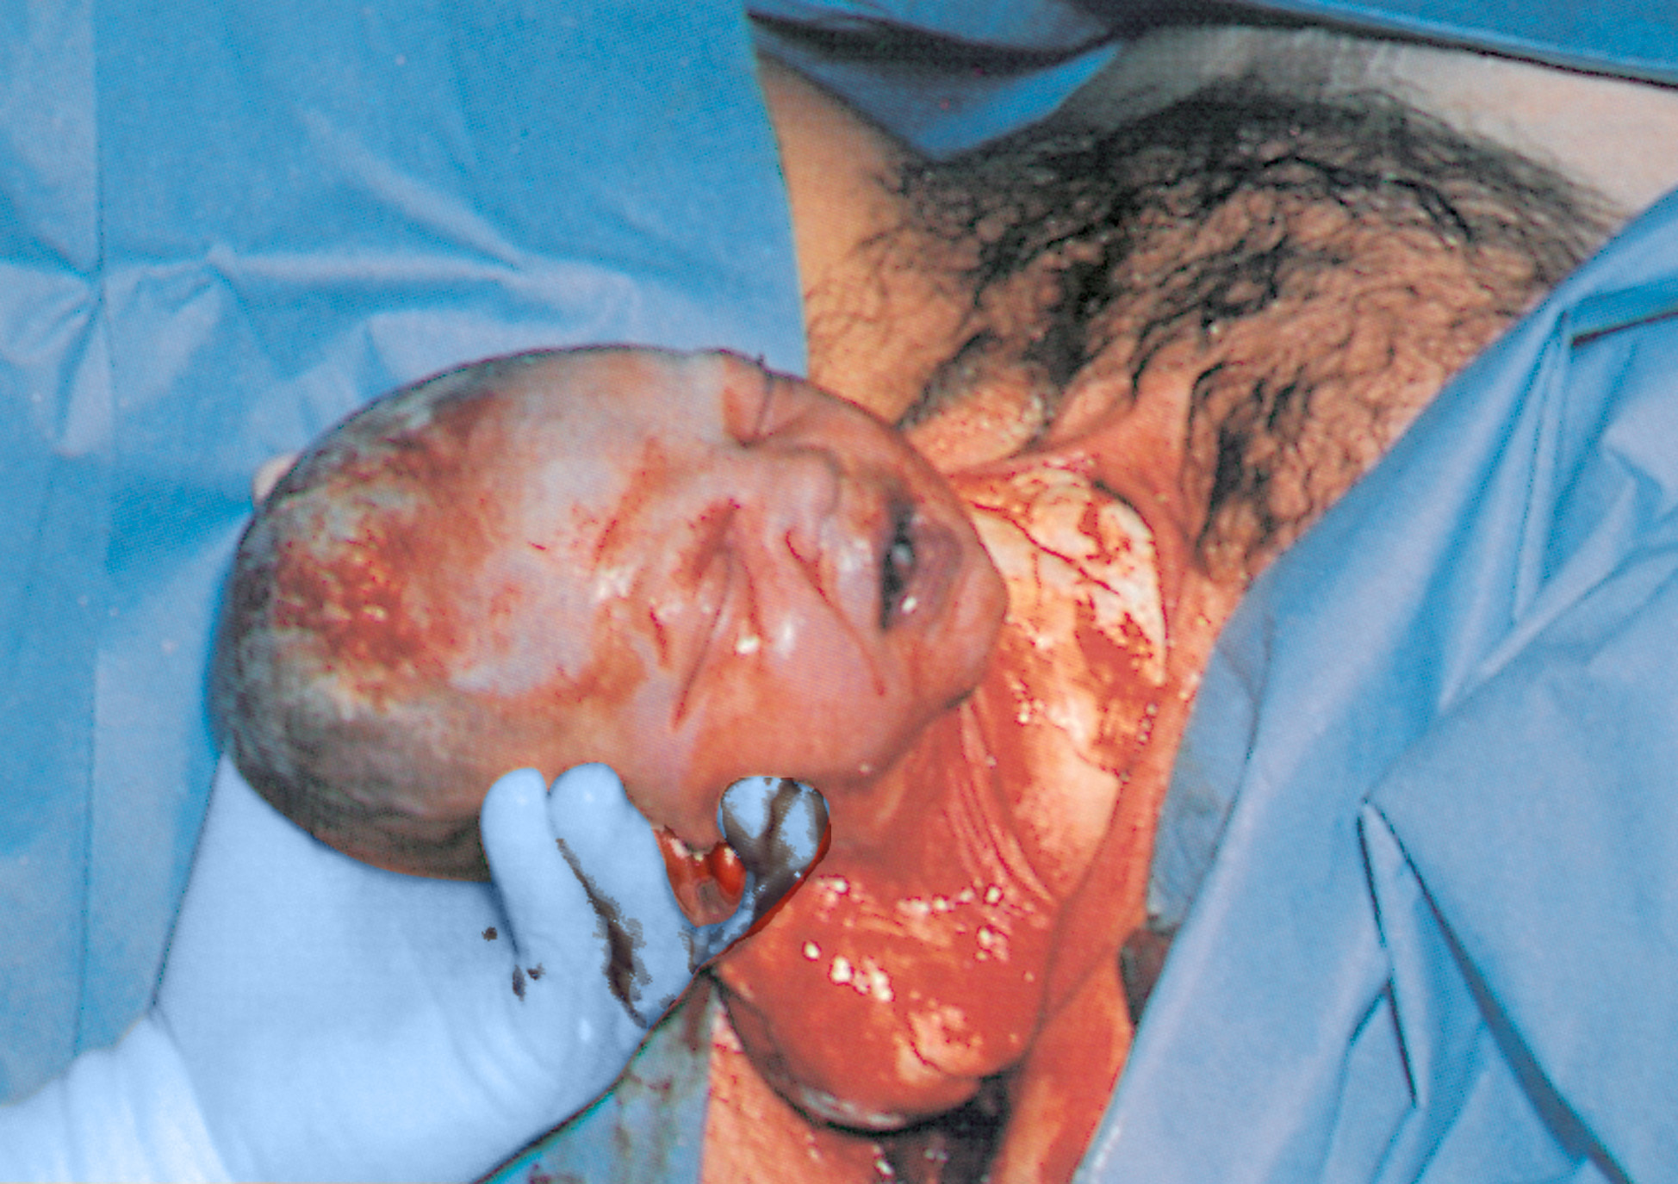
Pregnancy
continued

Slide 12
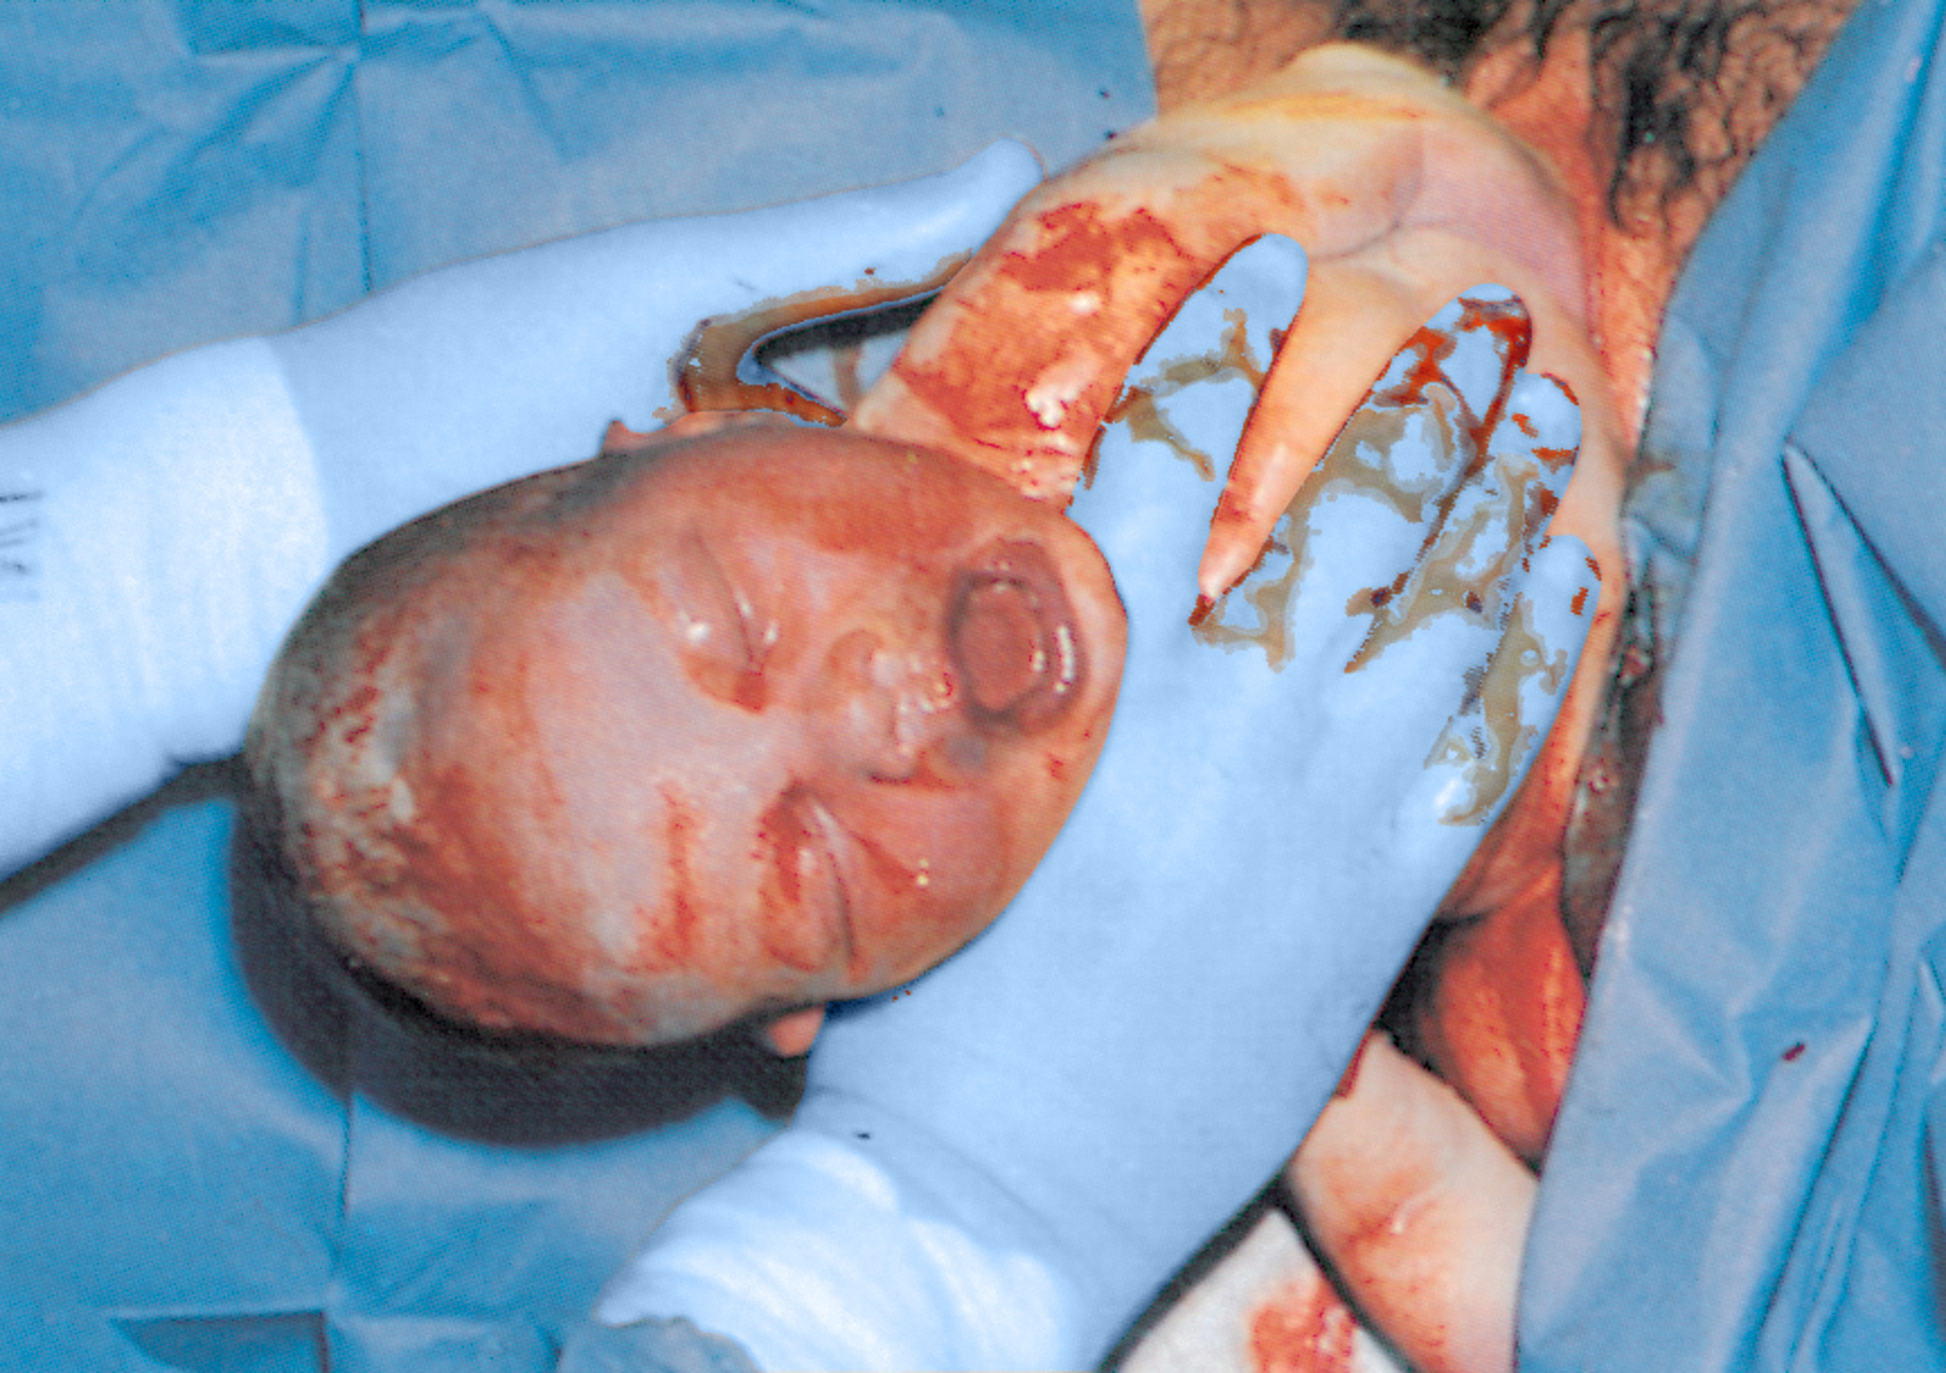
Pregnancy
continued

Slide 13
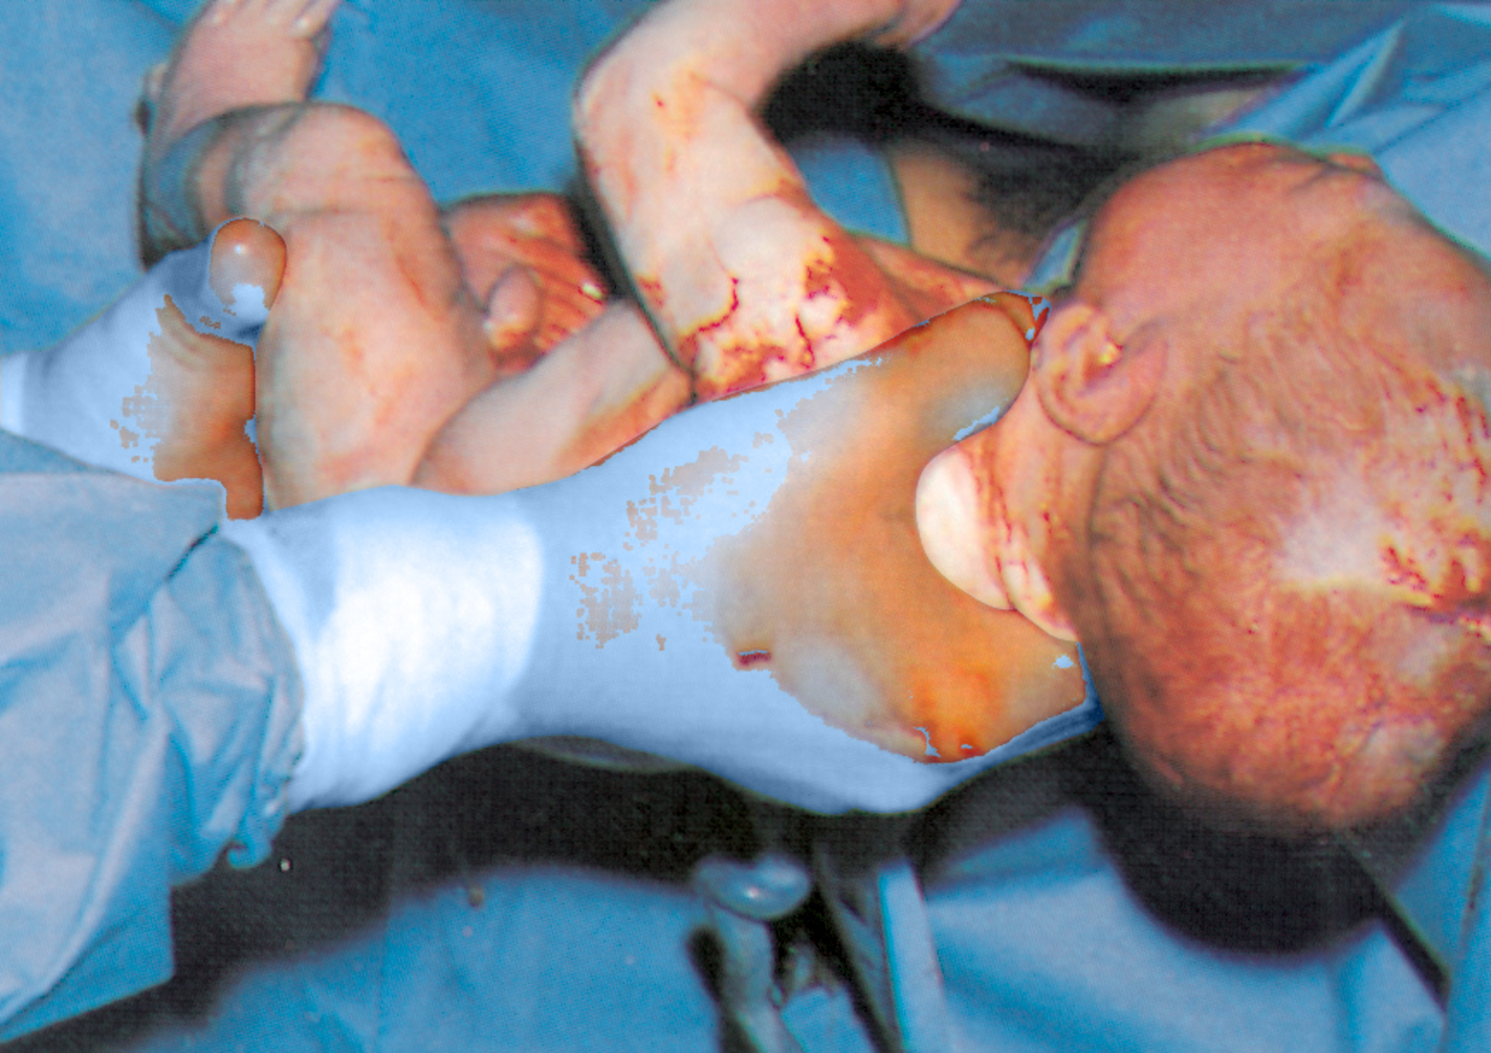
Pregnancy
continued

Slide 14
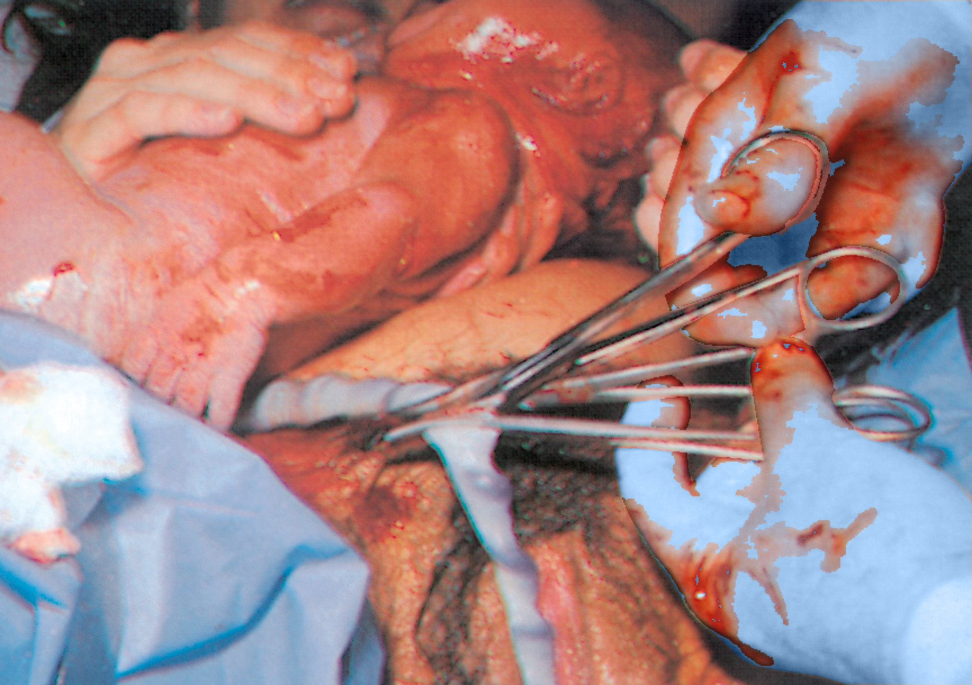
Pregnancy
continued

Slide 15
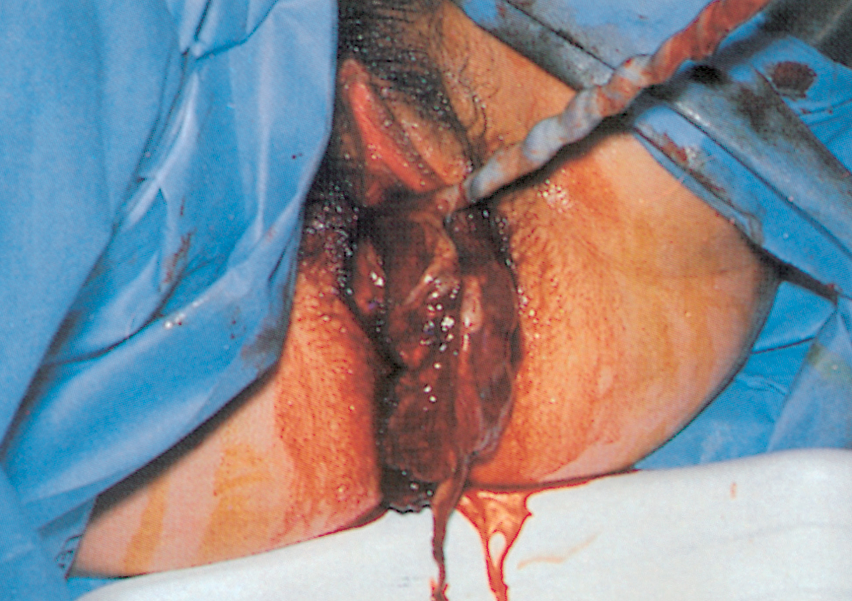
Pregnancy
continued

