Slide 1

Chapter 34
Obstetric and Gynecologic Emergencies
Notes:
1

Slide 2
Objectives
34.1 Identify the major anatomical structures within the pelvic cavity.
34.2 List the functions of the female genitourinary and reproductive system.
34.3 List the functions of the major gynecologic structures.
34.4 List three causes of abdominal pain of gynecologic or obstetrical origin.
34.5 List four possible causes of vaginal bleeding.
continued
Notes:
2

Slide 3
Objectives
34.6 List the three stages of a normal pregnancy.
34.7 List three possible consequences of abdominal trauma in a pregnant patient.
34.8 Describe four possible complications of pregnancy.
34.9 Demonstrate how to examine a female patient with abdominal or pelvic pain.
continued
Notes:
3

Slide 4
Objectives
34.10 Decribe how to assess the abdomen of a pregnant patient.
34.11 Describe the process of assisting an emergency delivery.
34.12 Describe the management of a pregnant patient with abdominal trauma.
continued
Notes:
4

Slide 5
Topics
Anatomy and Physiology
Common Obstetrical and Gynecological Emergencies
Complications of Pregnancy
Basic Care of the Newborn
Assessment
Management
Chapter Summary
Notes:
Discussion Point:
List four possible causes of vaginal bleeding.

Slide 6
Case Presentation
A woman is 34 weeks pregnant and is complaining of severe abdominal pain. She is lying supine on the snow with both knees flexed. She is awake and oriented. A ski school instructor is present and witnessed the patient fall onto her left side, striking her abdomen. Her abdominal pain as “sharp” and “all over”, unlike the labor contractions she had with her first delivery. She does not feel any leakage of fluid and denies feeling lightheaded. This is her second pregnancy and she states it has been uncomplicated to date.
continued
Notes:
Discussion Point:
What facts would make you concerned with this patient?

Slide 7
Case Presentation
She denies any injury other than to her abdomen. As you assess the patient, you notice that her radial pulse is quite weak and seems faster than normal.
Notes:
Discussion Point:
What facts would make you concerned with this patient?

Slide 8
Anatomy and Physiology
Falling puts a pregnant woman at high risk.
continued

Slide 9

Anatomy and Physiology
continued
Copyright Scott Smith

Slide 10
Anatomy and Physiology
Ovaries
Fallopian tubes
Uterus
Vagina
Perineum
Reproductive system
Notes:
Discussion Point:
An ova (or egg) is released from an ovary about every _____ days, during a female’s reproductive years which encompass approximately age ___ to _____.

Slide 11
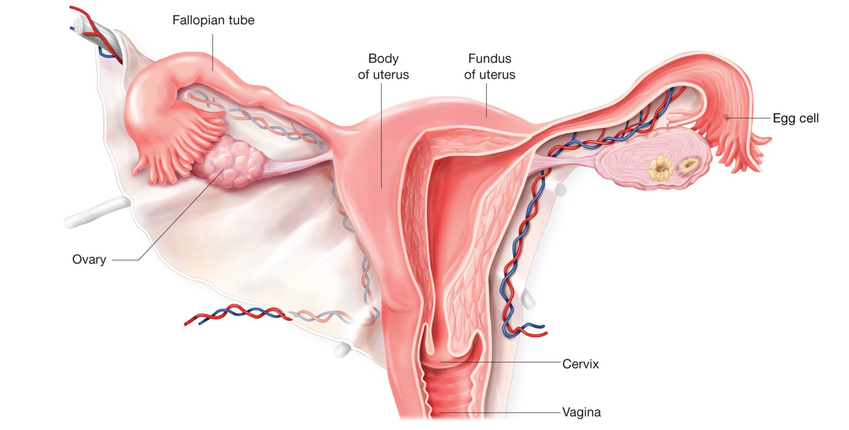
Anatomy and Physiology

Slide 12
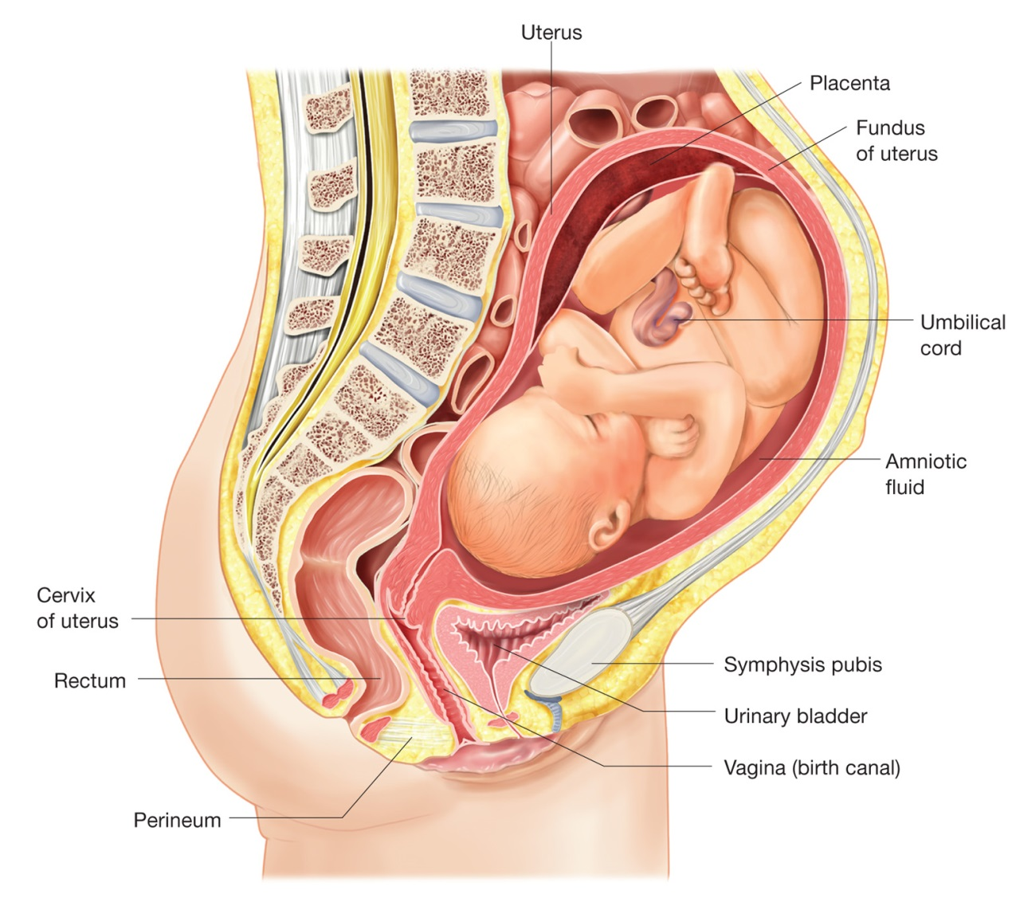
Anatomy and Physiology

Slide 13
Common Obstetrical and Gynecological Emergencies
Abdominal pain
  Dysmenorrhea
  Cystitis
  Ovarian cysts
  Pelvic inflammatory disease
  Ectopic pregnancy
continued
Notes:
Discussion Point:
A baby delivered prior to how many weeks gestation is considered to be premature?

Slide 14
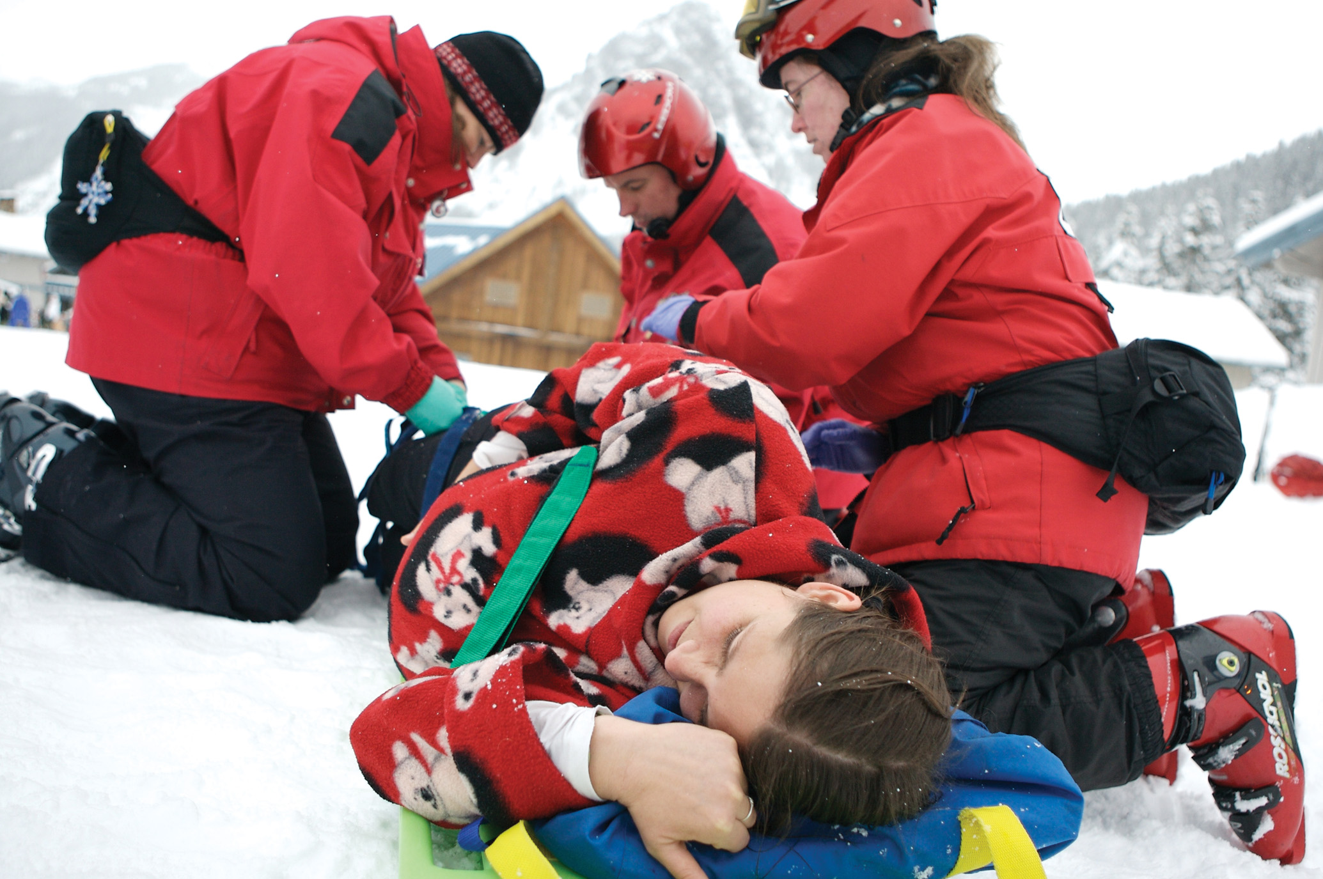
Common Obstetrical and Gynecological Emergencies
continued
Copyright Craig Brown

Slide 15
Common Obstetrical and Gynecological Emergencies
Cystitis
Ovarian Cysts
Pelvic Inflammatory Disease (PID)
Ectopic Pregnancy
Vaginal Bleeding
Gynecological Trauma
Sexual Assault
Notes:
Discussion Point:
Describe how to assess the abdomen of a pregnant patient.

Slide 16

Common Obstetrical and Gynecological Emergencies

