Slide 1

Chapter 33
Behavioral Emergencies and Crisis Response

Slide 2
Objectives
33.1 Define the following terms:
  behavior
  behavioral emergency
33.2 Compare and contrast neurosis and psychosis.
33.3 List and explain four factors that can cause stress or lead a person to behave strangely.
33.4 List the signs and symptoms of common behavioral emergencies.
33.5 Identify techniques to help maintain rescuer safety when responding to a behavioral emergency.
33.6 Describe and demonstrate how to assess a patient with a behavioral emergency.
33.7 Describe and demonstrate the treatment of a patient with a behavioral emergency.
33.8 List the indications for restraining a patient.
33.9 Describe and demonstrate how to properly restrain a patient.
33.10 List the five phases of the Kübler-Ross grieving process.

Slide 3
Topics
Common Behavioral Emergencies
Death and Grief
Assessment
Management
Chapter Summary

Slide 4
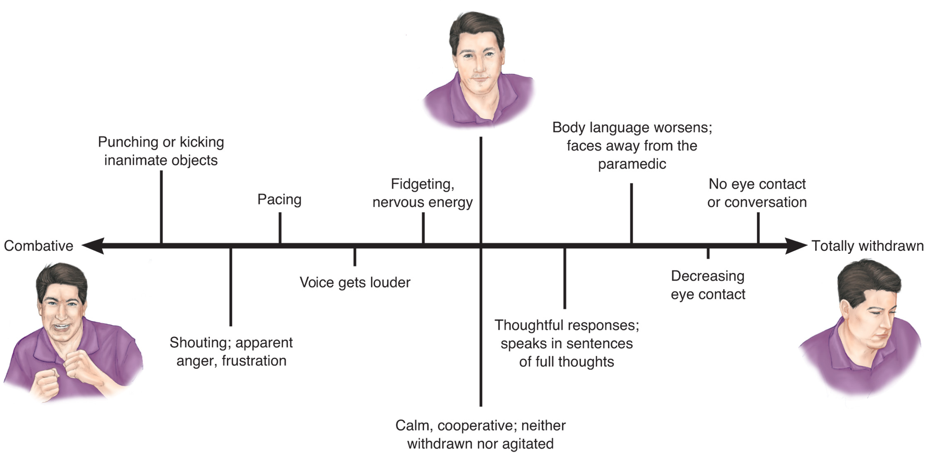
Continuum of Responses
Notes:
OEC Technicians can use their interpersonal skills to bring a patient, whether combative or withdrawn, to the calm, cooperative state in the center of the continuum of responses to a behavioral emergency.

Slide 5
Anatomy and Physiology
Brain is responsible for homeostasis.
Stress is a response to demands/ pressures (fight or flight)
  Structural abnormalities or chemical imbalances may alter perception of reality.
  Responses occur throughout the body
  Some stress is normal; too much or prolonged can cause imbalance /altered mental processes and abnormal behavior.
Notes:
Discussion Points:
Behavioral emergencies are often situational, and therefore, it is uncommon to blame any anatomical features as the culprit, but rather the interplay between the physical and psychological/emotional.
The text mentions drugs (legal or not), alcohol, hypoglycemia, hypoxia and their effects on the brain as one aspect of this problem OEC techs must be aware of. Other chemical imbalances may not be attributable to “outside” sources, and are typically related to mental illness. These are the issues presented in the next several slides.

Slide 6
Common Behavioral Emergencies
Medical disorders:
  Hypoxia and hypoglycemia
Chemical exposures:
  Alcohol and drugs
Trauma:
  Brain injury/hypoxia
Behavioral conditions:
  Neurosis and psychosis
Notes:
Discussion Point:
Knowledge and recognition are key points you want the students to absorb.

