Slide 1
Outdoor Adaptive Athletes
There is an increasing number of adaptive athletes and its great!
It is crucial to be respectful and use the basics of good communication
Speak to the athlete and not the disability
Life-threatening emergencies are no more common than among any other group
Thus our goal is to have the best understanding in order to give the best care!

Slide 2
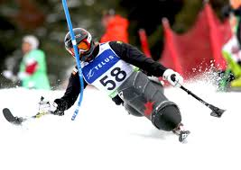
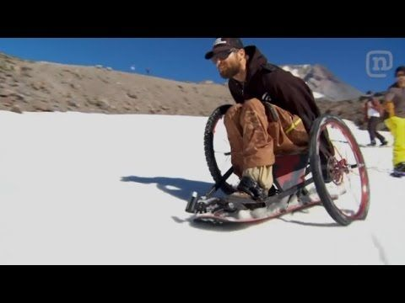
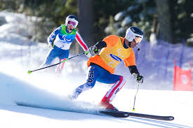
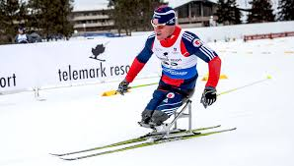
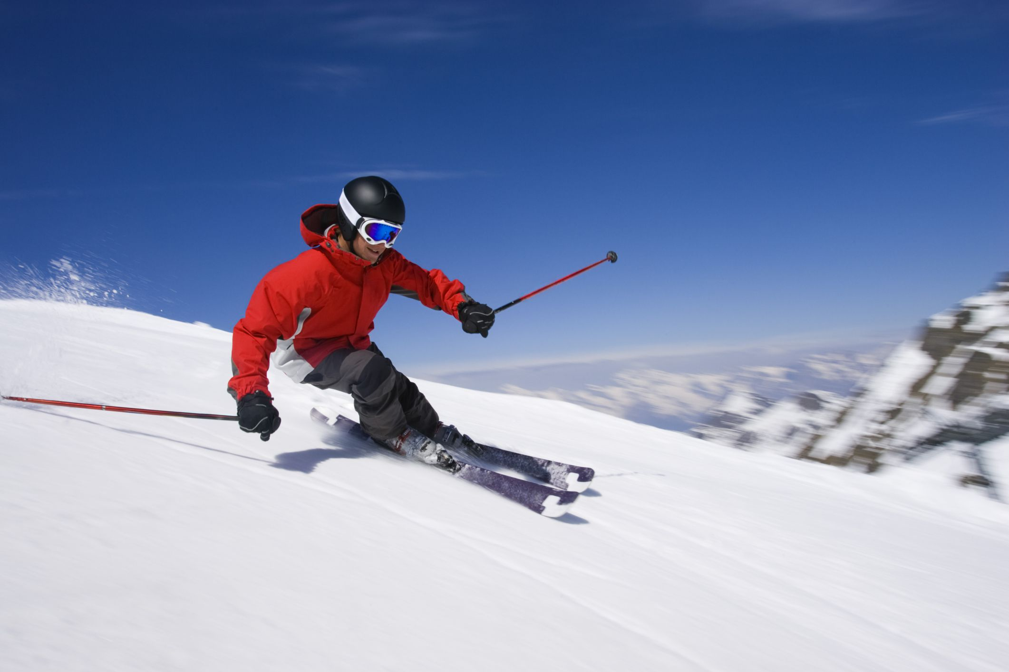
There are many different forms

Slide 3
Words are crucial
Disability: The best and appropriate term for a condition that impairs normal function or daily activities.
Impairment: Any loss or limitation of physical or intellectual function (not necessarily a disability)
Handicap: A condition that impairs normal physical or intellectual function (less desirable)
Adaptive Athlete: A person with a physical or intellectual disability who participates in a sport

Slide 4
Common Disabilities
Intellectual
ADD
Dyslexia
Autism Spectrum disorders- Wide array of developmental disabilies
Cognitive
Autonomic Dysfunction- affects nervous system and everyone differently
Mental Illness- Schizophrenia and manic-depressive disorder are examples
Intellectual Difficulties- examples
Down Syndrome is both intellectual and physical
Fetal Alcohol Syndrome
All need tremendous kindness and understanding. They can be frightened or disoriented from the unusual surroundings. Always try to communicate in the same manor. A caretaker can be very helpful to assist with communication.

Slide 5
Physical Disabilities
Visual Impairment- often will be skiing or riding with a guide
Amuputee
Paraplegics do not have use of their legs
Quadriplegics refer to all 4 extremities
Autonomic Dysreflexia from a spinal cord injury is abnormal function of the nervous system- Medical Emergency
Patients might have an Ostomy bag for poop

Slide 6
Continiued
Cerebral Palsy
Multiple Sclerosis
Spina Bifida
Multiple dystrophies
And others… just memorize these from the book and it will help you

Slide 7
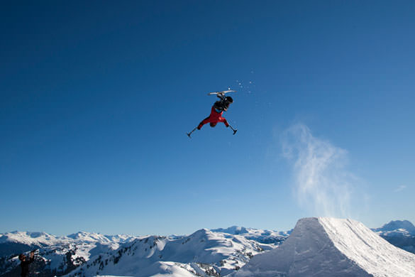
Adaptive Equipment
Sit skis and out riggers are really expensive so be careful!
If you want to know how much they cost ask Cole
There are also prosthetics with some being sport specific
Wheel chairs with or without motors and canes/crutches
Guide Dogs
Guides for skiing

Slide 8
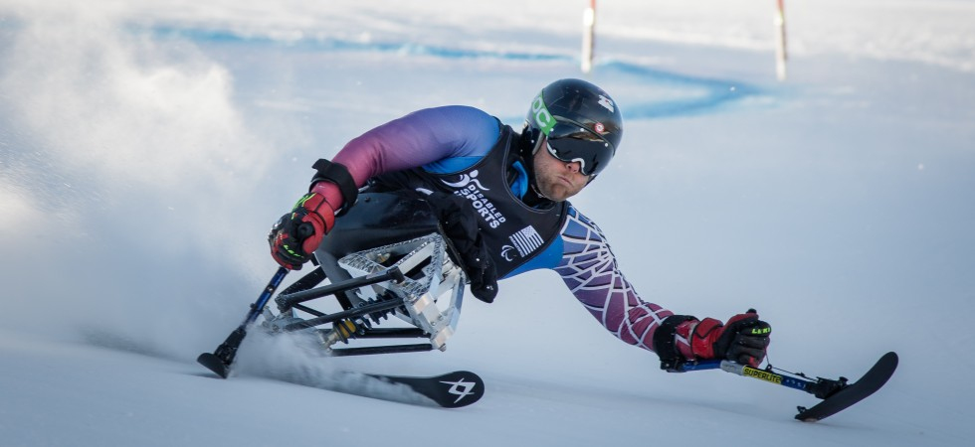
Sit Skis
Mono Ski
and bi-ski
Every time they get on and off a chairlift someone must attach a safety strap to the back of the chair
A three tracker is standing with one ski and two outriggers

Slide 9
Assessment and Management
There will be unique challenges and the physical exam might require modification
Principals are essentially the same
Good Communication is paramount
Speak directly to them and acknowledge that you may not be familiar with their specific impairments
Again family members or guides can be very helpful

