Slide 1
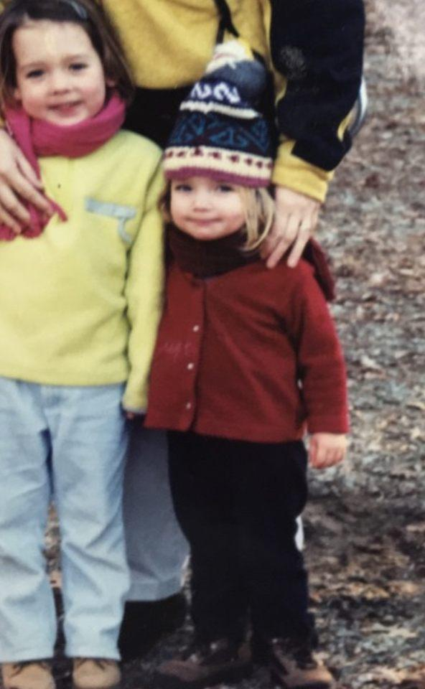
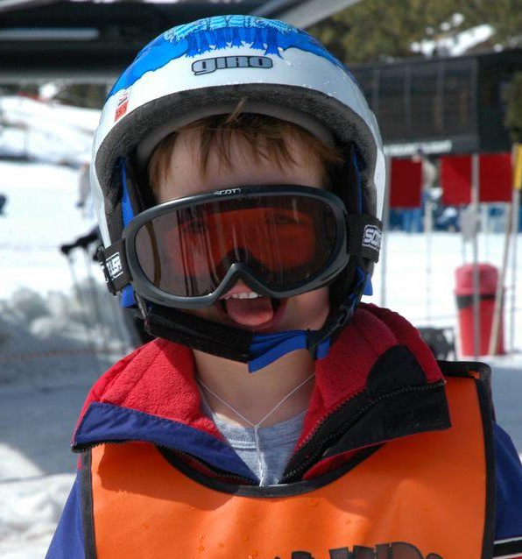
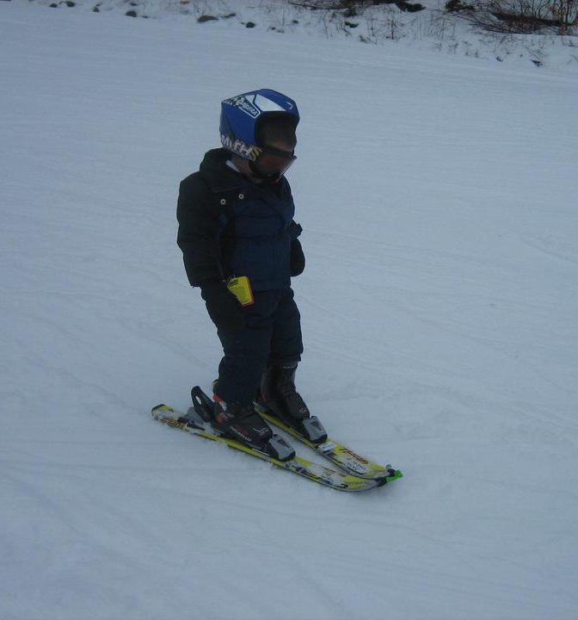
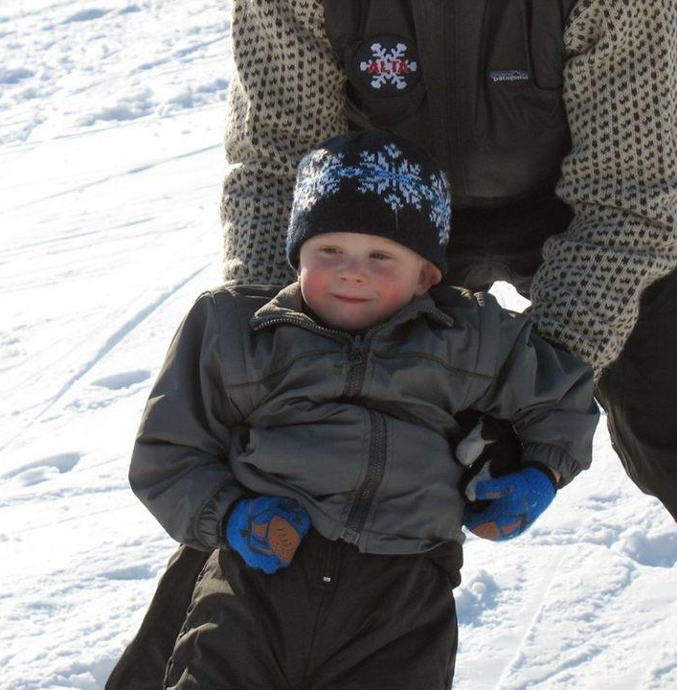
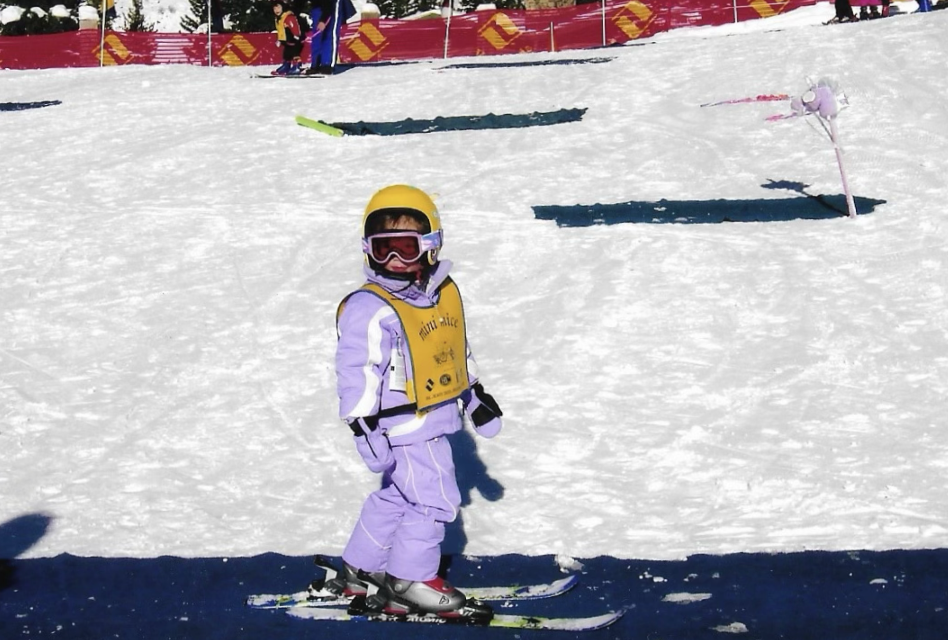
Ch. 30:
Pediatric Emergencies
Lexi and Eliza

Slide 2
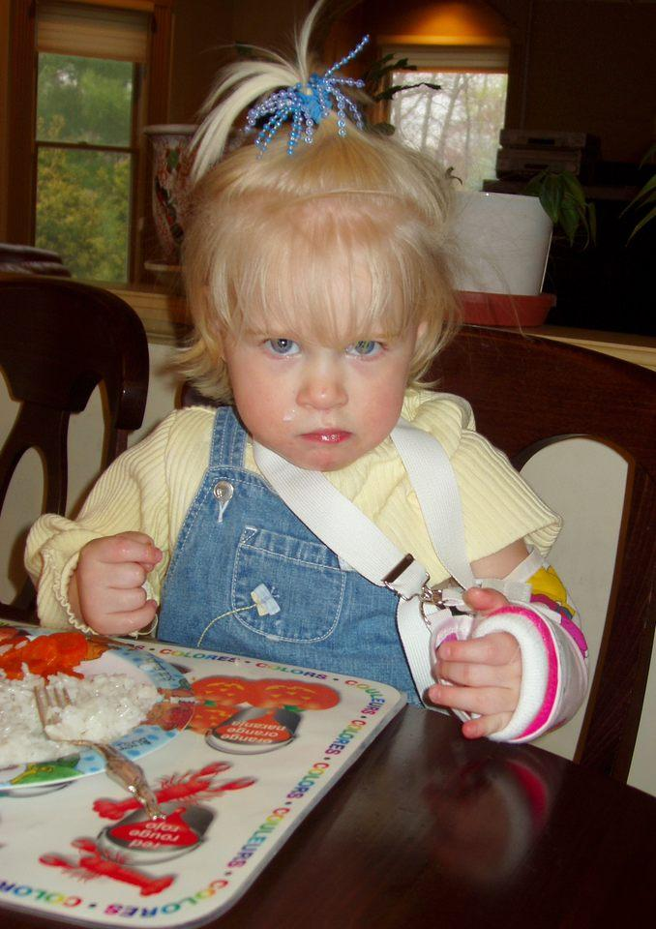
Chapter 30: Important Objectives
Understand the physiological differences between children and adults
Describe the signs and symptoms of various pediatric disorders
Understand best practices for providing medical aid to a child

Slide 3
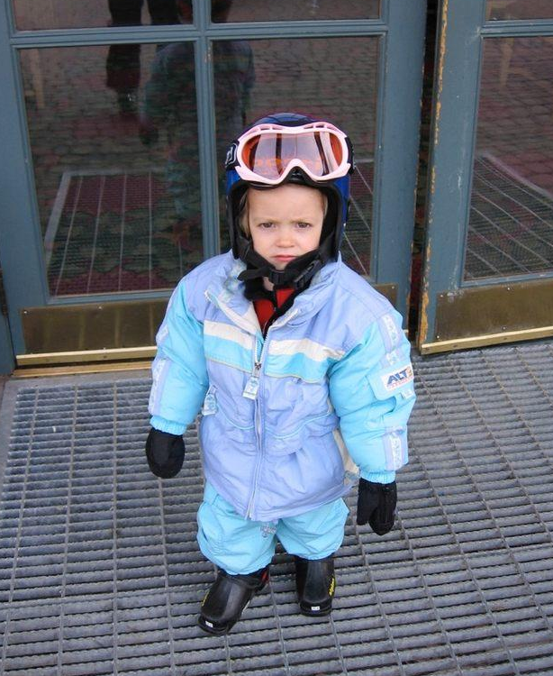
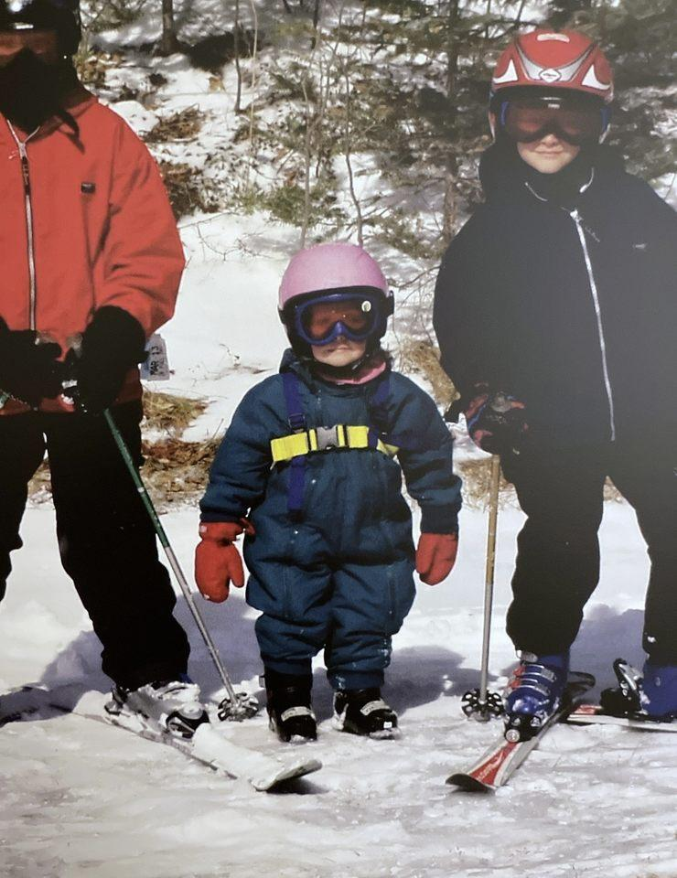
Anatomy & Physiology
Most important anatomic differences between children and adults
Size of the airway
Mechanism of breathing
Head is proportionally larger compared to the body
Greater body surface area leads to faster heat loss

Slide 4
Normal Vitals for Pediatrics
Pulse: 90-180 bpm (Infants), 70-150 bpm (Children)
Respirations: 25-60 rpm (Infants), 15-30 rpm (Children)
Systolic blood pressure: 50-95 (Infants), 80-110 (Children)

Slide 5
Six stages of human development
1. Newborn – 0 to 1 month
2. Infancy – 1 to 12 months
3. Toddler – 12 to 36 months
4. Preschool – 3 to 5 years
5. School Age – 6 to 12 years
6. Adolescent – 13 to 18 years

Slide 6
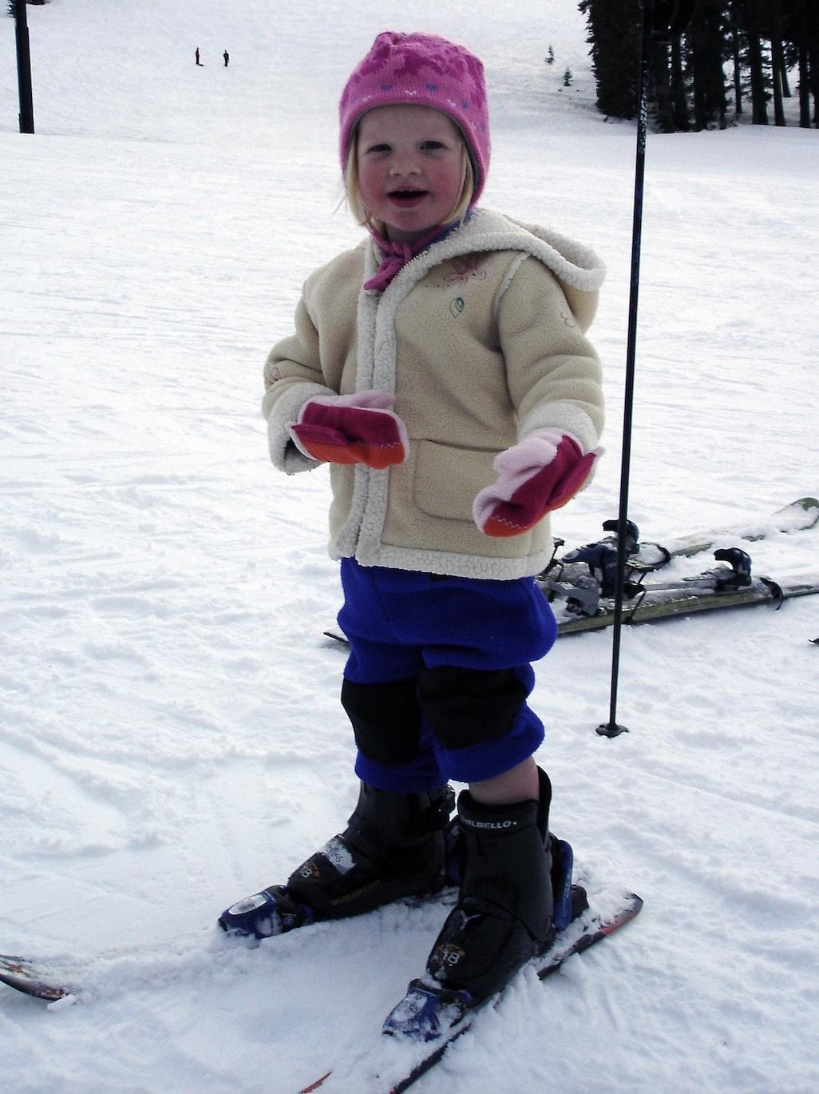
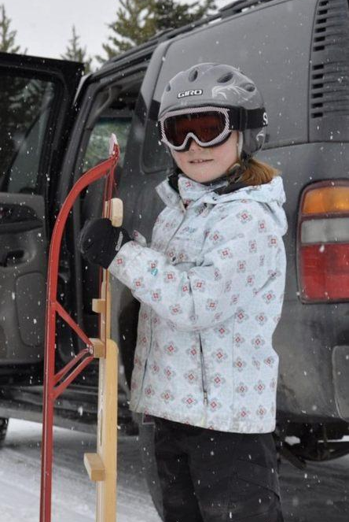
Common Pediatric Illnesses: Airway
Croup – inflammation of the larynx
Tonsillitis – inflammation of the tonsils
Foreign-Body Airway Obstruction – items like food/toys lodged in the airway
Bronchiolitis – inflammation of bronchioles due to viral infection
Pneumonia – infection of the lungs
Asthma – constriction of the bronchioles
Epiglottitis – inflammation of the epiglottis (can be life threatening)

Slide 7
Respiratory Failure
Children are far more susceptible to respiratory failure than adults
Respiratory muscles are not as fully developed
Labored breathing can exhaust a child and in serious cases lead to cardiac arrest (anoxia)

Slide 8
Other Common Pediatric Complications
Abdominal Pain
Nausea, Vomiting, Diarrhea
Seizures
Meningitis
Poisoning
Sudden Infant Death Syndrome (SIDS)
Trauma
Accidental trauma is the leading cause of death in children older than 1 year
Commotio Cordis
Notes:
Commotio Cordis - blunt force to a child’s chest can stop a heart

Slide 9
Child Abuse
Child abuse – any act, or the failure to act on the part of the caregiver, that results in serious physical or emotional harm or imminent risk of harm to any child
Child neglect – the failure to provide for the shelter, safety, supervision, and nutritional needs of a child
Signs of abuse
Shaken baby syndrome: possibility in the case of a child under 1 years old with a head injury

Slide 10
Child Abuse
When to suspect child abuse:
Multiple injuries
Bilateral injuries
Circumferential bruising
Bruises located in unusual places
Pattern bruises
Injuries that are not age appropriate
Inconsistent histories from the child and caregiver (or two caregivers)
History that is vague or changes over time
Older children who cannot or will not provide an explanation for their injuries

Slide 11
Pediatric Shock
Shock presents differently in the case of a pediatric patient
They are better at compensating initially but rapidly enter decompensated shock
Can bleed at the same rate as adults
Hyperthermia/Hypothermia
Hypovolemic shock
Dehydration from vomiting, external/internal blood loss
A pint of blood could be up to 30% of a small child’s total blood volume

Slide 12
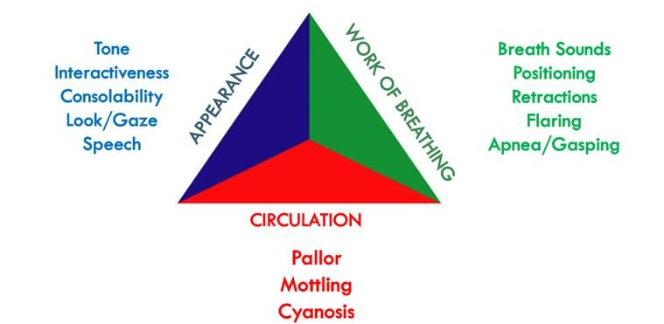
Pediatric Assessment
Same process as normal assessment but with some changes
Consent from parent/caregiver or implied consent
Pediatric assessment triangle
Children experiencing respiratory distress often assume the tripod position
Nasal flaring
For circulation, skin, lips, and palms should be pink and not pale or grey/blue
For the rest of the assessment use the patient’s caregiver as a resource
For assessment tips, see Table 30-3 (pg. 709-710)

Slide 13
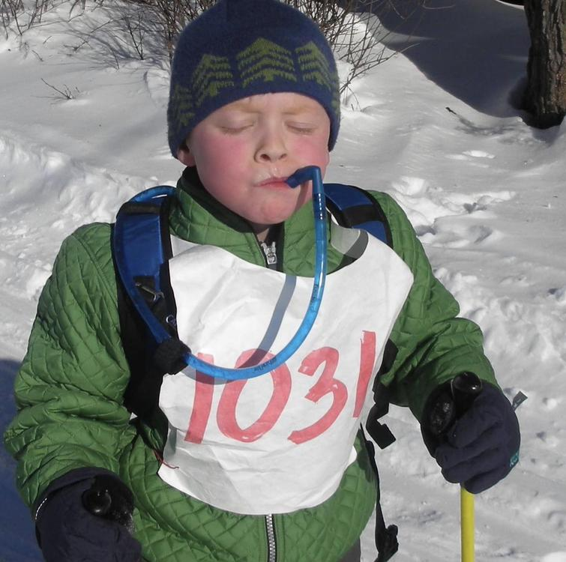
Practice Questions!
Which of the following explains why children compensate for shock differently than adults?
Higher blood volume, higher heart rate
Lower blood volume, lower heart rate
Lower blood pressure, higher heart rate
Lower blood pressure, lower heart rate
Notes:
Answer: C

Slide 14
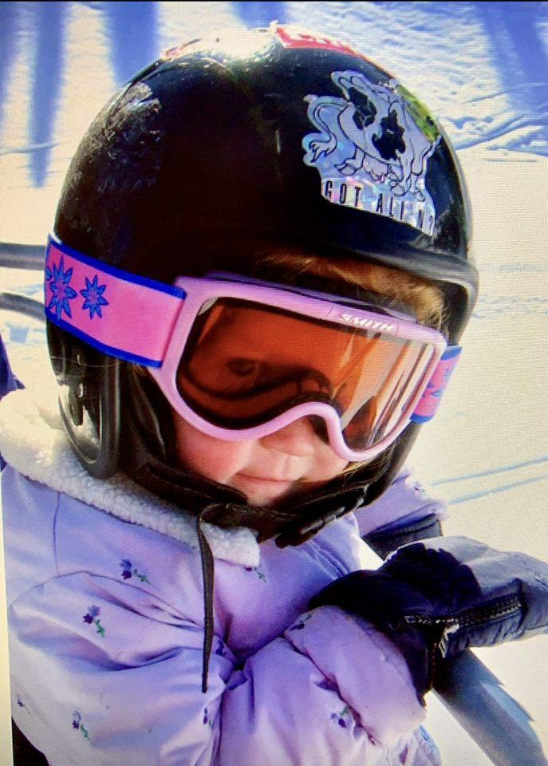
Practice Questions!
For a 7 year old, which of the following sets of vital signs is within normal limits?
Pulse 90, respirations 25, systolic BP 100 mm Hg
Pulse 130, respirations 50, systolic BP 70 mm Hg
Pulse 40, respirations 10, systolic BP 120 mm Hg
Pulse 80, respirations 40, systolic BP 110 mm Hg
Notes:
Answer: A

Slide 15
Practice Questions!
You are assessing a child who fell in ski school and is complaining of arm pain. During your assessment, which of the following findings would suggest that the child might be a victim of physical abuse?
Multiple bruises in various states of healing
Hypothermia
Reluctance by the child to explain older injuries
Both A and C
Notes:
Answer: D

Slide 16
Practice Questions!
Which patroller is this?
Ivo
Justin
Michael
Sam Marquis
Notes:
Answer: B

