Slide 1
Rescue Basics
OEC Chapter 3
10/1/2023

Slide 2
Goals
Understand necessary preparations to working outdoors
Explain different types of disease contact and how one can protect themselves
Examine some infectious diseases
Explore protocol in a hazmat scenario and at a crime scene

Slide 3
Working Outdoors
Consider current environment and prepare accordingly
Clothing, sun protection, eye protection, etc
Maintain a standard of physical fitness
Wear a helmet
Eat, sleep, and stay hydrated
We may lose up to 2 L of water per hour on the hill!

Slide 4
Working Outdoors: Stress Responses
Abnormal Stress Responses:
Immediate
Delayed
Cumulative
Take care of yourself first and foremost!

Slide 5
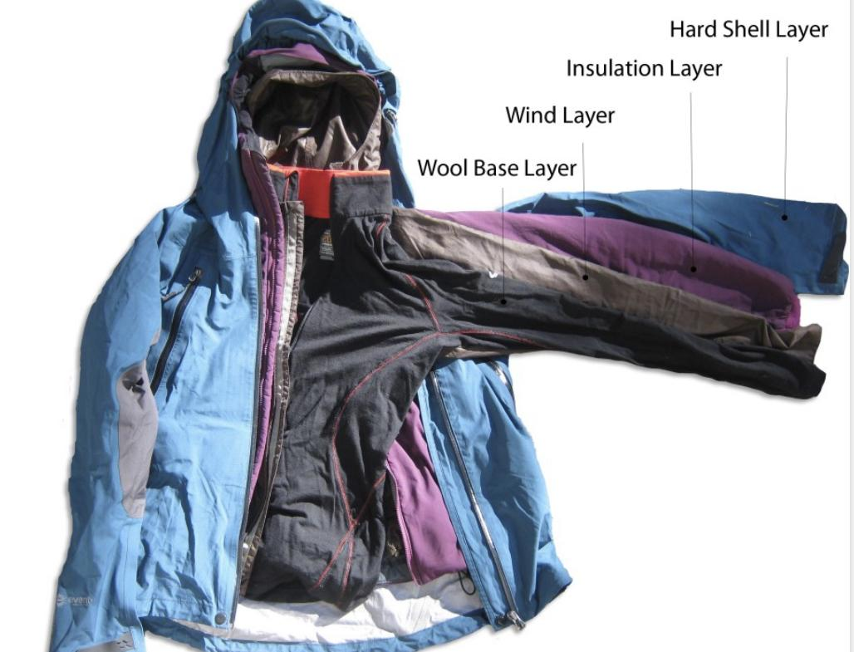
Working Outdoors: How to dress
Base Layer
Tight against skin, wicks moisture
Middle Layer
Insulates by trapping warm air
Fleece, wool, down
Outer Layer
Water and wind repellant, provides protection

Slide 6
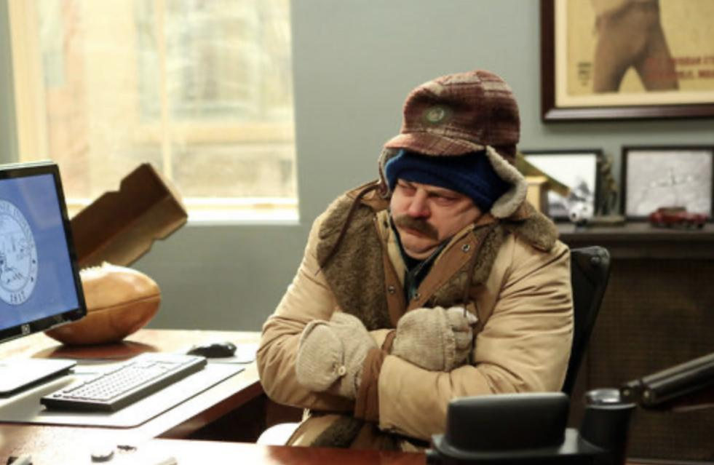
Protecting From Disease: Transmission
Forms of disease transmission:
Direct contact; close person to person contact
Indirect contact; contact with contaminated object
Airborne transmission; inhalation of infectious pathogens
Ingestion; eating/drinking contaminated food/water
Vector-borne transmission; human to animal disease spread

Slide 7
Protecting From Disease: Common Infectious Diseases
Meningitis, common cold, flu, chicken pox, tuberculosis all spread via airborne transmission
Gastroenteritis, hepatitis A spread via ingestion
Rabies is a vector borne illness
STDs spread via direct contact
Lice and athlete‘s foot spread via indirect contact

Slide 8
BSI and Standard Precautions
To prevent the spread of disease, each patient is to be considered potentially infectious. Accordingly, we follow Standard Precautions.
Body Substance Isolation (BSI) measures are steps we take to prevent contact with bodily fluids.
So… dispose of used materials, clean hands, disinfect surfaces and use PPE…

Slide 9
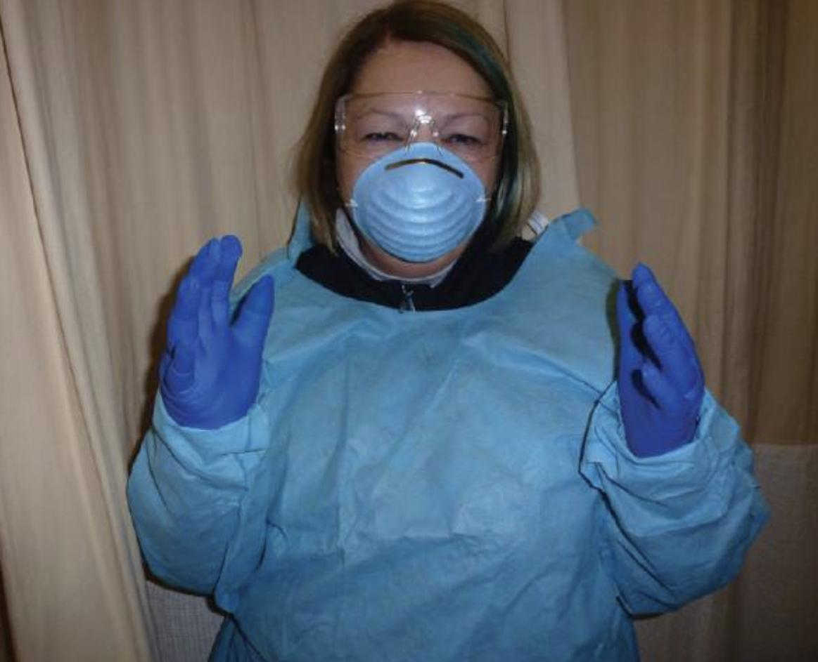
Personal Protective Equipment
Personal Protective Equipment (PPE) provides a barrier between yourself and the patient
Examples:
Gloves
Mask
Gown
Glasses

Slide 10
HazMat Incidents
Hazardous materials are any materials that can cause harm to life — radioactive materials, pathogens, flammable materials, corrosives, explosives
If you encounter a hazmat incident, recognize it and call 911, and remain uphill and upwind

Slide 11
Crime Scenes
Ensure scene safety
Treat as needed, but take care not to disturb evidence - treatment is a priority, however
Alert authorities if you are first to arrive on scene

Slide 12
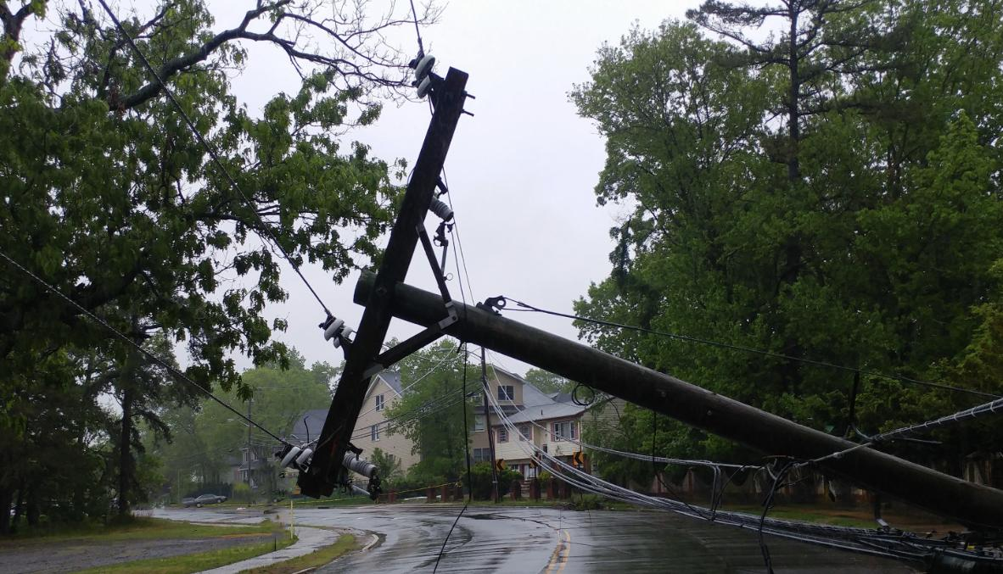
Scene Safety
On any scene, ensure your safety first and foremost
If a scene is dangerous, do not approach
Basically, try your best not to become a second patient!

Slide 13
Questions?

Slide 14
Quiz questions:
Which Layer is the insulating layer that traps body heat?
Sub layer
Base layer
Middle layer
Outer layer

Slide 15
Questions
Which Layer is the insulating layer that traps body heat?
Sub layer
Base layer
Middle layer
Outer layer

Slide 16
Questions
Which of the following is an example of PPE one would wear to prevent exposure to infectious agents in the patient’s bodily fluids?
Disposable medical gloves and surgical mask
Hand washing and decontamination
Blood tests and vaccinations
Biohazard bag and sharps container

Slide 17
Questions
Which of the following is an example of PPE one would wear to prevent exposure to infectious agents in the patient’s bodily fluids?
Disposable medical gloves and surgical mask
Hand washing and decontamination
Blood tests and vaccinations
Biohazard bag and sharps container

