Slide 1
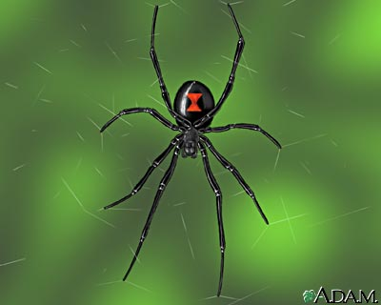
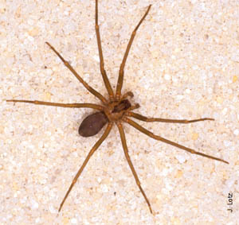
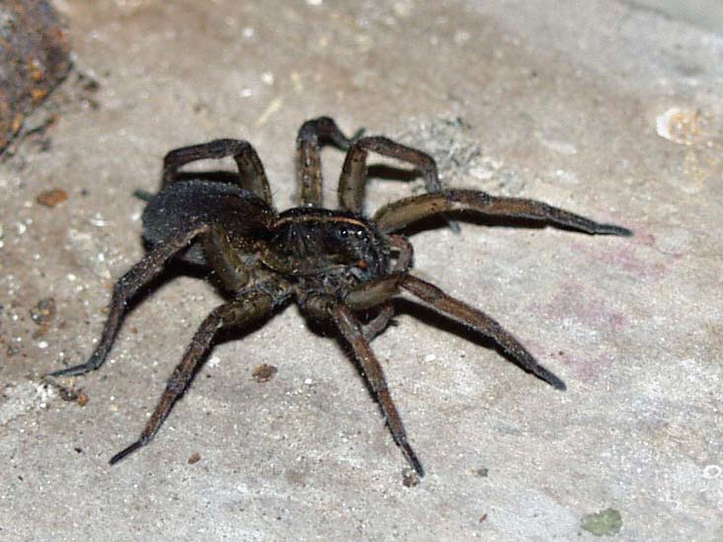
Spiders
Black Widow Spider
A Black Widow bite will swell and can spread to entire limb. Effects include nausea, abdominal pain, fever, sweating, paralysis
Brown Recluse Spider
Venom from bite can destroy walls of blood vessels, causing localized tissue death
Wolf Spider
Localized pain and swelling, symptoms of nausea and headache can also occur

Slide 2
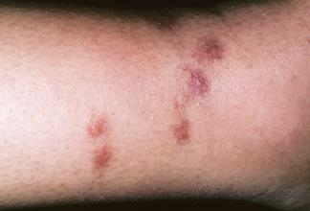
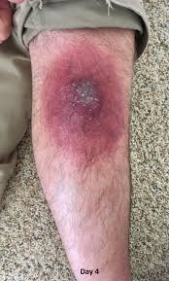
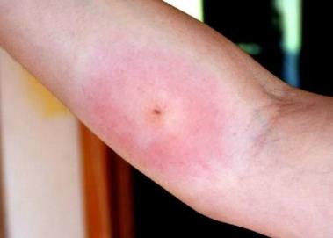
Spiders Bites: Mild to extreme

Slide 3
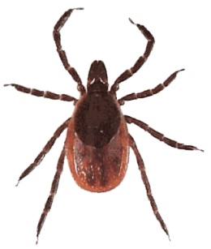
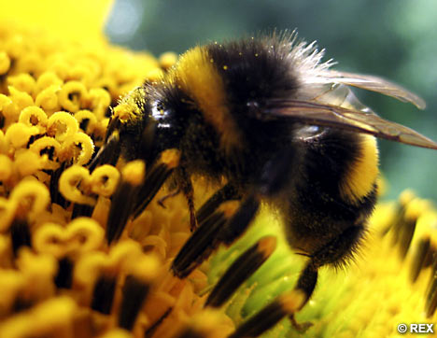
Insects
Ticks
Deer Tick
Transmits Lyme disease
Wood Tick and Dog Tick
Can transmit Rock Mountain Spotted Fever
Bees, Wasps, Hornets
Pain and localized swelling
In severe cases, anaphylaxis and death
Mosquitoes, Fleas, Biting Flies
Ants

Slide 4
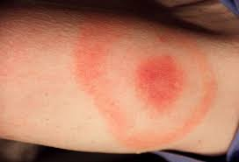
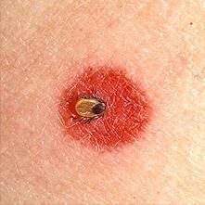
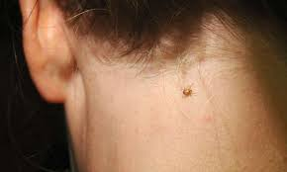
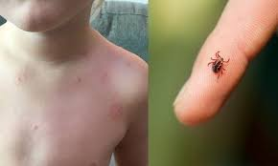
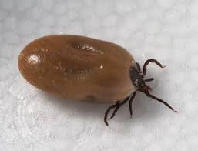
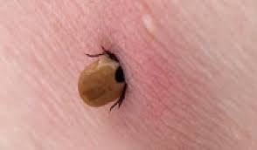

Slide 5
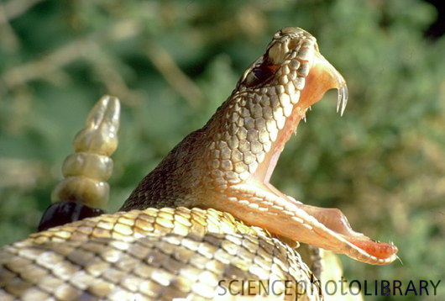
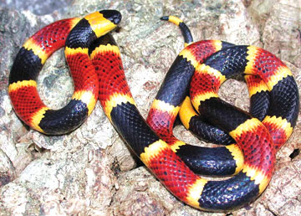
Snakes
Rattlesnake
Brown with checkered or diamond pattern
Bites destroy tissue, cause blood clotting, w/o treatment are potentially fatal
Coral Snake
Brightly colored bands
Venom is a potent neurotoxin that can lead to paralysis and respiratory failure

Slide 6
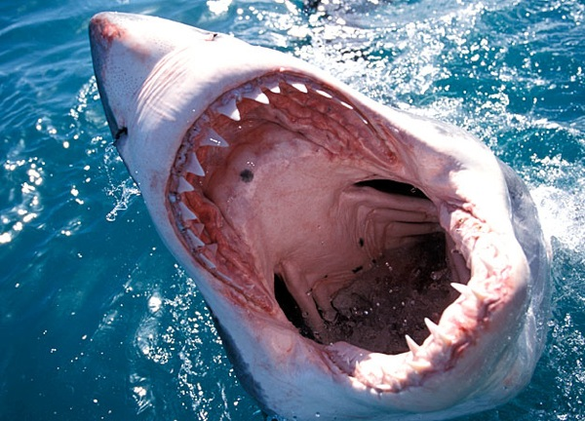
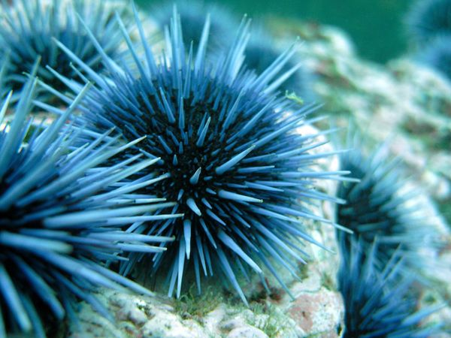
Marine Animals
Sharks
Moray Eel
Stingray
Jellyfish
Biting Fish
Spiny Aquatic Animals

Slide 7
Mammals
Injuries from these animals can lead to soft-tissue damage and in severe cases, internal injuries or broken bones.
Domestic and wild dogs
Domestic and wild cats
Pack animals
Rodents
Bats
Moose, Elk, Deer, Bison
Bear

Slide 8
Assessment and Treatment
Assessment
Scene safety (don’t fight the bear to get to the patient)
LOR and ABCDs
After primary assessment, SAMPLE and DCAP-BTLS
IMPORTANT to find any allergies (e.g., bee stings)
Keep re-evaluating ABCDs and checking for signs of shock

Slide 9
Plant Injuries
Assessment
Look for gastrointestinal upset, abdominal pain, muscle aches
Altered Mental Status
Hallucinogenic effects
Management
Supportive care
Call 911 for poison control (especially if you can identify the plant)

Slide 10
Insect/Animal Injuries
Assessment
Look for rash, pale skin, or swelling
Bite marks
Temperature of skin (fever or chills)
Management
Control bleeding
Wash bites in clean water
Watch for infection
Splint fractures and consider any possible spine injury

Slide 11
Snake Bites
Immediate evacuation
Constant evaluation of ABCDs, shock
Wrap the limb, proximal to distal- to the fang mark
Physical exertion will enhance spread of poison
DO NOT: suck the poison out, use a tourniquet, use ice
Marine Animals
For Bites: Control bleeding, rapid transport
Jellyfish stings
Prevent spread of stinging chemicals
Pain relief

