Slide 1
Plant and animal emergencies

Slide 2
Classifications
Toxin
A poison made by a living creature, whether plant or animal
Poison
Can come from a living creature or from chemicals and substances that are not from living things
Venom
A specific toxin or poisonous secretion of an animal, mostly snakes, spiders, or scorpions

Slide 3
Plants Toxic To The Skin
Usually results in a localized inflammatory/allergic response
Symptoms
Mild case often consists of a rash
Itching
Inflammation
Some pain
Severe cases can result in Anaphylactic Shock

Slide 4
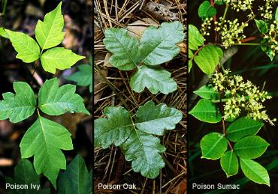
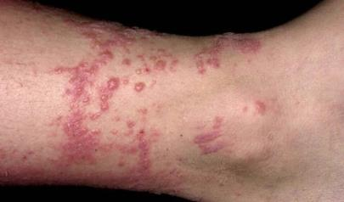
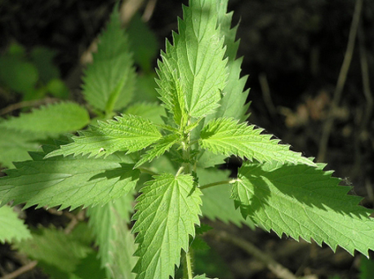
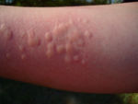
Examples

Slide 5
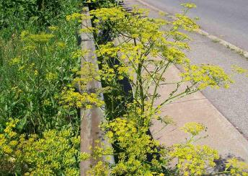
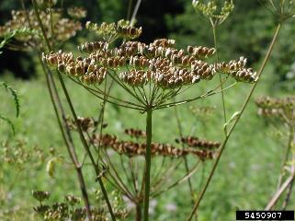
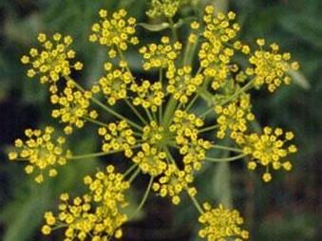
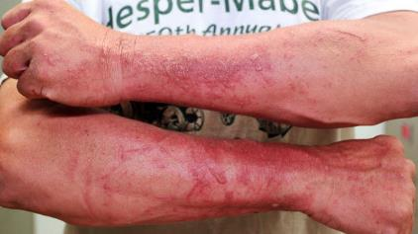
Poisonous Parsnip

Slide 6
Plants Toxic When Ingested
Toxins transferred to the body through the digestive system/stomach lining
Symptoms
Nausea and vomiting
Cardiac effects
Neurological effects
Hallucinations
Seizures

Slide 7
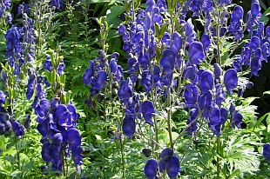
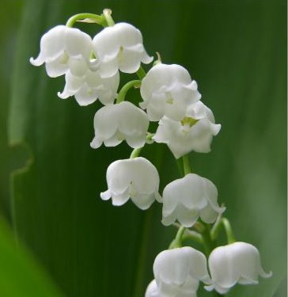
Examples
Monkshood
If eaten, causes nausea and ingestion, and neurological effects
Lilly of the Valley
If Ingested, causes nausea, vomiting, headache, and fatal arrhythmias

Slide 8
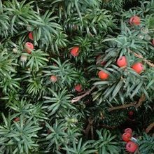
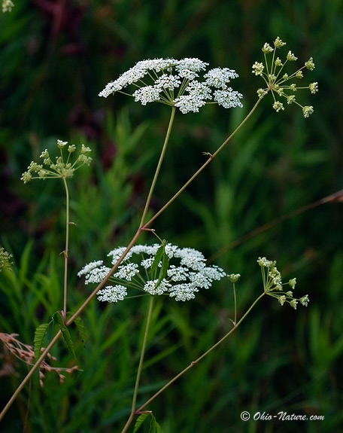
Examples
Yew
Nausea, vomiting, diarrhea. Can progress to shortness of breath, muscle spasms, cardiovascular collapse
Water Hemlock
Nausea and vomiting, followed by neurological effects such as slowed speech, poor coordination, paralysis

Slide 9
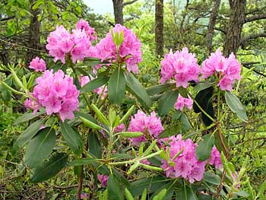
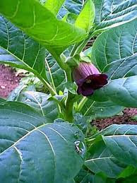
Examples
Rhododendron
Nausea and vomiting, bloody diarrhea, seizures, unresponsiveness, death
Belladona
Nausea, dry mouth, dizziness, visual disturbance, agitation

Slide 10
Poisonous Mushrooms
Three categories of mushrooms dangerous to humans:
Amanitas
False Morels
“Little Brown Mushrooms” (LBMs)
Symptoms
Nausea/Vomiting
Neurological Effects
Hallucination

Slide 11
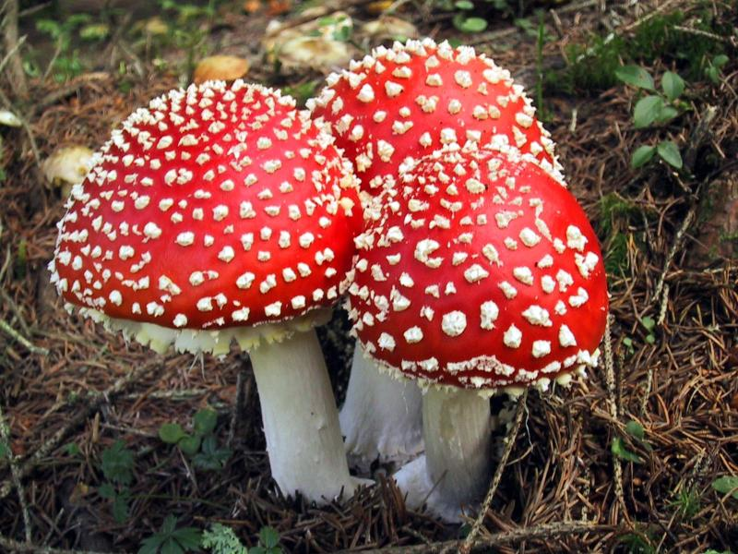
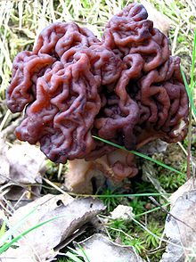
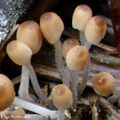
Amanitas
Primarily neurological toxic effects, produce auditory and visual disturbances, loss of equilibrium
False Morels
Nausea, vomiting, diarrhea, severe headaches
Little Brown Mushrooms
Effects vary from mild nausea to hallucinations

