Slide 1
Allergies and Anaphylaxis
Chapter 14

Slide 2
Terms
Allergy: an exaggerated immune response to a substance that does not normally cause a reaction
Allergic Reaction: a series of signs and symptoms that occur in response to exposure to an allergen
Antigen: foreign substance that when introduced into the body stimulates an immune reaction
Antibody: a protein that is produced by the body to neutralize or destroy specific antigens

Slide 3
More Terms
Hypersensitivity: an exaggerated immune response to an allergen, drug, or other foreign substance
Anaphylaxis: a severe allergic reaction that can result in serious cardiac or respiratory compromise
Allergen: a foreign substance whose presence in the body stimulates an allergic reaction
Histamine: a chemical released in the body as a result of an allergic reaction

Slide 4
Common Causes of Allergies
Foods (peanuts, shellfish, nuts, soy, milk, eggs, chocolate)
Insect bites and stings
Environmental irritants (smoke, airborne particles)
Pollen and plant parts (weeds, grasses, trees)
Molds (mildew, spores)
Animal dander (skin, flakes, fur)
Medications (antibiotics, pain medications)
Chemicals (latex)
Other causes (blood transfusions, organ transplants, radiographic dyes)

Slide 5
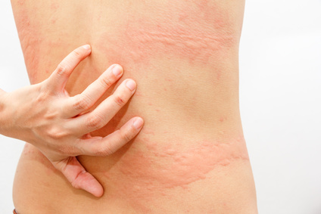
Mild Allergic Reaction
-Urticaria: hives or rashes that accompany an allergic reaction
-Pruritus: severe itching
-Tingling in and around mouth
-Swelling of nasal mucosa, runny nose, congestion, sneezing, watery red eyes
-Feeling tired or run down
-Watery, red eyes
-Increased heart rate

Slide 6
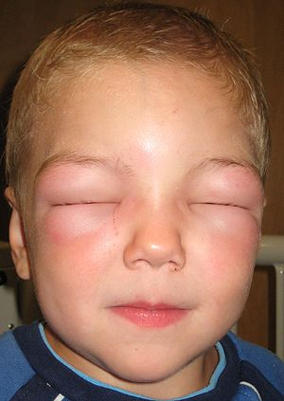
Moderate Allergic Reaction
-All mild symptoms
-but hives also on chest and arms
-Angioedema: swelling occurs beneath the skin or mucosa
-Skin can become flushed or pale
-Gastro can also be affected → abdominal pain, cramping, nausea, vomiting
-Tightness in throat, difficulty swallowing
-Difficulty breathing, wheezing

Slide 7
Severe Allergic Reaction
-Changes in respiratory, circulatory, gastrointestinal, release of massive amounts of histamine
-Hives may cover entire upper body
-Angioedema very pronounced
-Blood vessels dilate causing fall in blood pressure, weak pulse
-Anaphylaxis = sudden collapse of respiratory and circulatory system
-LOR decreases
-Increased heart and respiratory rates

Slide 8
Anaphylactic Shock
-Systolic blood pressure below 90 mmHg
-Respirations greater than 20 rpm
-Heart rate greater than 110 bpm
-Decreased LOR

Slide 9
Management
-Correct any ABCD-related problems
-Open the airway
-Oxygen should be given using a nonrebreather mask at 15 LPM
-Remove any tight-fitting necklaces, watches, rings, bracelets
-Transport
-If applicable assist patient in injecting epinephrine
-Place any patient that shows signs of shock in a supine position with feet elevated

Slide 10
Epinephrine
-promotes bronchodilation and vasoconstriction, thus relieving dyspnea and hypotension
-ensure medication is prescribed for the patient, and check expiration date
-take off cap, firmly inject into thigh for at least 10 seconds, ASSIST the patient in giving themselves their epinephrine (for legal reasons, get them to hold it)
-note time of injection
-massage the injection site for 10-20 seconds
-always transport if you have given epinephrine, even if the patient seems better

Slide 11
