Slide 1
Ch 13: Respiratory Emergencies
By: Maddy Lieblein

Slide 2
Objectives
Anatomy and physiology of breathing
Identify the normal respiratory rates for different age groups and describe normal and abnormal breathing
Causes of airway obstruction
Listening to lungs and assisting with an inhaler
Be able to identify the signs and symptoms for common respiratory emergencies
Assess and manage patients in respiratory distress

Slide 3
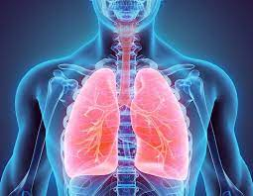
Overview
Ventilation: mechanisms by the lungs to take in oxygen and expel carbon dioxide
Oxygen interruption in brain cannot be longer than 4 minutes without severe damage - 10 in tissue
Causes of respiratory distress can be relatively harmless or life threatening
Amount of CO2 dissolved in blood that controls breathing
Dyspnea: difficult or labored breathing accompanied by shortness of breath
Common complaint OEC technicians encounter
Cannot diagnose problems, but perform assessments and provide life-saving care through oxygen and airway management

Slide 4
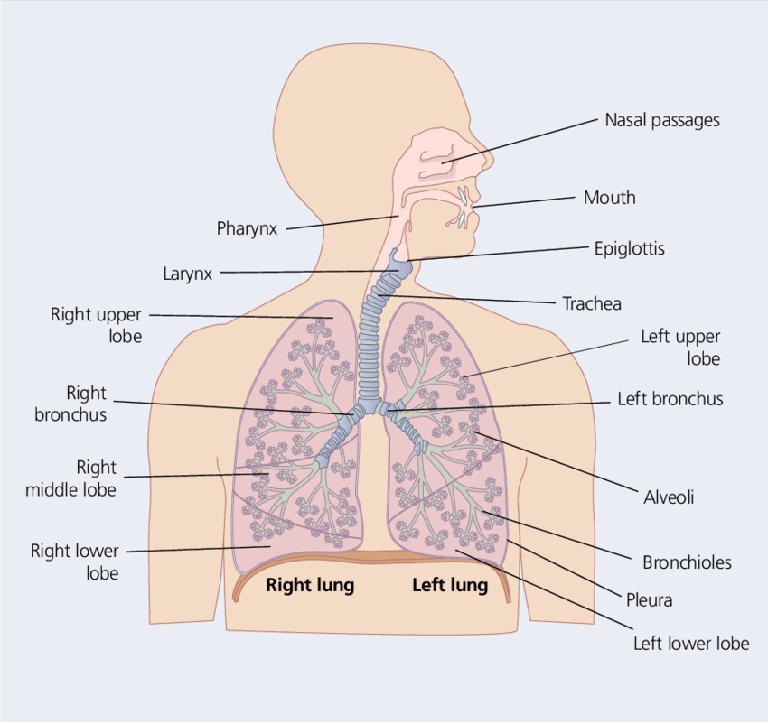
Anatomy and Physiology
Diaphragm is the most important muscle of respiration
Diaphragm and chest wall muscles expand chest cavity, sucking air into the alveoli during inhalation
Alveoli: Tiny air sacs in lungs that allow gas exchange
78% nitrogen, 21% oxygen, 1% other gases
Mechanism: oxygen diffuses into blood into capillaries of alveoli and CO2 diffuses back out and is exhaled
Pleural space is between surface of the lung and lining of chest. Contains fluid from the pleura allowing for movement of lungs
Rate and depth of breathing controlled by acidity in blood (pH)

Slide 5
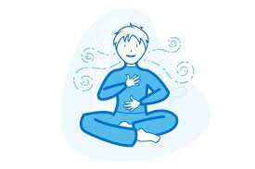
Normal Respiration Rates
Infant: 20 -60 bpm
Child: 15-30 bpm
Adult: 12-20 bpm
Rate
Rhythm
Quality
Depth

Slide 6
Respiratory Emergencies

Slide 7
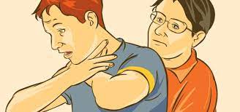
Obstruction/
Choking
Any airway obstruction from foreign body or swelling that limits gas exchange
Tongue is the most common cause of airway obstruction
Finger sweep, suction, gravity/positioning, abdominal thrusts

Slide 8
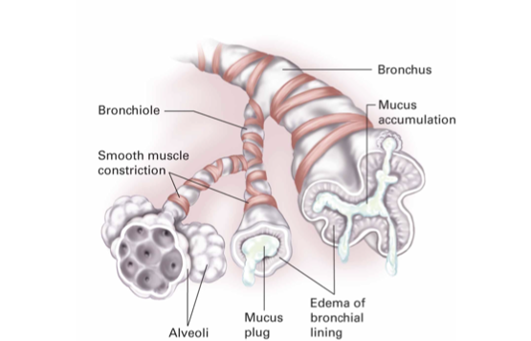
Asthma
Sudden, recurrent lower airway constriction (bronchospasm) and increased mucus production
Over 25 million cases in US, causes unclear
Status asthmaticus - severe attack that does not respond to inhaled medications
Inhalers

Slide 9
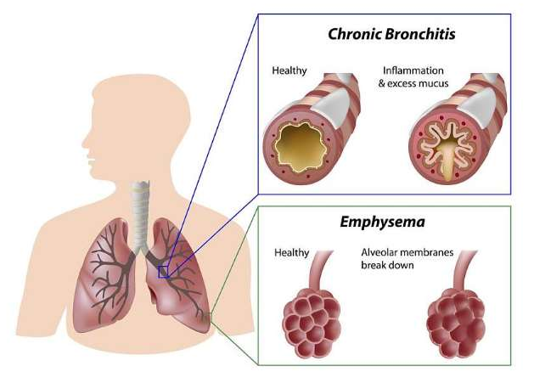
Chronic Obstructive Pulmonary Disease
Chronic inflammatory lung disease that constricts bronchi (tubes carrying air in/out of lungs)
Lung damage and hypoxia
3rd leading cause of death in US
Symptoms: cough, wheezing, mucus
Cannot be cured but treated by increased oxygenation
Chronic bronchitis
Persistent cough
Chronic emphysema: unable to exhale enough air so it gets trapped in lungs
Destruction of alveolar sacs

Slide 10
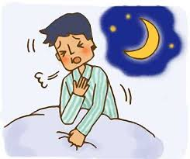
Hyperventilation Syndrome (HVS)
Abnormally low levels of CO2 in blood
Often preceded by anxiety or panic attack
Can be response to physiological insult (eg diabetes) or psychological
Usually benign but can mimic other serious conditions
Can cause hand/feet spasms, chest tightness, tachycardia, temp loss of responsiveness

Slide 11
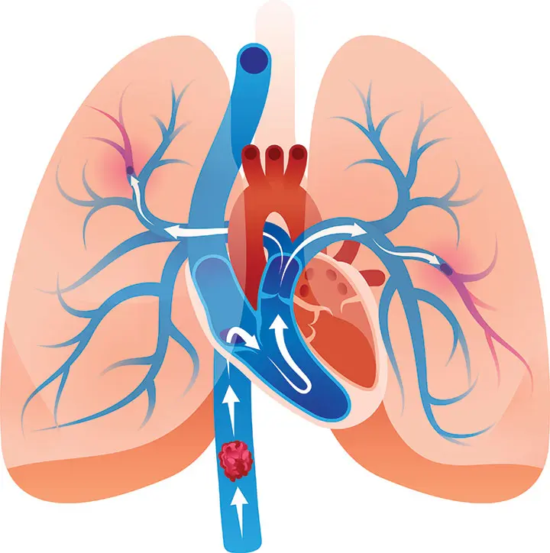
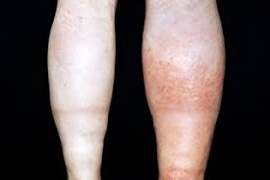
Pulmonary Embolism
Clot or embolus blocks pulmonary artery (goes from heart to lung)
Travels from distant location
Often from lower legs or pelvis
Deep venous thrombosis
Disrupts flow of blood, prevents gas exchange
Life threatening
Saddle embolus is most lethal (stops blood flow in both lungs)

Slide 12
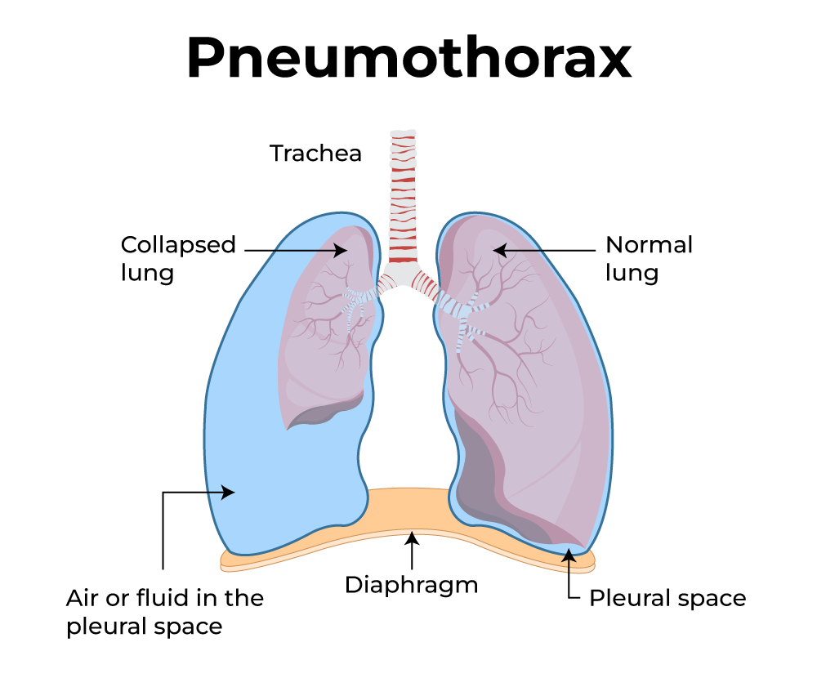
Pneumothorax
Accumulation of air between lung and inner chest wall (pleural space)
Trauma or spontaneous alveoli rupture (air escapes to pleural space)
Depending on size, can resolve on own or cause shock and hypoxia

Slide 13
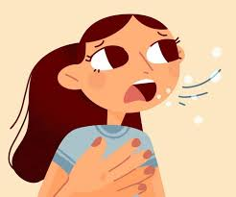
Other causes of respiratory distress
Trauma
Altitude illness
Pneumonia
Carbon monoxide poisoning
Colds

Slide 14
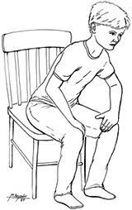
Patient Assessment
Scene size up - general impressions important
ABCD
Control life-threatening bleeds
Includes clearing the airway
LOR
Call for ALS immediately if severe respiratory compromise
Signs and Symptoms
choking/gagging, inability to speak, open-mouthed breathing, panting/gasping/wheezing, pursed lip breathing, tachypnea/bradypnea, cyanosis, nasal flaring, upright/tripod position, changes in LOR

Slide 15
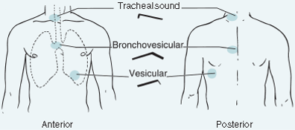
Secondary Assessment
SAMPLE and medical history are important
Chronic conditions
Medications
Recent surgeries
Illness
Full-body assessment
Palpating the chest: crepitus (crackling)
Vitals
Every 3-5 min
Listening to lung sounds
Can change rapidly
Less than 8/greater than 30 bpm signs of resp failure

Slide 16
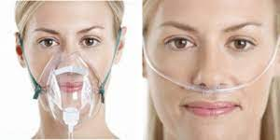
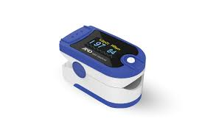
Management
Oxygenation
Pulse oximeters (94-99%)
Supplement with non-rebreather or nasal cannula
Keeping airway clear
Assess and monitor for shock
Vitals every 3-5 min
Position of comfort (only supine is signs of shock)
In toboggan, put head uphill, elevate chest/head

Slide 17
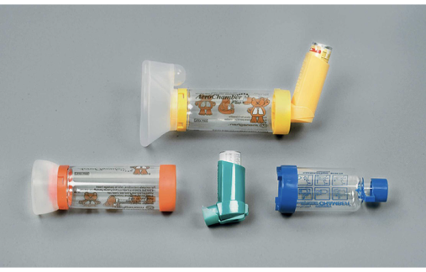
Inhalers
Metered-dose inhalers: dilates bronchioles to allow easier breathing
Make sure it is prescribed to patient/not expired
Assist in using

Slide 18
Practice Question 1
What is the most common cause of airway obstruction?
Foreign bodies
Soft-tissue swelling
The tongue
Vomit

Slide 19
Practice Question 1
What is the most common cause of airway obstruction?
Foreign bodies
Soft-tissue swelling
The tongue
Vomit

Slide 20
Practice Question 2
2. A patient comes in with respiratory distress. During your assessment, you find he is a long-time smoker and had knee surgery last week. He presents with tachypnea, tachycardia, chest pain, and has a swollen and tender calf. Which respiratory emergency could this be?
Pneumothorax
Pulmonary Embolism
Chronic Obstructive Pulmonary Disease
Asthma

Slide 21
Practice Question 2
2. A patient comes in with respiratory distress. During your assessment, you find he is a long-time smoker and had knee surgery last week. He presents with tachypnea, tachycardia, chest pain, and has a swollen and tender calf. Which respiratory emergency could this be?
Pneumothorax
Pulmonary Embolism
Chronic Obstructive Pulmonary Disease
Asthma

