Slide 1
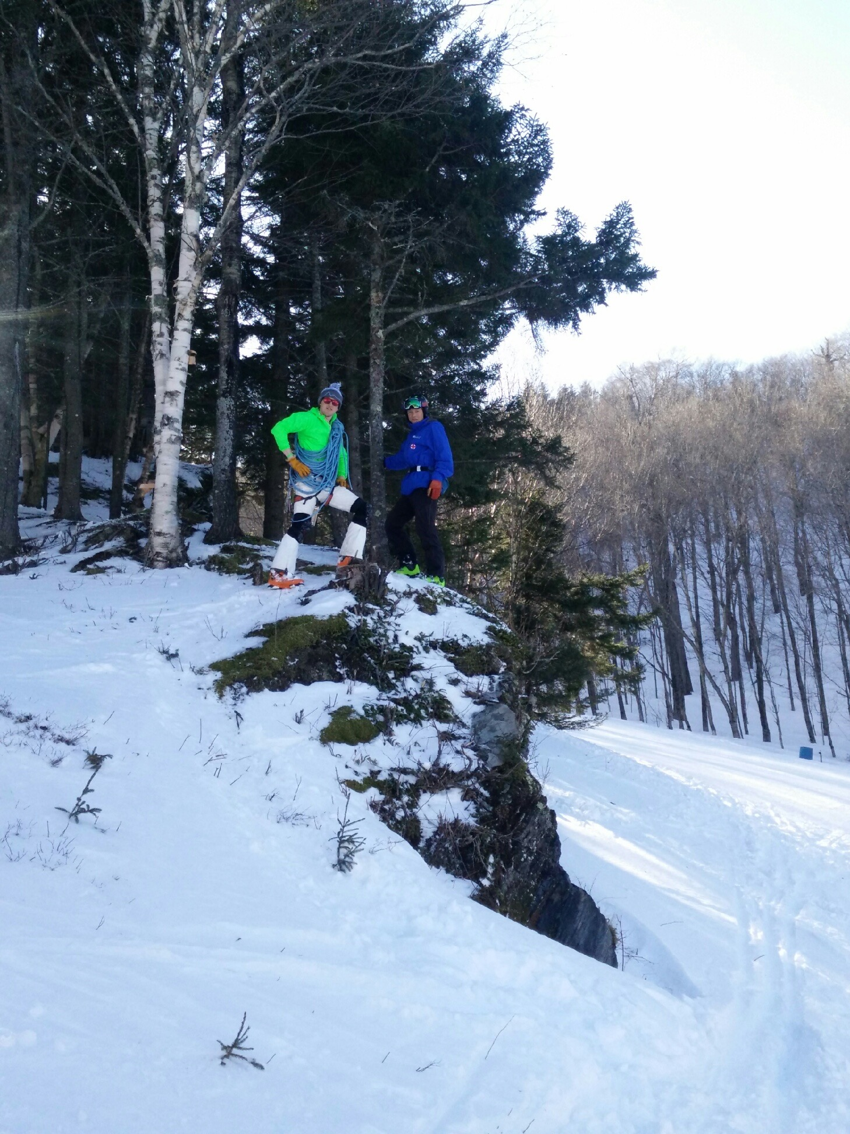
Alcohol on the Mountain

Slide 2
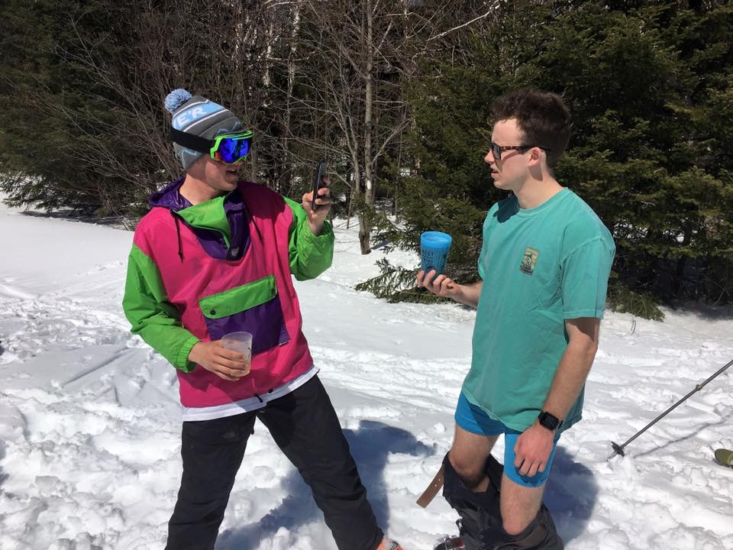
Alcohol will make a patient feel warmer then they actually are

Slide 3
Increases confidence with decreased sensitivity to pain

Slide 4
Assessment
Is the scene safe
If not contact a HazMat team
ABCD’s: Airway is key considering toxic inhalants
During sample and DCAP-BTLS focus on the way they respond and pay attention to LOR
Pay attention to surroundings
Reduce further exposure
Reduce absorption

Slide 5
The Take-Home
If It seems like a patient who has been abusing a substance or has been inadvertently exposed needs higher medical care – they probably do.
Protect yourself
Monitor the patients Airway, Vitals and LOR.

