Slide 1

Chapter 11
Altered Mental Status

Slide 2
Objectives
11.1 Define altered mental status.
11.2 List nine causes of altered mental status using the mnemonic AEIOU-TIPS.
11.3 List and compare the four major types of diabetes.
continued

Slide 3
Objectives
11.4 List the signs and symptoms and demonstrate the treatment of the following medical conditions:
  hypoglycemia
  hyperglycemia
  partial seizure
  generalized seizure
continued

Slide 4
Objectives
11.5 Compare and contrast the three types of stroke:
  ischemic stroke
  hemorrhagic stroke
  transient ischemic attack
11.6 Describe how to assess a patient with altered mental status.
11.7 Describe and demonstrate the treatment of a patient with altered mental status.

Slide 5
Topics
Anatomy and Physiology
Altered Mental Status (AMS)
Violent Behavior and Altered Mental Status
Chapter Summary

Slide 6
Case Presentation
In a convenience store, you hear the manager call for help and state that a customer is “really out of it” in the bathroom.
You identify yourself as an OEC technician and offer to help as you suspect this might be a case of AMS. You find a middle-aged man lying on the floor. He is confused and responds only to loud verbal stimuli. His radial pulse is fast and strong. His skin is pale, cool to the touch, and diaphoretic.
Notes:
Discussion Points:
What should you do?
After determining that the scene is safe, tell the manager to stabilize the man’s head and neck.
Instruct the clerk to call 9-1-1 for a middle-aged man with altered mental status.
Introduce yourself to the patient and ask permission to help.
Perform a secondary assessment, looking for injuries, signs and symptoms.

Slide 7
Anatomy and Physiology
CNS: Brain and spinal cord
  Brain: three main parts protected by skull and CSF:
    Brain stem – controls life functions, (i.e., breathing, swallowing, responsiveness, and cardiovascular system)
    Cerebellum – controls balance and coordination
    Cerebrum – controls emotion, thought, speech, integration, memory, sensation and motor function.
Notes:
Review CNS with your students. If necessary, return to Ch 6 Anatomy and Physiology.

Slide 8
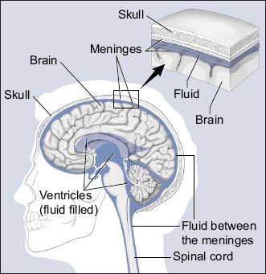
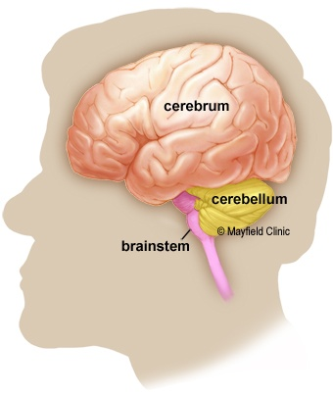

Slide 9
Anatomy and Physiology
Spinal Cord:
  Connects the peripheral nervous system to the brain, transmitting information to and from the brain.
  Part of the Central Nervous System
Peripheral nervous system: All other neural elements not included in the CNS.
continued

Slide 10
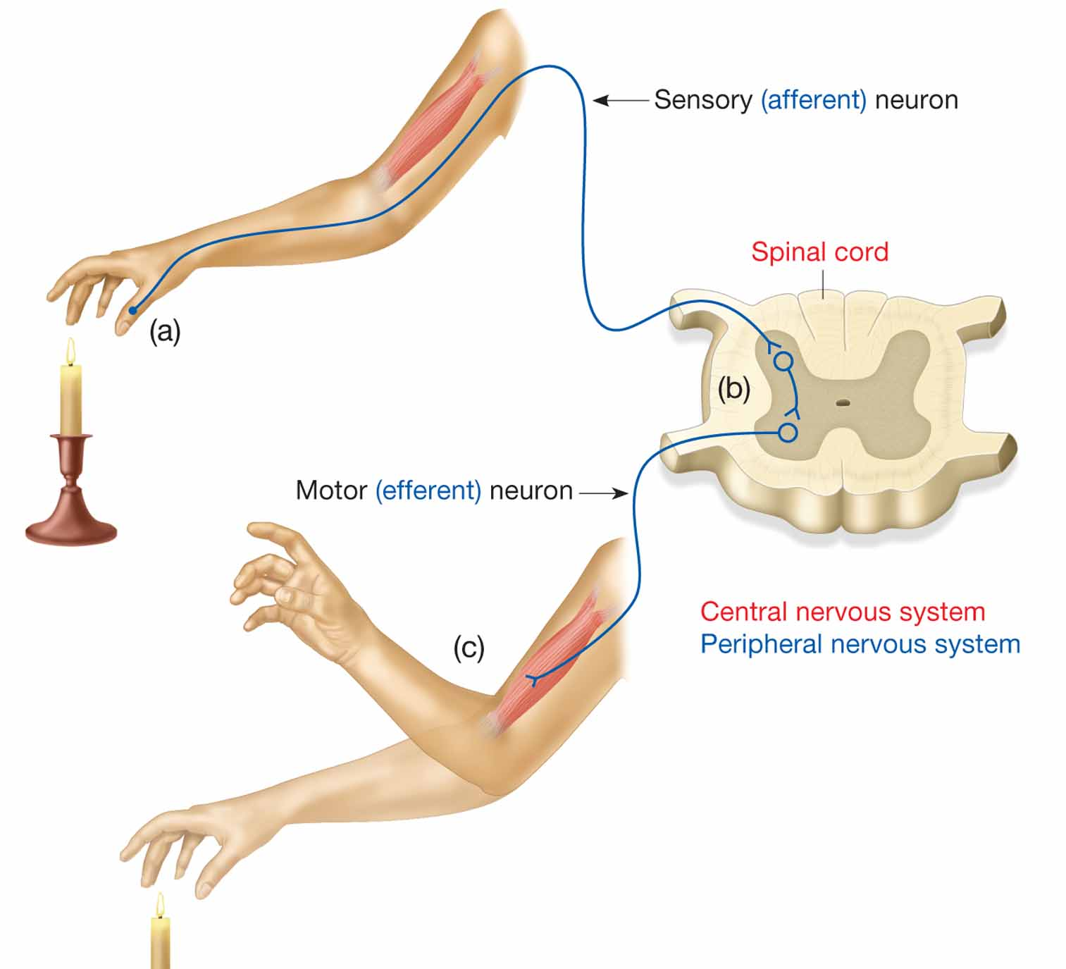
Anatomy and Physiology
continued

Slide 11
Anatomy and Physiology
Endocrine system regulates level of glucose available to nervous system.
  Endocrine organs produce and secrete hormones.
  Pancreas secretes insulin and glucagon to regulate levels of circulating glucose.
  Too high or too low blood glucose affects level of awareness or responsiveness.
Notes:
Discussion Point: Ask students if anyone has family members who have diabetes. Discuss any experiences they’ve had with their family members’ levels of awareness or responsiveness.

Slide 12
Altered Mental Status
AMS malfunction can be:
  Global – affecting all parts of the central nervous system equally.
    Decreased levels of responsiveness or abnormally stimulated states.
  Localized or focal – affecting a portion of the body.
    Motor weakness, balance problems, vision loss, or speech abnormalities.
Notes:
Explain AMS and how it is affected by different illness and conditions.

Slide 13
Causes of
Altered Mental Status
Causes of AMS: AEIOU-TIPS
  A: alcohol and acidosis
    Alcohol – most commonly abused drug in US; CNS depressant.
    Acidosis – decrease in body pH, affecting homeostasis; numerous causes, e.g. decreased respiratory or cardiac function, renal disease, severe hyperglycemia, and various gastrointestinal disorders.
continued

Slide 14
Causes of
Altered Mental Status
Causes of AMS: AEIOU-TIPS
  E: epilepsy, environment, and electrolytes
    Epilepsy –disorder resulting in sudden, recurrent seizures.
    Environment – extreme variation from normal body temperature; results in changes in level of responsiveness; also toxic bites/stings.
continued

Slide 15
Causes of
Altered Mental Status
Causes of AMS: AEIOU-TIPS
  E: epilepsy, environment, and electrolytes
    Electrolytes – imbalance disrupts homeostasis; levels affected by diet, exercise, medications, ill health, sweating, vomiting, or diarrhea.
continued

Slide 16
Causes of
Altered Mental Status
I: insulin
  Any condition that adversely affects production or use of insulin or regulation of blood glucose level.
continued

Slide 17
Causes of
Altered Mental Status
O: oxygen and overdose
  Oxygen – any decrease in cerebral O₂ level will result in decrease of global CNS function and responsiveness; most common cause of AMS.
  Overdose – due to overuse or abuse of prescription or illicit drug; depressants may negatively affect both CNS and respiratory function.
continued

Slide 18
Causes of
Altered Mental Status
U: uremia
  Poor kidney function results in toxic build-up of waste products, lethargy, coma, and death.
continued

Slide 19
Causes of
Altered Mental Status
T: trauma and tumors
  Trauma – traumatic brain injury causes brain swelling and increased intra-cranial pressure; results in focal or global AMS.
  Tumors – abnormal growth of cells in brain: malignant or benign; focal or global AMS.
continued

Slide 20
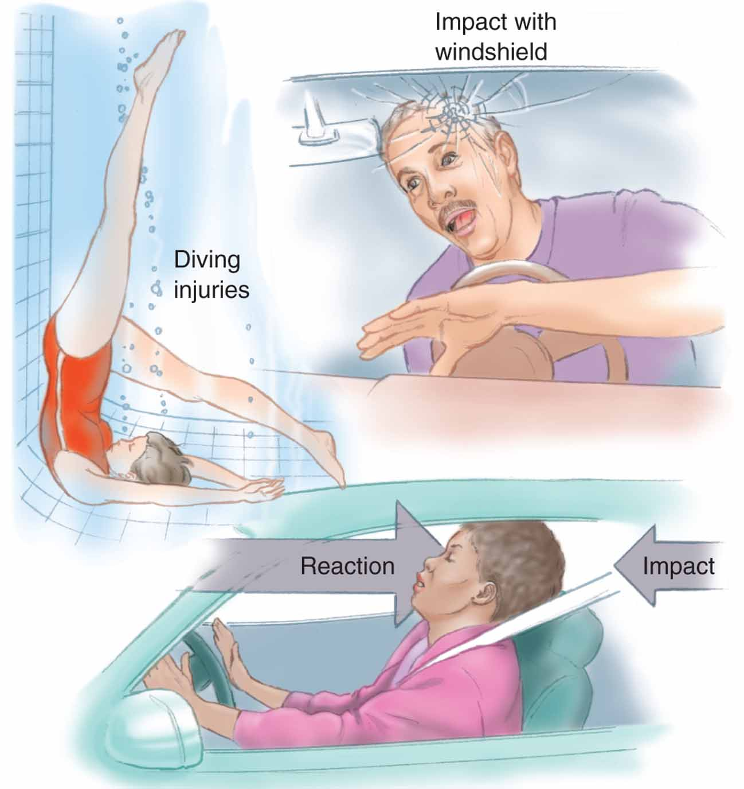
Causes of
Altered Mental Status
continued

