Slide 1
Chapter 1: Intro to OEC

Slide 2
What is OEC?
Primary prehospital care professionals
OEC text is primarily focused on skiing, but also carries over to rafting, mountain biking, and other backcountry activities.

Slide 3
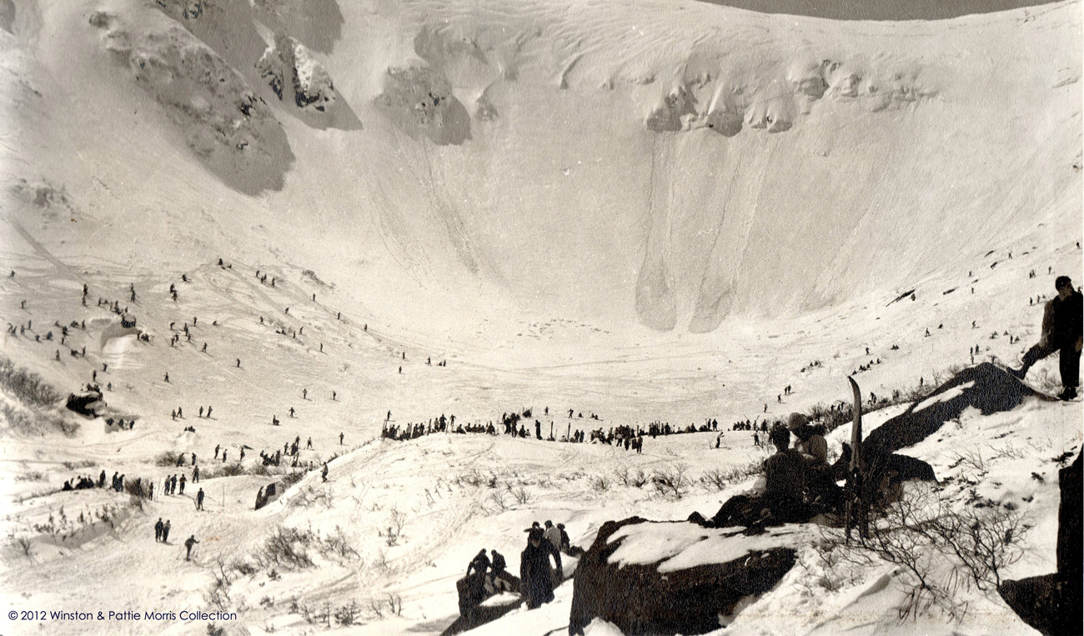
Ye Old National Ski Patrol
Founded by Minnie Dole
Insurance broker from Connecticut
Busted his ankle at Stowe
Realized lack of rescue system
Began NSP

Slide 4
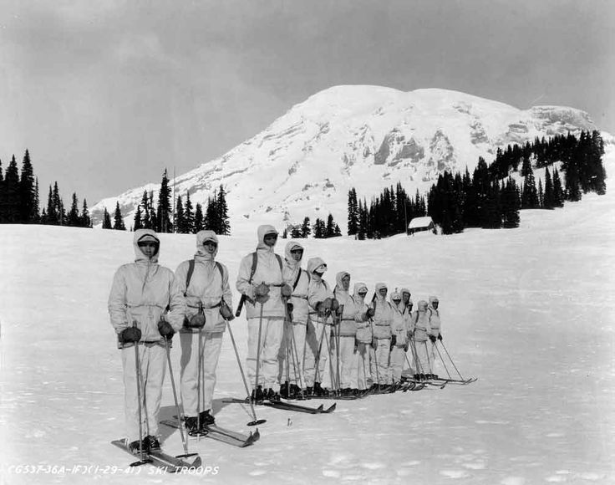
Ski patrol goes to war
Dole sees the need for a winter warfare unit
7000 volunteers showed up
Deployed to Italy in 1944
10th Mountain Division

Slide 5
NSP/OEC Today
What do I get out of the class?
OEC certification, which includes...
Written and practical exams
Three year cert
Annual refresher course
CPR also required at most mountains

Slide 6
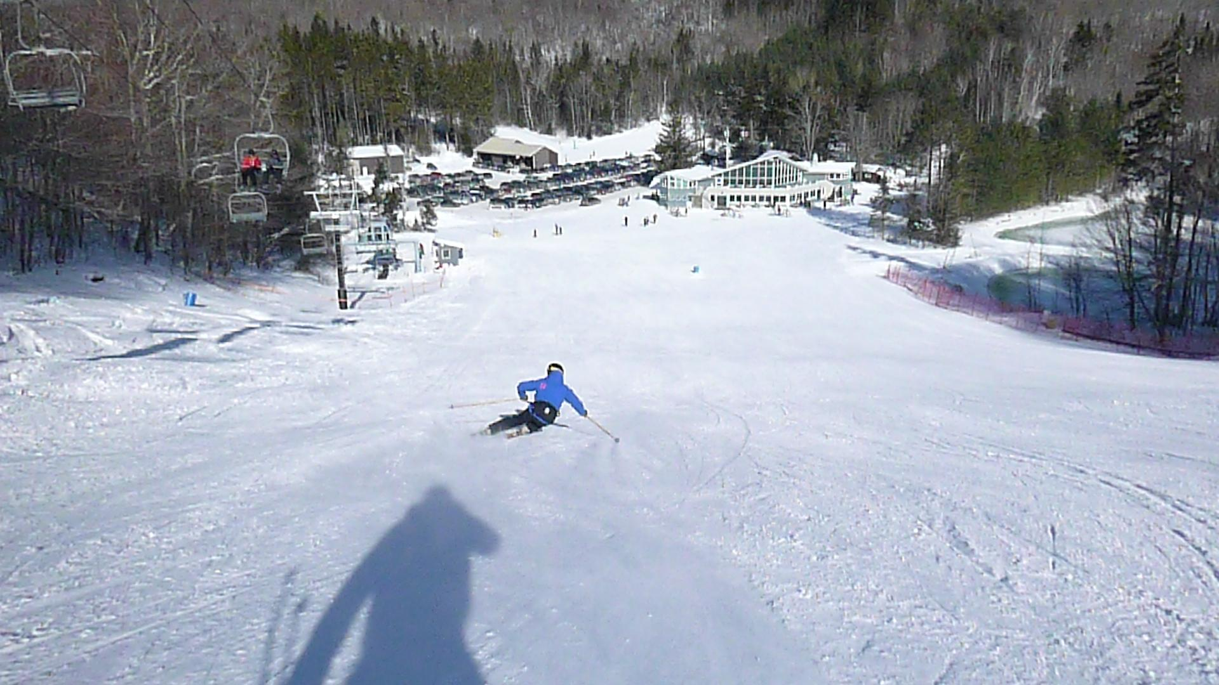
What do I do as a patroller?
Foremost, medical care provider
Second, Ski!!!!
Mountain ambassador
Work outdoors

Slide 7
Ethics of being an OEC technician
Respect the independence of a patient
Do not harm your patient
Do good and benefit all
Be just and faithful

Slide 8
Ethics and Legality
Good Samaritan Laws
Doctrine of Public Reliance
Duty to Act
Breach of duty
Abandonment
(Comparative) negligence
Scope of Training versus Standard of Care

Slide 9
Ethics and Legality
Types of patient consent
Expressed
Informed
Implied
Minor
Refusal of Care
HIPAA

Slide 10
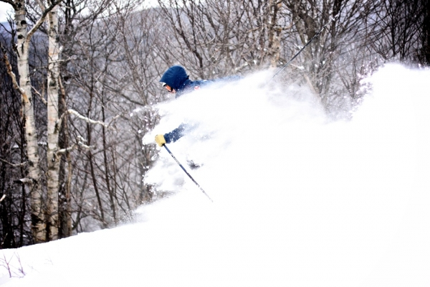
Chapter 2

Slide 11
Emergency Care systems
Bring in specifically trained individuals and resources to the scene of an emergency short after the situation occurs.
Emergency Medical Services
Integration of Health Services
Human Resources
Education
Prevention of Injury
Communication Systems
Clinical Care

Slide 12
Levels of Emergency Personnel
EMR
EMT
WEMT, AEMT
Paramedic
“Scope of Practice”
Emergency Facilities

Slide 13
Continuity of Care
Communication and commonality are key!!!
Everyone can help out...as long as they have direction

Slide 14
Medical Communications
Documentation and writing
Clear and concise language
Radio Etiquette (use local standards)

Slide 15
Final Important bits
Medical oversight in emergency care systems
Direct versus indirect oversight
Emergency care protocols
Quality improvement
Continuing education

Slide 16
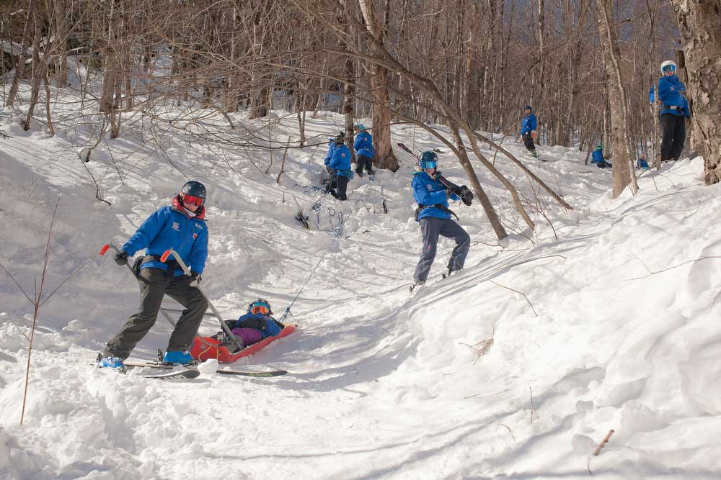
Rescue Basics
Chapter 3

Slide 17
Objectives
Body temperature regulation
Four mechanisms of heat exchange
“Fight or flight response”
Five modes of disease transmission
PPE, BSI and standard precautions
Scene size up
YOUR SAFETY AS A RESCUER IS PARAMOUNT

Slide 18
Adapting to Environments
Fight or Flight response:
A function of the autonomic nervous system as a response to a stressor
Release of epinephrine/adrenaline, elevated HR and BP, pupil dilation
Homeostasis:
The body’s ability to regulate its inner environment in response to changes in outside environment

Slide 19
Four Methods of Heat Transfer
Conduction: transfer of heat by direct contact
Convection: body heat lost to surrounding air
Radiation: loss of heat by infrared rays
Evaporation: sweat or water evaporating and cooling body

Slide 20
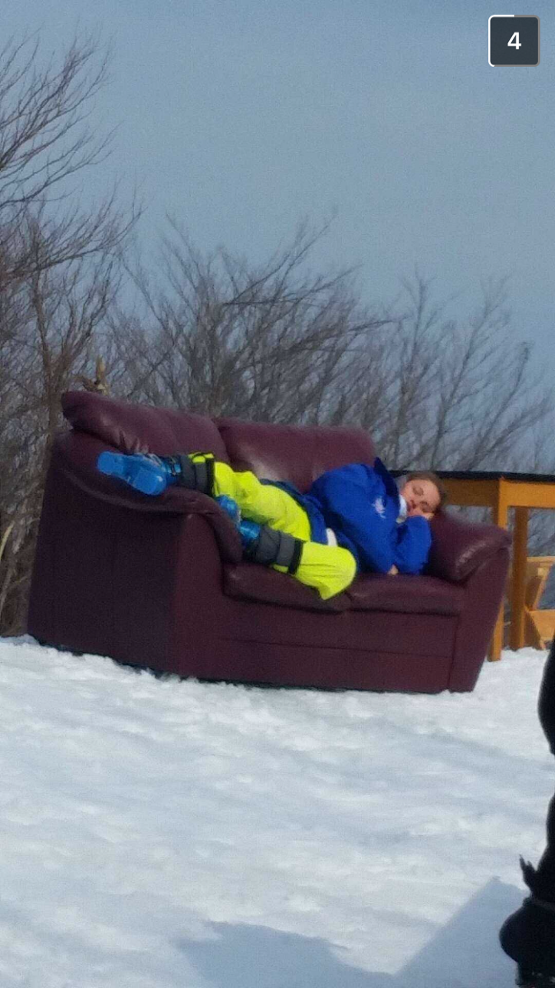
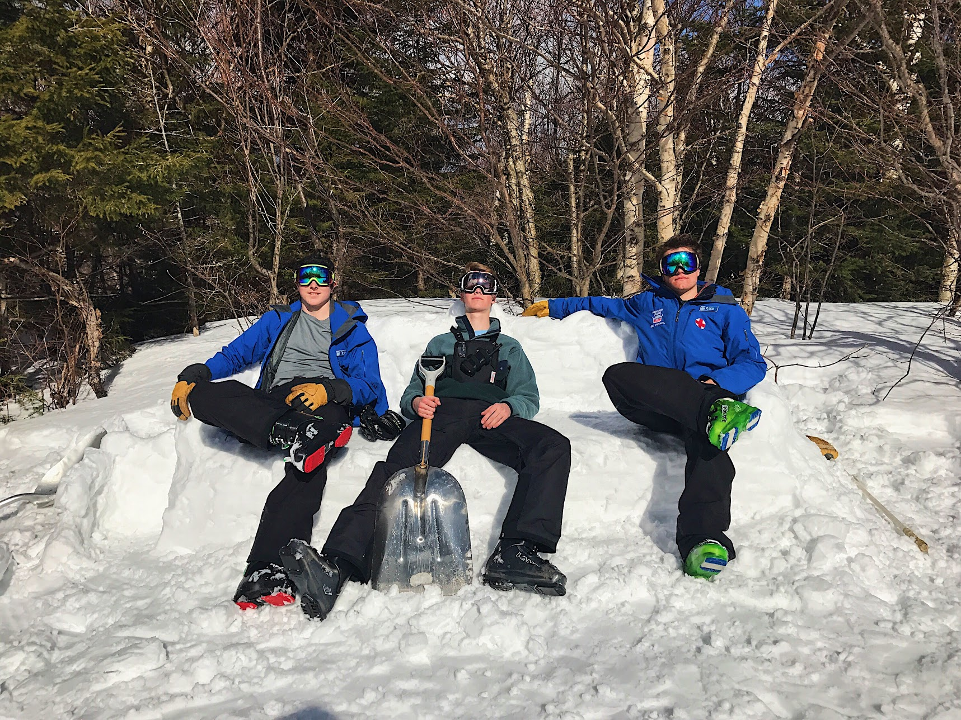
Who is doing a better job dealing with heat loss here?

Slide 21
Working Outdoors
Environmental Conditions
Equipment for all types of weather
Conditions changes fast
Mental Preparedness
Patient will be more relaxed if you are more relaxed
Physical Fitness
Notes:
Going inside when the weather turns to shit is not an option when on duty sometimes

Slide 22
Working Outdoors
Proper Equipment
First aid
Personal
Hydration
Drink more water than you think you need
Gatordew
Prolonged Rescue Response Preparation

Slide 23
Protecting Yourself From Disease
Five ways infections diseases are transmitted:
Direct contact → person/person contact
Indirect contact → contaminated gear, snow...etc.
Airborne transmission → occurs from inhaling infectious pathogens
Ingestion → ingesting contaminated food/water
Vector borne transmission → ticks, mosquitos…
BSI: Body Substance Isolation
PPE: Personal Protective Equipment.
Gloves, eye protection, gown (ski clothing is good protection)

Slide 24
Assessing Emergency Situations
Scene Safety
Scene size up.
MOI: Mechanism of Injury
Mechanical forces involved in producing a patient's injuries
NOI: Nature of Illness
Number of patients and need for additional resources

Slide 25
HAZMAT and Crime Scenes
Hazardous materials (HazMat)
Priority is to remain an effective rescuer and medical care provider
Stay 250 feet from dangerous scene
All dangerous materials should be clearly marked. Call fire dept for HazMat removal. We do not deal with HazMat. Check MSDS.
Crime Scenes
Notify law enforcement immediately, do not tamper with crime scene
Always respect privacy of patients, keep media away

Slide 26
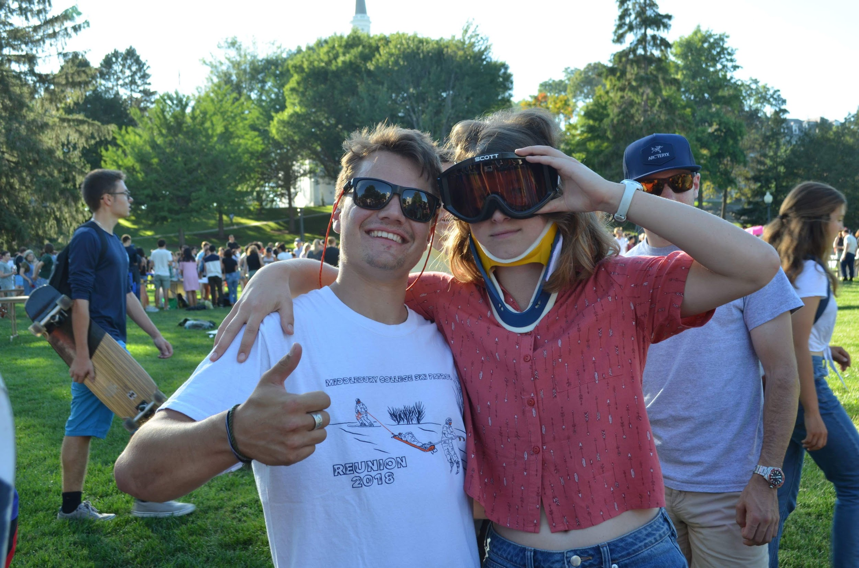
See you next Sunday!!!

