Slide 1
Cardiovascular emergencies
Charlie Kauffman and Sam Marquis

Slide 2
Objectives
Upon completion of this chapter, the OEC technician will be able to:
15-1 List the Arrythmias associated with sudden cardiac death.
15-2 Demonstrate how to assess and treat a patient with a cardiovascular emergency.
15-3 Describe what you should ask a patient who takes a heart medication
15-4 Explain what an anticoagulant (“blood thinner”) is
15-5 List the signs and symptoms for each of the following cardiovascular disorders:
Acute myocardial infarction
Congestive heart failure
Aortic aneurysm
Pericardial tamponade
15-6 Give the indications and contraindications of aspirin and nitroglycerin therapy
15-7 Describe and demonstrate assisting a patient in taking nitroglycerin and/or aspirin

Slide 3
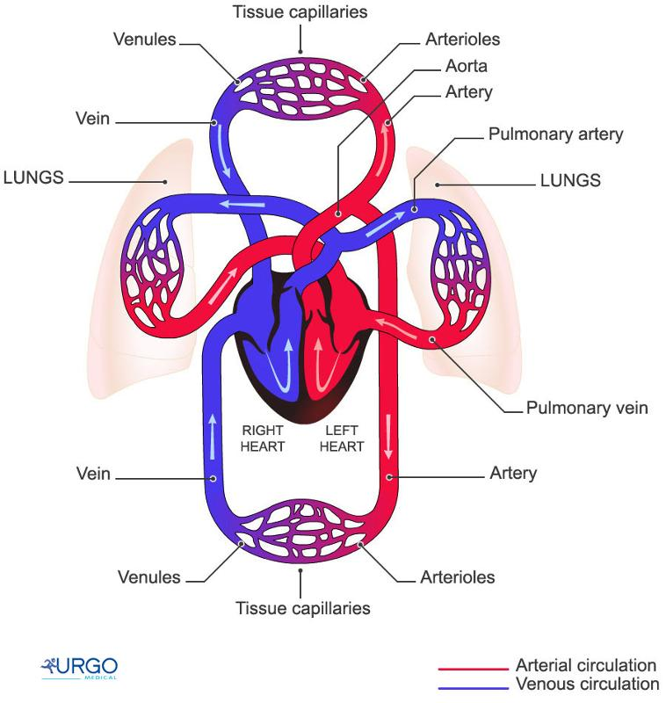
Major components of the Cardiovascular System
1. Heart
2. Blood Vessels
3. Blood

Slide 4
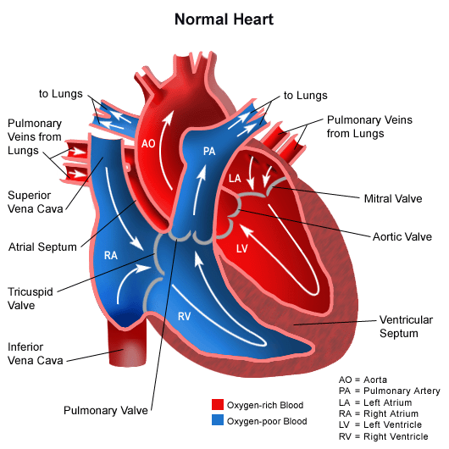
The Heart
Pumps blood, bring nutrients and oxygen to body
Deoxygenated blood returns with unwanted waste product and carbon dioxide
Oxygen-poor blood flows from right atrium to right ventricle to the lungs
Oxygen-rich blood flows from left atrium to left ventricle to the body
Normal HR 60-100bpm for adults

Slide 5
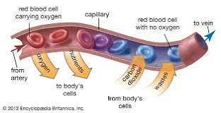
Blood Vessels
Arteries carry blood away from the heart (oxygenated), veins to the heart (oxygen-poor)
Vena cava returns blood to the heart, aorta carries oxygenated blood to the body
Capillaries bridge between arteries and veins, and allow for transfer of nutrients and waste with tissue

Slide 6
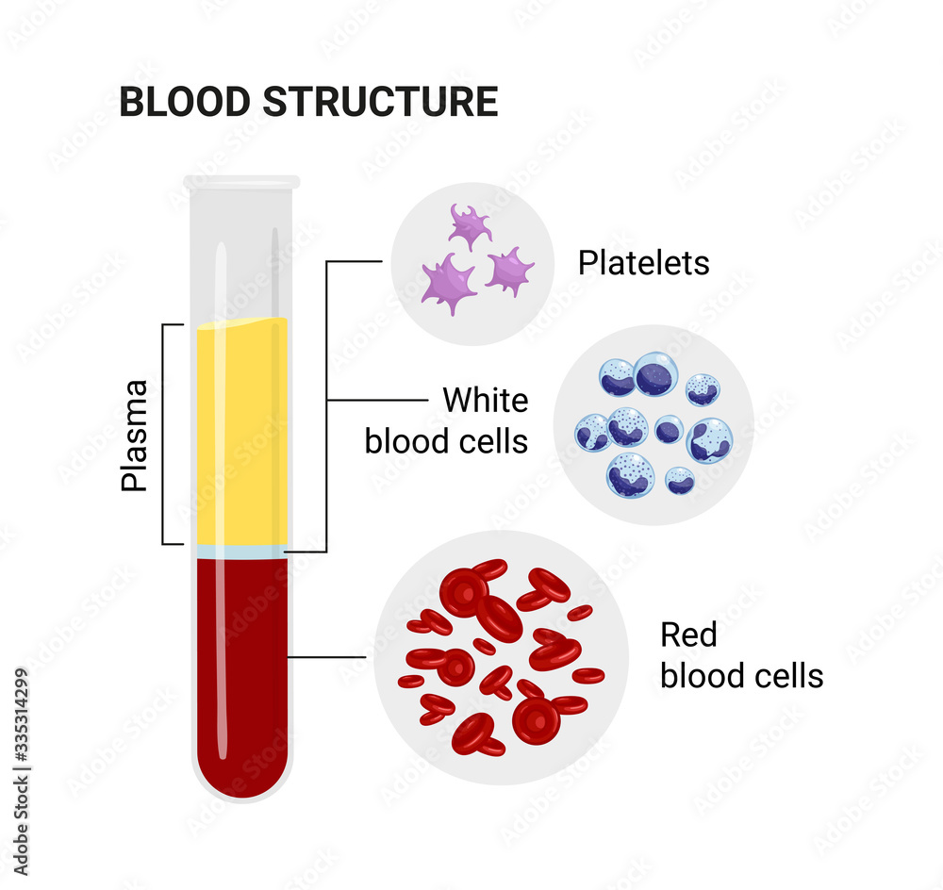
Blood
Carries oxygen, nutrients, and waste products to and from tissue
Fights infections, carries hormones
Blood Pressure: 120/80 normal blood pressure for adults

Slide 7
Cardiovascular emergencies
Atherosclerosis
Hypertension
Congestive Heart Failure
Pulmonary Edema
Angina Pectoris
Myocardial Infarction
Cardiac Arrhythmias
Cardiogenic Shock
Sudden Cardiac Arrest
Thromboembolism
Pericarditis and Pericardial Tamponade
Aortic Aneurism
Heart Values Disorders
Concurrent Cardiovascular Disease

Slide 8
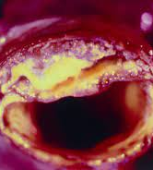
Atherosclerosis
Hardening and buildup/blockage of arteries with plaque
Results in high blood pressure
Restricts blood flow to tissues
Can cause parts of heart to die

Slide 9
Hypertension
Abnormally high blood pressure, usually due to atherosclerosis
Damages organs and small arteries, and can lead to stroke or kidney failure if untreated

Slide 10
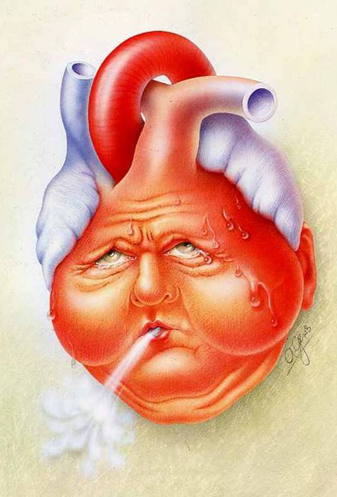
Congestive Heart Failure
Failure of heart to pump blood to organs
Right-sided: blood backup in systemic circulation
Left-sided: blood backup in lungs

Slide 11
Pulmonary Edema
Backup of fluid in lungs, often due to left-sided congestive heart failure
Trauma to lung tissues or certain drugs may also be the cause
Can cause hypoxia and cardiogenic shock

Slide 12
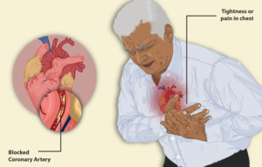
Angina Pectoris
Low supply of oxygen to the heart muscle(ischemia), resulting in chest pain
Can be sudden or chronic
Highly associated with coronary artery disease

Slide 13
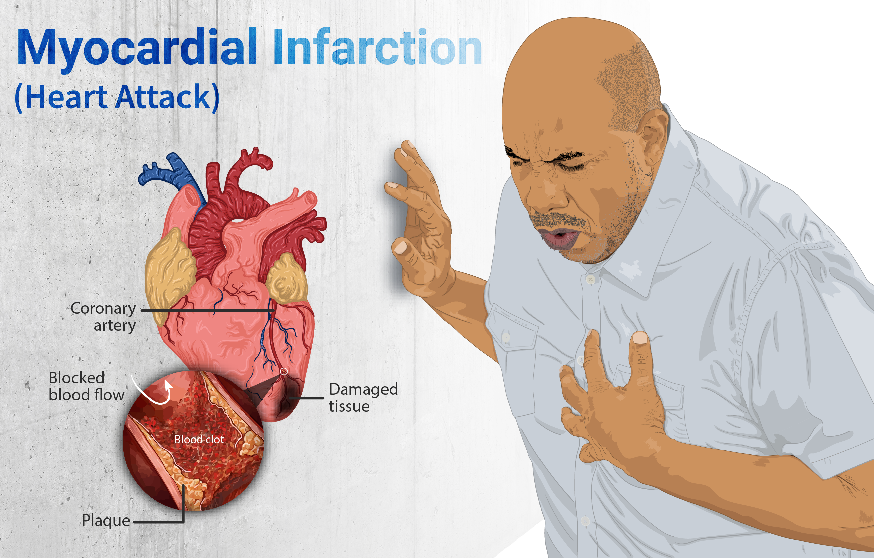
Myocardial infarction
Blockage of coronary arteries leading to ischemia and death of heart muscle
Often caused by blood clots and plaque blocking flow of blood to heart muscle

