Slide 1
Chapter 15: Cardiovascular Emergencies Pt. 2

Slide 2
Cardiac Arrhythmias
Irregular heartbeat or heart rhythm
Ex. heartbeats outside of normal limits, irregular rhythm, or a stopped heart
Life-threatening arrhythmias are often caused by ischemia or lack of oxygen
Some arrhythmias can be non life threatening or chronic
Notes:
Abnormality in coordination of electrical stimulation can cause irregular heart beat and rhythm
Arrhythmias reduce/increase heartbeat or alter the regularity of it
People with chronic arrhythmias often take blood thinners to avoid blood clots

Slide 3
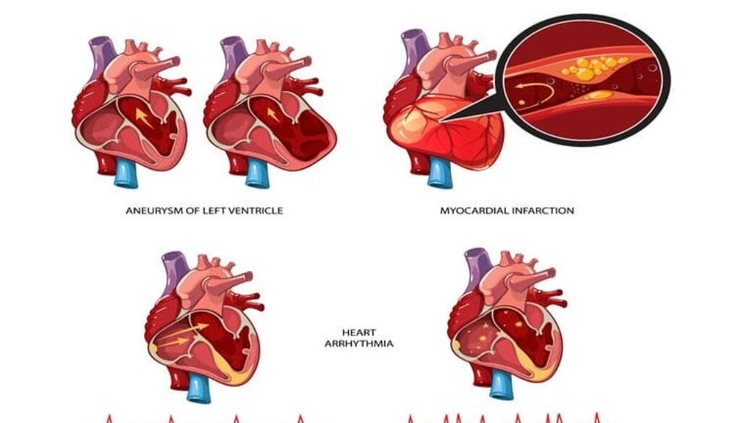
Cardiogenic Shock
If the heart is damaged, the muscle can no longer pump effectively
Bad pumpage -> Low Blood Pressure -> Cardiogenic Shock
Most common type is myocardial infarction
Notes:
You have already learned about myocardial infarctions with charlie

Slide 4
Sudden Cardiac Arrest (SCA)
Abrupt cessation of effective pumping of blood from the heart into the arteries and organs
Occurs without warning
No pulse is present if someone is affected by SCA
Lethal arrhythmias: (CPR and AEDs can prevent lethality)
Ventricular fibrillation
Ventricular tachycardia
Asystole
Notes:
Caused by abrupt cessation of cardiac electrical activity or an arrhythmia
CPR=cardiopulmonary resuscitation

Slide 5
Pericarditis and Pericardial Tamponade
Pericarditis: Inflammation of the pericardial sac around the heart
Causes: myocardial infarction, bacterial and viral infections, and trauma
Pericardium can rub against the heart which doesn’t feel nice
Pericardial Tamponade: fluid buildup in the pericardial sac, which puts pressure on the heart and restricting it’s pulse
Pericarditis: slow development, Pericardial Tamponade: rapid

Slide 6
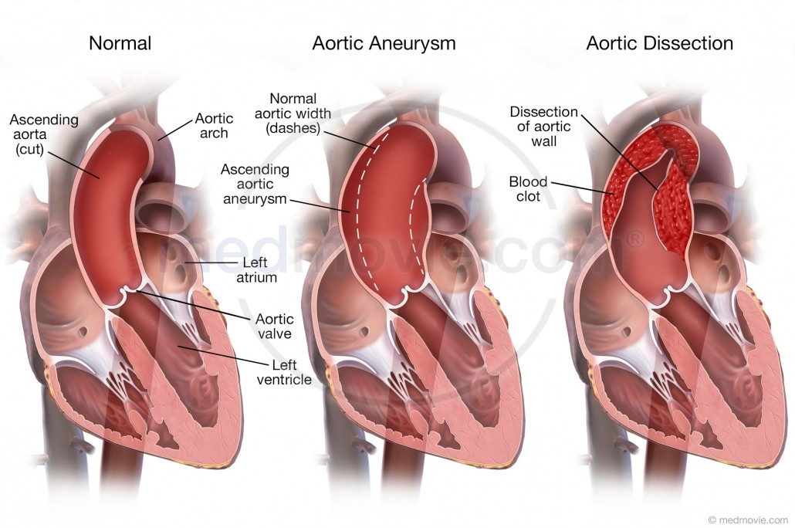
Aortic Aneurysm / Aortic Dissection
Aortic Aneurysm: Dilation of a blood vessel creates “bubble” on the aorta
Aortic Dissection: tearing of the inner wall from the outer wall of the aorta, making the aorta susceptible to rupture
Notes:
An aneurysm is a localized dilation in a blood vessel, can be congenital or result from weakening of the vessel wall
If an aortic aneurysm ruptures the patient will have lethal and rapid internal bleeding

Slide 7
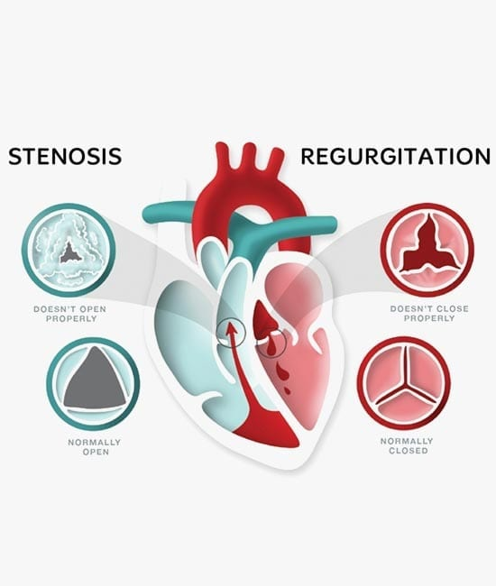
Heart Valve Disorders
If a problem occurs in the heart valves, blood can leak backward, pool, and clot
Most heart valve problems are congenital, but problems can also occur from heart disease, myocardial infarction, infection, and trauma

Slide 8
Patient Assessment
Conduct primary assessment, satisfying ABCD’s
During SAMPLE pay attention to medicine such as nitroglycerin or aspirin as they could suggest a history of heart problems
Use OPQRST to assess chest pain
Cardiac chest pain is often described as “heavy”, “crushing”, or “tight”
If a cardiovascular emergency is suspected continuously check blood pressure and signs of shock

Slide 9
Signs and Symptoms
Hypertension:
Headache, vision disturbances, seizures, nausea/vomiting, facial flushing, bounding pulse
Angina and Myocardial Infarction
Usually a “crushing chest pain” that can radiate to the jaw, arms, and back
Cardiogenic shock
Patients appear deathly ill and exhibit signs of shock
Often tachycardic and hypotensive

Slide 10
More Signs and Symptoms
Congestive Heart Failure
Right CHF: Edema in lower extremities
Left CHF: Blood back ups in the lungs leads to shortness of breath and possible dyspnea with bubbling noises or gasping breaths
Pericardial Tamponade
Deathly appearance: pale skin, diaphoresis, anxiety, and respiratory distress (distended neck veins)
Aortic Aneurysm
Abnormal dilation, bulging, or ballooning of the aorta, severe chest or back pain described as “tearing, ripping, or stabbing”
Abdominal pain that radiates back and possible dizziness
Pulmonary Embolism
Sudden onset of chest pain, shortness of breath, tachycardia

Slide 11
Management
Transport and advanced life support (ALS) requested ASAP
If patient is not breathing or pulse is absent begin basic life support (BLS) immediately
Five links in the adult out-of-hospital chain of survival
Recognition of early warning signs and immediate activation of EMS
Immediate CPR with an emphasis on chest compressions
Basic and advanced emergency medical services
Advanced life support and post-arrest care

Slide 12
CVD Patient NOT in Cardiac Arrest
Call for immediate assistance, oxygen, AED, and ALS
Keep patient calm, put in a position of comfort
If hypotensive, keep supine and warm, and elevate legs
If CHF, sit patient up and put legs in dependent position
Notes:
This is for a patient that could go into Cardiac arrest at anytime due to suspected cardiovascular emergency,

Slide 13
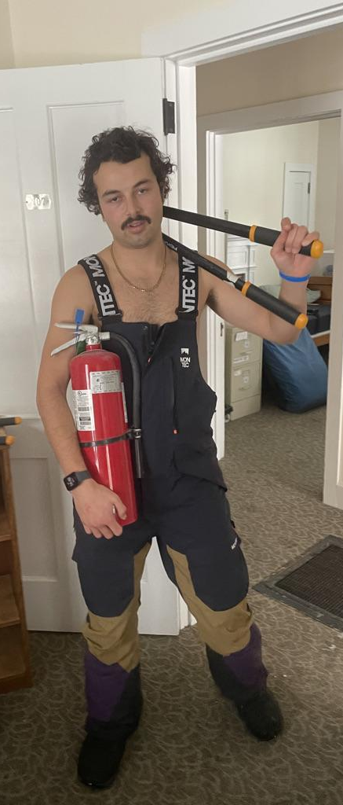
Other Considerations
Implantable devices may be in place
High flow oxygen therapy is crucial
Nitroglycerin
Assist patient if they have their prescription with them and conditions/protocols allow
Aspirin
Assist patient if they have aspirin and protocols allow for it
Notes:
A patient wiht a ventricular assist device will not have a pulse and a blood ox will not read their oxygen levels correclty
When the patient is inside, oxygen might not be needed if they are maintaining 94 to 99% blood ox

Slide 14
Questions:
A visitor is in the lodge watching a skiing event and he is complaining of left arm pain, is sweating and has mild shortness of breath. He may be experiencing which of the following?
Indigestion from eating lunch
A common cold
An acute myocardial infarction
The flu
Notes:
C. an acute myocardial infarction

Slide 15
Questions:
The first steps to care for patients in SCA are:
Assess the pulse, perform chest massage, and use an AED
Connect the AED. assess the airway and call for help
Call for help and wait for them to arrive
Perform rapid primary assessment, perform CPR and AED if needed, and provide rapid transport
Notes:
D. perform rapid primary assessment, perform CPR and AED if needed and provide rapid transport

