Slide 1
CHAPTER 19: BURNS

Slide 2
Objectives:
list four types of burns
list the signs and symptoms for each type of burn
compare and contrast the methods for classifying burns
describe the clinical significance of a voice change in the setting of a thermal burn
compare and contrast direct current and alternating current
describe how to assess burn severity using the “Rule of Nines” system
describe and demonstrate the management of a burn patient

Slide 3
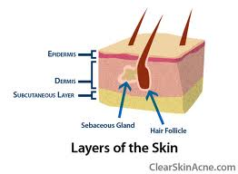
ANATOMY + PHYSIOLOGY
Epidermis – outside, excretes fluids, provides protection
Dermis - cushion
Subcutaneous layer – fat layer for insulation
Notes:
skin = the largest organ in the human body

Slide 4
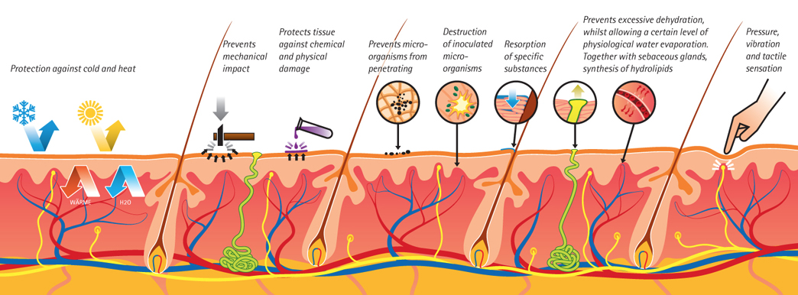
Skin Functions
temperature regulation
excretion
prevent fluid loss
defense
protection of underlying structures
sensation
vitamin D

Slide 5
TYPES OF BURNS

Slide 6
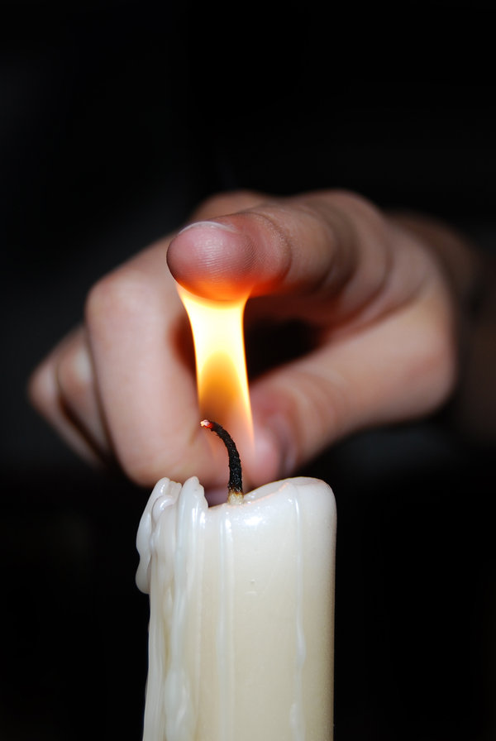
Thermal Burn
DEFINITION: caused when heat comes directly into contact with the skin
Heat from open flames, hot water or steam, or physical contact with hot object
mostly on skin surface unless breathing in hot air
MANAGEMENT:
remove clothing (unless attached to skin)
don’t break blisters because this could cause infection
don’t apply cold compress (this will hurt person more because skin will adhere to compress)
Notes:
burn = an injury caused by excessive exposure to thermal, chemical, electircal or radioactive agents

Slide 7
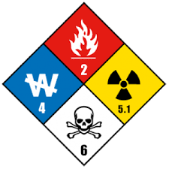
Chemical Burn
DEFINITION: burn from exposure to caustic substances (acids or bases)
acidic and alkaline solutions, concentrated cleaning solutions
alkaline/basic materials cause more harm than acidic materials
MANAGEMENT:
Call Hazmat
Irrigate affected area with water for fifteen minutes; do not rub tissue

Slide 8
Electrical Burn
DEFINITION: burn from exposure to an electrical current; severity will depend on amount of electricity contacted, where electricity enters and exits the body and duration of contact
normally, skin is a poor conductor BUT, when skin becomes wet/oily it is a better conductor
MANAGEMENT:
turn off power source
immobilize patient on backboard
cardiac arrest common secondary effect (if so, apply CPR)
look for points of entry/exit to determine which underlying structures have been affected
Notes:
- Electrical current = a stream of electricity that moves along a conductor
o Direct current = e.c. flows in one direction only
o Alternation current = e.c. that flows in opposite directions
o Amp = unit of current
o Volc = unit of electric potential

Slide 9
RADIATION BURN
DEFINITION: burn from exposure to object or substance or element that emits radiation
sources: x-rays, heat lamps, black lights, the sun
MANAGEMENT:
Call Hazmat

Slide 10
Heart Burn? Definition: When Kye makes your heart melt.

Slide 11
CLASSIFYING BURNS
THICKNESS | DEGREE | DEPTH | CHARACTERISTICS
superficial | 1st | epidermis | skin appears red no blisters
partial thickness | 2nd | epidermis dermis | blisters wet appearance
full thickness | 3rd | epidermis dermis subcutaneous | skin is charred or white dry
 | 4th | extends into bone/muscle | skin is blackened

Slide 12
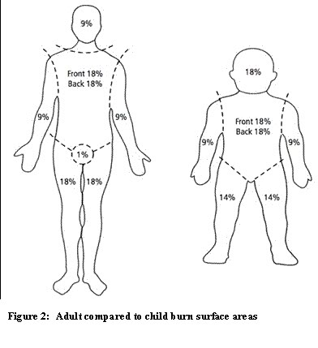
RULE OF ‘NINES’
Notes:
“Rule of Nines” – 11 sections which each represent approx. 9% of TBSA
way to calculate body surface area involved in burns
Head (front & back), chest, abdomen, upper back, lower back, Right arm, Left Arm, Front of Right Leg, Back of Right Leg, Front of Left Leg, Back of Left Leg
Kids & Infants same except the head =18% & legs = 14%
Genitals regardless of age = 1%

Slide 13
Critical Burns:
partial thickness/second degree greater than 10% area
Kids – because kids decompensate much faster, any child under 10 is a critical burn
Adult over 65
Head/feet/hands/neck/genitals/major joints – any burn on these areas classified as critical burn
Inhalation injury or burns
Burns w/ difficulty breathing/hoarseness
Chemical/electrical burns
Any full thickness burn
Burns associated w/ trauma burns w/ serious underlying medical disorder (diabetes, heart disease)
Burns in patient who has special social, emotional, or physical needs
Exposure to radioactive materials

Slide 14
INHALATION SIGNS
obvious burns involving head, face, or neck
singed hair, including the eyebrows, nose hairs and facial hair
soot and other by-products of combustion on the face, in the mouth or around the nostrils
hoarseness or voice changes
airway swelling
darkened oral/nasal discharge
Notes:
A hoarse voice can be a sign of injury to the airway, so always assess patients with hoarseness for potential respiratory compromise

Slide 15
Notes:
28 D 589-90 Know how to calculate using Rule of Nines
each leg is 18, since he burned half of each leg, he burned 18%

Slide 16
Notes:
30 C 592
“do not apply antimicrobial ointments, creams, aloe vera burn cream, or other emollients because their use complicates future hospital care” (592)

Slide 17
Notes:
35 B 594

