Slide 1
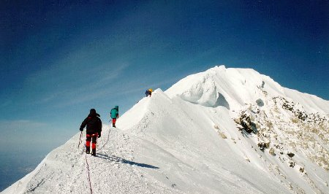

Altitude-related emergencies

Slide 2
Basic info
Key point to remember: as altitude increases, air density decreases, and therefore less O₂ is available.
All altitude-related illnesses are related to this!
Rate of ascent

Slide 3
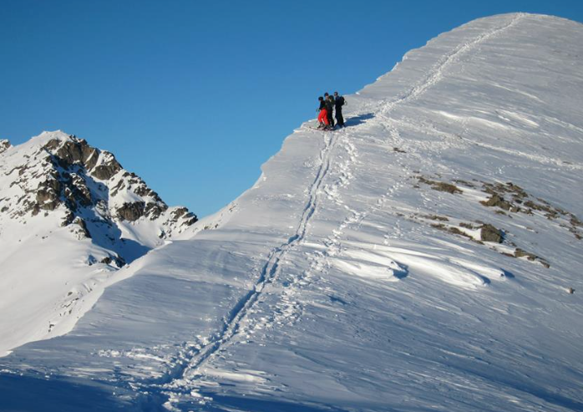
Classifications of altitude
Low: below 5,000 ft.
Intermediate: 5,000-8,000 ft
High: 8,000-12,000 ft
Very High: 12,000-18,000 ft
Extreme: 18,000 ft+

Slide 4
Acclimatization: increase O₂ to cells
Increased resp. rate/depth
Increased heart rate
Increased RBC production
Constriction of pulmonary blood vessels
Increased enzyme production

Slide 5
Acute Mountain Sickness (AMS)
Headache
Generalized sickness: dizziness, fatigue, shortness of breath, loss of appetite, nausea, sleep disturbances, malaise.
Rate of ascent outpaces body’s compensatory ability
Usually above 6,500 ft

Slide 6
HAPE
High-Altitude Pulmonary Edema
Extracellular fluid accumulates in the lungs caused by excessive blood pressure in the pulmonary artery
Persistent dry couch, labored breathing, and in extreme cases, pink frothy sputum
8,200ft+
Fatal in a few hours

Slide 7
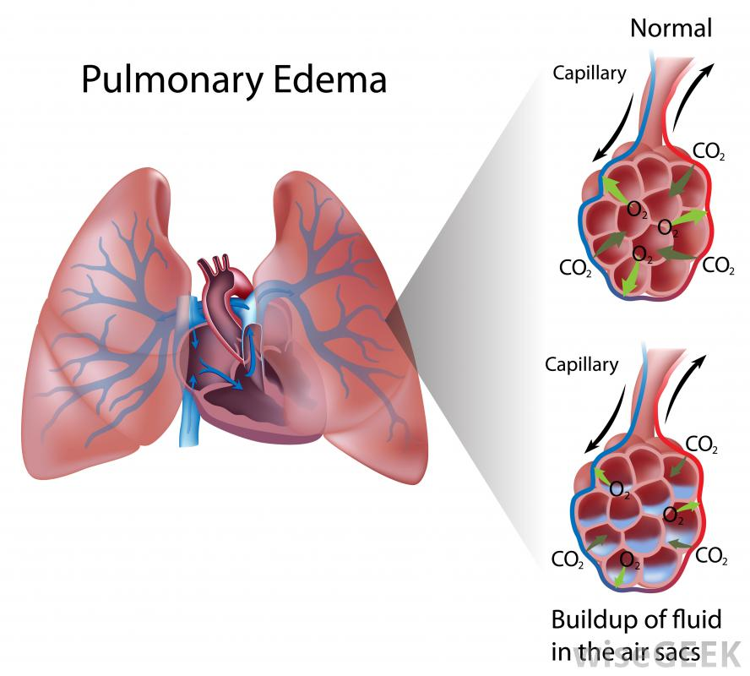

Slide 8
HACE
High Altitude Cerebral Edema
Most severe altitude sickness, may be accompanied by HAPE
Brain swells
Headache, nausea, ataxia, AMS, fatigue, paralysis, difficulty speaking, coma
Leads to death if untreated

Slide 9
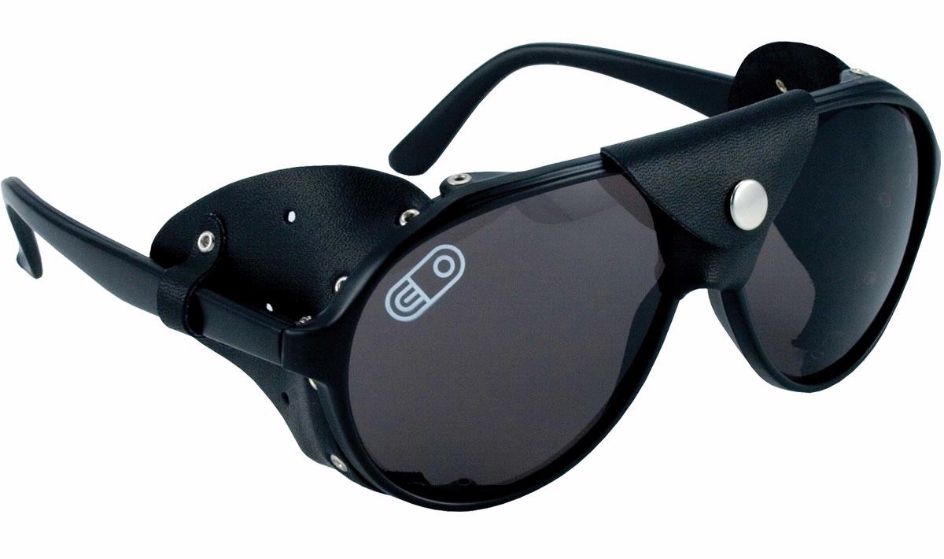
Other Alt-related Problems
Khumbu Cough
High Altitude Retinal Hemorrhage (HARH)
Solar Keratis (snow blindness)
Notes:
Khumbu cough
-high-altitude bronchitis
-dry, persistent cough
-common at altitudes above 14,000 ft
Retinal hemorrhage
-blood vessels in the back of the eye rupture
-can caused blurred vision, but rarely has long-term effects
Snow blindness
-light reflecting of snowy surfaces can cause reduced vision and intense eye pain

Slide 10
Avoiding Altitude Illnesses
Gradual ascent
Layovers at intermediate altitude
More rest and smaller gains as you get higher
DRINK WATER!
Avoid alcohol or other drugs
“Climb high/sleep low”

Slide 11
Management
Clear ABCDs
High flow O₂ via nonrebreather
Keep patients warm
AMS: halt ascent until symptoms are gone
HAPE: Rapid descent if no O₂, Gamow bag
HACE: Rapid descent
Always definitive care!

