Slide 1
Abdominal and Pelvic Trauma
Chapter 24

Slide 2
Objectives:
24.1 Identify and locate the major anatomical structures within the abdominopelvic cavity.
24.2 List the functions of the major anatomical structures within the abdominopelvic cavity.
24.3 List and describe at least six abdominopelvic injuries.
24.4 Describe and demonstrate how to assess a patient with abdominopelvic trauma.
24.5 Describe and demonstrate how to manage a patient with abdominopelvic trauma.
24.6 Describe and demonstrate how to manage an evisceration.
24.7 Describe and demonstrate how to manage an impaled object in the abdomen or pelvis.
24.8 Describe and demonstrate how to manage a pelvic fracture.

Slide 3
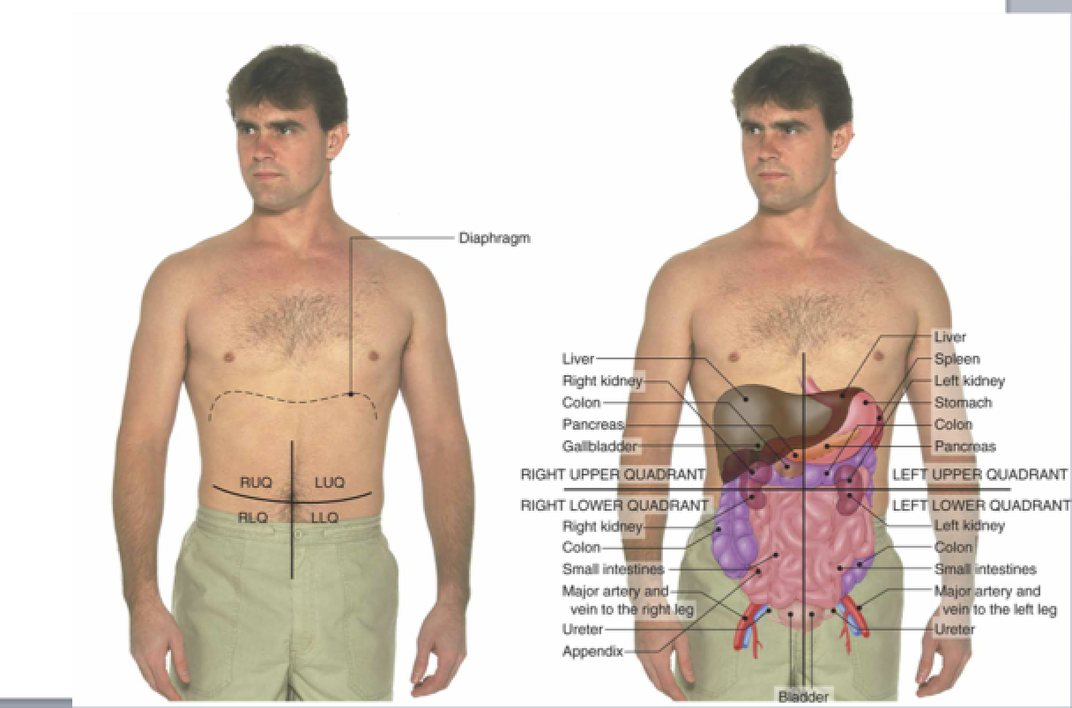
Anatomy and Physiology

Slide 4
Example Question
When palpating the anterior portion of a patient’s abdomen, you note tenderness in the left upper quadrant. As a knowledgeable OEC technician, you would recognize that which of the following organs may be involved?
The kidney
The gallbladder
The spleen
The liver
Notes:
Answer: c

Slide 5
Anatomy and Physiology
Solid Organs:
Spleen
Liver
Pancreas
Kidneys
Posterior to abdominal cavity

Slide 6
Anatomy and Physiology
Hollow Organs:
Stomach
Gallbladder
Duodenum
Large Intestine
Small Intestine
Bladder

Slide 7
Common abdominal and pelvic injuries
Abdominal wall contusion:
Trauma to wall can cause bruising of the skin and superficial abdominal muscles.
Most mild trauma does not cause internal injury.
Any concerns should be evaluated at higher level of care.

Slide 8
Common abdominal and pelvic injuries
Liver Injuries:
Protected by rib cage, still vulnerable to blunt and penetrating trauma.
Highly vascular organ, so injuries to it frequently cause internal bleeding.
Notes:
Largest solid organ in the abdomen, so injuries are common

Slide 9
Common abdominal and pelvic injuries
Spleen Injuries:
One of the more fragile organs in the human body.
Most injuries occur from blunt trauma, still can be injured from penetrating trauma or a fractured rib.
If the delicate capsule ruptures, internal bleeding can be severe, can result in hypovolemic shock from hemorrhage.
Notes:
Its fragile bc it surrounded by a thin membranous capsule and has little fibrous material holding it together.

Slide 10
Common abdominal and pelvic injuries
Pancreas Injuries:
Pancreas can tear or rupture. This can lead to digestive enzymes leaking into abdominal cavity, which can destroy the pancreas or other structures and can cause peritonitis.
Handlebars to the abdomen is the most common cause of pancreas injury.
Becoming very common, remember that any injury to middle of the abdomen above the naval can damage the pancreas.
Notes:
Peritonitis: Inflammation of the membrane lining the abdominal wall and covering the abdominal organs.

Slide 11
Common abdominal and pelvic injuries
Vascular Injuries:
Abdomen and pelvis contain many arteries and veins, important one are abdominal aorta, inferior vena cava, hepatic vessels, renal vessels, and iliac arteries and veins.
Body hitting a fixed object is most common, penetrating trauma can also damage blood vessels.
Bleeding can be severe and may be immediately life threatening, depending on size of vessel, whether it’s an artery or vein, and extent of damage.

Slide 12
Common abdominal and pelvic injuries
Diaphragm tear/rupture:
Diaphragm vulnerable to both blunt and penetrating trauma.
Severe blunt trauma can cause increased intra-abdominal pressure, causing diaphragm to tear away from its attachments or causing holes in diaphragm.
Most common injury is a hernia.
Tears or holes can allow structures in abdominal cavity to migrate into thoracic cavity. Presence of abdominal organs in chest cavity can compromise breathing.

Slide 13
Common abdominal and pelvic injuries
Intestinal tear/rupture:
Penetrating trauma to small intestine can cause food and fecal matter to leak into abdominal cavity, resulting in severe pain, infection, and peritonitis.
Severe bleeding can also occur if a vessel in the intestinal wall is damaged.

Slide 14
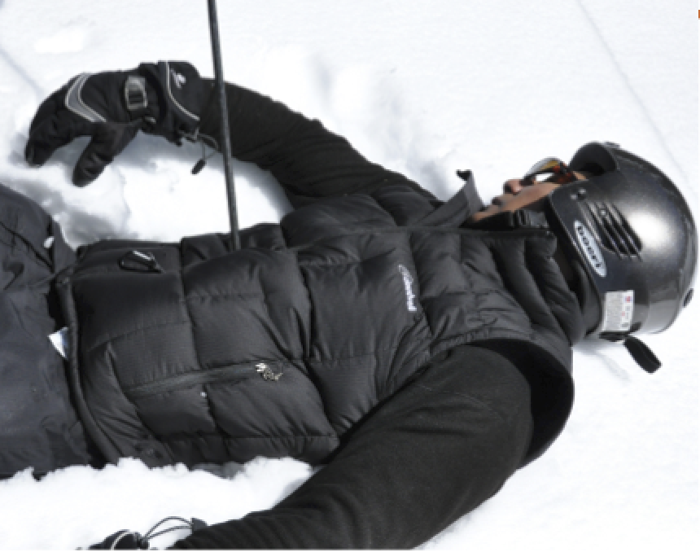
Common abdominal and pelvic injuries
Impaled Objects:
Can result in a variety of life threatening injuries.
Ski poles, tree branches, fence posts, knives, pipes…
Major complications are bleeding(initially)
and infection(later).

Slide 15
Common abdominal and pelvic injuries
Evisceration:
When a tear in the abdominal cavity wall exposes the intestine and/or other organs to the external environment.
Severe bleeding, rapid heat loss, and risk of infection.

Slide 16
Common abdominal and pelvic injuries
Pelvic fractures:
Fractures usually require great force and should be suspected in high speed collisions, falls from 20 ft or higher (10 for children), motor vehicle crashes, pedestrian vehicle crashes…
May result in injuries to internal structures .
Most significant compilation of a pelvic fracture is acute internal bleeding.
Likely to fracture in more than 1 location.

Slide 17
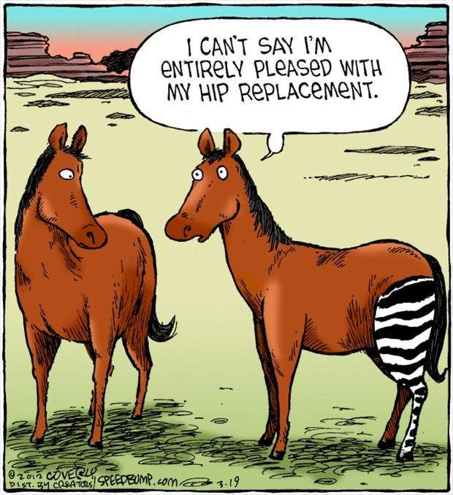
Common abdominal and pelvic injuries
Hip injuries:
Most common hip fractures and hip dislocations.
Both covered in detail in chapter 20

Slide 18
Common abdominal and pelvic injuries
Lower urinary tract injuries:
Urinary bladder is located behind and is protected by the symphysis pubis.
If the symphysis fractures, bone fragments can lacerate the bladder. Most commonly occurs by blunt trauma.
Blunt trauma can also cause the bladder to rupture. Can result it internal bleeding and urine leaking into the pelvic cavity.
Notes:
symphysis pubis: the site on the anterior pelvis at which the two pubic bones are joined together.

Slide 19
Common abdominal and pelvic injuries
Straddle injuries:
Genital trauma usually not life threatening, but still challenging for patient and rescuer.
Straddle injury: when patient’s groin strikes an object, such as a ski pole.
Females: labia are very vascular, extreme injuries to them can cause profuse bleeding
Males: injuries to genitalia are often more serious, can be very painful, and can result in long-term complications.

Slide 20
Common abdominal and pelvic injuries
Genital injuries:
External genitals can receive blunt or sharp trauma.
Males: blunt trauma to the testicles can result in hematoma in the scrotum. Lacerations can occur to the penis or scrotum.
Females: genital trauma causing a hematoma to the external labia or lips can be quite painful and cause mental anguish for the patient.

Slide 21
Assessment
Process follows same guidelines we’ve learned.
Emphasis on recognizing an abdominal or pelvic injury exists. If you know what quadrant, you may be able to suspect what injury it is.
Note the presence of the following signs/symptoms that are consistent with an abdominopelvic injury:
Pain Visible External Wounds Abdominal rigidity
Tenderness Abdominal distension Unexplained shock
Notes:
Abdominal distension occurs when substances, such as air (gas) or fluid, accumulate in the abdomencausing its outward expansion beyond the normal girth of the stomach and waist.

Slide 22
Assessment
Inspect the abdomen for distension and overall symmetry.
Distension, especially if it’s increasing over time, can be an indication of severe intra-abdominal bleeding.
Note any discoloration of the abdominal wall. “Seat belt sign” is a large band of bruising across the lower abdomen.
Rib tenderness and crepitus are a sign of rib fracture.
Kehr’s sign: pain in an uninjured shoulder caused by the accumulation of blood beneath the diaphragm; a painful right shoulder indicates a lacerated liver; whereas a painful left shoulder indicates a lacerated spleen.

Slide 23
Assessment
When assessing the pelvis, crepitus, increased pain, or tenderness suggest a pelvic fracture. Palpate pubic bones gently (if not can worsen the fracture and/or cause more bleeding).
Genital injuries can be very painful and may be associated with a pelvic fracture. Examination requires discretion of the rescuer. Unless active bleeding is suspected, you may want to perform this exam in a more controlled environment.
Because the abdomen and pelvis are filled with blood vessels, monitoring for shock is very important! Several liters of blood can accumulate in these cavities. Left upper quadrant injuries especially worrisome (spleen).

Slide 24
Management
Impaled objects should be secured in place and control bleeding. Do not remove object, but can shorten it if needed for transport.
Do not attempt to put eviscerated structures back into the abdomen, instead cover area with sterile dressing.
Pelvic fracture: start with a cervical collar. Use pelvic binder: compress the pelvis and control bleeding in a traumatic injury.
If shock is suspected, treat how you normally would.

Slide 25
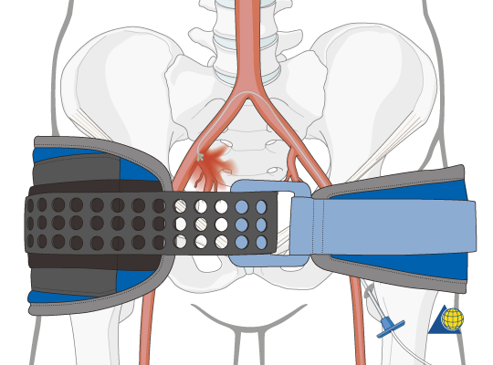
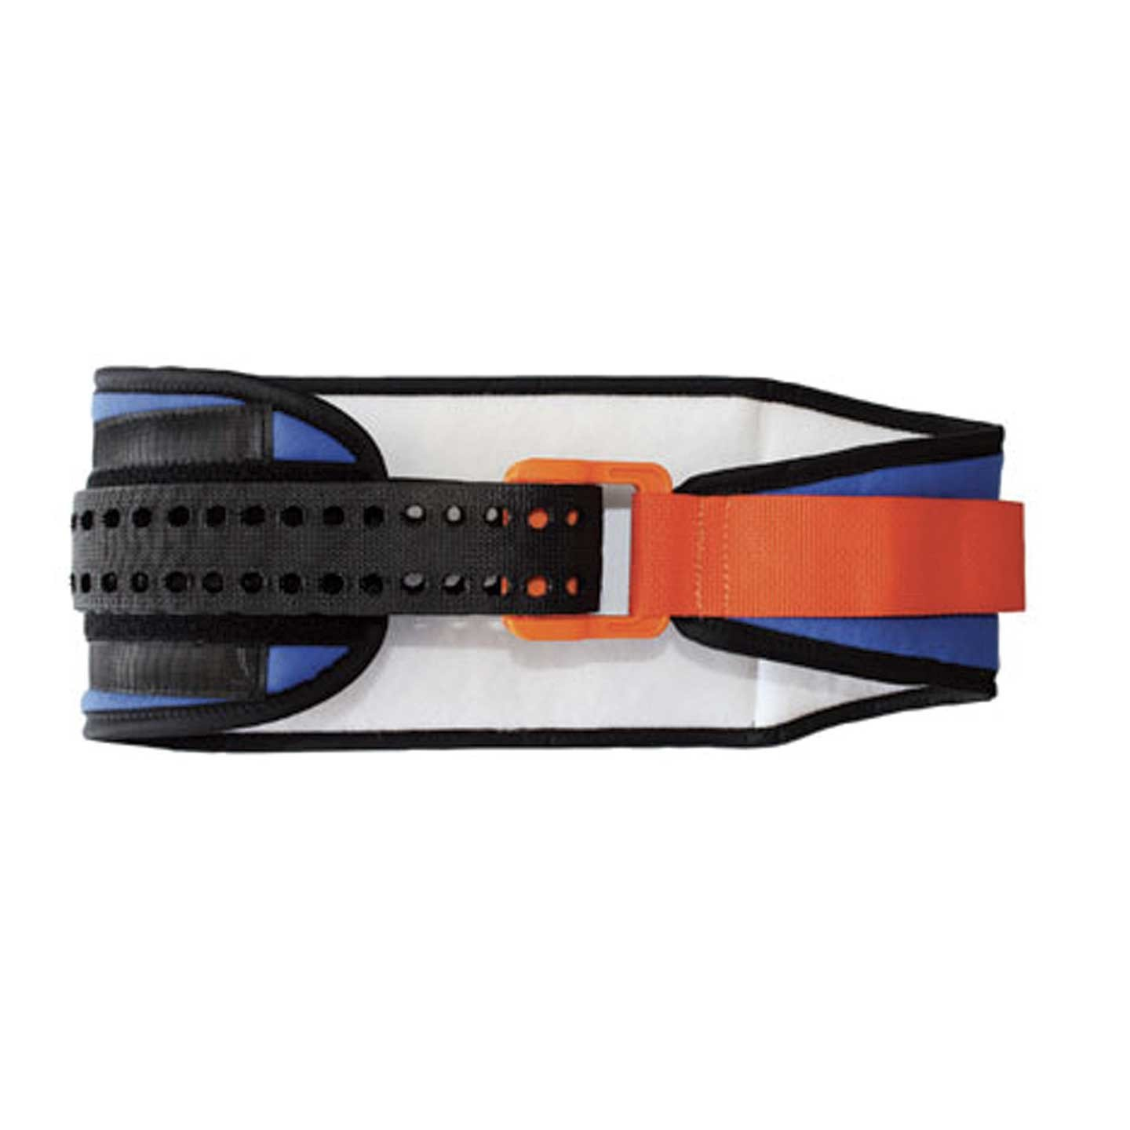
Pelvic Binder

